Slide 1

IBA
International Bar
Association
OPENING REMARKS
International Arbitration
in a Fragmented World
Geopolitics, Sovereign Immunity and New Paths to Resolution
Amir Singh Pasrich, Senior Advocate
IBA Asia Pacific Arbitration Group Symposium
Maxwell Chambers, Singapore · 26 August 2026
Dispute Resolution Section
Arbitration Committee
Asia Pacific Arbitration Group

Slide 2

IBA ARBITRATION COMMITTEE
One of the IBA's most active committees
The Asia Pacific Arbitration Group is a part of the IBA Arbitration Committee which is within the Dispute Resolution Section.
G
RECENT GUIDELINES & REPORTS
P
ACTIVE PROJECTS
2024 Guidelines on Conflicts of Interest
Task Force on AI in International Arbitration
Insolvency and Arbitration Toolkit
Arbitrability of ESG disputes
Updated IBA Rules on the Taking of Evidence
Arbitrator Nationality Project
Report on Res Judicata in Arbitration
Autonomous res judicata standard
Third-Party Participation in Investment Arbitration
Update of Guidelines on Party Representation
Country-by-Country Guides to Arbitration
Comparative analysis of sports arbitration panels
The Asia Pacific Arbitration Group is one of the sub-groups within the Arbitration Committee alongside Investment Arbitration, ESG, Sports Arbitration and Recognition & Enforcement of Awards and so on.
Amir Singh Pasrich, Sr. Adv. International Bar Association
2

Slide 3
THE SYMPOSIUM
A system built for a cooperative era,
tested by an adversarial one
[Investor State Dispute Settlement Mediation]
01
02
03
Geopolitics & Sanctions
Sovereign Immunity & Enforcement
ISDS Mediation
Can arbitration stay neutral when sanctions reshape seats, arbitrators and payment mechanisms?
Winning an award is the easy part, enforcing it against a state is the real fight.
Is the reform process building a genuine pressure valve alongside adjudication?
IAmir Singh Pasrich, Sr. Adv. International Bar Association
3

Slide 4
Geopolitics & Sanctions
EL ONE
Sanctions cover seats of arbitration, arbitrator nationality, payment banks and enforceability itself.
Indian lens
Balancing Russia/Iran sanctions against energy security and treaty obligations — rupee-rouble and rupee-yuan workarounds now land in front of tribunals when challenged as invalid discharge.
Regional exposure
Hong Kong-seated tribunals are grappling with US/EU sanctions on mainland Chinese respondents; Korean counsel facing similar issues in sanctioned-state trade disputes.
Wintershall Dea v Russian Federation (II)
PCA Case No. 2024-42 — Moscow Arbitrazh Court held arbitrators and counsel jointly liable for over €7.5bn for continuing a halted PCA proceeding.
OMV v Gazprom
Anti-enforcement relief granted this year, blocking recognition of any award abroad.
Amir Singh Pasrich, Sr. Adv. International Bar Association
4

Slide 5
Sovereign Immunity & Enforcement
Winning the award is the easy part — Asia-Pacific courts are converging on a pro-enforcement approach.
Devas v Antrix
Dutch Supreme Court (March) and US Ninth Circuit (12 August) both ruled this year — the Ninth Circuit held forum non conveniens unavailable as a defence to a New York Convention enforcement action, on a $1.3bn award.
Hulley Enterprises v Russian Federation
[2025] SGHC(I) 27 — the SICC rejected Russia's state-immunity defence via transnational issue estoppel, since Russia had already lost the same argument in the Dutch seat courts.
India lens
NHAI guidelines steer procurement disputes away from arbitration; Gayatri Balasamy v ISG Novasoft, 2025 INSC 605, recognised a limited judicial power to modify awards.
Regional variation
Australia's Foreign State Immunities Act 1985 has its own restrictive-immunity case law; sovereign debt distress in Sri Lanka and Pakistan now sits alongside outstanding arbitral claims.
Amir Singh Pasrich, Sr. Adv. International Bar Association
5

Slide 6
ISDS Mediation — A New Frontier
If the first two panels describe a system under pressure, this asks whether reform is building something better.
Reform momentum
The rise of ICSID conciliation and the UNCITRAL Working Group III process — building room for negotiated outcomes alongside adjudicated ones.
India lens
After the early-2010s investor claims wave, India terminated dozens of BITs and replaced them with a new Model BIT requiring exhaustion of local remedies first.
Regional infrastructure
Singapore's SIMC alongside SIAC; China's CIETAC and Belt and Road mechanism; Japan and Korea expanding domestic mediation infrastructure for cross-border disputes.
The takeaway
This region is not just watching the ISDS reform conversation — it is actively shaping it.
Amir Singh Pasrich, Sr. Adv. International Bar Association
6

Slide 7
Asia-Pacific sits at the centre of this
story — not at its periphery
Where sovereign wealth meets private capital
Where great-power competition plays out in commercial terms
Where Singapore, Hong Kong, India and Korea compete to be seat, enforcement forum and reform leader of choice
Fragmentation does not end international arbitration as a discipline, it ends treating it as a purely technical, apolitical exercise.
Amir Singh Pasrich, Sr. Adv. International Bar Association
7

Slide 8
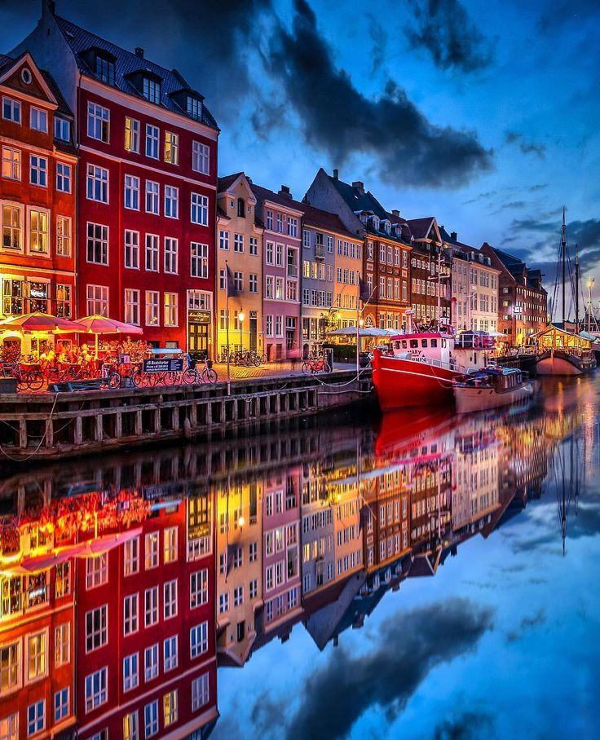
SAVE THE DATE
IBA Annual
Conference 2026
Copenhagen, Denmark
4TH to 9TH OCTOBER 2026
Amir Singh Pasrich, Sr. Adv. International Bar Association
9

Slide 9
Thank you
Amir Singh Pasrich, Sr. Adv. International Bar Association
11

