Slide 1
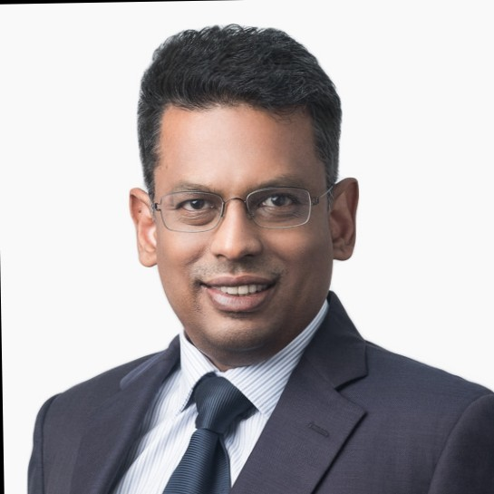
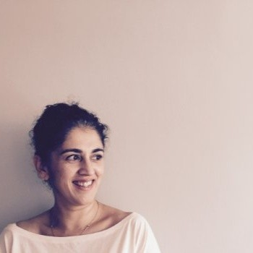
IBA 6th Asia Law Firm Management Event
Are we finally adopting technology?
Rodney Yap
Co-founder & CEO
Regall Private Limited
Bazul Ashhab
Managing Partner
Oon & Bazul LLP
Joanne Chuang
Innovation Lab Lead
Clifford Chance Asia
Arti Daryanani
General Manager
Tan Rajah & Cheah

