Slide 2
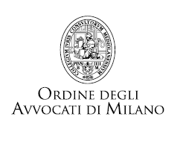
Digitising of
International Commerce:
new trends from product development
and purchasing through to manufacturing,
logistics, supply chains and transportation
17 – 18 November 2021, Tribunale di Milano, Milan, Italy
2

Slide 3
Digitisation of goods and services: the legal framework for electronic sales, product liability and digital technology
18 November 2021
3

Slide 4
Has the Art Market Gone Digital ?
Avv. Giuseppe Calabi
CBM & Partners - Milan
gcalabi@cbmlaw.it
www.cbmlaw.it
4

Slide 5
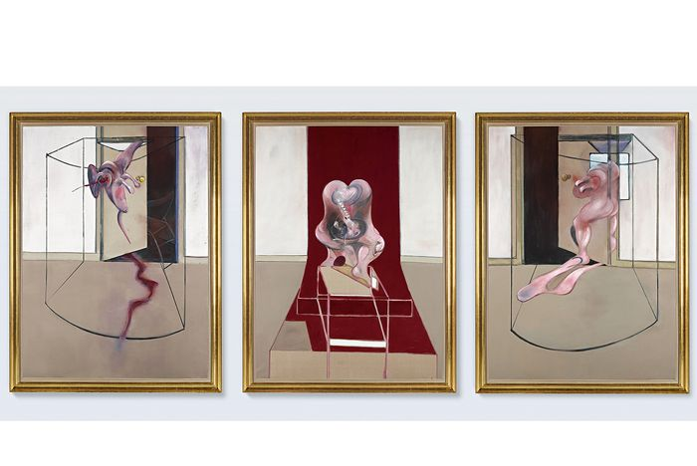
The Rise of Art Online Sales
June 29, 2020: Sotheby’s online only auction - Bacon sold for $ 84,550,000
2020 online-only auction sales of three top auction houses (Sotheby’s, Christie’s, Phillips):
- 644 online-only auctions
- $1.05 billion: 524% year-over-year
- Growth rates:
- Sotheby’s + 824%
- Christie’s + 266%
- Phillips: + 184%
Source: https://www.barrons.com/articles/global-online-only-auction-sales-surpassed-us-1-billion-in-2020-01610580341
Francis Bacon (1909-1992), Triptych Inspired by the Oresteia of Aeschylus, 1981, oil on canvas panels (198 cm x 147,5 cm), courtesy of Sotheby's
5
5

Slide 6
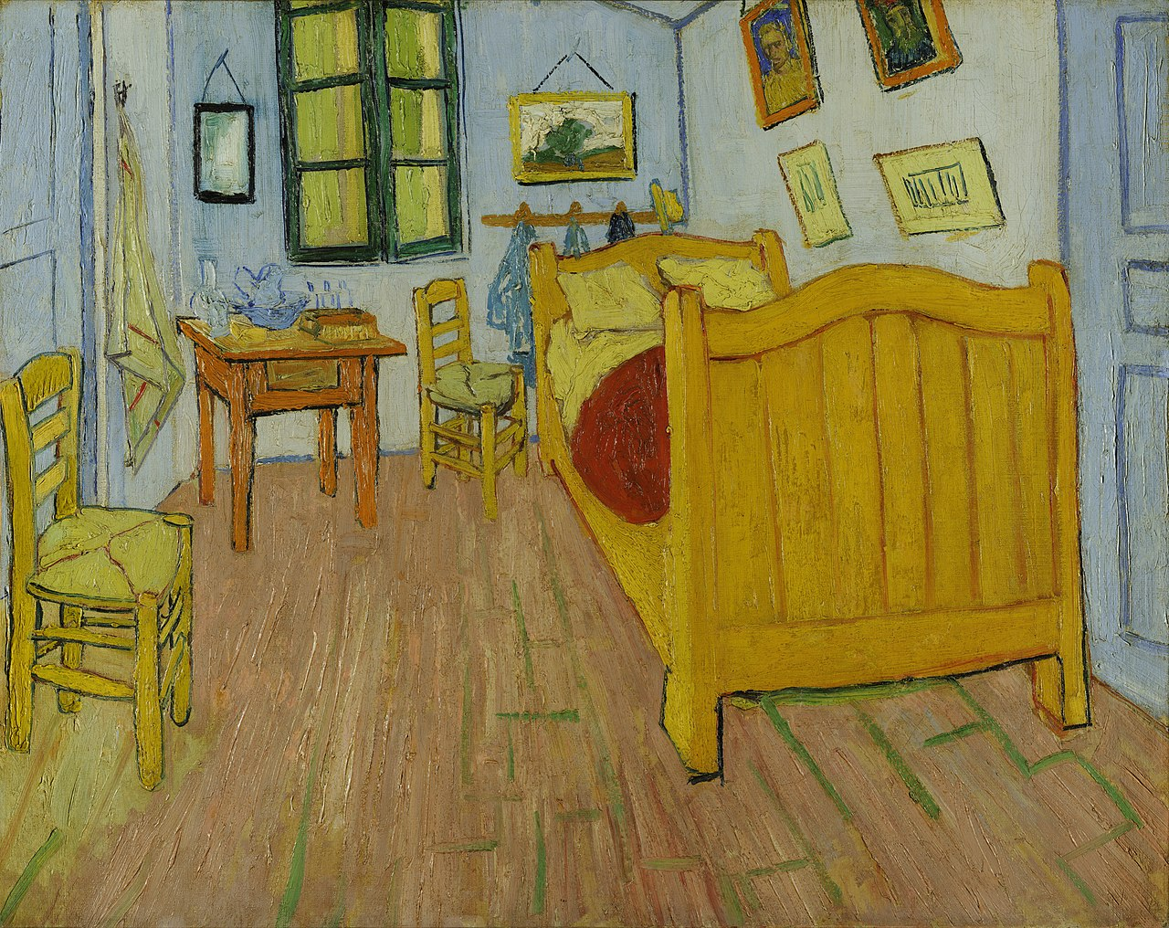
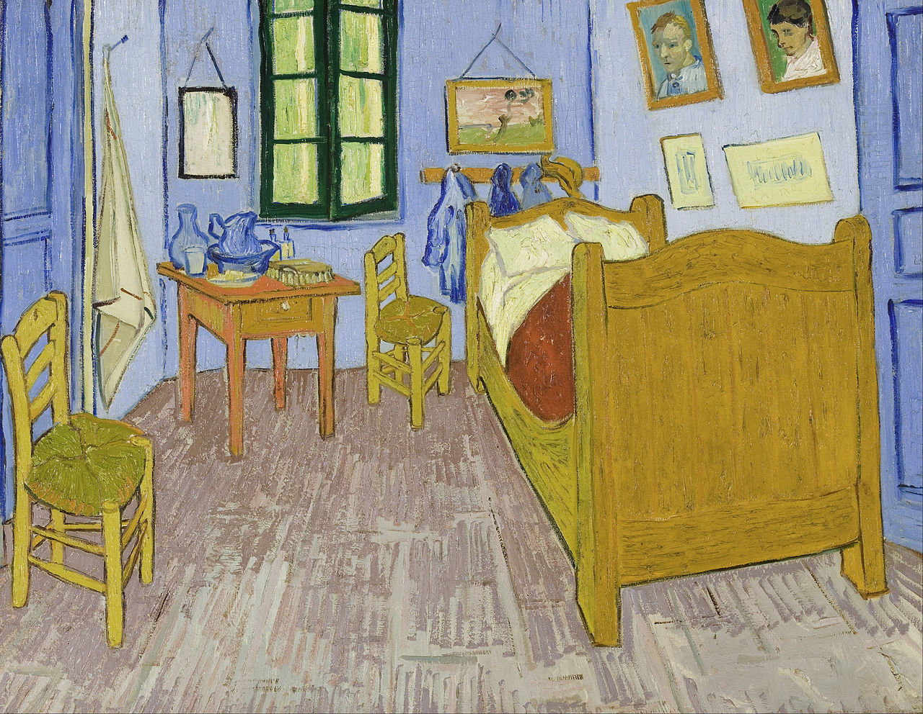
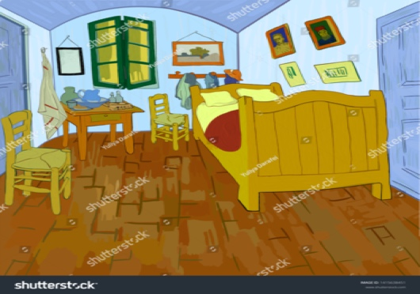
Digitised Works
Vincent van Gogh (1853-1890), The Bedroom,
11988- 1889, oil on canvas., 72 cm X 90 cm/ 57,5 cm x 74 cm
6
6

Slide 7
Digitised Works
• Skill and labour of the photographer
• Mere use of a digital scanner
• Manipulation and enhancement of the scanned image
7
7

Slide 8
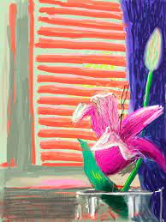
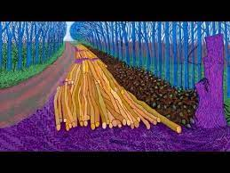
Computer as a Slave
David Hockney’s use of iPad or iPhone to make drawings
8
8

Slide 9
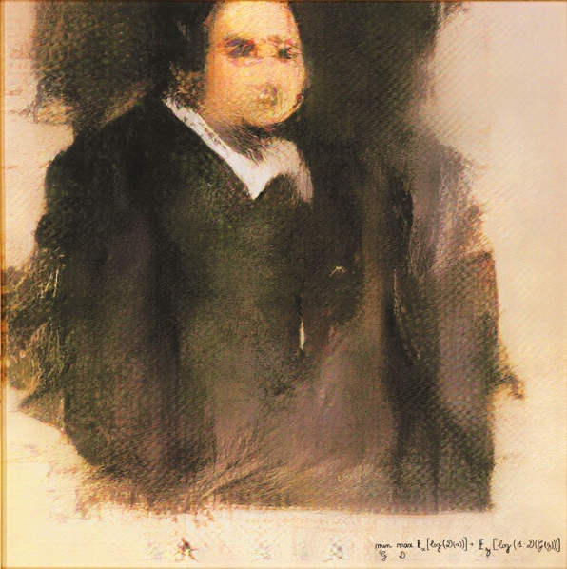
Computer as a Collaborator
Obvious – Portrait of Belamy
Artists use the machine to create a work by training the machine learning system, choosing the algorithm and inputs used to train the machine and selecting the output → final work
2018: French collective Obvious created an AI algorithm and fed it with dataset of 15,000 portraits painted from the 14th to 20th centuries to produce the portrait. The AI algorithm was “trained” by the artwork of previous artists and created a new work based on information from its dataset.
Obvious, Portrait of Edmond Belamy, ink on canvas, 70 cm x 70 cm
9
9

Slide 10
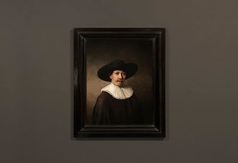
Computer as a Collaborator
The Next Rembrandt
400 years after the death of Rembrandt, a “new Rembrandt”- known as “The Next Rembrandt”- was created.
Digitization of the artist’s painting method
The program “learned” the style of the painter by gathering all the 346 existing Rembrandt painting and created a new work of art.
10
10

Slide 11
AI and Art
UK
UK CDPA 1988
Section 1(1) “Copyright is a property right which subsists ... in ... (a) original ... artistic works …”
Section 4(1) “... ‘artistic work’ means—(a) a graphic work, photograph, sculpture or collage, irrespective of artistic quality ...”
Section 9 (1): Author”, in relation to a work, means the person who creates it.
Section 9 (3): In the case of a literary, dramatic, musical or artistic work which is computer-generated, the author shall be taken to be the person by whom the arrangements necessary for the creation of the work are undertaken.
Test for originality must satisfy two conditions:
a. The work must originate from the author and not have been copied.
b. It must result from sufficient skill, labour and judgement.
11
11

Slide 12
AI and Art
USA
17 USC §102 (a)
“original works of authorship fixed in any tangible medium of expression, now known or later developed, from which they can be perceived, reproduced or otherwise communicated, either directly or with the aid of a machine or device”
12
12

Slide 13
AI and Art
European Union
Article 1 (3) of Directive 91/250/EEC - Software Directive; Article 6 of Directive 2006/116/EC - Term Directive; Recitals 9-11 Directive 2001/29/EC – InfoSoc Directive
“Author's own intellectual creation” (AOIC): Copyright only applies to original works.
Originality must reflect AOIC . See Infopaq and Painer ECJ cases.
European Commission, 2020 - Final Report on Trends and Developments in AI – Challenges to the IP Rights Framework
“Copyright doctrine and case law lend support to our conclusion that the production of an artefact executed by a largely autonomous AI system could qualify as a work protected under EU copyright law on condition that a human being initiated and conceived the work and subsequently redacted the AI-assisted output in a creative manner. That is to say, mere human intervention at the conception and redaction stages could suffice for copyright protection”.
13
13

Slide 14
Who is the copyright owner ?
Authorship status will be granted to the person or persons who creatively contributed to the output (i.e., determined the paintings or images to feed into the algorithm, set the goal(s) for the AI, chose the artistic style to follow/copy, and so on)
Programmer vs. User
14
14

Slide 15
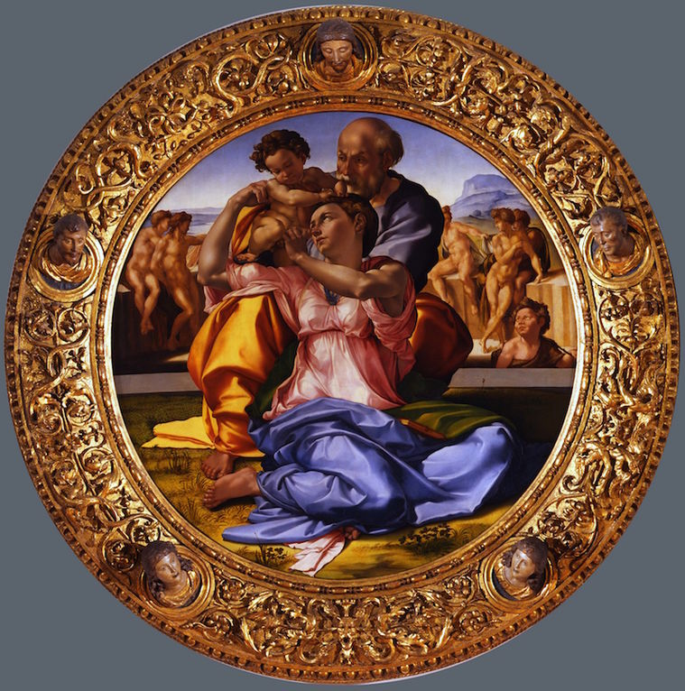
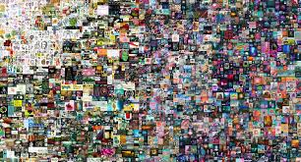
Blockchain and NFT
• Authentication of artworks
• Tokenisation of art
• Management of reproduction and distribution: scarcety value
• Copyright management
Mike Winkelmann (a.k.a.Beeple), NFT Collage, Everydays: The First 5000 Days,
Michelangelo Buonarroti (1475-1564)
Tondo Doni, 1503-1505, oil and tempera on panel,120 cm
15
15

Slide 16
Open issues
What do you own ?
Transfer of digital assets
Loss of private keys
AML compliance
16
16

Slide 17
□ Avv. Giuseppe Calabi
□ gcalabi@cbmlaw.it
Via MonteNapoleone, 20
20121 Milano
Italy
Phone +39 0276022178
Fax +39 02782743
www.cbmlaw.it
© tutti i diritti riservati

