Slide 1


Elements of AI and
Legal Implications
Valerio Bruno
November 18, 2022

Slide 2
HOW?
WITH A SYSTEM THAT SENSES & OBSERVES THE WORLD.
SENSE.
COMPREHEND.
ACT.
LEARN.
The AI System takes all types of data (images, speech, text)
It comprehends information by collecting & matching patterns
It takes actions based on its own understanding of the information.
It will continue to learn through the failure & success of its actions, to become then more intelligent.

Slide 3
THE RELATIONSHIP
BETWEEN AI AND ML
Artificial Intelligence
Machine
Learning
An umbrella term, which can loosely describe as: "all the various techniques we might use to make a computer do something smart"
A successful subset of AI that focuses on learning from data, not on programming explicit rules to follow

Slide 4

WHAT IS AI
THE DIFFERENT WAYS A MACHINE CAN LEARN
One of the real strengths of machine learning is that there are different types of learning algorithm it can use, including supervised, unsupervised, and reinforcement.
SUPERVISED LEARNING. This kind of algorithm takes a labelled data set (data that has been organised and described), deduces the salient features that characterise each label, and learns to recognise those features in new data. So, for example, you might show the algorithm a large number of labelled images of cats, and it would then learn how to recognise a cat and spot one in any number of other, completely different pictures.
UNSUPERVISED LEARNING. This kind of algorithm requires no pre-defined labels in the data it uses. It takes an unlabelled data set, finds similarities and anomalies between different entries within that data set, and categorises them into its own groupings. So, you might show the algorithm a large number of unlabelled images containing, say, cats and dogs, and it would sort images with similar characteristics into different groups without knowing that one contained “cats” and the other “dogs”.
REINFORCEMENT LEARNING. This kind of algorithm works by trial and error, using a feedback loop of “rewards” and “punishments”. So, when the algorithm is fed a data set, it treats the environment like a game, and is told whether it has won or lost each time it performs an action. This way, it builds up a picture of the “moves” that result in success, and those that don’t. DeepMind’s AlphaGo and AlphaZero (page 14) are good examples of the power of reinforcement learning.

Slide 5
WHAT IS AI
OR
PUPPY
BAGEL
How hard is it to tell an animal from an item of food? Sometimes, much more difficult than you might think. One of the big trends storming the internet is all about the odd similarities between certain pets and snacks. Take the puppies and bagels in the image opposite, for instance. At first glance, it can be surprisingly challenging for a human to tell which is which. Not so for an AI. Pass the images through an image recognition API and you’ll find the AI can distinguish the food from the pets with impressive accuracy.

Slide 6
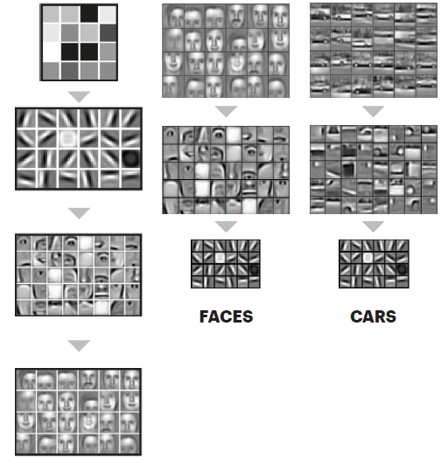
WHAT IS AI
FACIAL RECOGNITION
Layer 1:
The computer identifies pixels of light and dark.
Layer 2:
The computer learns to identify edges and simple shapes.
Layer 3:
The computer learns to identify more complex shapes and objects.
Layer 4:
The computer learns which shapes and objects can be used to define a human face.
How a neural network recognizes objects

Slide 7
WHAT IS AI
WHAT KIND OF INTELLIGENCE ARE WE TALKING ABOUT?
When data scientists and others talk about AI, they often use two categorizations to clarify their meaning. These are narrow AI vs. general AI and weak AI vs. strong AI.

Slide 8
WHAT IS AI
WEAK AI
This describes "simulated" thinking. That is, a system which appears to behave intelligently, but doesn’t have any kind of consciousness about what it’s doing. For example, a chatbot might appear to hold a natural conversation, but it has no sense of who it is or why it’s talking to you.
STRONG AI
This describes "actual" thinking. That is, behaving intelligently, thinking as a human does, with a conscious, subjective mind. For example, when two humans converse, they most likely know exactly who they are, what they’re doing, and why.
NARROW AI
This describes an AI that is limited to a single task or a set number of tasks. For example, the capabilities of IBM’s Deep Blue, the chess-playing computer that beat world champion Gary Kasparov in 1997, were limited to playing chess. It wouldn’t have been able to win a game of tic-tac-toe – or even know how to play.
GENERAL AI
This describes an AI which can be used to complete a wide range of tasks in a wide range of environments. Google DeepMind used reinforcement learning to develop an AI that learned to play a whole range of different games. The AI achieved human-like levels of performance at 29 classic Atari video games using only the on-screen pixels as its data input
SUPERINTELLIGENCE
The term "superintelligence" is often used to refer to general and strong AI at the point at which it surpasses human intelligence, if it ever does.

Slide 9
RISKS INVOLVED
The huge opportunities and benefits that AI offers don’t come risk free, of course. It certainly pays to begin an AI journey with a clear-sighted view of what the risks might be for an organization.

Slide 10
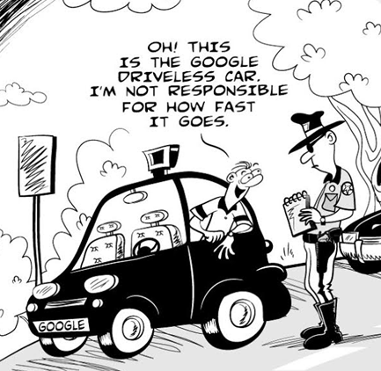
LEGAL TOPICS
LIABILITY

Slide 11
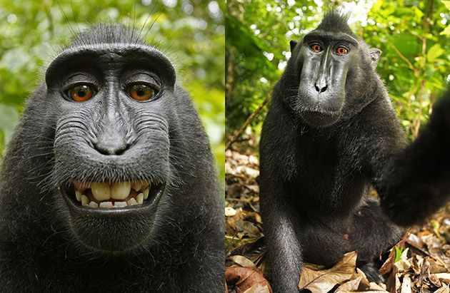
LEGAL TOPICS
On July 2011, British photographer David Slater travelled to a national park in North Sulawesi, Indonesia, to take pictures of the local wildlife. Once there he followed a troop of monkeys, trying to get a few unique pictures. Mr. Slater claims that he was specifically looking for a very close shot of a monkey’s face using a wide-angle lens, but the monkeys were obviously shy, and didn’t allow him to get too close. While he managed to take a few pictures, he didn’t get the shot he was looking for. He claims he placed his camera on a tripod as the monkeys were curious about the equipment, and clicked a few shots. The first pictures they took were of poor quality. He claims he then changed the camera settings and that one monkey in particular, was drawn to the reflection of the lens. The monkey then went on to take a few pictures.
IPRs
David Slater case
In most jurisdictions, ingenuity and IPRs on new assets can only be held by humans.

Slide 12

LEGAL TOPICS
Italy - Article 6 of Law 633/41: "Copyright shall be acquired on the creation of a work that constitutes the particular expression of an intellectual effort."
US - US Copyright Office confirmed that: "will register an original work of authorship, provided that the work was created by a human being".
Japan – Japanese legislator confirmed that: "IP rights cannot be extended to original works created by AI".
While
UK - UK Copyright Designs and Patent Act in connection with new assets created by machine confirmed that "author shall be taken to be the person by whom the arrangements necessary for the creation of the work are undertaken“.
IPRs

Slide 13
CONTRACTING TOPICS
What kind of data are we using?
How should I price AI services?
What can I commit to?

