Slide 2
Desmond Ang
Overview
(1) Introduction to the speakers
(2) Introduction to the corruption defence
(3) Circumstances under which the corruption defence has been upheld
(4) Whether a host State can be prevented from using its own corruption to its advantage, and if so how
(5) Q&A

Slide 3
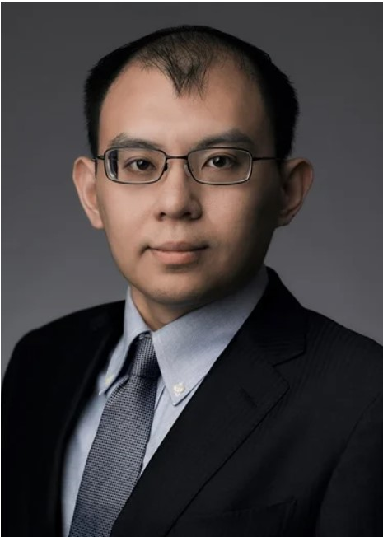
Partner of Sidley Austin in Hong Kong and Singapore.
Focuses his practice on international commercial litigation and arbitration, with an emphasis on high-stakes disputes involving business relationships and investments with companies in China, Taiwan and Japan.
Represented clients in proceedings conducted under ICC, HKIAC, SIAC, CIETAC, JCAA, ICDR and UNCITRAL arbitration rules as well as before the Hong Kong courts.
Has experience in disputes involving mergers and acquisitions, joint ventures, private equity, which have been heard in Hong Kong, Singapore, Beijing, Tokyo, California and Switzerland.
Serves as arbitrator under both ICC and HKIAC arbitration rules in Hong Kong, Shanghai and London.

Slide 4
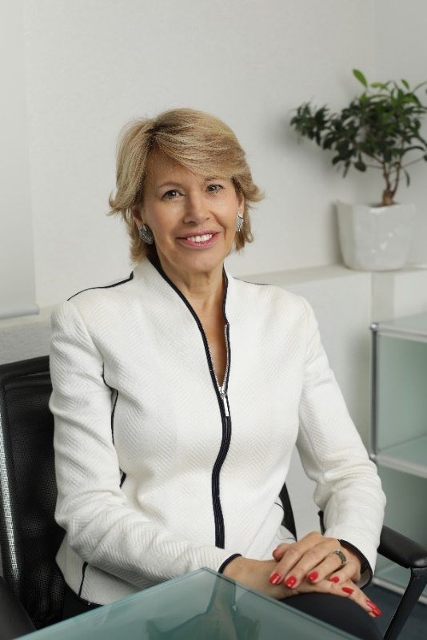
Prof. Geneva University, partner Lévy Kaufmann-Kohler, international commercial and investment arbitrations (mainly as president)
Honorary President of ICCA and Swiss Arbitration Association (ASA)
Founder of the Geneva LLM in International Dispute Settlement (MIDS)
Visiting professor at NUS Georgetown Law, Sciences Po Paris, MIDS, Tsinghua University

Slide 5
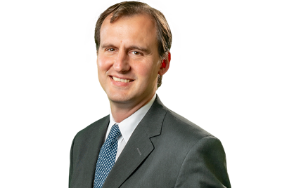
Partner in the Madrid office of Uría Menéndez and co-head of the firm’s international arbitration and litigation group.
Specialist in international arbitration. He has participated in over 70 investment arbitrations, both as a lawyer and as an arbitrator. He was the first National Director of International Affairs and Disputes of the Treasury-Attorney General’s Office of Argentina, representing the country in arbitrations administered by the International Centre for the Settlement of Investment Disputes (ICSID), the Permanent Court of Arbitration and the International Chamber of Commerce, and before courts of the United States of America.
Member of the ICSID panel of arbitrators designated by the Chairman of ICSID’s Administrative Council. Adjunct Professor of Public International Law at the University of Buenos Aires.

Slide 6
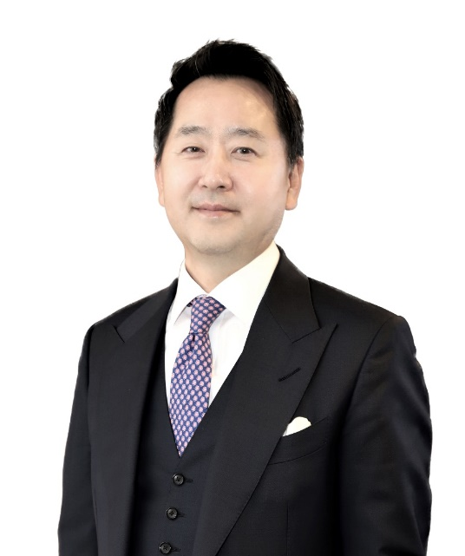
Founder and Senior Partner of Peter & Kim in Seoul
Former senior partner and co-founder and head of the International Arbitration Practice at Bae, Kim & Lee LLC
Acted as counsel, presiding arbitrator, co-arbitrator or sole arbitrator in more than 300 international arbitration cases over 30 years
Adjunct professor at Seoul National University Law School
Advisory Board Member of the International Council for Commercial Arbitration (ICCA)
Chairman of the Korean Commercial Arbitration Board’s (KCAB) International Arbitration Committee

Slide 7
Partner in Debevoise & Plimpton’s International Dispute Resolution Group
Dual-qualified in civil and common law, her practice focuses on international arbitration, international litigation and public international law.
Leads matters in English, Spanish and French and regularly handles complex disputes arising out of Latin America and Africa.
Sits as arbitrator and serves as counsel in a broad range of international matters and has particular experience in the energy, mining, and technology, media and telecommunications sectors.
Holds a variety of leadership positions, including as a Member of the ICC International Court of Arbitration, a member of the Court of the Casablanca International Mediation and Arbitration Center (CIMAC), and Chair of the Corporate Counsel Task Force of the Silicon Valley Arbitration & Mediation Center (SVAMC).

Slide 8
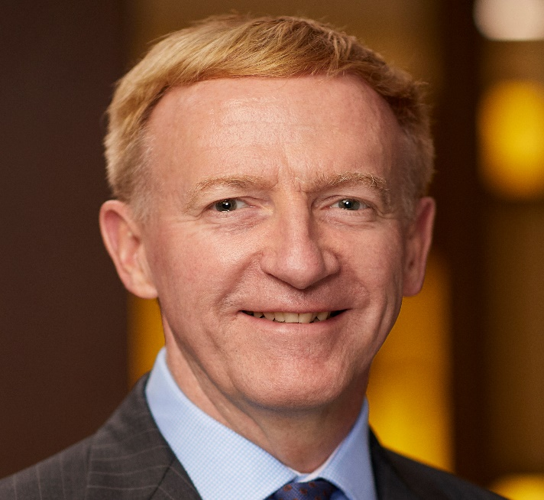
Robert practices in transnational commercial crime at Johnson Winter Slattery, Sydney.
This includes regulatory investigations and prosecutions, white collar crime and fraud, extradition and trade and export sanctions, bribery and corruption, money laundering, whistle-blower advice for individuals and companies, taxation disputes, international arbitration and cross-border investigations.
He has written texts on Australia's anti-corruption laws, published in the UK (2013-2023), the US (2019) and in Germany (2015) and on sanctions laws (2020-2021).
Co-Chair of the IBA Anti-Corruption Committee (2015-2016).
Member of the IBA Anti-Corruption Committee Advisory Board (2021 – 2024).

Slide 9
Desmond Ang
Overview
(1) Introduction to the speakers
(2) Introduction to the corruption defence
(3) Circumstances under which the corruption defence has been upheld
(4) Whether a host State can be prevented from using its own corruption to its advantage, and if so how
(5) Q&A

Slide 10
Desmond Ang
Gabriel Bottini

Slide 11
CORRUPTION AS A SHIELD OR AS A SWORD?

Slide 12
Corruption as a shield
Contracts of corruption
Contracts tainted by corruption
Corrupt conduct of the investor
Corruption as a sword
Chevron v. Ecuador
EDP v. Romania
Corruption in annulment proceedings

Slide 13
Standard of Proof
Balance of probabilities
Clear and convincing evidence
Options for Tribunal
Red flags
Adverse inferences
Witnesses
Forensic experts

Slide 14
Desmond Ang
Kevin Kim

Slide 15
Is Corruption an Issue of Jurisdiction, Admissibility, Merits, and/or Enforcement?
Jurisdiction
Admissibility
Merits
Enforcement
Cause of action when overlapping with a breach of Treaty (e.g., FET)
Ground for seeking annulment of an award
Investors engaged in corrupt activities
in acquiring Investment denied access to ISDS
(treaty specific “consent”/“qualification” issues)
Metal-Tech v. Uzbekistan
Inceysa Vallisoletana v. El Salvador
Vladislav Kim et al v. Uzbekistan
P&ID v. Nigeria
World Duty Free v. Kenya
Churchill Mining and Planet Mining v. Indonesia
Chevron and TexPet v. Ecuador (II)
Mamidoil Jetoil v. Albania
Niko Resources (Bangladesh) Ltd. v. Bapex and Petrobangla
P&ID v. Nigeria

Slide 16
Jurisdiction & Admissibility
Jurisdiction |  | Admissibility
Metal-Tech Ltd. v. Republic of Uzbekistan (ICSID Case No. ARB/10/3) | Corruption Defense: Claimant violated Uzbek law by paying USD 4.4 million in bribes to public officials for approval of its investment. (para. 279) Timing: Inception of the investment Tribunal Decision: “[T]he rights of the investor against the host State, including the right to access arbitration, could not be protected because the investment was tainted by illegal activities, specifically corruption.” (para. 422) | World Duty Free Company v. Republic of Kenya (ICSID Case No. ARB/00/7) | Corruption Defense: Claimant’s investment was procured by providing a bribe of USD 2 million to Kenya’s then President’s election campaign. (para. 105) Timing: Inception of the investment Tribunal Decision: “[T]he Tribunal concludes that the Claimant is not legally entitled to maintain any of its pleaded claims in these proceedings on the ground of ex turpi causa non oritur actio (from a dishonorable cause an action does not arise).” (para. 179)

Slide 17
Merits
Chevron and TexPet v. Ecuador (II) (PCA Case No. 2009-23) | Mamidoil Jetoil Greek Petroleum Products Societe S.A. v. The Republic of Albania (ICSID Case No. ARB/11/24)
Corruption Claim: Respondent breached its obligation to afford fair and equitable treatment including protection against denial of justice by committing judicial corruption when a judge agreed to receive a bribe and allowed ‘ghostwriting’ of a judgment against Claimants. Timing: After the lifetime of the investment ended and during the arbitration proceedings Tribunal Decision: “[T]he Tribunal bases its decisions on the merits on the corrupt misconduct of the Lago Agrio Court […] The Tribunal decides that the Respondent violated the FET standard and customary international law in Article II(3)(a) of the Treaty” (paras. 8.76-8.77) | Corruption Defense: Construction of an oil tank farm that led to a series of substantial investments in 1999 and 2000. During this period, local government officials sent a series of letters related to Claimant’s failure to obtain permits. Respondent alleged (and the Tribunal agreed) that “the composite parts of the investment form a whole and must be considered together.” (para. 364) Timing: Illegality occurred when the Claimant allegedly failed to obtain proper permits. Tribunal Decision: Regarding Claimant’s claim that there was no stable and transparent legal framework provided by Respondent, the Tribunal found that it “dealt extensively with the different permits and licenses at issue” and that the legal texts for the issuance of licenses and permits were “stable and transparent.” (paras. 671, 674)

Slide 18
Enforcement
Process and Industrial Developments Ltd. v. Nigeria Ministry of Petroleum Resources (Ad Hoc)
Corruption Claim: The agreement at issue in the dispute was obtained through “industrial scale” bribery by both Nigeria public officials and even lawyers representing Nigeria in the arbitration. Timing: Inception of the Investment Commercial Court Decision: The decision to set aside the Tribunal’s USD 11 billion award is pending.

Slide 19
Desmond Ang
Overview
(1) Introduction to the speakers
(2) Introduction to the corruption defence
(3) Circumstances under which the corruption defence has been upheld
(4) Whether a host State can be prevented from using its own corruption to its advantage, and if so how
(5) Q&A

Slide 20
Desmond Ang
Ina Popova

Slide 21
Corruption Argument Successful
World Duty Free Company Limited v. The Republic of Kenya, ICSID Case No. ARB/00/7
Metal-Tech Ltd v. Republic of Uzbekistan, ICSID Case No. ARB/10/3
Penwell Business Limited (by MegaCom) v. Kyrgyz Republic, PCA Case No. 2017-31

Slide 22
Corruption Argument Unsuccessful
Karkey Karadeniz Elektrik Uretim A.S. v. Islamic Republic of Pakistan, ICSID Case No. ARB/13/1
Tethyan Copper Company Pty Limited v. Islamic Republic of Pakistan, ICSID Case No. ARB/12/1
Unión Fenosa Gas, S.A. v. Arab Republic of Egypt, ICSID Case No. ARB/14/4
Niko Resources (Bangladesh) Ltd. v. Bangladesh Oil Gas and Mineral Corporation (Petrobangla), Bangladesh Petroleum Exploration and Production Company Limited (Bapex), ICSID Case Nos. ARB/10/11, ARB/10/18
MOL Hungarian Oil and Gas Company PLC v. Republic of Croatia, ICSID Case No. ARB/13/32

Slide 23
Desmond Ang
Overview
(1) Introduction to the speakers
(2) Introduction to the corruption defence
(3) Circumstances under which the corruption defence has been upheld
(4) Whether a host State can be prevented from using its own corruption to its advantage, and if so how
(5) Q&A

Slide 24
Desmond Ang
Robert Wyld

Slide 25
Corruption and Arbitrations – Risks or Rewards?
What drives the corruption defence in investor – state arbitration?
Examining alleged corruption?
Official investigation of corruption?
Reporting potential criminal conduct?
Should contractual obligations be avoided?
Public policy and the administration of justice?

Slide 26
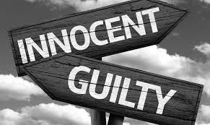
Investor vs State: Criminal Law Issues
Criminal law can apply territorially and extra-territorially
Primary liability and secondary liability.
Liability strict or require a mens rea (intent, recklessness, negligence).
States promote anti-corruption measures, pressure to act.
What criminal law applies?
Impact on investment?
Impact on State population?

Slide 27
Reporting Criminal Conduct
Obligations to report criminal conduct
Domestic laws
Threshold tests
Mere suspicion, reasonable belief or knowledge an offence committed
Section 202, Singapore Penal Code, “whoever, knowing or having reason to believe that an offence has been committed, intentionally omits to give any information respecting that offence…”
Section 39(1), Corruption, Drug Trafficking and Other Serious Crimes (Confiscation of Benefits) Act, Chapter 65A, imposes a duty to disclose knowledge or suspicion that any property represents the proceeds of, or is linked to a criminal activity.
Who to report to?
Risks of cover-up – disclosure by third parties
Role of regulatory authorities – proactive action
Search and seizure warrants – how to respond?

Slide 28
Desmond Ang
Overview
(1) Introduction to the speakers
(2) Introduction to the corruption defence
(3) Circumstances under which the corruption defence has been upheld
(4) Whether a host State can be prevented from using its own corruption to its advantage, and if so how
(5) Q&A

Slide 29
Desmond Ang
Q&A

