Slide 1
Real estate investment and financing in singapore
The 4th Asia-based International Financial Law Conference
Angela Lim, Rajah & Tann Singapore LLP

Slide 2
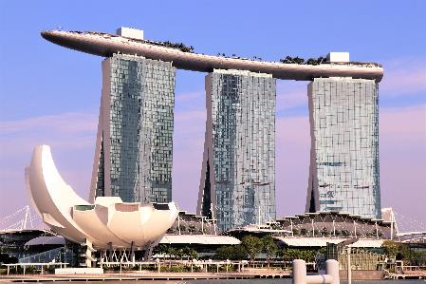
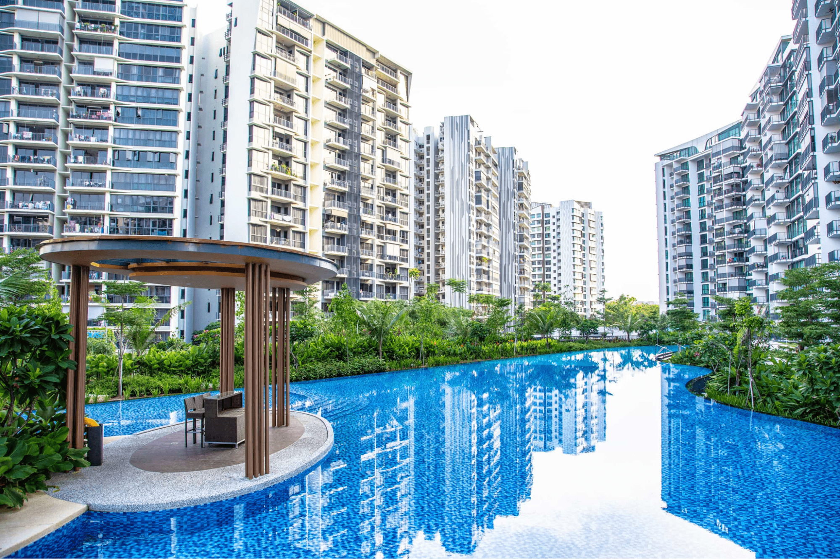
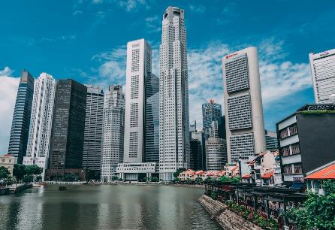
Market trends in property investments and development

Slide 3
1. HOSPITALITY
Strong demand for hospitality assets in Singapore as hotels observed increased occupancy and revenue per available room from Q3 2022
Tourists and business travellers returning in droves as many indulge in revenge travelling
New room supply expected to grow at a compound annual rate of 2.4%, from 2023 to 2025, with approximately 5,415 new hotel rooms projected
Two white sites in Marina View and River Valley have been listed on the government’s land sales reserve list

Slide 4
HOTELS
The SO/ Singapore in the Central Business District (CBD) sold at S$1.8m per room by Royal Group to Viva Land Group in 2022.
Hotel Clover in Jalan Sultan sold for S$74.8m to Hong Kong’s Weave Living via a special purpose vehicle in which a Singapore group is also taking a minority stake.

Slide 5
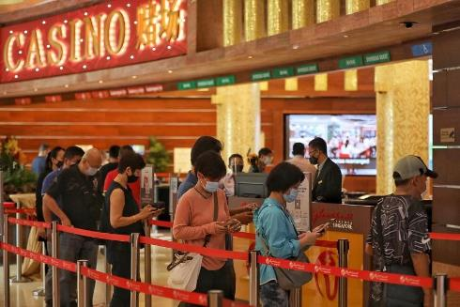
Integrated resorts
Marina Bay Sands (MBS)’ net revenue nearly doubled from 2021 to 2022, to US$682 million
Genting Singapore’s net profit for the second half of 2022 more than doubled. This growth was primarily driven by gaming revenue (S$753.7 million)
MBS is due for a US$3.3 billion expansion under a Development Agreement with the Singapore government
Genting Singapore is similarly embarking on a S$4.5 billion expansion of Resorts World Sentosa, which will allow for:
an expansion of Universal Studios Singapore and the SEA Aquarium
refurbishment of three hotels and the Resorts World Convention Centre

Slide 6
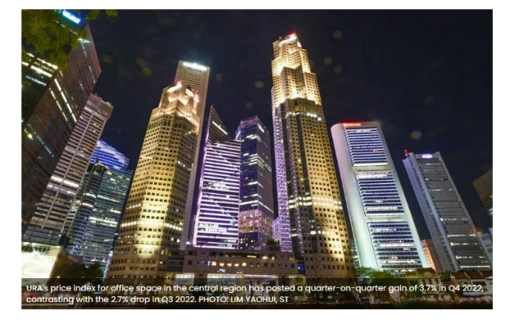
2. offices

Slide 7
OFFICEs
CBD Grade A office rents climbed 0.8% q-o-q in Q4 2022, driven by higher grade office developments amidst the ongoing flight to quality
On a y-o-y basis, CBD Grade A office rents grew 6.5% in 2022
Office rental was stable notwithstanding Covid-19 and work from home initiatives during lock-down
Net demand reached 870,000 sf outweighing net supply of 760,000 sf
Rental growth for CBD Grade A office is projected at 2%-4% y-o-y in 2023, fueled by higher property service charges and a still-tight supply situation
New CBD Grade A office stock will only amount to about 0.7 million sf (msf) per annum from 2023 to 2028, lower than the ten-year historic annual average of 1 msf
Redevelopments in CBD coupled with a progressive expiry of transitional office sites over the next few years could further tighten supply and spur displacement demand

Slide 8
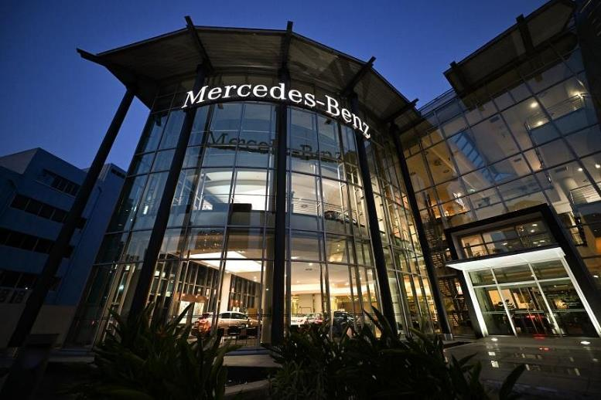
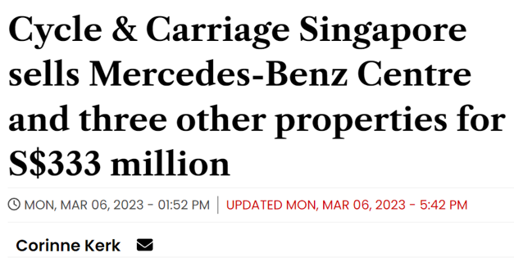
3. industrial

Slide 9
industrial
Advantages of industrial real estate
- relatively shorter land tenure (30 years vs 99 years)
- lower capital entry point
- relatively stable yield

Slide 10
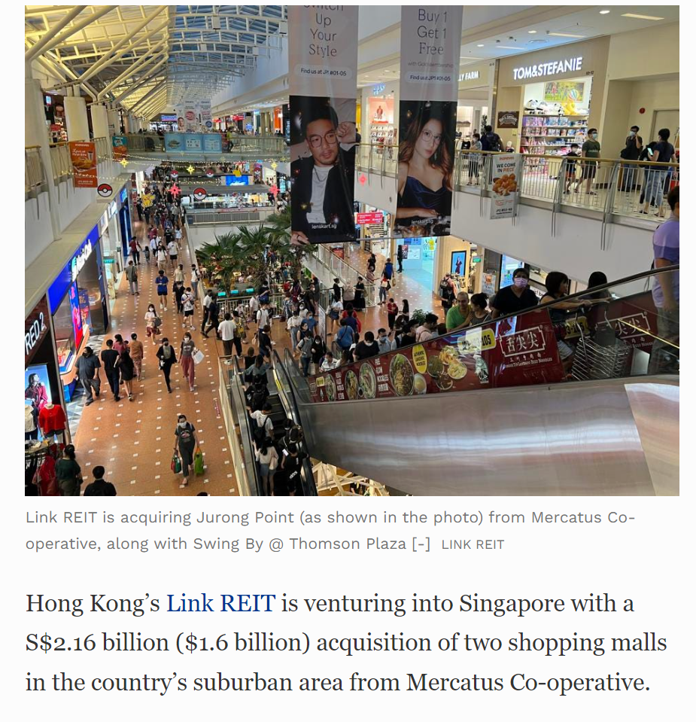
retail
Link REIT, Asia’s largest REIT, agreed to buy 2 suburban shopping malls in Singapore for S$2.16b
Deal value was reduced from about S$3b due to Singapore assets being removed from the sale

Slide 11
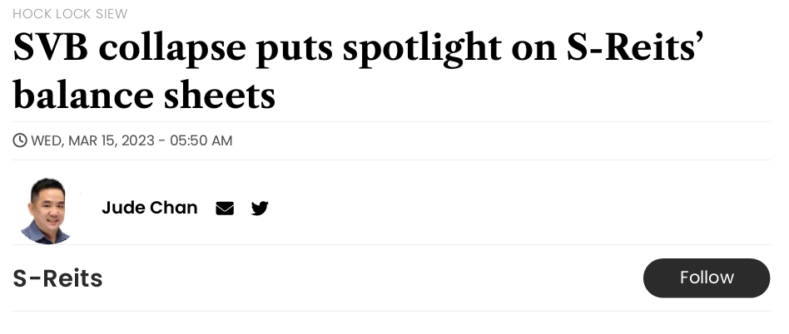
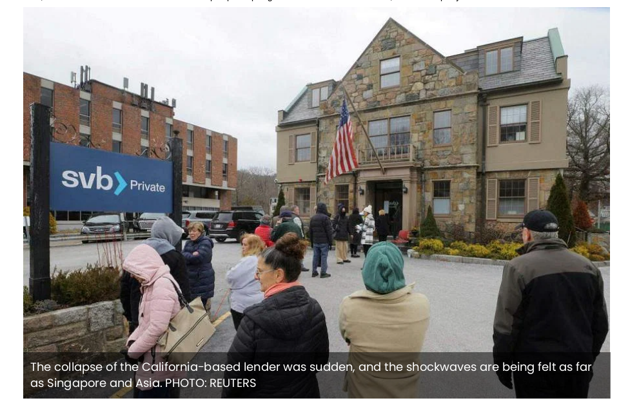
REITS

Slide 12
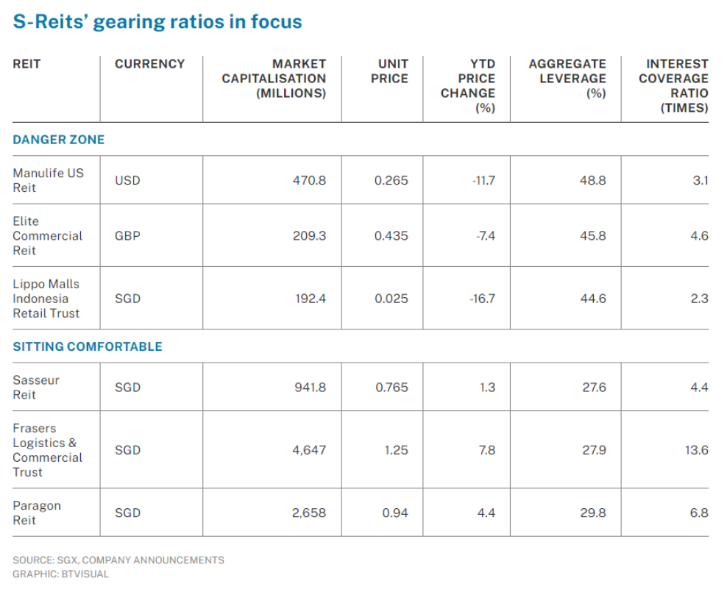
REITS

Slide 13
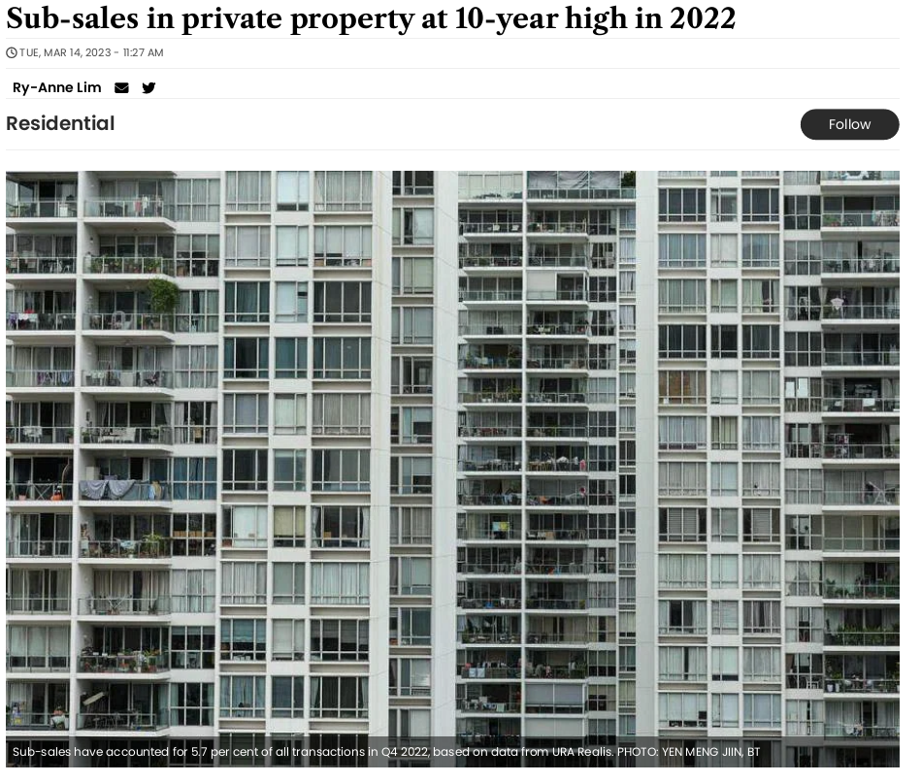
4. residential
765 sub-sale transactions in 2022, the highest since 2013
Average transaction turned S$373,230 profit
Sub-sale transactions were 5.7% of all deals in 2022

Slide 14
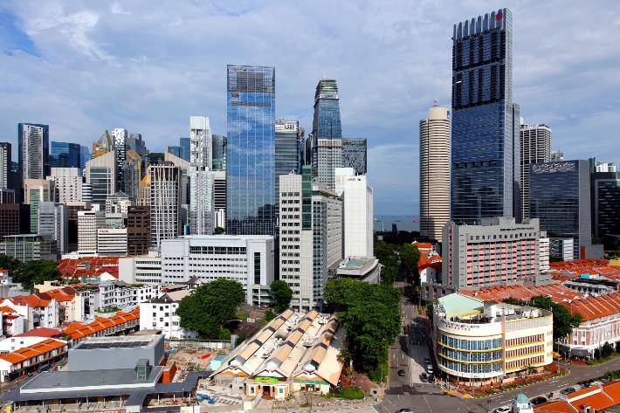
Renewal is taking place in the CBD with the URA having received 12 outline applications under the CBD Incentive Scheme (CBDI), of which eight have been given in-principle approval as at April 5, 2022.

Slide 15
Incentives for redevelopment
The CBD Incentive Scheme and the Strategic Development Incentive (SDI) Scheme aim to encourage the rejuvenation of the CBD and other strategic areas in Singapore
The CBD Incentive Scheme aims to encourage the conversion of existing, older, office developments into mixed-use developments that will help rejuvenate the CBD
Office developments which are more than 20 years old in designated areas are eligible

Slide 16
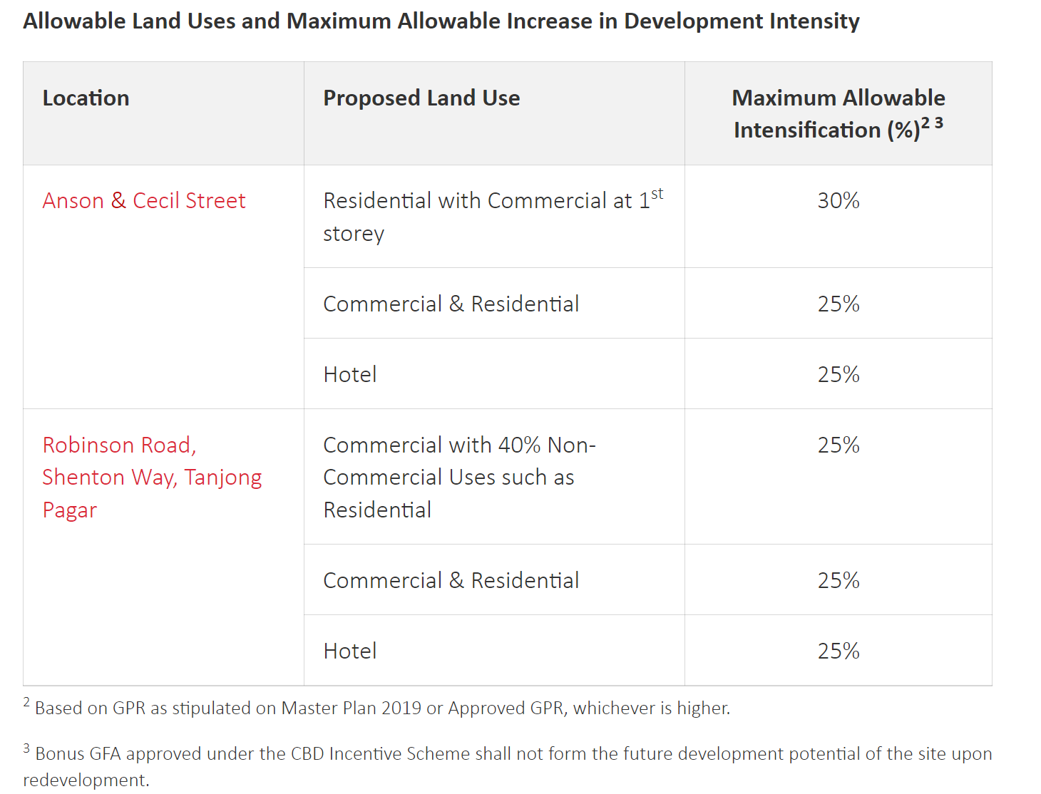
CBD incentive scheme

Slide 17
Strategic Development incentive scheme
Building owners of developments in strategic areas across Singapore may make use of the SDI Scheme in their applications for re-development if it meets the eligibility criteria
The SDI Scheme is open to applications from building owners for developments in strategic areas across Singapore that meet the eligibility criteria
Applications to redevelop existing developments in Orchard Road, CBD and Marina Centre areas are encouraged, in line with the broader planning intention to rejuvenate these areas
Commercial or mixed-use developments which are 20 years and older with predominantly commercial uses are eligible
The redevelopment proposal shall include a minimum of two adjacent sites, such that the amalgamated redevelopment can have a strong transformational impact on the surrounding environment that will enhance and rejuvenate the area

Slide 18
buyer’s stamp duty
Increase in BSD for non-residential properties
Higher of purchase price or market value of the property | Rates on/before 14 Feb 2023 | Rates on/after 15 Feb 2023
First $180,000 | 1% | 1%
Next $180,000 | 2% | 2%
Next $640,000 | 3% | 3%
Next $500,000 |  | 4%
Next $1,500,000 |  | 5%
Amounts exceeding $3,000,000
BSD is payable on the market value or purchase price of the property, whichever is higher.
The portion of the value of the property in excess of $1 million and up to $1.5 million will be taxed at 4%, while that in excess of $1.5 million will be taxed at 5%; up from the current rate of 3%.

Slide 19
buyer’s stamp duty
Increase in BSD for residential properties
Higher of purchase price or market value of the property | Rates on/before 14 Feb 2023 | Rates on/after 15 Feb 2023
First $180,000 | 1% | 1%
Next $180,000 | 2% | 2%
Next $640,000 | 3% | 3%
Next $500,000 | 4% | 4%
Next $1,500,000 |  | 5%
Amounts exceeding $3,000,000 |  | 6%
The portion of the value of the property in excess of $1.5 million and up to $3 million will be taxed at 5%, while that in excess of $3 million will be taxed at 6%; up from the current rate of 4%

Slide 20
Additional buyer’s stamp duty
Profile of Buyer | ABSD Rates from 12 Jan 2013 – 5 Jul 2018 | ABSD Rates from 6 Jul 2018 – 15 Dec 2021 | ABSD Rates on/after 16 Dec 2021
Singapore Citizens (SCs) buying 1st residential property | N.A. | N.A. | N.A.
SCs buying 2nd residential property | 7% | 12% | 17%
SCs buying 3rd and subsequent residential property | 10% | 15% | 25%
Permanent Residents (PRs) buying 1st residential property | 5% | 5% | 5%
PRs buying 2nd residential property | 10% | 15% | 25%
PRs buying 3rd and subsequent residential property | 10% | 15% | 30%
Foreigners buying any residential property | 15% | 20% | 30%
Entities buying any residential property | 15% | 25% | 35%
Housing Developers buying any residential property | 15% | 25% (plus Additional 5% (non-remittable)) | 35% (plus Additional 5% (non-remittable))

Slide 21
Additional buyer’s stamp duty

Slide 22
Other taxes
ABSD of 35% on the value of the property will be payable for any transfer of residential property into a living trust
Seller’s Stamp Duty (SSD) is payable on all residential properties and residential lands that are acquired on or after 20 Feb 2010 and disposed of within the holding period:-
Up to 1 year – 12%
More than 1 year and up to 2 years – 8%
More than 2 years and up to 3 years – 4%
More than 3 years – 0%
Ad valorem stamp duty of 0.4% of loan amount on mortgage/charge over immoveable property located in Singapore (up to S$500)
10% property tax on annual value of non-residential properties (commercial and industrial buildings and land)

Slide 23
approvals for property investment
Residential property
Foreign persons may purchase non-landed residential property
Foreign persons may purchase non-restricted residential property (eg vacant residential land, strata landed property, shophouses (for non-commercial use), serviced apartments). They must seek approval to acquire these properties
Commercial property
Foreign persons may freely acquire non-residential property like industrial and commercial property
Industrial property
Foreign buyers may acquire industrial land owned by JTC Corporation directly from them
Under schemes such as the Industrial Government Land Sales programme
Buyers would need to obtain approval from JTC to carry out redevelopment projects

Slide 24
Legal issues
Generally no foreign exchange or currency restrictions on remittance of capital/profit in or out of Singapore
Generally no prohibition on foreign guarantees or security for lending to purchase real estate
JTC approval is required if mortgage over JTC property in favour of an entity which is not a licensed financial institution
Per the Casino Control Act, a casino licence is not transferable and casino operators cannot mortgage, charge or encumber a casino license in any way, except with the Gambling Regulatory Authority of Singapore’s approval.

Slide 25
Common Investment and Financing Structures
for real estate investment

Slide 26
Typical financing structures
Pays stamp duties for acquisition of property
Lends $$
Bank
Purchaser
Acquires
Mortgage
LTV 60%
Property

Slide 27
Acquisition of company owning property
Purchaser pays stamp duty on executed transfer instrument (rate differs depending on instrument, for share transfers it is 0.2% of the purchase price/value of shares, whichever is higher), and/or Additional Conveyance Duty (ACD)
Lends $$
Bank
Purchaser
Debt push-down
Acquires
Mortgage
LTV 60%
Property-owning Company
Owns
Property

Slide 28
Acquisition of company owning property
ACD is payable by a purchaser of equity interest in a property holding entity (PHE) who either is a significant owner of the PHE, or who will become a significant owner of the PHE through the purchase
PHE = entities that own primarily residential property, primarily = at least 50% total tangible assets of the PHE are prescribed immovable properties
Significant owner = own at least 50% of equity interest in PHE
ACD for Buyers (ACDB): BSD at 1%-6%, plus ABSD at flat rate of 40%
ACD is also payable by sellers who dispose of such an equity interest, which was acquired on/after 11 Mar 2017 and within 3 years of acquisition on first-in-first-out basis
ACD for Sellers (ACDS): SSD at flat rate of 12%
Both ACDB and ACDS rates are charged on the market value of PHEs’ residential properties
Dutiable documents for ACD include contracts/SPAs, assignments/transfers, gifts, settlements and declaration of trust (including electronic documents)

Slide 29
Mezzanine financing
Holding Company
Lends $$
Mezzanine Lender
Acquires
Mortgage over shares in
Lends $$
Property-owning Company
Bank
Lends $$
Owns
Mortgage
LTV 60%
Property

Slide 30
Speaker Profile
Angela Lim
Co-Head, Banking & Finance
Partner, Rajah & Tann Singapore LLP
E angela.lim@rajahtann.com
T +65 6232 0189
LLB (Hons), National University of Singapore
Advocate & Solicitor, Supreme Court of Singapore
Solicitor, England and Wales
Angela has experience acting for financial institutions and borrowers in a wide range of cross border banking and finance transactions, with particular expertise in acquisition leveraged financing, project financing, structured financing and real estate/construction financing.

Slide 31
Disclaimer
The material in this presentation is prepared for general information only and is not intended to be a full analysis of the points discussed. This presentation is also not intended to constitute, and should not be taken as, legal, tax or financial advice by Rajah & Tann. The structures, transactions and illustrations which form the subject of this presentation may not be applicable or suitable for your specific circumstances or needs and you should seek separate advice for your specific situation. Any reference to any specific local law or practice has been compiled or arrived at from sources believed to be reliable and Rajah & Tann does not make any representation as to the accuracy, reliability or completeness of such information.

Slide 32
THANK YOU
Rajah & Tann Singapore LLP
9 Straits View
Marina One West Tower, #06-07
Singapore 018937
+65 6535 3600
info@rajahtannasia.com
www.rajahtannasia.com

