Slide 1
Changing REITS Markets
4th Asia-based International Financial Law Conference 2023
Panel Discussion
Moderated by
Jerry K C Koh Managing Partner, Allen & Gledhill 30 March 2023

Slide 2
Speakers
Panellists
Judit Budai Attorneys at Law, Budapest, Hungary; Co-Chair, Securities Law Committee
Eng-Kwok Seat Moey DBS Bank, Singapore
Taro Fujikawa Nikko Securities Inc, Tokyo, Japan
Jan Peeters Stibbe, Brussels, Belgium; Conference Quality Officer, Securities Law Committee
Susumu Tanizawa Nishimura & Asahi, Tokyo, Japan
Sammuel Xiyong Zhao JunHe LLP, Beijing, China
Moderator
Jerry K C Koh Allen & Gledhill, Singapore
2

Slide 3
Overview
Uncertain Global Economic Outlook
China and its Re-opening
Equity Capital Markets (“ECM”) Activity
Mergers and Acquisitions (“M&A”) Activity
REIT Structures in Various Jurisdictions
3

Slide 4
REIT Structures in Various Jurisdictions
Singapore
Hong Kong
China
Japan
Europe
4

Slide 5
REIT Structures in EUROPE
14 out of 27 member states and he UK have REIT legislation mainly after between 1995-2022 (Source: EPRA Global Reit Survey 2022)
Country | Name | Company Form | Regulatory status | Nr. | Specifics
Belgium | SIR/GVV (BE-REIT) | Public listed company (or fund) but mainly operated as a company as per respective legislation. | Usually not subject to AIFMD but requires either financial supervisory or tax authority license or supervision. | 17 | Activity: Real estate management activity is required via direct ownership of real estate assess (in some cases limited investment in real estate holding or development companies or other real property investment related instruments is allowed) There is usually diversification requirement (e.g. limiting the investment in one investment only) Leverage level is regulated in many cases upto e-g- 50-60% of the asset value Tax and dividend distribution on Company level: Most of the cases local real estate expert services (management, valuation) is needed to support local economy with personnel requirements. Usually laws de facto tax exempt rental income. But in many cases there is an obligation to distribute upto 90% of the profits. Other tax exemption may be applied, e.g. from local taxes Lesser acquisition duty for acquisition of real estates is applied. Shareholders level: Corporate shareholders can get dividend or maybe return without withholding and even tax free after a period of holding Individuals may be taxed as capital gain or not taxed at all in case of exempted long term investment commitments. All these encourage long terms utilization of real estate at local markets at high level with continuos income flow with a transparent umbrella which makes the structure attractive for financial institutions to finance developments and the company level and on investor level to hold as a long term tax efficient instrument,
Bulgaria | SPIC | Public corporation | BFSC license | 33 | Max 50 shareholders (1?) 20% leverage allowed.
Finland | Finnish Residential Reit | Public corporation |  | - | Fully exempt from corporate income tax. 90% div. obligation.
France | SIIC |  | CIT / tax authority | 28
Germany | G-REIT |  | FCTO tax registration | 6 | 90% dividend obligation.
Greece | REMF |  | HCMS | 4 | Overall leverage must remain under 75% of total asset.
Hungary | REIT (SZIT) |  | National Tax Authority | 2 | 70% real estate. Total dividend distribution obligation.
Ireland | Irish Reit |  | Irish Rev Comm | 1
Italy | SIIQ |  | Revenue Agency | 3
Lithuania | Collective Inv |  | Central Bank | 24
Luxembourg | SIF / RAIF |  |  | N/A
Netherlands | FBI (CITA) (1969!) |  | Fin or Sec supervision | 5 | Longest legislation as of 1969
Portugal | SIGI |  |  | 2
Spain UK | SOCIMI UK REIT |  |  | 74
 |  |  |  | 53
5

Slide 6
Uncertain global economic outlook
6

Slide 7
Uncertain global economic outlook
Key challenges include:
Significant inflation
High interest rates
Geopolitical tensions (including the Russia-Ukraine war)
Energy crisis
World Bank’s projection: 2023 global GDP growth to slow down to 1.7%
JP Morgan’s projection: 1.6% global GDP growth
Tight financial conditions and disruptions caused by geopolitical tensions
Jones Lang Lasalle: Real estate investment expected to contract by 5-10% in 2023 due to economic and financing conditions weighing on sentiment
Global REIT performance also affected
FTSE EPRA Nareit Global REITs Index fell by close to 25% in price returns in 2022
Continuing economic headwinds, with recent stresses in the banking industry
Collapse of Silvergate Capital, Silicon Valley Bank and Signature Bank – Silvergate Capital and Signature Bank were the two main banks for crypto companies, while Silicon Valley Bank had a lot of crypto start-ups and venture capital firms as customers
Credit Suisse’s takeover by UBS
7

Slide 8
Uncertain global economic outlook
Questions
What is your view on the outlook of the REIT industry in your country? How do you expect the real estate sector to perform in 2023 and 2024?
How can REITs prepare themselves to tackle challenges and stay resilient?
What opportunities lie ahead for the REIT industry?
What are some areas where we might see a further technology push?
How has the sustainability movement in your country evolved over the years?
8

Slide 9
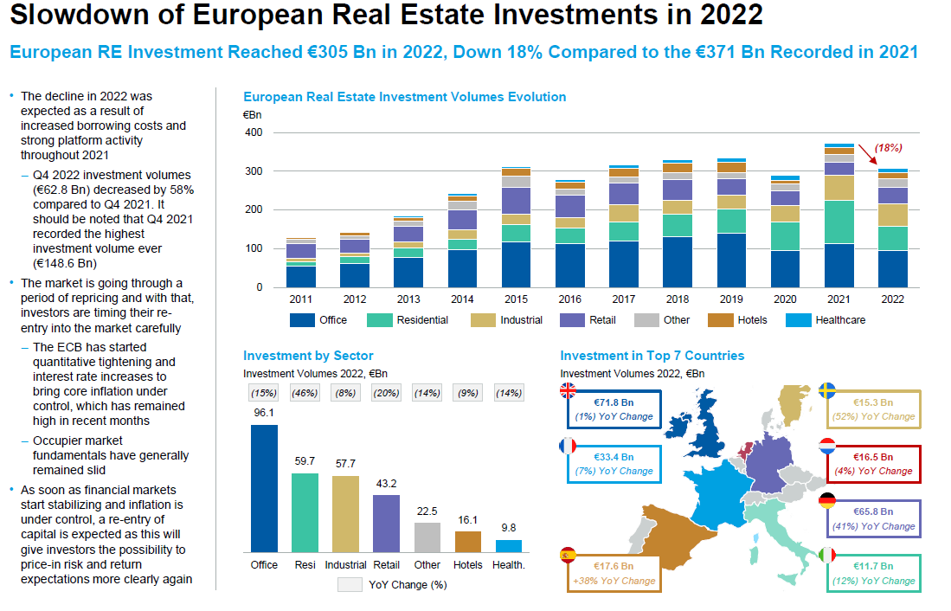
9

Slide 10
China and its re-opening
10

Slide 11
China and its re-opening
China set a lower-than-expected GDP growth target of “around 5%” for 2023
China government’s focus for the year: “prioritise economic stability”
Even so, a 5% growth rate still means that China will continue to be one of the world’s fastest-growing major economies
China will target “disorderly expansion” in the property sector and ensure “effective risk prevention and mitigation” for the country’s leading developers
C-REITs: Potential growth area
C-REITs introduced as an investment vehicle for infrastructure assets, to improve the efficiency and transparency of the price discovery mechanism of the infrastructure market
Initial batch of nine C-REITs listed in Shanghai and Shenzhen in June 2021
Aggregate value of RMB 31.2 trillion; held infrastructure assets ranging from toll roads and waste treatment plants to logistics and industrial parks
C-REIT market has grown significantly, raising >RMB 75 billion, with the listing of 24 C-REITs (generally involving infrastructure and rental housing assets) as of December 2022
In August 2022, C-REITs expanded their asset classes to include affordable rental housing, with three public rental housing REITs raising RMB 3.8 billion in total
On 24 March 2023, the PRC regulators introduced new policies expanding C-REITs’ underlying asset types to include retail properties
11

Slide 12
China and its re-opening
Questions
How do you see the C-REIT market developing? Will it expand into more asset classes?
China’s re-opening bodes well for its commercial real estate market. Do you think it will grow in 2023 and 2024?
How can REITs and funds position themselves to benefit from the economic trends in China, including infrastructure investment? What risks should they be mindful of?
12

Slide 13
ECM activity
13

Slide 14
ECM Activity
Ernst & Young: Global initial public offering (“IPO”) market generally took a sharp dive in 2022, after record performance in 2021
2022 saw only 1,333 IPOs raising US$179.5 billion (IPO activity dipped 45% and 61% by number of deals and proceeds, respectively, year-on-year)
Average deal size shrank due to lowered valuation and poor stock market performance
Volatility from rising geopolitical tensions, inflation and aggressive interest rate hikes
Weakened stock markets, valuations and post-IPO performance deterred IPO investor sentiment
14

Slide 15
ECM Activity
Singapore and China
Singapore
2022: Three IPOs on the SGX Main Board (none involving REITs) and eight IPOs on SGX Catalist, which raised S$581 million in total
2021: Eight IPOs (including two REITs), which raised S$1.62 billion in total
Secondary equity fundraisings (“EFRs”) by SGX-listed REITs (“S-REITs”) fell sharply in 2022 compared to 2021 – only three EFR launches in 2022, down from 18 EFR launches in 2021
China
China’s A-share market saw a historical high in funds raised – 410 deals raising an aggregate of RMB 610.3 billion in 2022, representing a 5% increase in funds raised compared to 2021
Two of the top 10 largest A-share IPO listings were of C-REITs
CICC Anhui Traffic Control Expressway and Huaxia China Jiaojian Expressway raised RMB 10.9 billion and RMB 9.4 billion respectively
15

Slide 16
ECM Activity
Japan and Europe
Japan
In 2022, there were 91 IPOs (excluding those on the Tokyo Stock Exchange’s Tokyo Pro Market for professional stock investors)
This was close to the average figure in the past 10 years
Only three IPOs where >JPY10 billion was raised in 2022, down from 18 in 2021, reflecting increase in the number of smaller-sized IPOs
Amid factors such as the Russia-Ukraine war and global inflation, some companies which had been considering IPOs halted plans or kept smaller the number of new shares to be issued when going public
Europe
Proceeds from European ECM transactions amounted to €90.4 billion over 1,186 transactions in 2022
This was a decrease of 59.6% in value compared to 2021
European IPO issuance levels decreased in volume and number in 2022
Fell by 78.9% to €16.2 billion in volume compared to 2021
Fell by 64.9% to 190 in number compared to 2021
Volatility and uncertainty in the market, making investors more risk-averse
Macroeconomic environment not conducive to EFRs – inflation, recession fears, supply issues, and the Ukraine-Russia war
16

Slide 17
ECM Activity
Questions
What trends do you foresee for REIT IPOs globally and in your country in 2023 and 2024?
What trends do you foresee for secondary EFRs globally and in your country in 2023 and 2024?
What are your thoughts on the shift in focus from public fundraising to private capital in recent times?
17

Slide 18
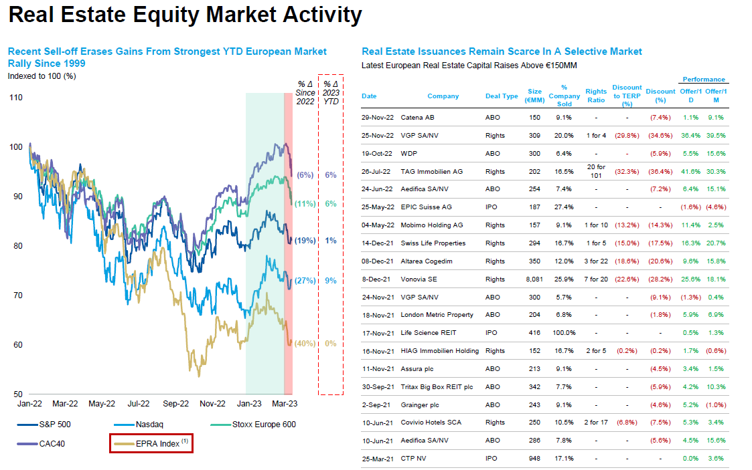
18

Slide 19
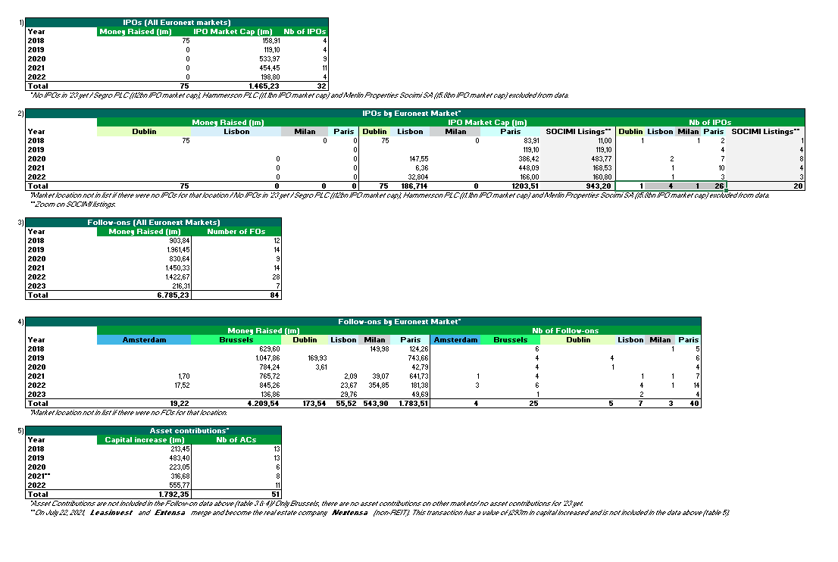
Euronext market data
19

Slide 20
M&A activity
20

Slide 21
M&A Activity
Morgan Stanley: M&A activity was strong in the first half of 2022, but slowed in the second half
Affected by macroeconomic uncertainty, volatile capital markets, rapidly rising interest rates and impact of inflation
Potential sellers faced declining valuations and were reluctant to transact at prices that were down significantly from earlier in 2022
Large financing costs, particularly driven by high interest rates, could lead REITs and other investors to carefully scrutinise deal economics and may have increased the difficulty of implementing big M&A transactions
Potential rise in distressed M&A and restructuring deals, in light of challenging economic conditions
Influence of ESG considerations in the M&A context, as businesses become more ESG-conscious
ESG-motivated deals have emerged in various sectors, such as:
Hershey’s acquisition of health-forward food brand Lily’s in 2021
Keppel REIT's acquisition of Keppel Bay Tower, a green commercial building in Singapore, in 2021
21

Slide 22
M&A Activity
Singapore and China
Singapore
Although there continues to be some M&A activity, there has been a dip in activity levels
In terms of S-REIT property acquisitions in 2022, there were at least 30 deals announced and an aggregate purchase consideration value of at least S$5 billion
In contrast, 2021 saw S-REITs announce at least 50 property acquisitions, exceeding S$11.5 billion in total purchase consideration
China
MSCI: Across mainland China and Hong Kong, transaction volumes for commercial real estate fell by 23% on a year-on-year basis in the first nine months of 2022
Key contributing factors include the Covid-19 restrictions in China and the ongoing liquidity squeeze
Observers are optimistic that the lifting of the Covid-19 restrictions will help with recovery in real estate transaction activity
22

Slide 23
M&A Activity
Japan and Europe
Japan M&A activity has remained relatively resilient
MSCI: Overseas investment in Japanese assets rose 11% in the first three quarters of 2022 to US$8.1 billion
A recent key transaction was the merger of Mori Trust Sogo Reit (“MTR”) and Mori Trust Hotel Reit (“MTH”) announced in November 2022 – MTR agreed to acquire MTH for ¥66.2 billion pursuant to an absorption-type merger agreement
Europe M&A activity
Brookfield Asset Management Inc. (“Brookfield”) (the Canadian investment giant) has been actively pursuing M&A activity in Europe
In 2022, Brookfield saw its Europe assets under management grow more than 20-fold in the last decade
As of 5 July 2022, Brookfield’s spending in Europe had already hit an annual record of more than US$12 billion since the start of the year
Brookfield’s recent acquisitions include: UK household repairs provider HomeServe Plc; property firms Hibernia REIT Plc, Befimmo SA and Alstria Office REIT-AG; slate producer Cupa Group
23

Slide 24
M&A Activity
Questions
What trends do you observe in the M&A market in your country?
What types of assets do you think will be attractive to REITs and other real estate funds in the year ahead?
What do you think are the key hurdles which parties to an M&A transaction should be mindful of in the prevailing economic climate?
24

Slide 25
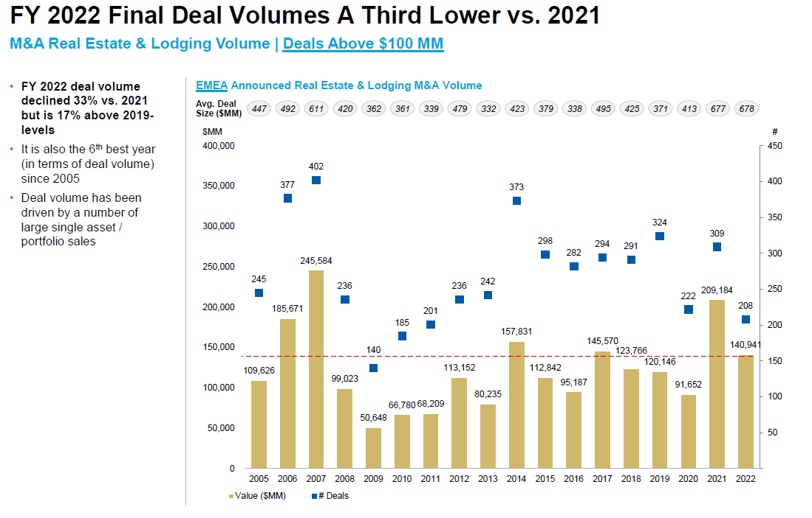
25

Slide 26
Index Fund Behaviour Precedents
Prior to an offer being declared unconditional, Vanguard and Blackrock, large index investors, have tendered on average between c. 30% and 60% of their shares in recent Real Estate tender offers
Vanguard
Blackrock
% of shares still owned at each stage of the public tender offer
% of shares still owned at each stage of the public tender offer
Precedent PTO | Pre-Offer | Initial close | Final close
Adler (2019) | 100% | 54% | 8%
TLG (2019) | 100% | 95% | 14%
Hembla (2019) | 100% | 36% | 1%
Buwog (2017) | 100% | 99% | 3%
Average | 100% | 71% | 6%
Precedent PTO | Pre-Offer | Initial close | Final close
Adler (2019) | 100% | 0% | 0%
TLG (2019) | 100% | 94% | 7%
Hembla (2019) | 100% | 1% | 0%
Buwog (2017) | 100% | 65% | 65%
Average | 100% | 40% | 18%
Higher proportion tendered as some active funds may be consolidated in Blackrock institution level disclosure
Note: Analysis based on publicly available ownership disclosure. Selection based on 4 most recent European RE PTOs with data availability
Source: Thomson Eikon, Press releases
26

Slide 27
Case Study of a Precedent Transaction
Most of index investors waited until the stock was withdrawn from the index (when offer declared unconditional) before tendering in the offer
Two clear spikes in acceptances
Just before and after the offer is unconditional
Just before offer closing
Offer opened to tenders
Offer declared unconditional
Offer closing
Majority of index investors tendering
Source: Deutsche Bank Corporate Finance, Georgesons
27

Slide 28
CONCLUSION
28

Slide 29
Thank You
29

