Slide 1
Changing REITS Markets
4th Asia-based International Financial Law Conference 2023
Panel Discussion
Moderated by
Jerry K C Koh Managing Partner, Allen & Gledhill 30 March 2023

Slide 2
Speakers
Panellists
Judit Budai
Attorneys at Law, Budapest, Hungary; Co-Chair, Securities Law Committee
Eng-Kwok Seat Moey
DBS Bank, Singapore
Taro Fujikawa
Nikko Securities Inc, Tokyo, Japan
Jan Peeters
Stibbe, Brussels, Belgium; Conference Quality Officer, Securities Law Committee
Susumu Tanizawa
Nishimura & Asahi, Tokyo, Japan
Sammuel Xiyong Zhao
JunHe LLP, Beijing, China
Moderator
Jerry K C Koh
Allen & Gledhill, Singapore
2

Slide 3
Overview
Uncertain Global Economic Outlook
China and its Re-opening
Equity Capital Markets (“ECM”) Activity
Mergers and Acquisitions (“M&A”) Activity
REIT Structures in Various Jurisdictions
3

Slide 4
REIT Structures in Various Jurisdictions
Singapore
Hong Kong
China
Japan
Europe
4

Slide 5
Uncertain global economic outlook
5

Slide 6

Uncertain global economic outlook
Key challenges include:
  Significant inflation
  High interest rates
  Geopolitical tensions (including the Russia-Ukraine war)
  Energy crisis
World Bank’s projection: 2023 global GDP growth to slow down to 1.7%
JP Morgan’s projection: 1.6% global GDP growth
  Tight financial conditions and disruptions caused by geopolitical tensions
Jones Lang Lasalle: Real estate investment expected to contract by 5-10% in 2023 due to economic and financing conditions weighing on sentiment
Global REIT performance also affected
  FTSE EPRA Nareit Global REITs Index fell by close to 25% in price returns in 2022
Continuing economic headwinds, with recent stresses in the banking industry
  Collapse of Silvergate Capital, Silicon Valley Bank and Signature Bank – Silvergate Capital and Signature Bank were the two main banks for crypto companies, while Silicon Valley Bank had a lot of crypto start-ups and venture capital firms as customers
  Credit Suisse’s takeover by UBS
6

Slide 7
Uncertain global economic outlook
Questions
What is your view on the outlook of the REIT industry in your country? How do you expect the real estate sector to perform in 2023 and 2024?
How can REITs prepare themselves to tackle challenges and stay resilient?
What opportunities lie ahead for the REIT industry?
  What are some areas where we might see a further technology push?
  How has the sustainability movement in your country evolved over the years?
7

Slide 8
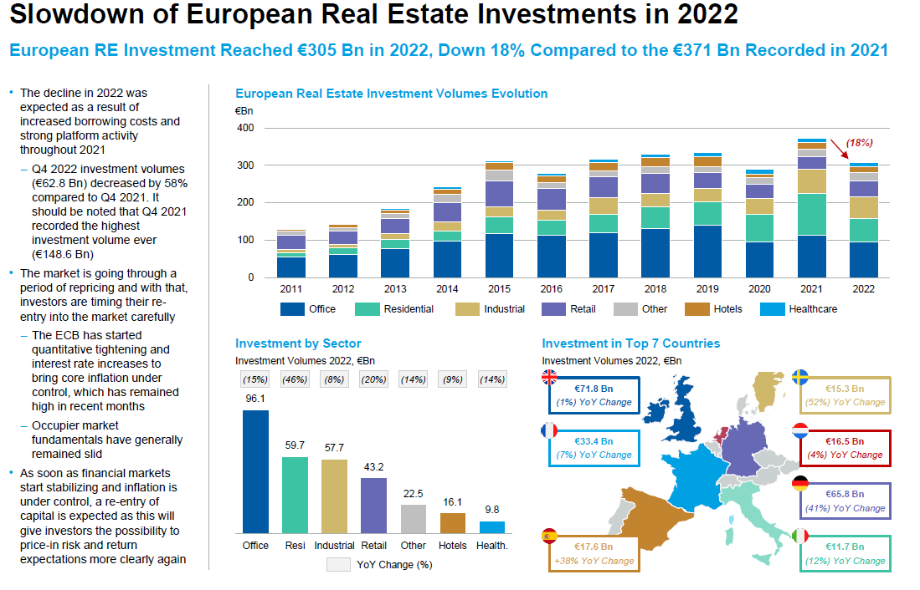
8

Slide 9
China and its re-opening
9

Slide 10
China and its re-opening
China set a lower-than-expected GDP growth target of “around 5%” for 2023
  China government’s focus for the year: “prioritise economic stability”
  Even so, a 5% growth rate still means that China will continue to be one of the world’s fastest-growing major economies
China will target “disorderly expansion” in the property sector and ensure “effective risk prevention and mitigation” for the country’s leading developers
C-REITs: Potential growth area
  C-REITs introduced as an investment vehicle for infrastructure assets, to improve the efficiency and transparency of the price discovery mechanism of the infrastructure market
  Initial batch of nine C-REITs listed in Shanghai and Shenzhen in June 2021
    Aggregate value of RMB 31.2 trillion; held infrastructure assets ranging from toll roads and waste treatment plants to logistics and industrial parks
  C-REIT market has grown significantly, raising >RMB 75 billion, with the listing of 24 C-REITs (generally involving infrastructure and rental housing assets) as of December 2022
    In August 2022, C-REITs expanded their asset classes to include affordable rental housing, with three public rental housing REITs raising RMB 3.8 billion in total
  On 24 March 2023, the PRC regulators introduced new policies expanding C-REITs’ underlying asset types to include retail properties
10

Slide 11
China and its re-opening
Questions
How do you see the C-REIT market developing? Will it expand into more asset classes?
China’s re-opening bodes well for its commercial real estate market. Do you think it will grow in 2023 and 2024?
How can REITs and funds position themselves to benefit from the economic trends in China, including infrastructure investment? What risks should they be mindful of?
11

Slide 12
ECM activity
12

Slide 13

ECM Activity
Ernst & Young: Global initial public offering (“IPO”) market generally took a sharp dive in 2022, after record performance in 2021
  2022 saw only 1,333 IPOs raising US$179.5 billion (IPO activity dipped 45% and 61% by number of deals and proceeds, respectively, year-on-year)
  Average deal size shrank due to lowered valuation and poor stock market performance
  Volatility from rising geopolitical tensions, inflation and aggressive interest rate hikes
  Weakened stock markets, valuations and post-IPO performance deterred IPO investor sentiment
13

Slide 14
ECM Activity
Singapore and China
Singapore
  2022: Three IPOs on the SGX Main Board (none involving REITs) and eight IPOs on SGX Catalist, which raised S$581 million in total
  2021: Eight IPOs (including two REITs), which raised S$1.62 billion in total
  Secondary equity fundraisings (“EFRs”) by SGX-listed REITs (“S-REITs”) fell sharply in 2022 compared to 2021 – only three EFR launches in 2022, down from 18 EFR launches in 2021
China
  China’s A-share market saw a historical high in funds raised – 410 deals raising an aggregate of RMB 610.3 billion in 2022, representing a 5% increase in funds raised compared to 2021
  Two of the top 10 largest A-share IPO listings were of C-REITs
    CICC Anhui Traffic Control Expressway and Huaxia China Jiaojian Expressway raised RMB 10.9 billion and RMB 9.4 billion respectively
14

Slide 15
ECM Activity
Japan and Europe
Japan
  In 2022, there were 91 IPOs (excluding those on the Tokyo Stock Exchange’s Tokyo Pro Market for professional stock investors)
    This was close to the average figure in the past 10 years
    Only three IPOs where >JPY10 billion was raised in 2022, down from 18 in 2021, reflecting increase in the number of smaller-sized IPOs
  Amid factors such as the Russia-Ukraine war and global inflation, some companies which had been considering IPOs halted plans or kept smaller the number of new shares to be issued when going public
Europe
  Proceeds from European ECM transactions amounted to €90.4 billion over 1,186 transactions in 2022
    This was a decrease of 59.6% in value compared to 2021
  European IPO issuance levels decreased in volume and number in 2022
    Fell by 78.9% to €16.2 billion in volume compared to 2021
    Fell by 64.9% to 190 in number compared to 2021
  Volatility and uncertainty in the market, making investors more risk-averse
  Macroeconomic environment not conducive to EFRs – inflation, recession fears, supply issues, and the Ukraine-Russia war
15

Slide 16
ECM Activity
Questions
What trends do you foresee for REIT IPOs globally and in your country in 2023 and 2024?
What trends do you foresee for secondary EFRs globally and in your country in 2023 and 2024?
What are your thoughts on the shift in focus from public fundraising to private capital in recent times?
16

Slide 17
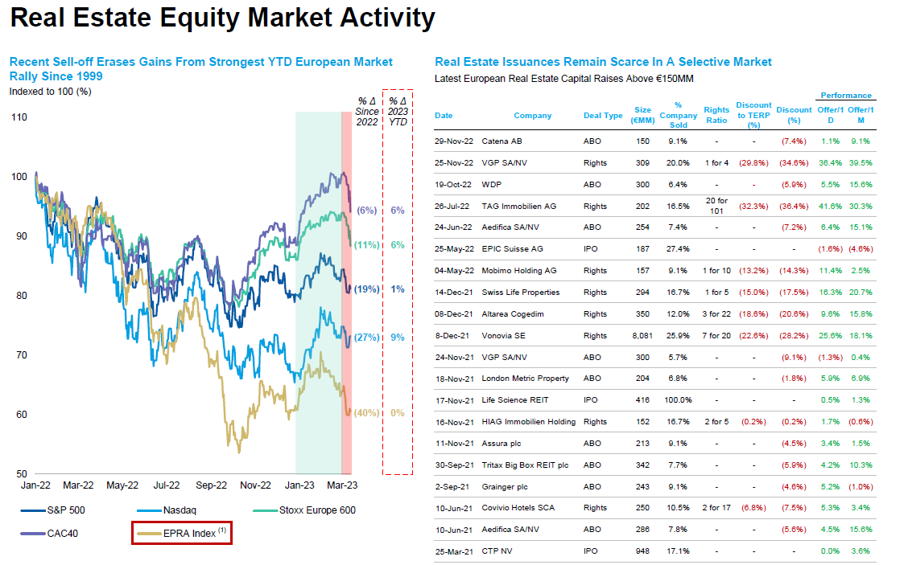
17

Slide 18
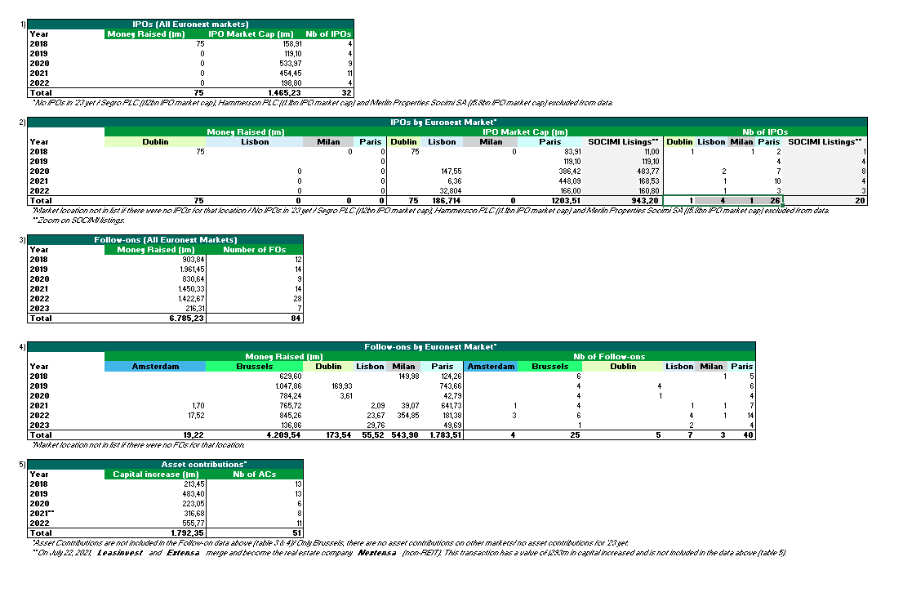
Euronext market data
18

Slide 19
M&A activity
19

Slide 20
M&A Activity
Morgan Stanley: M&A activity was strong in the first half of 2022, but slowed in the second half
  Affected by macroeconomic uncertainty, volatile capital markets, rapidly rising interest rates and impact of inflation
  Potential sellers faced declining valuations and were reluctant to transact at prices that were down significantly from earlier in 2022
Large financing costs, particularly driven by high interest rates, could lead REITs and other investors to carefully scrutinise deal economics and may have increased the difficulty of implementing big M&A transactions
Potential rise in distressed M&A and restructuring deals, in light of challenging economic conditions
Influence of ESG considerations in the M&A context, as businesses become more ESG-conscious
  ESG-motivated deals have emerged in various sectors, such as:
    Hershey’s acquisition of health-forward food brand Lily’s in 2021
    Keppel REIT's acquisition of Keppel Bay Tower, a green commercial building in Singapore, in 2021
20

Slide 21
M&A Activity
Singapore and China
Singapore
  Although there continues to be some M&A activity, there has been a dip in activity levels
  In terms of S-REIT property acquisitions in 2022, there were at least 30 deals announced and an aggregate purchase consideration value of at least S$5 billion
    In contrast, 2021 saw S-REITs announce at least 50 property acquisitions, exceeding S$11.5 billion in total purchase consideration
China
  MSCI: Across mainland China and Hong Kong, transaction volumes for commercial real estate fell by 23% on a year-on-year basis in the first nine months of 2022
    Key contributing factors include the Covid-19 restrictions in China and the ongoing liquidity squeeze
  Observers are optimistic that the lifting of the Covid-19 restrictions will help with recovery in real estate transaction activity
21

Slide 22
M&A Activity
Japan and Europe
Japan M&A activity has remained relatively resilient
  MSCI: Overseas investment in Japanese assets rose 11% in the first three quarters of 2022 to US$8.1 billion
  A recent key transaction was the merger of Mori Trust Sogo Reit (“MTR”) and Mori Trust Hotel Reit (“MTH”) announced in November 2022 – MTR agreed to acquire MTH for ¥66.2 billion pursuant to an absorption-type merger agreement
Europe M&A activity
  Brookfield Asset Management Inc. (“Brookfield”) (the Canadian investment giant) has been actively pursuing M&A activity in Europe
    In 2022, Brookfield saw its Europe assets under management grow more than 20-fold in the last decade
    As of 5 July 2022, Brookfield’s spending in Europe had already hit an annual record of more than US$12 billion since the start of the year
    Brookfield’s recent acquisitions include: UK household repairs provider HomeServe Plc; property firms Hibernia REIT Plc, Befimmo SA and Alstria Office REIT-AG; slate producer Cupa Group
22

Slide 23
M&A Activity
Questions
What trends do you observe in the M&A market in your country?
What types of assets do you think will be attractive to REITs and other real estate funds in the year ahead?
What do you think are the key hurdles which parties to an M&A transaction should be mindful of in the prevailing economic climate?
23

Slide 24
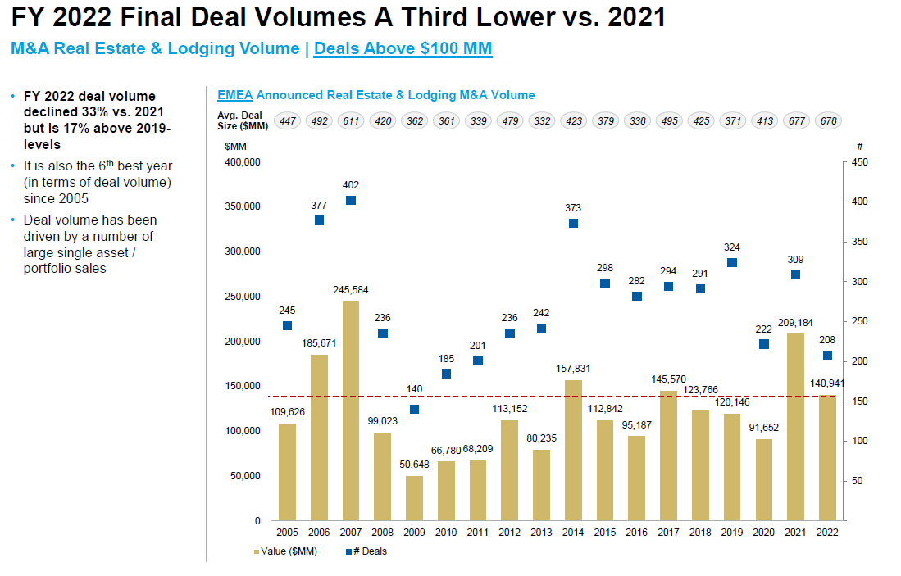
24

Slide 25
Index Fund Behaviour Precedents
Prior to an offer being declared unconditional, Vanguard and Blackrock, large index investors, have tendered on average between c. 30% and 60% of their shares in recent Real Estate tender offers
Vanguard
Blackrock
% of shares still owned at each stage of the public tender offer
% of shares still owned at each stage of the public tender offer
Precedent PTO | Pre-Offer | Initial close | Final close
Adler (2019) | 100% | 54% | 8%
TLG (2019) | 100% | 95% | 14%
Hembla (2019) | 100% | 36% | 1%
Buwog (2017) | 100% | 99% | 3%
Average | 100% | 71% | 6%
Precedent PTO | Pre-Offer | Initial close | Final close
Adler (2019) | 100% | 0% | 0%
TLG (2019) | 100% | 94% | 7%
Hembla (2019) | 100% | 1% | 0%
Buwog (2017) | 100% | 65% | 65%
Average | 100% | 40% | 18%
Higher proportion tendered as some active funds may be consolidated in Blackrock institution level disclosure
Note: Analysis based on publicly available ownership disclosure. Selection based on 4 most recent European RE PTOs with data availability
Source: Thomson Eikon, Press releases
25

Slide 26
Case Study of a Precedent Transaction
Most of index investors waited until the stock was withdrawn from the index (when offer declared unconditional) before tendering in the offer
Two clear spikes in acceptances
    Just before and after the offer is unconditional
    Just before offer closing
Offer opened to tenders
Offer declared
unconditional
Offer
closing
Majority of index investors
tendering
Source: Deutsche Bank Corporate Finance, Georgesons
26

Slide 27
CONCLUSION
27

Slide 28
Thank You
28

