Slide 1
ESG: Strategic Priorities to lead the M&A trail - Is India Ready?
Cyril Shroff
Managing Partner

Slide 2
The Indian Overview
Market Driven and Regulatory Push
Initial Footprint- S. 166 of Companies Act, SEBI LODR
Newer Initiatives Driven by Global Push
SEBI’s BRSR – detailed disclosures
RBI’s Green Finance
Sophistication Needed in ESG Ratings
No standardization
Nascent in India and Sector agnostic
Problems of Greenwashing
2

Slide 3
ESG and the Rest of the World
Rise of Mandatory Climate and Sustainability Disclosures
SEC Climate, Cybersecurity, Human Capital and Board Diversity Rules
EU’s Corporate Sustainability Reporting Directive
Macroeconomic Headwinds and Anti-ESG Backlash Giving Investors Pause
Global energy transition “rethink” amid renewed focus on energy security
Domestic U.S. political backlash creating a chilling effect around “E” and “S” issues
Renewed Focus on the “G”
Boards under increasing scrutiny to oversee and respond to “mission-critical” ESG-related issues
Ongoing demand for board education and development on ESG issues
ESG “Umbrella” Continues to Broaden
Geopolitical and biodiversity risks coming to the fore

Slide 4
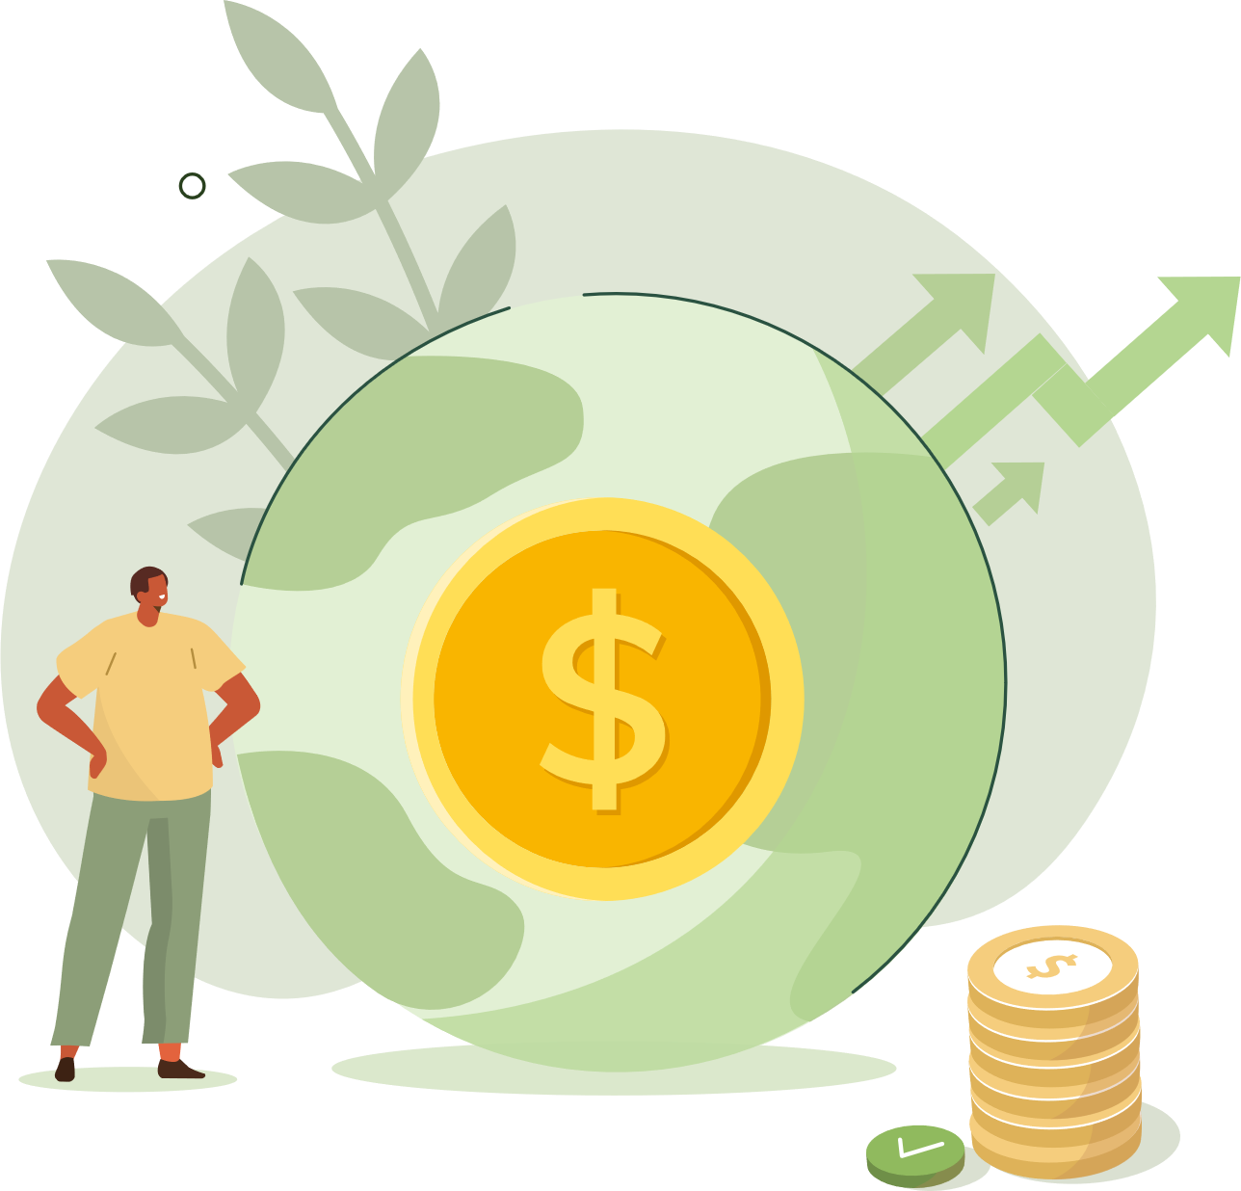
01
Theme 1:
ESG in an emerging economy:
E and S gaining prevalence in a G-focused landscape

Slide 5
ESG in an emerging economy: E and S gaining prevalence in a G - focused landscape
India trying to move from a glorified CSR Regime
Sensible investor relevant disclosure:
short term metrics vs long term benefits of appealing to long term investors
Standardised, comparable, consistent and reliable data
smart disclosure over data quantity
Environment and social performance affects financial performance IFRS – ISSB metrics for ESG disclosure – India’s ability to report on the new metrics
Greenwashing – Fixing supply chain

Slide 6
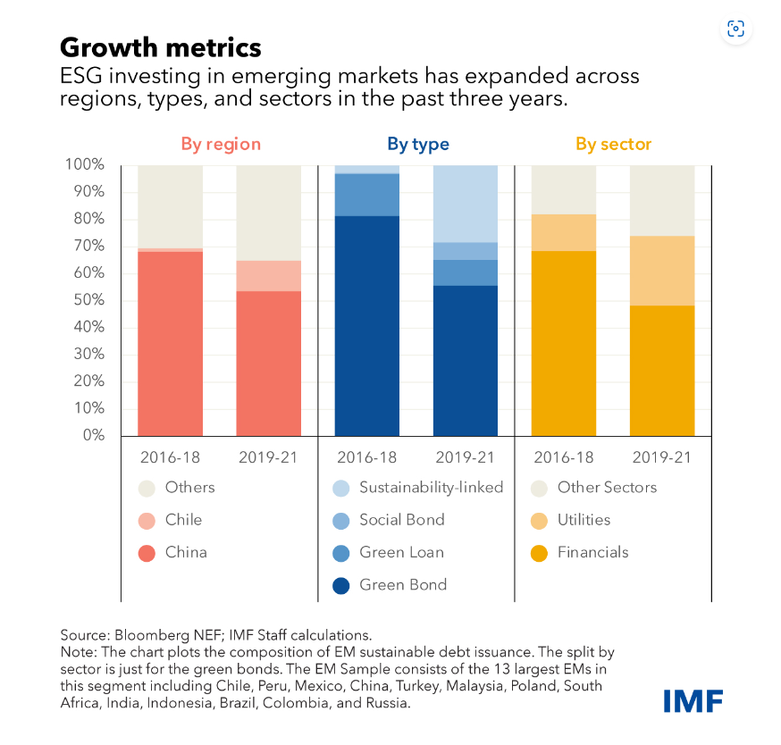
ESG in emerging economies
Sustainable Finance in Emerging Markets is Enjoying Rapid Growth
ESG linked investments made up in 2021 almost 18 percent of foreign financing for emerging markets (excluding China)
Early adopters were mainly institutional investors such as pension funds and sovereign wealth funds
Some pension funds and sovereign wealth funds even developed active ESG ownership approaches
The ESG ecosystem in emerging markets has grown not only in size but also broadened across other dimensions:
Green Bonds remain core part of the ecosystem
other sustainability linked instruments becoming more important
Source: IMF (03/2022): Sustainable Finance in Emerging Markets is Enjoying Rapid Growth, But May Bring Risks (imf.org)

Slide 7
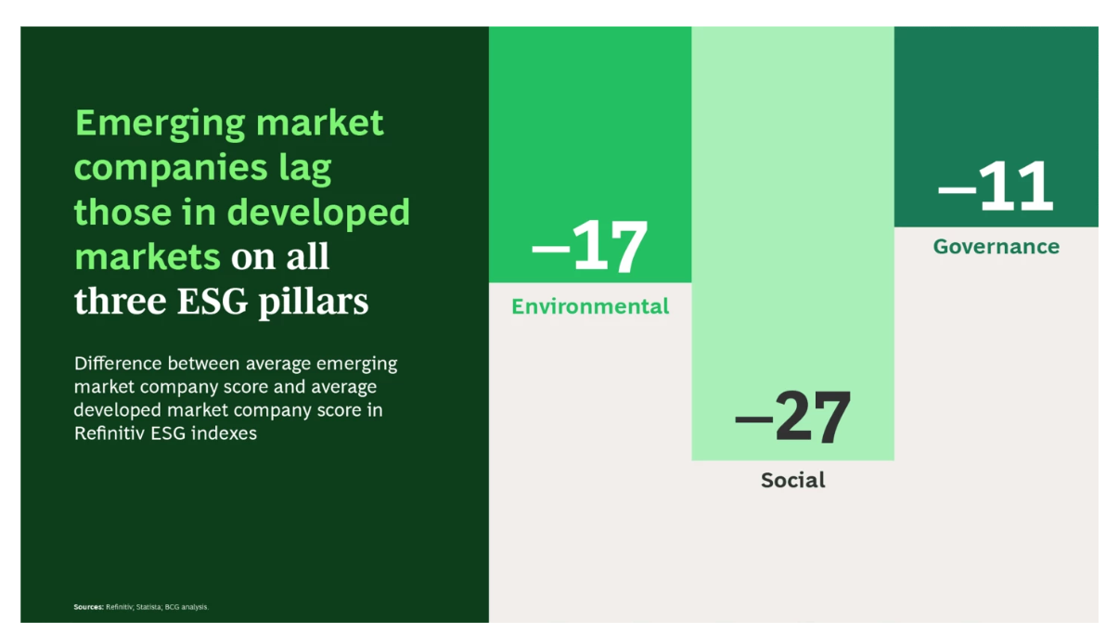
E and S gaining prevalence in a G - focused landscape
A wholistic ESG approach is important for long-term growth and value creation
Companies in advanced economies realized this decades ago and began to act accordingly
Businesses in emerging economies need to catch up
Source: BCG Analysis (03/2023): The Sustainability Imperative in Emerging Markets | BCG

Slide 8
02
Theme 2:
ESG trends in deal making:
the acquirer and investors checklist

Slide 9
ESG trends in deal making: the acquirer and investors checklist
Regulatory Compliance vs. Investor Requirements and Cultural Alignment
ESG Risks and Risk Mitigation / Management including Supply Chain
Post Deal Integration and Monitoring
Will there be a focus on G based on recent global developments?

Slide 10
Increasing ESG shareholder activism / ESG litigation
Compared to traditional corporate governance topics, it is easier to generate public pressure via the topics of sustainability and ESG and possibly also to gain the support of institutional investors and proxy advisors
Activist demands include amongst others
References to the overall corporate strategy: pushing for ESG intentional business purposes and strategic decisions
Implementation of certain measures, also via acquisition or disposal of certain business units
Demands for a different composition of the administrative bodies, including sustainability advisory boards, ethic committees etc. with the respective experts
A change in executive board compensation, based on selected ESG objectives
Strategy-consistent sustainability reporting
ESG litigation
Greenpeace ./. Royal Dutch Shell (26/5/2021) → reduction of CO₂ emissions by 45 % compared to 2019
Lliuya ./. RWE → 0.47 % CO₂ emissions caused by RWE; farmer from Peru initiated action against RWE in Germany

Slide 11
Business areas in which consideration of ESG criteria become relevant
Safeguarding of business judgment decisions:
Component of required trade-offs | Component of due diligence reviews.
Reporting
ESG
Compliance: Monitoring of compliance with legal requirements and voluntary commitments; in addition, development of compliance to integrity culture
Determination of sustainability and ESG targets in variable compensation
Preparation of significant corporate events (e.g. protests surrounding the Annual General Meeting)

Slide 12
03
Theme 3:
Start-up “Tug of War”:
Board / Investor vs. The Founder

Slide 13
Start-up “Tug of War”:
Board / Investor vs. The Founder
Healthy deliberations on all Decision Making
Role of the Board
Some practical points to ponder
Disclosures
Internal deliberation

Slide 14
04
Theme 4:
ESG Ratings and Indicators

Slide 15
ESG Ratings and Indicators
ESG is data driven
Ratings lack standardization
ESG Ratings – Expectation vs. Reality
ESG Fundamentals vs. ESG Ratings: the gap leading to failed ESG investment decisions?

Slide 16
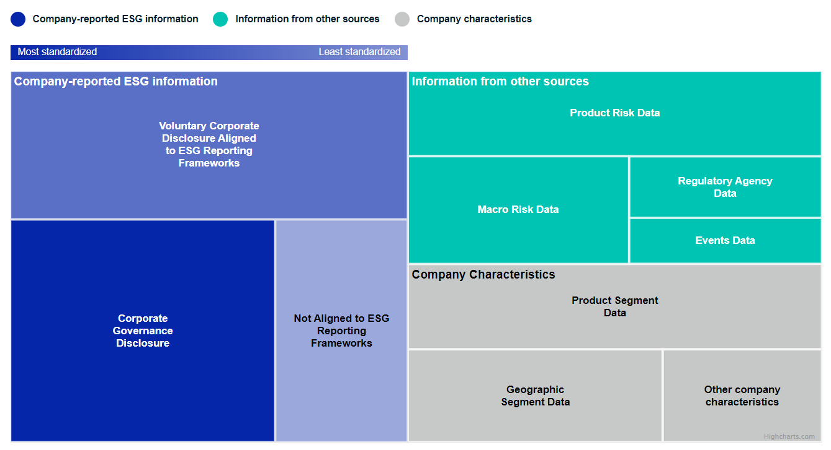
ESG is data driven
Increasing formal rules for ESG data
Regulators are issuing ESG-focused legislation and regulations in response to stakeholder demands
Effective ESG reporting strategy starts with high quality data sources
Strong internal controls will be required to ensure the application of quality management standards
Exemplarily composition of data point recognition for the ESG rating evaluation of MSCI
Source: MSCI (04/2023) https://www.msci.com/what-if-esg-disclosures-become-standardized

Slide 17
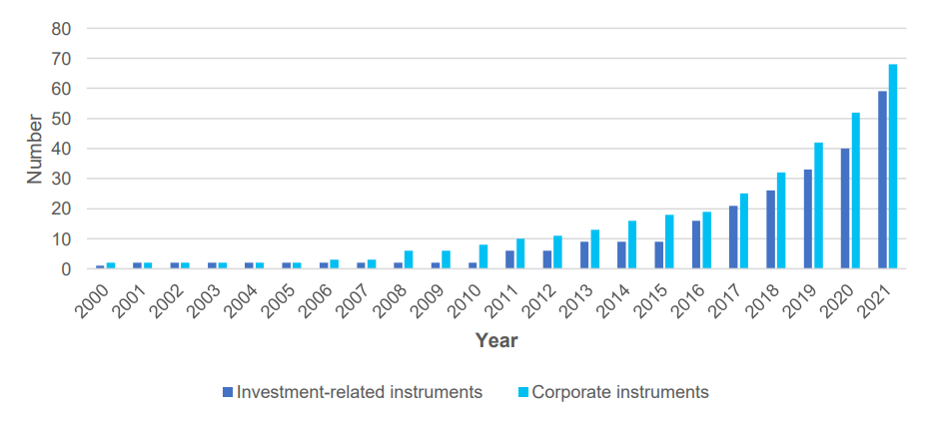
Ratings lack standardization
ESG performance is difficult to measure
Ratings are inconsistent due to wide differences in the KPIs usage
Growth in ESG reporting instruments over time
Reviewed reporting instruments across nine jurisdictions and five global initiatives by UNPRI, a global reporting initiative
Key findings:
Investment-related ESG reporting requirements are growing, but not in all jurisdictions
move from "tell me" to "show me" reporting
long way from consensus on investment-related ESG reporting
Source: UNPRI (07/2023): Review of trends in ESG reporting requirements for investors | Policy report | PRI (unpri.org)

Slide 18
ESG Ratings – Expectation vs. Reality
Current situation creates several risks
Absence of a common definition prevents authorities and investors from mapping the market in a transparent way
Leading towards misunderstandings about the objectives and comparability of ESG ratings, which causes an even more increasing risk for Greenwashing claims for companies
The EU Commission has published on 22 March 2022 a proposal for a directive on misleading environmental advertising claims ("Green Claims Directive")
Including increased requirements for environmental statements by companies via uniform reporting and information standards
Verification of such statements in advance
Compliance with recognized scientific test procedures and in advance verification by an independent body
Source: Hengeler Mueller (03/2023): Richtlinienvorschlag zu Greenwashing – verschärftes public und private enforcement gegen unbelegte Werbeaussagen | Hengeler Mueller News (hengeler-news.com)

Slide 19
Questions?

Slide 20
THANK YOU

