Slide 1
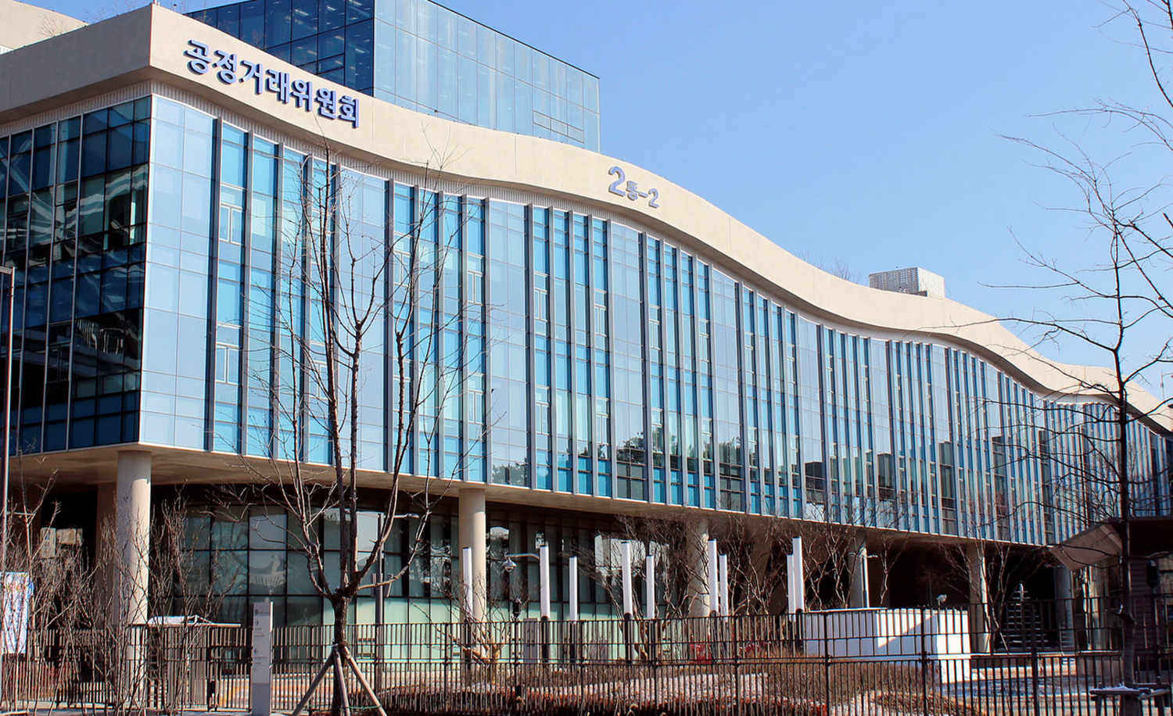
KFTC’s Organizational Restructuring
Heeeun Jeong
Korea Fair Trade Commission

Slide 2
Before
After
Chairperson, Vice-chairperson,
Commissioners
& General Council
Chairperson, Vice-chairperson,
Commissioners
& General Council
Committee
Secretary General
for Policy
Secretary General
for Investigation
Secretariat
Secretary General
Policy-making + Investigation
Policy-making
Investigation

Slide 3
Organization Chart
Chairperson
Commissioners
Vice-chairperson
General Counsel
Secretary General
for Policy
Secretary General
for Investigation
Director General for
Planning & Coordination
Anti-Monopoly
Investigation Bureau
Competition Policy Bureau
Cartel
Investigation Bureau
Director General for
Business Cooperation Policy
Business Group
Monitoring Bureau
Consumer Policy
Bureau
Business Trade / M&A
Bureau

