Slide 1
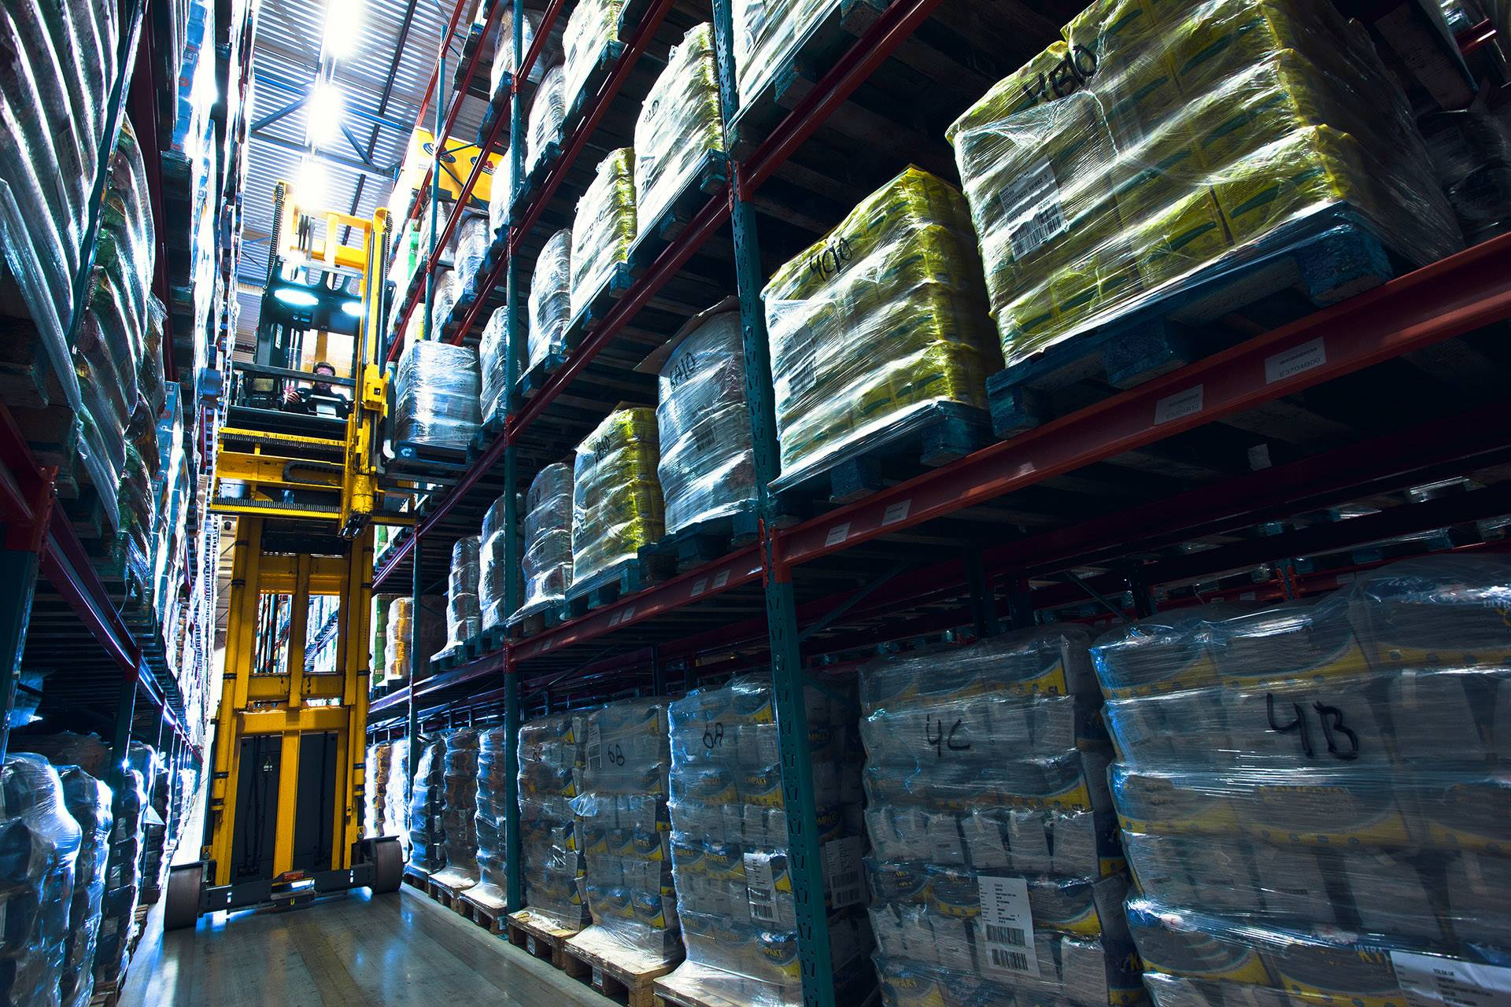
Warehousing – when transport takes a break
Eugene Nai, Senior Legal Counsel, APA

Slide 2
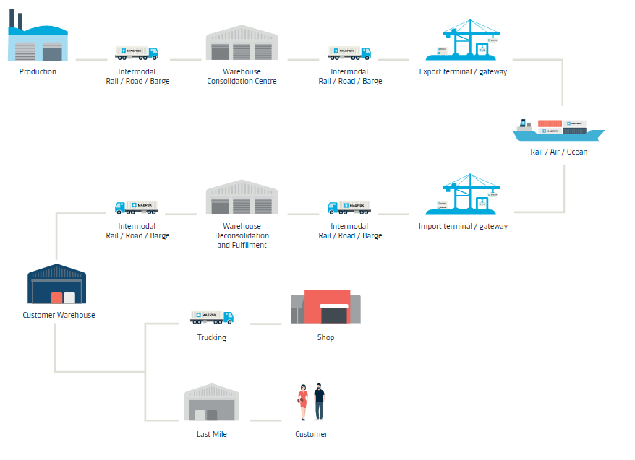
Warehousing’s Place in the Supply Chain (when Transport takes a Break)

Slide 3
Developments in Warehousing Services
Plain Vanilla
Primarily used to assist customers manage inventory requirements.
Value-Added Services may be provided.
(De-)Consolidation
Primarily used in origin and destination supply chain management.
Consolidation works at origin, where goods are delivered by multiple vendors and consolidated into single containers for export to specific destinations.
De-consolidation works vice versa at destination.
Cross-Docking
Primarily used in efficient management of shipping equipment or multi-modal transport.
Shipping containers are unloaded, consolidated or re-stuffed into outbound trailers / containers for further inland transportation.
Fulfilment / Distribution
Primarily used to manage complex supply chains where recipients are yet unknown.
Value-Added Services / Reverse Logistics may be provided.
May be scaled up as regional distribution centres to co-ordinate fulfilments across different geographies.

Slide 4
Key Legal Issues and Challenges
Managing
“Back-To-Back” Leases
Protecting Commercial Interests
Minimizing Legal Liability
“Back-to-Back” Leases
Warehouse Service Providers are not usually Landlords.
Management of lease obligations “back-to-back” with customer obligations to synchronise major terms.
Key issues, relating to term and termination need to be carefully managed, especially termination consequences.
Legal input with impact to the top-line:
minimum volume commitments;
volume forecast clauses
inflation protection clauses;
etc.
Legal input with impact to the bottom-line:
Managing penalty clauses;
Managing set-off clauses;
“Shrinkage” clauses;
etc.
Key Clauses affecting legal liability
Exclusions of liability (indirect damages, etc);
Fault-based liability (negligence or other standards);
Value of goods to be used (EXW price, etc)
Limitations of liability (per claim, per occurrence, aggregate);
Indemnity clauses
Force Majeure clauses (whether specific events should be named)

Slide 5
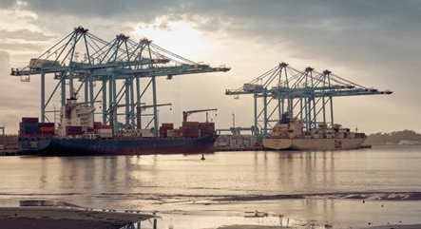
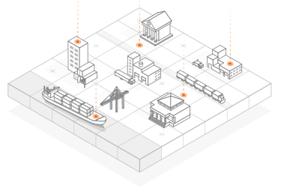
Key Developments and Future Challenges
Regulatory Landscape
Increased Digitisation
Sustainability
Imperative
Rules impacting customs, export control and trade compliance.
Business “Friendly” Initiatives: free trade zone warehouses, bonded warehouses, tax-efficient activities, etc.
Restrictions: foreign investment restrictions, corporate shareholding restrictions, etc.
Sanctions risk.
Increasing use of technology – automated and autonomous processes.
Traditional assessment of liability and insurance coverage may be impacted.
Increased susceptibility to Cyber-Events = increased reliance on Force Majeure clauses?
Increasing focus on sustainability.
Applicable policy frameworks, local / international?
Voluntary assumption of environmental management standards (e.g. ISO 14001, etc)

Slide 6
Thank you

