Slide 1
Dr Sanjay C Kuttan
Chief Technology Officer
This presentation is confidential and is intended, among other things, to present a general introduction to the Centre.
The contents are not to be reproduced or distributed, in whole or in part, without the prior written consent of the Centre.

Slide 2
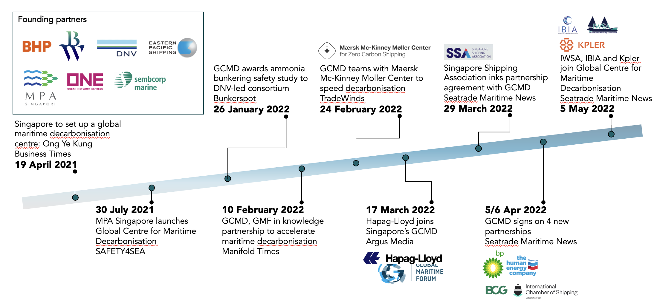
To help the maritime industry eliminate GHG emissions by shaping standards, deploying solutions, financing projects, and fostering collaboration across sectors
Source: GCMD

Slide 3
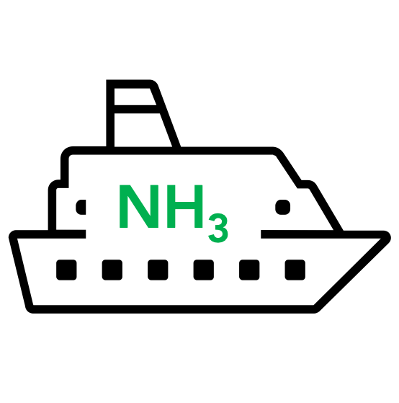
5-year projects outlook
 | Ammonia bunkering
 | Assurance for drop-in green fuels
 | Shipboard carbon capture
 | Near-term retrofit solutions
2022
2023
2024
2025
2026
Safety study
Pilot with proxy assets
Pilot with operational assets
Pilot with biofuels
Pilot with bioLNG
CO₂ capture pilot
CO₂ offloading pilot
Pilot with storage/utilisation
CO₂ transport + offload study
Wind-assisted ship propulsion
List is not exhaustive; current as of May 2022.

Slide 4
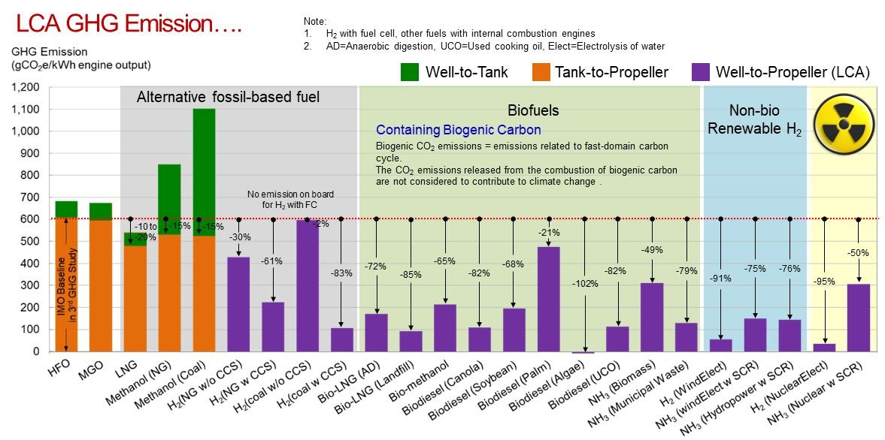
A robust life cycle analysis for alternative fuels is key if we truly want to fight climate change
Source: “Alternative Fuels for International Shipping” 2019, MESD, NTU

Slide 5
Use of alternative fuels - considerations
Fuel properties
New
Existing
Standards
Handling
Custody transfer
Testing
Commercial terms
Price premium
Insurance
Compliance
Sectorial and geographical regulations
Data management with increased digitalisation
Manpower
Readiness
Competency
Volumetric energy density
Hazardous materials classification
Fuel supply
Ubiquitous production
Availability of supply chain assets
Infrastructure
Source: GCMD

Slide 6
Government and industry must complement enabling efforts to ensure effective deployment of decarbonisation solutions
Government-led enablers
Industry-led enablers
Decarbonisation solutions
Industry led enablers*
Decarbonisation solutions
Policy
Adoption incentives of green solutions
Effective carbon tax, carbon credits
Green procurement
Consumer green labelling
Risk management
Establishment of :
Safety and interoperability standards, operating guidelines,
Standard GHG accounting system (LCA basis),
Data/information standards
Manpower development
Capability development schemes
Accreditation of training courses
Infrastructure development
Energy convertors
Supply chain assets
Sensors and ICT backbone
Risk management
Adoption of operations standards, data/information standards
Manpower training
Finance
Green financing instruments
Green procurement
Bunker levy / Carbon tax
Insurance instruments
Technical measures
Fuel usage reduction systems
Engine derating
Harnessing renewable energy
New hull / propeller designs
Zero / low carbon fuels / energy vector
Carbon Capture U/S
Operational measures
Slow steaming
Hull & propeller cleaning
Weather routing
Automation
Market-based measures
Bunker levy
Carbon tax/credits
Source: GCMD

Slide 7
10 Pasir Panjang Road #17-02 Mapletree Business City | Singapore 117438
www.gcformd.org
projects@gcformd.org
+65 6979 7660

