Slide 1

This is your International cover slide.
To rotate the client name, click the Layout button and choose the "Rotated" version
IFLC REAL ESTATE AND INVESTMENT PANEL 2023
Hiroyuki Kano
Partner, Clayton Utz
Australia
Tokyo, Japan
30 March 2023

Slide 2


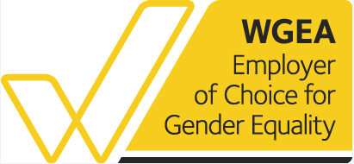
ABOUT US: CLAYTON UTZ
A reputation for standing out. And for being outstanding.
For over 180 years, our confident approach to complex transactions and litigation has seen us grow into one of Australia's premier firms.
Now, with 168 partners and over 1,700 employees across six offices, we continue to strengthen our reputation for innovative and incisive advice.
With a genuine commitment to client service, we are trusted advisers to a range of government departments and agencies,
as well as leading Australian and international corporations.
As a full-service commercial law firm, we have lawyers with diverse and broad-ranging legal experience, across a range of industry sectors. Our strength lies not only in the range of skills and depth of expertise held by our individual lawyers, but also in our ability to work together effectively as a full-service national team.
Darwin
Brisbane
Sydney
Canberra
Perth
Melbourne

Slide 3
Key issues: foreign investment in australia
Legal and regulatory barriers
Tax and foreign surcharge implications
Structuring & Financing
Key takeaways

Slide 4
LEGAL AND REGULATORY BARRIERS

Slide 5
Foreign investment review board
Investment into Australia by foreign entities (individuals, trusts, corporations, etc.) is regulated by the Foreign Acquisitions and Takeovers Act 1975 (Cth)
The majority of large foreign investment into Australia requires review and approval by the Foreign Investment Review Board (FIRB), particularly investment in Australian land and buildings
If FIRB Approval is required, it must be obtained before being bound to acquire the property

Slide 6
When firb approval is required
Whether FIRB Approval is required will depend upon the type of acquisition, the value of the acquisition, and the location of the foreign acquirer
Types of Australian land that are subject to FIRB regulations include:
  Acquisitions of:
    Agricultural land
    Residential land
    Commercial land
    Mining or production tenements
    National security land
  Leases exceeding 5 years

Slide 7
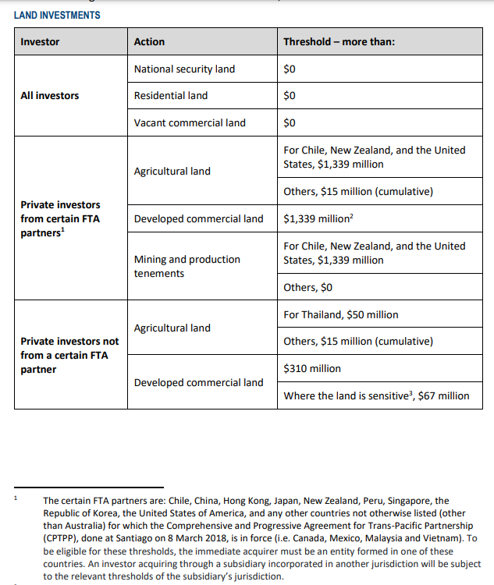
When firb approval is required
Monetary thresholds for all foreign investors from 1 January 2023:
For Japanese investors, FIRB approval is usually required for acquisitions of:
  Any residential land, national security land or vacant commercial land;
  Agricultural land exceeding $15m AUD in value; and
  Developed commercial land exceeding $1.339m AUD.
Source: FIRB Website, February 2023

Slide 8
MANAGING FIRB ISSUES
Transactions must be conditional upon FIRB Approval if FIRB Approval is required (or approval must be obtained before entering into the agreement to acquire the property)
Complex purchasing vehicle structuring will not usually be sufficient to avoid the need for FIRB Approval because tracing provisions operate to capture the ultimate foreign acquirer
FIRB application fees are payable at the time the application is submitted

Slide 9
Tax & foreign surcharge implications

Slide 10
Tax & foreign surcharge implications
By State/Territory
Nationally
Income tax payable annually (depends upon tax residency, whether there is a Permanent Estabalishment in Australia and/or source of income)
Withholding tax payable on a variety of payments, including interest (subject to some exceptions), certain dividends, royalties and managed investment trust distributions.
Capital gains tax payable on capital gains upon disposal of assets (depends upon tax residency and nature of assets being sold – generally, Australian real estate and other land interests, whether held directly or indirectly, are in the Australian tax net, regardless of residency)
Goods and Services Tax
Stamp Duty and Land tax are implemented by each State/Territory
Each State/Territory in Australia treats investment in land differently, including:
  'transfer duty/stamp duty' applies on the acquisition of land, interests in land (such as mining leases, exploration licences), certain chattels and business assets (such as goodwill, receivables and IP);
  "landholder duty" on the acquisition of shares in companies and units in unit trusts which directly hold land or hold land through other companies and unit trusts;
  Additional duty may be payable by foreign persons buying residential land and there are also ongoing land tax payable for foreign landowners, sometimes relating to both residential and non-residential land.

Slide 11
Stamp duty
Any investment in Australia is likely to have stamp duty implications and the structure of the transaction will have key implications on whether there is exposure to ongoing liability. For example, is the investment by way of an acquisiton of:
  shares in a company or units in a trust;
  an interest in an incorporated joint venture or unincoporated joint venture;
  a partnership interest; or
  land or business assets, directly.
For example, if a purchaser buys all the shares in an unlisted company that holds AUD$20 million of land in Victoria, then the purchaser will pay $1.3 million in stamp duty (being "landholder duty") in Victoria. This will need to be paid within 30 days of the transaction completing. See next slide for stamp duty and land tax rates across all States and Territories.
Due diligence will also play a key role in working out whether a "target" has unpaid stamp duty liabilities.
From an enforcement perspective, any document that has not been stamped (and was required to be stamped) cannot be produced as evidence in any court proceedings until such time as the stamp duty has been paid and the document stamped. Therefore, when acquiring a company, if that company is a party to a contract which has not been stamped, then in the scenario that that contract becomes the subject of a dispute, the only way in which that contract can be produced in court as evidence will be if the new owner of that company has paid the duty and attended to stamping.

Slide 12
ADDITIONAL DUTY & LAND TAX
New South Wales
Victoria
Queensland
Western Australia
South Australia
ACT
Tasmania
ADDITIONAL DUTY
Top Rate of Tranfer Duty for all taxpayers
5.5%
6.5%
5.75%
5.15%
5.5%
4.54% residential
4.5%
Normal Duty
Additional
Duty payable by foreign persons
+8%
+8%
+7%
+7%
+7%
N/A
+8%
+1.5%
residential
primary
production
Land
Affected
Land
Affected for Additional Duty payable foreign persons
Residential land including development land - with some exceptions.
Residential land including development land - with some exceptions.
Residential land including development land - with some exceptions.
Residential property including development land - with some exceptions.
Residential land including development land - with some exceptions.
N/A
Residential land including development land - with some exceptions.
Primary production land.
ADDITIONAL LAND TAX
Highest Rate of Tax
2%
2.55%
2.75%
2.67%
2.4%
1.14%
1.5%
Additional
Land Tax
2%
2%
2%
N/A
N/A
0.75%
2%
Land
Affected
All land subject to land tax in Queensland, plus homes and primary production land.
N/A
N/A
Residential land.
Residential land.
Land
Affected
Residential land.
All land subject to land tax in Victoria.
Who is
Foreign For Land Tax Purposes?
NB: Figures current as at July 2022

Slide 13
Structuring & financing

Slide 14
Structuring
It is common for foreign private buyers to acquire Australian property through an Australian incorporated company (and trust, if required). Corporate structures can be as simple or as complex as required.
Depending on the value and number of properties acquired, buyers should consider using "special purpose vehicle" (SPV) structures to own different properties. This is usually done on an individual property basis or for different classes of property – e.g. XYZ Industrial Property HoldCo Pty Ltd as trustee for the XYZ Industrial Property Trust.
SPVs are useful for limiting risk, future sale of specific assets or asset classes, reducing land tax (i.e. each different SPV will obtain the benefit of any available land tax tax-free thresholds) and other reasons.

Slide 15
Structuring - Financing considerations
Different financing arrangements can be put in place depending on which vehicle in the relevant structure will be borrower, and whether there will be overlapping security between different lenders, necessitating intercreditor and priority arrangements.
A "common terms deed" structure could be implemented to streamline the borrower's financing arrangements, pursuant to which different debt facilities on different commercial terms with different lenders can be entered into by the borrower, while retaining a central covenant package in a common terms deed poll accepted by all financiers.

Slide 16
Example of Head Unit Trust Structure
Investor
Investor
Investor
Management Company
Often a special purpose holding entity is also established to hold the interests in the various SPV entities which directly hold the relevant property.
Such a structure provides flexibility as individual properties can be separately financed by different lenders without encountering priority or intercreditor issues.
Alternatively, debt funding can be provided at the holding entity level and undertaken on a property portfolio basis, with capacity for the borrower to accede properties into the security pool from time to time or to replace existing properties with new properties.
Head Unit Trust
Trustee
Investment Management Agreement
Sub-trust
Sub-trust
Sub-trust
Sub-Trustee
Property
Property
Property

Slide 17
Joint ventures
Joint ventures are often used where one or more parties have complementary expertise or resources.
Most of the time, one party has funds available for investment and the other party has development skills.
Party with Capital
JV Project
Party with Expertise

Slide 18
Joint Ventures
The parties would usually want to carry out a development project as a "joint venture" in order to maximise returns and reduce risk.
Joint ventures do not have any fixed structure or requirement, but most of the time the parties will be shareholders in a company or unitholders in a trust (in their agreed proportions). That entity will then carry out the development and the profits are received by the joint venture parties in accordance with their interests in the entity.
A "Joint Venture Agreement" / "Shareholder Agreement" or similar is required to set out the terms of the arrangement.
Party A
JC Company
Project
Party B

Slide 19
Financing – some alternatives
Bank finance for propery acquisitions (direct and indirect) is common in Australia. Interest rates are competitive and banks are generally secure.
Green loans or sustainability linked loans are becoming more common, where borrowers are incentivised through the loan pricing to achieve pre-agreed sustainability/green performance targets.
Finance would usually be backed by a mortgage registered on the title of the land to secure repayment, as well as a general security deed over all assets of the borrowing entity and landowning entities to cover off "voluntary administrator" risk.
Lenders often also require security from the relevant entity holding the equity interest in the borrower/landowner for flexibility of enforcement, so that the subsidiary can be sold with all its property and non-property assets intact on enforcement.

Slide 20
Financing – some alternatives
In addition to taking security, lenders will also enter into side deed arrangements with key stakeholders involved in any transaction, such as property managers, investment managers, anchor tenants on leased properties, developers on development properties.
"Fund-throughs" are becoming more popular for property developments. A fund-through is a transaction where a property owner secures construction finance for a development from an investor who will take over ownership of the property on completion of the development, and take a coupon payment on the finance provided for the duration of the development. The property owner will manage the development and be able to access capital uplift on the transfer of the property on completion of the development.

Slide 21
Fund-through basics
In a typical fund-through structure, there are two key parties involved - the investor and the land-owning developer (or a developer who has acquired the rights to develop the land).
The fundamental workings of this structure are usually outlined in a development agreement signed between the investor and the developer.
Investor
Investor takes ownership of completed Project
Investor finances development
Project
Land owner / Developer
Project completed
Land owner / Developer carries out project

Slide 22
Fund-through basics
Due to the extended payment schedule involved in the purchase of the finished development by the investor, the fund-through structure is similar to an acquisition through an installment plan.
In cases where the developer does not require external debt financing, the fund-through structure typically offers investors a lower price than a take-out structure. This lower price compensates for the additional risk that investors assume, as well as the earlier deployment of capital.

Slide 23
Fund-through benefits
From the developer's perspective, this structure offers certain benefits.
Firstly, the project is effectively "pre-sold" to the investor, eliminating the need for the developer to incur costs that could result from a delay between completion and finding a buyer.
Secondly, the investor's continuous payments fully fund the developer's ongoing costs, thereby reducing the risk of liquidity issues. By receiving these payments, the developer can obtain project finance at rates below the market average.
This is particularly advantageous for developers who are unable to secure finance through traditional sources, such as major banks.

Slide 24
Fund-Through considerations for investors
Investors in this structure must have sufficient capital or financing to cover the ongoing progress payments.
If access to a large pool of capital is not available, securing debt financing may prove challenging.
The process is further complicated by the fact that property title may not transfer until construction is complete, making it difficult for the investor to use the land as collateral.
Even if the land could be used as security, its value may not be sufficient to secure the necessary financing during the construction phase.

Slide 25
Fund-Through considerations for landowners
Typically, these structures come with increased investor control. In this setup, payments are only made after an independent certifier has verified the progress of the development.
This arrangement effectively gives the investor more supervisory power compared to a typical development structure.
A developer operating within this framework is more likely to be obligated to a specific delivery date.

Slide 26
Fund-Through considerations for landowners
This increased level of control allows the investor to have greater certainty and control over the completion and delivery timeline of the project.
In the event of an investor default, the developer's financial risk is restricted to the expenses needed to finalize the project from the point of default.
Depending on the construction phase, the developer may opt to bring in a new investor who would take over the defaulted investor's share and fund the remaining project. Alternatively, the developer could secure a loan to finish the development and sell the finished project to a third party.

Slide 27
Key takeaways

Slide 28
Key takeaways for foreign investor
Before contracting for investment in Australia, consider whether FIRB Approval will be necessary and if so, consider including conditions for FIRB Approval in the transaction documents as well as carefully consider the practical timeline for the whole transaction
Consider the additional fees and taxes that will be payable as part of the transaction and on an ongoing basis as a result of any foreign ownership
Determine which investment and ownership structure would best suit the investor

