Slide 1
A general counsel’s view
16 May 2022

Slide 2
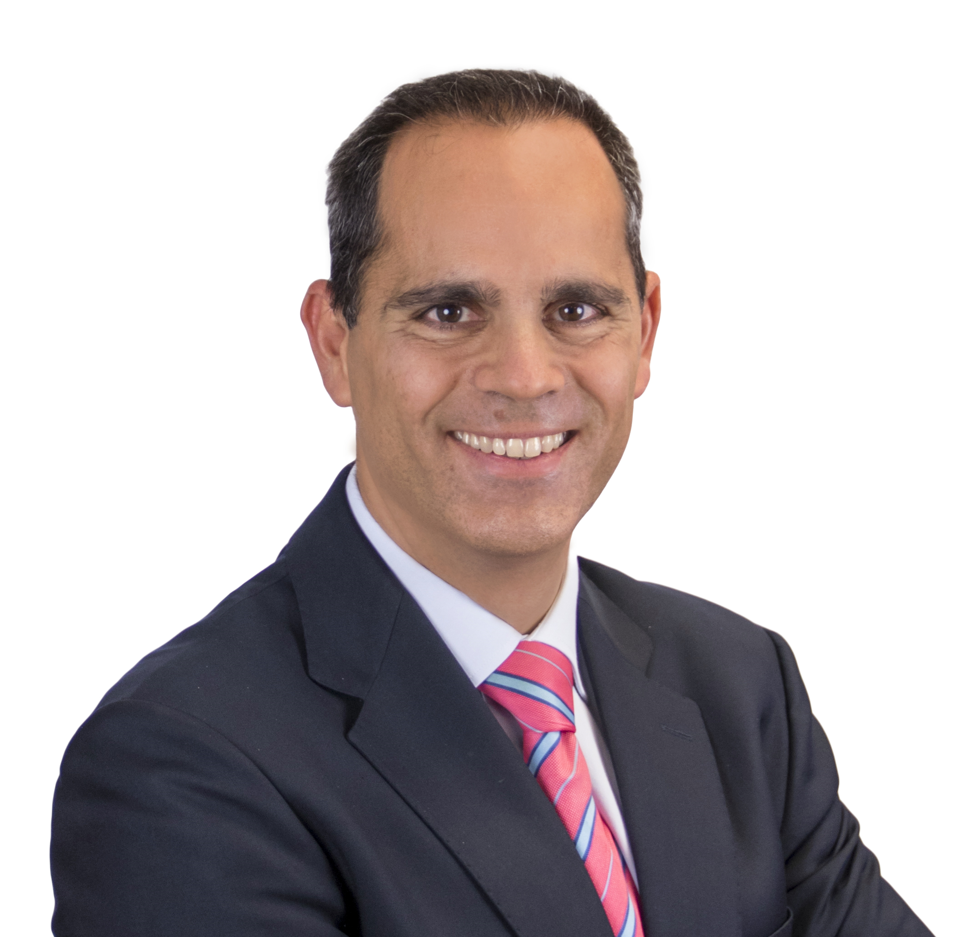
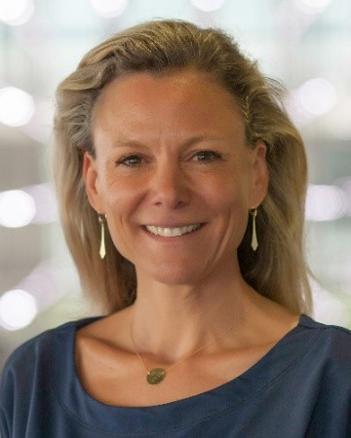
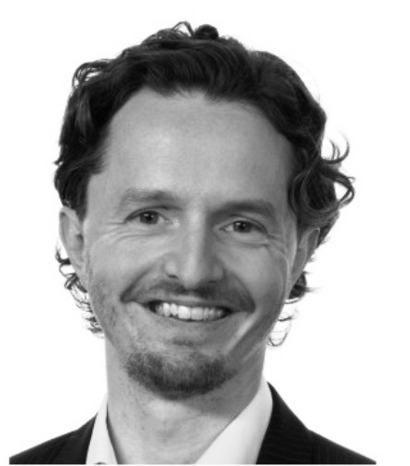
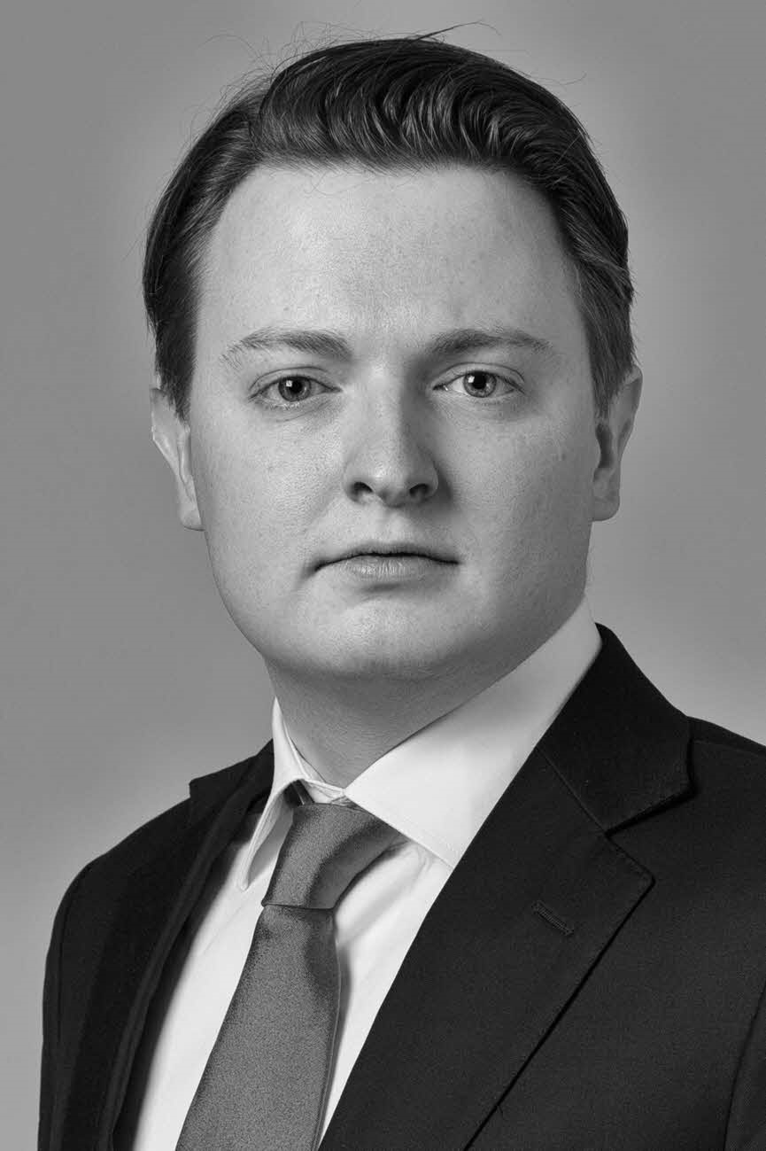
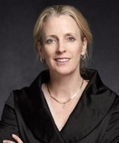
Session Co-Chairs
Alejandro Payá
Philip van Hilten
Speakers
Pauline Bottema-Sanders
Vincent Brugge
Martin Roberts
Caroline de Waele
Nora Klug

