Slide 2
CONNECTIVITY AND INTERNET USE IN BRAZIL
2020
152 million Internet users
83% of Brazilian households with Internet access - 61.8 million
Increase in line with other Latin American and Caribbean countries

Slide 3
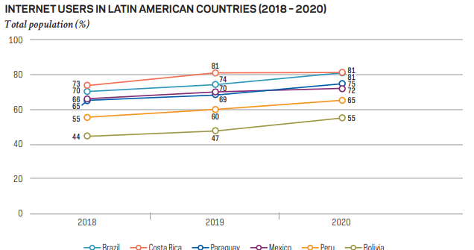
CONNECTIVITY AND INTERNET USE IN BRAZIL
Source: ITU, 2020A. Note: countries that reported 2020 data to the International Telecommunication Union (ITU).

Slide 4
INTERNET USE IN BRAZIL – GENERAL
93%
80%
72%
55%
53%
Instant messages
Voice or
video calls
Social
networks
audio or video live streaming
health or healthcare services

Slide 5
INTERNET USE IN BRAZIL – SOCIAL NETWORK
Almost
99 million users
In 2021
Almost 100 million of monthly accesses from Brazil in 2021
127 million users
In 2021
19 million users
In 2021
Source: numbers reported by platforms

Slide 6
DISINFORMATION AND SOCIAL NETWORKS - ELECTIONS
Latest elections 2018 (presidential) and 2020 (local) - disinformation campaigns about electoral process
Research by Fundação Getúlio Vargas (FGV) and Electoral Court (Tribunal Superior Eleitoral):*
335,169 publications that questioned the legality and security of Brazilian elections. Those posts had more than 16 million interactions online.
2,035 posts about disinformation had nearly 24 million views.
*Desinformação On-line e Eleições no Brasil: A circulação de links sobre desconfiança no sistema eleitoral brasileiro no Facebook e no YouTube (2014-2020).

Slide 7
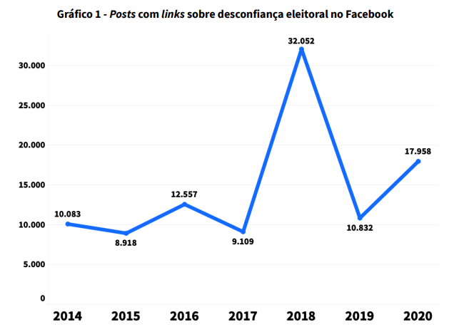
DISINFORMATION AND SOCIAL NETWORKS - ELECTIONS
The research reveals that the spread of false information about the electoral process has a significant increase in election years, but also occurs in non-election years.
Source: “Desinformação On-line e Eleições no Brasil: A circulação de links sobre desconfiança no sistema eleitoral brasileiro no Facebook e no YouTube
(2014-2020)” - https://bibliotecadigital.fgv.br/dspace/bitstream/handle/10438/30085/%5bPT%5d%20Estudo%201%20%281%29.pdf?sequence=1&isAllowed=y

Slide 8
DISINFORMATION AND SOCIAL NETWORKS – COVID-19 OUTBREAK
110 million Brazilians believe at least one fake news about the pandemic - seven out of ten Brazilians.
6 out of 10 Brazilian internet users reported received fake news about the new coronavirus through WhatsApp.
5 in 10 Brazilian internet users received false news through Facebook.
Parliamentary Commission of Inquiry in the Brazilian Federal Senate - dissemination of fake news and misinformation about vaccines by political agents
Source: Avaaz – “O Brasil está sofrendo uma infodemia de Covid-19”

Slide 9
“EX ANTE” LEGISLATION IN BRAZIL – INTERNET BILL OF RIGHTS – 2014
Connection Providers
Application Providers
2019, 151 content removal actions in São Paulo State Court (100 Facebook , 24 Google).
Not liable for damages resulting from content generated by third parties.
Content removal after court decision or notification if “sexual content”

Slide 10
NEW LEGISLATIVE INIATIVES
Brazil : Bill No 2630/2020
Transparency reporting
Complaint and redress mechanisms
Legal representation in Brazil
Criminalization spread of fake news – 1 to 3 years imprisonment
Other attempts to regulate internet:
Argentina
Colombia
Chile

Slide 11
THANK YOU!
Camila Borba Lefèvre
clefevre@vieirarezende.com.br

