Slide 2
Bruna Marrara
Machado Meyer, Brazil
Juan Manuel Iglesias Mamone
Mitrani, Caballero & Ruiz Moreno, Buenos Aires
Jennifer A. Migliori
Duane Morris LLP, Miami
Lyyn Cramer
MAPPLES GROUP, Ireland
Michael Orchowski
Sullivan & Cromwell, London
Floran Ponce
Lenz & Staehelin, Geneva
Reported by: Clodagh Rochford, Matheson, Ireland

Slide 3
Taxes and social responsibility: managing opportunities and risks of ever complex tax laws

Slide 4
Section 1
THE ROLE OF TAXES IN ESG
The US vs the EU approach

Slide 5
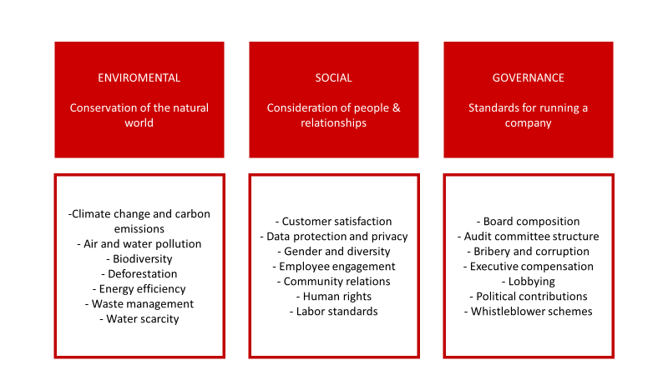
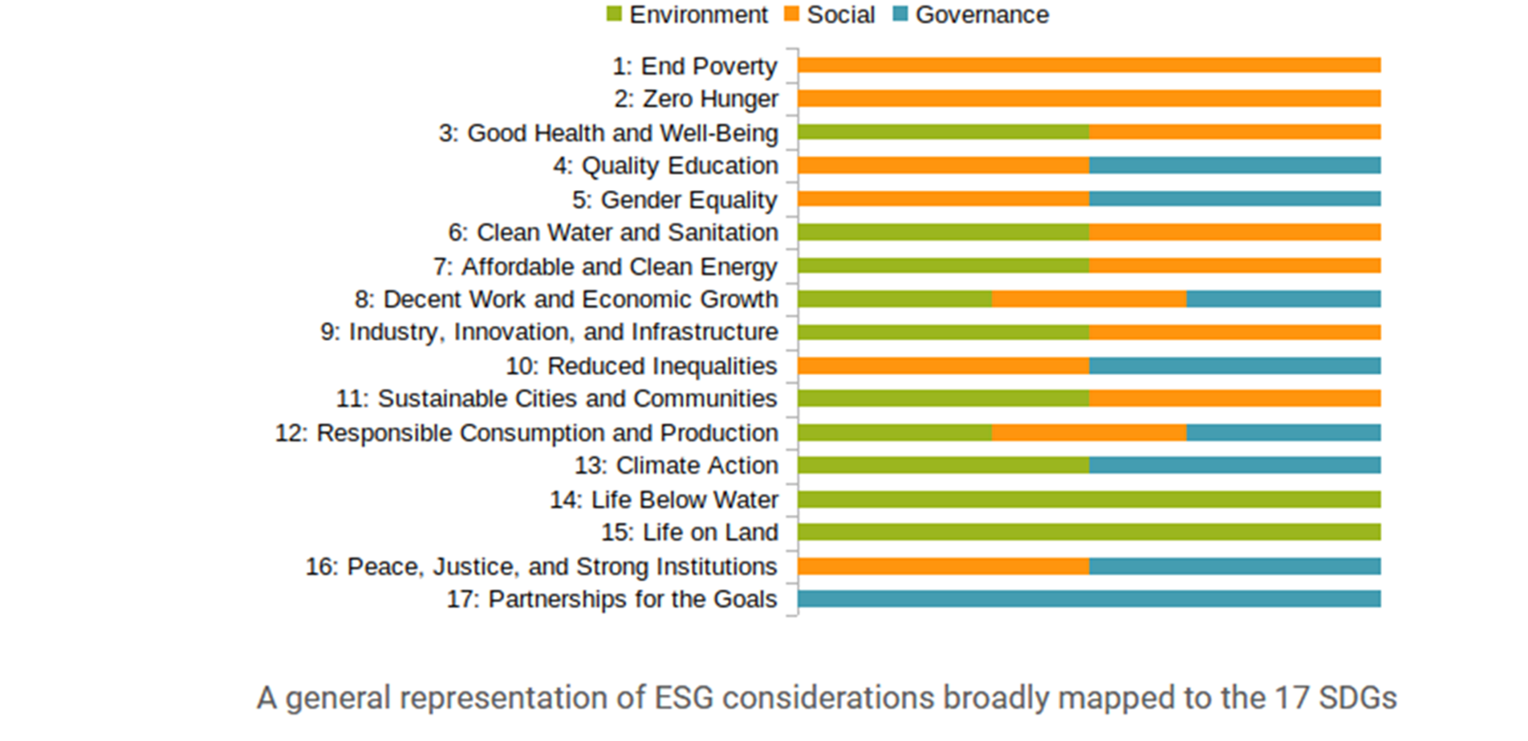
ESG + SDG

Slide 6
SECTION 2
THE ROLE OF TAXES TO INFLUENCE ON THE TAXPAYER’S BEHAVIOR
Should the government mind its own business?

Slide 7
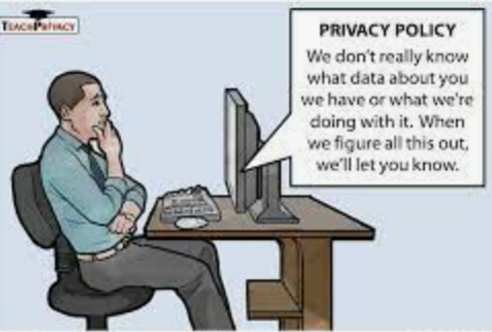
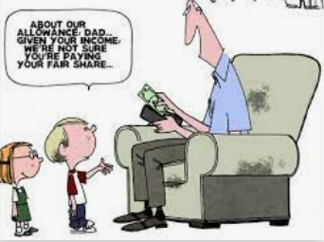
SECTION 3
TAXES & PUBLIC SCRUTINY
Transparency in exchange of certainty, fair deal?

Slide 8
Section 1
THE ROLE OF TAXES IN ESG

Slide 9
ESG and Tax: The US Perspective
Historical position (or at least perception): “ESG-light” in relation to tax (and perhaps otherwise).
According to 2019 OECD data, environmental taxes represent 0.72% of US GDP (vs. the OECD average of 1.52%).
Some exceptions (e.g., the 1978 Gas Guzzler Tax, taxes on CFCs).
Beyond “E”, various “sin” taxes, but generally at the state and local level.

Slide 10
ESG and Tax: The US Perspective
Environmental tax incentives, however, are a different matter.
E.g., incentives for renewables (ITC and PTC), alternative fuels.
You can even (with official approval) effectively sell some of these benefits.
US tax incentives also go beyond “E” and move into “S” and “G”.
E.g., Work Opportunity Tax Credit, Low-Income Housing Tax Credit.
On the individual side, social incentives are especially prominent. E.g., credits for retirement savings, education expenses and certain energy efficiency home improvements; deductions for charitable contributions, teacher expenses, investments in distressed areas and student loan interest.
What can be learned from the historical US experience?
Used correctly, taxes can be very effective at incentivising / dis-incentivising.
However, tax can also be a blunt tool.

Slide 11
ESG and Tax: The US Perspective
US political process: very challenging to get legislation through the US congress.
Nevertheless, significant demand for sustainable investment.
Other initiatives (e.g., SEC).

Slide 12
ESG and Tax: The US Perspective
“Build Back Better Act” would:
Extend and expand renewables credits (subject to, e.g., prevailing wage requirements and with enhancements for investments in disadvantaged communities) and make these credits refundable.
Allow green energy entities to be publicly traded partnerships.
Provide various ESG incentives at the individual level (e.g., electric cars, bicycle commuting).
Add a number of revenue raisers with an ESG element (e.g., the US version of Pillar II, certain international provisions).
However, will it pass?.

Slide 13
ESG and Tax: The European Perspective
Tax as a tool to incentivise behaviour
ESG
Tax as an ESG criteria

Slide 14
ESG and Tax: The European Perspective
Historical position:
Macro policies at Member State level
Incentives aimed at individual and entity level actions

Slide 15
ESG and Tax: The European Perspective
ESG / Tax
ESG / Financial and Regulatory

Slide 16
ESG and Tax: The European Perspective
Future:
Alignment of tax, financial and ESG measures?
Relaxation of State Aid rules?
VAT reform?
EU Directives?
€€€€€€

Slide 17
ESG and Tax: The European Perspective
What needs to happen next:
Tax
Net Zero
ESG / Financial and Regulatory
ESG

Slide 18
SECTION 2 The role of taxes to influence on taxpayers’ behavior

Slide 19
Taxes on “unhealthy” products.
Selective taxes on goods which are deemed to be unhealthy or poor choices. Tax designed to mitigate drinks, candy, alcohol, and tobacco consumption.
Overview and history in the United States and Argentina. Cases in other countries.
Is the tax effective in reducing consumption?
Compliance with constitutional principles (non-confiscation, non-discrimination, right to perform any lawful industry, property, antitrust).
Hidden Costs of Selective Taxation or “Sin Tax”.
The Political Process.

Slide 20
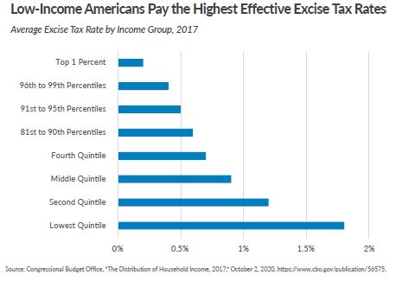
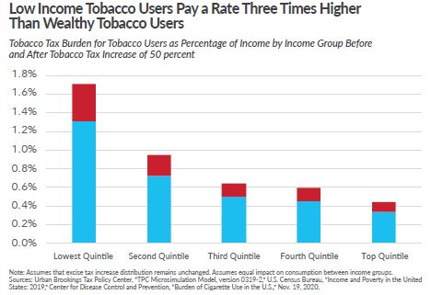
Taxes on “unhealthy” products borne by low income taxpayers (US)
Taxfoundation.org

Slide 21
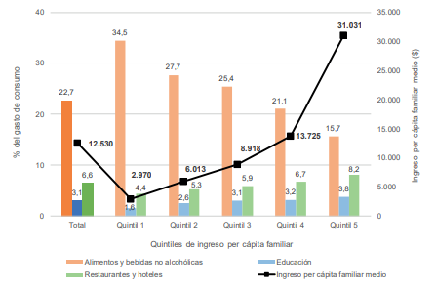
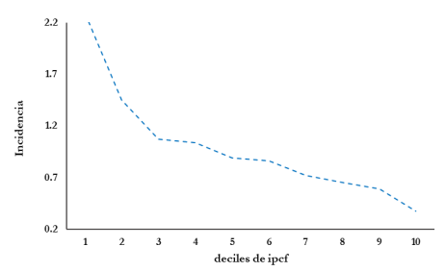
Taxes on “unhealthy” products borne by low income taxpayers (Arg.)
Percentage of expenditure on food and non-alcoholic beverages (orange column) and average per capita family income. (National Household Expenditure Survey (2017/2018)
Incidence of cigarette tax in Argentina, by household per capita income decile (Prepared based on National Household Expenditure Survey (2004/2005)

Slide 22
SECTION 3
TAXES & PUBLIC SCRUTINY

Slide 23
Tax transparency
Link to ESG, in particular "Social"
Social awareness of tax and requirements to pay the "fair share" of tax
Core focus of listed MNEs
Privately held MNEs less amenable to share information

Slide 24
Drivers of tax transparency
Regulatory forces
Market forces
Mandatory
CbCR
EITI (Extractive Industries Transparency Initiative)
EU accounting directive
CRD IV (Capital Requirements Directive)
UK tax strategy
National regulations
Voluntary
B-Team
UN PRI (Principles for Responsible Investment)
GRI (Global Reporting Initiative)
WEF
Stakeholders
Shareholders - Employees
Government - Public
International tax community - Clients
Investors

Slide 25
Standards of tax transparency for MNEs
Public tax policy and public CbCR
Public tax policy and disclosures of taxes paid
Public tax policy
Public statements
Compliancewith law

Slide 26
Overview of listed Swiss companies (SMI)*
Compliance with law
Alcon
Lonza
Geberit
Swisscom
Logitech
Public tax policy
ABB
Credit Suisse
Givaudan
Novartis
Richemont
Roche
SGS
SIKA
UBS Group
Public tax policy and disclosures
Partners Group
Public tax policy and public CbCR
Holcim
Nestlé
Swiss Life
Swiss Re
Zurich Insurance
* Research conducted based on a search of publicly available information for fiscal year 2020; this may not be exhaustive as groups sometimes do not publish the information in their annual reports or sustainability reports

Slide 27
Public CbCR
New upcoming EU legislation
MNEs with EUR 750 million and active in more than one EU country
Tax information in relation to each EU Member State as well as in relation to states listed as non-cooperative jurisdictions or on the "Grey List"
Planned entry into force for fiscal year 2025, to be published in December 2026; individual member countries can anticipate
Non-EU groups: impact likely limited to CbC data published for EU countries
Public investor pressure to publish full CbCR

Slide 28
Tax Nomads versus "Tax Me Now"
What is the limit to taxation of HNWI?
High tax rates
Legal uncertainty
Austro-German initiative "Tax Me Now"
www.taxmenow.eu
Requests:
Re-introduction of wealth tax for assets worth millions and billions of euros
Limitation of exemptions for business assets and other special regulations for inheritance and gift tax
Progressive tax rates instead of flat rates for investment income
Wealth tax on assets worth millions and billions if government tasks cannot be financed
Stricter rules against tax avoidance and evasion and better equipment for tax authorities

Slide 29
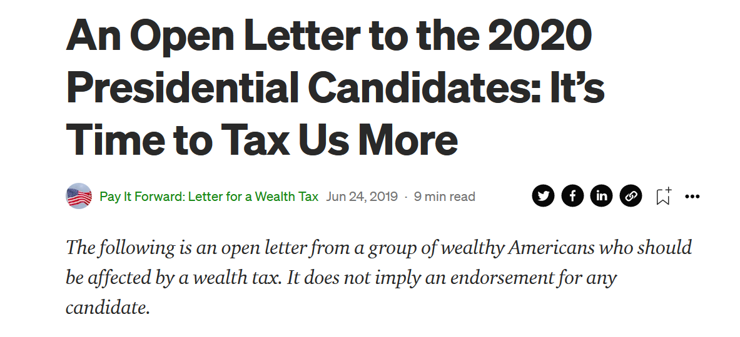
Tax Nomads versus "Tax Me Now"
"We are writing to call on all candidates for President […] to support a moderate wealth tax on the fortunes of the richest 1/10 of the richest 1% of Americans — on us. The next dollar of new tax revenue should come from the most financially fortunate, not from middle-income and lower-income Americans.“
https://medium.com/@letterforawealthtax/an-open-letter-to-the-2020-presidential-candidates-its-time-to-tax-us-more-6eb3a548b2fe

Slide 30
DAC 2 – Pending Case before the Austrian Constitutional Court
Facts:
Austrian tax resident individual held German bank account with a balance of EUR 40
Exchange of financial account information under DAC 2: German bank > German competent authority > Austrian competent authority
Information exchanged:
name, address, date and place of birth
TIN
account balance
Complaint with the Austrian data protection authority: automatic processing and transfer of sensitive personal and financial data between financial institutions and across national borders violates data protection laws and fundamental rights > rejected
Appeal to the Austrian Federal Administrative Court > rejected
Complaint with the Austrian Constitutional Court > pending
Claim: infringement of right of protection of personal data under Arts. 8 and 52(1) of the Charter on Fundamental Rights of the European Union
Recommendation to request a preliminary ruling from the ECJ on the interpretation of Arts. 8 and 52(1) of the Charter

Slide 31
DAC 2 – Pending Case before the Austrian Constitutional Court
Legal basis:
Tax data is personal data
Art. 8(2) of the Charter: "Such data must be processed fairly for specified purposes and on the basis of the consent of the person concerned or some other legitimate basis laid down by law."
Art. 52(1) of the Charter: "Any limitation on the exercise of the rights and freedoms recognised by this Charter must be provided for by law and respect the essence of those rights and freedoms. Subject to the principle of proportionality, limitations may be made only if they are necessary and genuinely meet objectives of general interest recognised by the Union or the need to protect the rights and freedoms of others."
Principle of proportionality: infringement must be suitable, necessary and proportionate to achieve a legitimate objective
Objective of DAC 2: to combat cross-border tax fraud and tax evasion
Reasoning:
It is not necessary to process all the data actually processed in order to meet the objective of DAC 2
The processing of personal data is not proportionate in view of the objective of DAC 2
Consequently, the Austrian provisions implementing DAC 2 infringe the taxpayer's right to protection of personal data and are thus unconstitutional

Slide 32
THANK YOU
Bruna Marrara
Machado Meyer, Brazil
Juan Manuel Iglesias Mamone
Mitrani, Caballero & Ruiz Moreno, Buenos Aires
Jennifer A. Migliori
Duane Morris LLP, Miami
Lyyn Cramer
MAPPLES GROUP, Ireland
Michael Orchowski
Sullivan & Cromwell, London
Floran Ponce
Lenz & Staehelin, Geneva

