Slide 1


Slide 2

Speakers:
Jisun Choi – Skadden Arps Slate Meagher & Flom (UK) LLP, London, England
Laetitia Fracheboud – Homburger AG, Zürich, Switzerland
Charlotte Kiès – Loyens & Loeff, Amsterdam, the Netherlands
Hendrik Bogers – Former Global Head of Tax, Perrigo plc, Dublin, Ireland
Professor Andrés Báez Moreno – Universidad Carlos III de Madrid, Madrid, Spain
Joe Sullivan – Covington & Burling LLP, Washington, District of Columbia, USA
Panel Co-Chairs:
Meyyappan Nagappan – Nishith Desai Associates, Mumbai, Maharashtra, India
Amelia O’Beirne – A&L Goodbody, Dublin, Ireland
Session Reporter:
Clemens Willvonseder – Binder Grösswang, Vienna, Austria
Pillar 2 – practical aspects, GloBE, GILTI and US tax reform

Slide 3
Pillar Two – Four measures for global minimum taxation
PILLAR ONE
PILLAR TWO
Subject-to Tax Rule
    Focuses on achieving a minimum income taxation for MNEs in each jurisdiction where the MNE has a taxable presence
    Mix of 4 measures
Income Inclusion Rule
Undertaxed Payments Rule
Switch-over Rule

Slide 4
Pillar Two – Four measures for global minimum taxation
  Domestic
  legislation
  Tax treaties
Income Inclusion Rule (IIR)
3
2
Undertaxed Payments Rule (UTPR)
Inclusion of the income of a low-taxed constituent entity in the tax base of the ultimate parent entity if that income is not taxed at the minimum 15% ETR.
Secondary rule which is meant as a backstop in case the minimum taxation is not achieved through the IIR. The UTPR is applied by the jurisdiction of the payer.
Switch-over Rule (SOR)
Subject to Tax Rule (STTR)
1
Ensuring proper application IIR by allowing a switch from the exemption method to the credit method.
Additional source taxation (withholding) and deny treaty benefits for “mobile payments” (interest, royalties, etc.) not sufficiently taxed in the recipient’s jurisdiction (<9% nominal rate).
  Parent/Residence jurisdiction
  Source jurisdiction
  Summary: The proposal works as worldwide minimum corporate taxation with either the source or the parent/residence jurisdiction picking up the tax if the other does not.

Slide 5
U.S. approach to minimum tax - GILTI
U.S. 2017 tax law introduced a minimum tax for the first time – primarily through a tax on “Global Intangible Low-Tax Income” (GILTI)
Generally imposes ~10-13% tax on most income of U.S.-controlled foreign corporations (CFCs)
Exemption for 10% of “QBAI” – generally, basis in tangible property
Allows for “global blending” of CFC income/losses
High-tax exclusion available
Limited foreign tax credit may relieve double tax
Result: Most income of CFCs is subject to current tax each year, but at less than the full U.S. corporate tax rate of 21%

Slide 6
U.S. approach to minimum tax - BEAT
For inbound structures: Base Erosion and Anti-Abuse Tax (BEAT)
Imposes 10% minimum tax on “base erosion payments” – deductible payments to any foreign related party
$500 million group-wide revenue minimum
3% “base erosion percentage”
Exceptions to definition of base erosion payment: most importantly, COGS
Result: Limited direct application of BEAT

Slide 7
U.S. approach to minimum tax - overall
GILTI and BEAT attempt to impose minimum tax on inbound and outbound structures
GILTI generally successful, but exceedingly complex
  Many traps for the unwary
  Planning opportunities remain
BEAT has had less impact
  Exceptions reduce application
  Planning opportunities – though may have diverted to other taxes

Slide 8
Calculation of ETR – IFRS vs. Local GAAPs
Amount of covered taxes
Formula:
Major differences between taxable profit under IFRS and under local GAAPs and thus between local tax base and GloBE tax base → certain adjustments for permanent differences (e.g. exclusion of restructuring gains from GloBE tax base) and temporary differences (e.g. tax carry forwards); still, local ETR becomes irrelevant
Jurisdictional blending is uncommon in most States; there can be local differences within one jurisdiction
Loss carry forwards: without limitation for GloBE purposes; differences from local tax losses
Profit adjustments following tax audits → MAP with multiple jurisdictions?
Amount of income

Slide 9
Pillar Two and incentive regimes
  Exposure to STTR
  Are intragroup interest or royalty payments subject to incentive regime at the level of the recipient?
    E.g. IP regime
    nominal minimum rate of 9% on payment
    Top-up withholding tax on gross amount!
  Exposure to IIR
  Does the incentive regime lead to an ETR below 15%?
    STTR taken into consideration for ETR calculation
    Jurisdictional blending

Slide 10
U.S. rules – compatibility with OECD
Fundamental differences between existing GloBE and U.S. regimes
GILTI directionally consistent, but changes required
  Global vs. jurisdictional blending
  QBAI
  Carryovers
BEAT requires significant changes
  Coordination with GILTI
  Application to low-tax payments only

Slide 11
GloBE, Double Taxation Conventions and EU Law.
“Nothing new under the sun”.
IIR/UTPR and tax treaties (compatibility based upon “literal reading”)
  IIR: a literal approach to articles 7(1) and 10(5)/longstanding principle?
  UTPR:
    UTPR and article 9(1): once allocated according to ALS just a question of domestic Law.
    UTPR and article 24(4): no discrimination based upon residence but just upon ETR
  OK: but what about the liberal/purposive inspiration of BEPS 1.0?
IIR/UTPR and EU/EEA Law
  IIR, UTPR, “wholly artificial arrangements” and “compensatory taxes”
  Is there a way out?
    A case-law U-turn?
    Under the traditional case law: formulaic carve-out and “a Directive to the rescue”.

Slide 12
Sample Structure UTPR (1/2)
Rule priority: IIR before UTPR → primary applicability expected to be cases of low-tax income in UPE jurisdiction
Potential IIR application also to domestic entities in certain jurisdictions?
Allocation of top-up tax following a two-step approach:
  Allocation in proportion to the total of deductible payments made directly to the low-tax Constituent Entity (here: UPE) by all UTPR Taxpayers (here: OpCo 1 and OpCo 2)
  Allocation of the remaining top-up tax in proportion of the net intra-group expenditure of one UTPR Taxpayer to the total amount of net intra-group expenditure incurred by all UTPR Taxpayers
  Direct payments and net intra-group expenditure of low-tax Constituent Entities are disregarded
UPE
Royalty
Royalty
Switzerland
Germany
Spain
100%
100%
OpCo 1
OpCo 2

Slide 13
Sample Structure UTPR (2/2)
UPE
No IIR
If no IIR applies at level of UPE, IIR can apply at sub-holding level
If low-tax Constituent Entity is not controlled by Constituent Entity in an IIR jurisdiction, UTPR applies
To avoid double taxation, UTPR excludes portion of the top-up tax that has already been imposed under IIR
100%
SubHoldCo
IIR
100%
40%
60%
OpCo 1
OpCo 2
Service Fee

Slide 14
U.S. tax reform
Pending legislation in U.S. Congress - intended to conform to Pillar 2
GILTI changes
  Increase GILTI rate to 15%
  Would apply on country-by-country basis (including FTCs)
BEAT changes
  Increase BEAT rate to 18% after 2024
  High-tax exception keyed to 15% OECD rate
Adds 15% “minimum tax” on financial statement income for large corporations

Slide 15
Pillar two: A business perspective
External environment, the political scene
Is this going to happen?
Something will
When, what, how wide spread unclear
Lack of engagement with business, but many new concepts

Slide 16
Pillar two: A business perspective
How do we respond, internal
Who, CFO, Board, Business
What, will it affect us?:
  above/ just below/well clear of thresholds,
  mind the acquisition!
By how much, precisely wrong vs broadly accurate, modelling?
How do we get ready:
  Collecting data, system redesign, spreadsheet/manual
  Resource constraints, use of external advisers

Slide 17
Pillar two: A business perspective
How do we respond, external
Engage OECD on what:
  Where do we see most impact.
  The political agenda is set, focus on practicalities
Tax authorities:
  Implementation focus, input into OECD discussions
External auditor manage expectations/what are they looking for
Investor relations/Public affairs messaging:
  NGO’s, Newspapers, Investor community

Slide 18
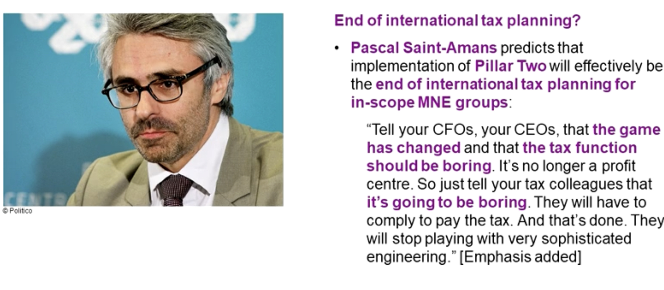
Pillar two: A business perspective
Closing: The future of tax

Slide 19


