Slide 1
‘Sustainability Agreements in Competition Law’: any green light at the end of the tunnel?
Carolyn Oddie – Partner, Allens
Kyriakos Fountoukakos – Partner, Herbert Smith Freehills
Herbert Fung – Economist, Competition and Consumer Commission of Singapore
Etsuko Hara – Partner, Anderson Mori & Tomotsune
Stanley Tan – APAC Regional Director, Legal Menarini Asia-Pacific
Elizabeth Richmond – Partner, Clifford Chance

Slide 2
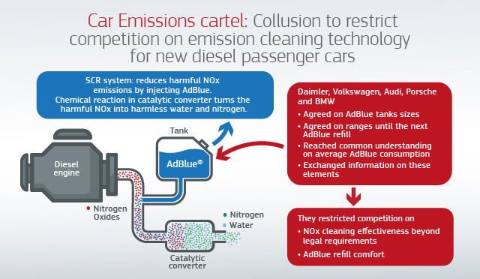
Competition risks when collaborating on sustainability
European Commission fined car manufacturers €875 million for restricting competition (2021)
“So today's decision is about how legitimate technical cooperation went wrong.”
Executive Vice-President Margrethe Vestager
“But the dividing line is clear: companies must not coordinate their behaviour to limit the full potential of any type of technology. Companies must not restrict their competition on performing better than what is required by law... Agreeing not to do so is simply illegal.”
Executive Vice-President Margrethe Vestager

Slide 3
ACCC v Colgate-Palmolive & Ors
“Ultra concentrate detergents are cheaper to produce, store and transport. The ACCC alleges that this offered significant cost savings which, by agreement, were not passed onto consumers. These alleged arrangements also standardised the ultra-concentrate products offered, denying consumers a variety of choices on pricing, package volumes and the strength of the concentrate product” – Former ACCC Chair, Rod Sims
Agreement regarding supply of laundry detergent
Consumers

