Slide 1
International Bar Association Transfer Pricing: Anticipating and Responding to New Challenges
March 3, 2022
Rezan Okten, Counsel, Houthoff (Amsterdam)
Raul-Angelo Papotti, Partner, Chiomenti (Milan)
Clifford Rand, Partner, Aird & Berlis (Toronto)
Fernando Tonanni, Partner, Machado Meyer (São Paulo)
Philip Tully, Partner, Matheson (Dublin)
Monique van Herksen, Partner, Simmons & Simmons (Amsterdam)
Moderator: Richard Slowinski, Partner, Alston & Bird (Washington, DC)

Slide 2
Agenda
Key points and trends in transfer pricing litigation
New developments in applying transfer pricing rules to financial transactions
How tax authorities’ transfer pricing audits are evolving for hidden PEs, forward subscription structures and other cases
Changing role of profit split methods in resolving transfer pricing disputes
Getting to “yes” through the MAP and APA procedures
Practical issues with COVID-19 impact on transfer pricing and year-end adjustments

Slide 3
Key Points and Trends in Transfer Pricing Litigation

Slide 4
Italian Supreme Court Decision No. 1232/2021 [1/2]
Facts and Background:
ItaCo is the Italian parent company of a multinational group
ForeignCo is a subsidiary of the group resident for tax purposes in US
ForeignCo assumes the role of distributor of the group’s products in the US market and pays a royalty in order to use ItaCo’s trademark
Tax Assessment:
Italian Tax Authority challenged the royalty paid arguing that it doesn’t meet the arm’s length principle (i.e., was lower than arm’s length) and claimed a higher taxable income based on an arm’s length royalty
Taxpayer’s Argument:
According to ItaCo, as part of the group business strategy, the royalty shall be considered at arm’s length since it was determined to help ForeignCo penetrate the US market

Slide 5
Italian Supreme Court Decision No. 1232/2021 [2/2]
Italian Supreme Court Decision:
The economic interest of a given group cannot be used, per se, to waive the application of the arm’s-length principle
A non-arm’s-length royalty would be acceptable only for a limited period, whereas if implemented for an undefined period it could determine an uneconomical behavior not compliant with the arm’s-length principle
The burden of proof regarding the compliance with the arm’s-length principle rests with the taxpayer
Key Insights:
The group economic interest may override the arm’s-length principle only if combined with other economic or technical elements
The relevance of the business strategy in determining the transfer pricing is endorsed by the Italian courts, as well as the OECD Transfer Pricing Guidelines
Importance to prepare a proper documentation illustrating the relevant facts and circumstances (e.g., assessing how long an independent party would have supported and granted benefits to another independent contractor in comparable circumstances)

Slide 6
Canada v. Cameco Corporation, 2020 FCA 112 [1/4]
Cameco Corporation is a large uranium producer resident in Canada
In 1999, it designated a European subsidiary to be the signatory of agreements to acquire uranium from third parties. The European subsidiary also agreed to acquire uranium from the Canadian parent. When the price of uranium increased sharply during the term of the agreements, the European (Swiss) Subsidiary realized significant income from the acquisition and resale of the uranium
The CRA issued reassessments to reallocate the profits of its European subsidiary to Cameco Corporation

Slide 7
Canada v. Cameco Corporation [2/4]
There are two sets of transfer pricing provisions that the CRA may use to challenge cross-border non-arm’s length transactions:
Paragraphs 247(a) and (c) of the ITA – This allows the CRA to adjust the terms of a transaction or series of transactions to those that would have been made between persons dealing at arm’s length, i.e., apply the arm’s length principle to the transaction or series; or
Paragraphs 247(b) and (d) of the ITA – which provides that If the transaction or series would not have been entered into between persons dealing at arm’s length, and can reasonably be considered not to have been entered into primarily for bona fide purposes other than to obtain a tax benefit, then the CRA may recharacterize the transaction or series to one that would have been entered into between persons dealing at arm’s length
The CRA’s main argument was that paragraphs 247(2)(b) and (d) of the ITA allowed it to reallocate the profits

Slide 8
Canada v. Cameco Corporation [3/4]
The focus of the case in the Federal Court of Appeal was whether the series of transactions that gave rise to the Swiss subsidiary’s profits, would have been entered into between persons dealing at arm’s length
The Court held that paragraphs 247(2)(b) and (d) of the ITA “apply only where a taxpayer and non-arm’s length non-resident have entered into a transaction or a series of transactions that would not have been entered into between any two (or more) persons dealing at arm’s length, under any terms or conditions (at para 82)

Slide 9
Canada v. Cameco Corporation [4/4]
The Court accepted the lower court’s finding that the transactions would have been entered into between persons dealing at arm’s length, so it was not necessary for the Court to determine whether the series was entered into primarily for bona fide purposes other than to obtain a tax benefit
The Court also accepted that the transactions would have been entered into between persons dealing at arm’s length because the economic benefit of participating in the agreements was negligible or negative at the time they were entered into and because the prices charged by Cameco to its foreign subsidiary were well within an arm’s length range of prices
The Supreme Court of Canada denied the Crown’s application for leave to appeal the decision of the Federal Court of Appeal

Slide 10
US - Transfer Pricing Litigation Developments [1/2]
High-profile transfer pricing disputes continue to be litigated through the courts (selected cases):
Coca-Cola Co. v. Commissioner
3M Co. v. Commissioner
Medtronic, Inc. v. Commissioner
Facebook, Inc. v. Commissioner
Eaton Corp. v. Commissioner
Perrigo Co. v. United States

Slide 11
US - Transfer Pricing Litigation Developments [2/2]
How may trends and key takeaway points impact legal and economic transfer pricing analyses:
Increased judicial acceptance of Comparable Profits Method (CPM)?
Treatment of prior years’ audit resolutions?
Higher bar for applying Comparable Uncontrolled Price or Transaction (CUP or CUT)?
More rigorous due diligence of legal agreements and economic substance?
More stringent document retention strategies?

Slide 12
New Developments in Applying Transfer Pricing Rules to Financial Transactions

Slide 13
Financial Transactions - Focus Areas
New OECD Guidance
Characterization
Treasury functions (Loans, cash pooling, hedging)
Guarantee
Captive insurance
Risk free / risk adjusted return
Characterization
Accurate delineation of the transactions
Commercial rationale
Perspective of all the parties involved incl. options realistically available
Debt capacity (incl. debt to equity ratio) / Financial capacity
Substance: people functions, control over risk
Service provider model vs. Entrepreneurial model
Synergies
Implicit support / impact of group credit rating
Explicit guarantees
Risk free / risk adjusted return
Pricing

Slide 14
Types of Financing Entities
Routine Entity
Entrepreneur
Profit/Loss
1
2
3
4
Value-add
Examples for a classification
Shell
Routine
Hybrid
Entrepreneur
1
2
3
4
Cash rich companies with no substance
Remuneration: risk free or risk adjusted return
Routine treasury services
Routine cash pool / captive insurance services
Remuneration: cost plus
Intermediate financing companies with some substance
Remuneration: gross spread
In-house banks
Risk taking captive insurance companies
Remuneration: premiums/residual profits

Slide 15
Dutch Perspective / Focus Areas
New guidance is different from some of the current practices
Commercial rationality test (Dutch borrower but also foreign lender)
Intermediate financing companies – low / but stable remuneration with limited or no substance
Determined through back-to-back spread
In some cases, spread can be significant (not justifiable by functions)
No rulings are given on financial transactions
Unless support services are provided with sufficient substance
Informal meetings to at least obtain some sort of comfort
New guidance is expected soon which could have significant impact on existing structures

Slide 16
Irish Perspective / Focus Areas
OECD Guidance on Financial Transactions
Formally adopted in Irish legislation from December 2021, but Revenue had already noted in published guidance that following the OECD guidance on financial transactions is best practice
Irish to Irish Exemption
Exemption from arm’s length requirement for certain “Irish to Irish” transactions
Related to differences in 12.5% rate (for trading income) and 25% rate (passive income) and interest deductibility rules
Limited in scope

Slide 17
US Perspective / Focus Areas
New US Treasury and IRS regulatory projects relevant for financing transactions
Realistic alternatives
Clarification of “group membership” (e.g., passive association)
Arm’s length pricing of financial transactions
Determining risk allocation based on facts and circumstances
Selected financing transaction issues in examination or APA due diligence
Character (e.g., service, interest) and source of income
Role of implicit support
Guarantor’s cost to provide guarantee vs. benefit to recipient
Comparability analysis (e.g., internal CUPs, external data regarding credit facilities, commitment fees)
Examination or APA due diligence issues
Role of financing within MNC group (e.g., standalone, integrated function)
Identification of intercompany transactions, both actual and imputed
Comparability analysis (e.g., independent financing companies, market risk premium)

Slide 18
How Tax Authorities’ Transfer Pricing Audits Are Evolving

Slide 19
Ireland - Transfer Pricing Audit Developments
Recent tax assessments in Ireland:
Focused on IP / high risk / value areas
No published decisions from Irish Tax Appeals Commission
Number of assessments under appeal

Slide 20
Forward Subscription Structures – Canada [1/9]
There are a number of hybrid transactions used by multinational enterprises over the years that are designed to obtain more tax deductions than inclusions within the corporate group
One of these is the Forward Subscription Structure, a financing arrangement used by multinationals with a Canadian subsidiary
On July 4, 2019, the Canada Revenue Agency issued a Notice to Tax Professionals stating that Forward Subscription Structures are “hybrid mismatch arrangements" and that it may seek to apply the re-characterization rule in Canada’s transfer pricing legislation, paragraphs 247(2)(b) and (d) of the ITA, to reassess the arrangements
The CRA has in fact started to do just that

Slide 21
Forward Subscription Structures [2/9]
USco
As a general rule, when a non-resident contributes capital to a private Canadian corporation, the capital may be returned free of Canadian withholding tax
100%
Paid-Up Capital = $25M.
Once Canco starts to earn income, USco may want to convert some of Canco’s share capital to debt, so that Canco may claim an interest deduction
CANCO

Slide 22
Forward Subscription Structures [3/9]
USco
(2) $10M Loan to Canco
(1) USco creates a ULC
(3) Canco
Returns $10M
of P.U.C
CANCO
ULC
USco creates a ULC
USco agrees to lend $10 million to Canco, repayable in 20 years, at an interest rate of 10%
(3) Canco passes a resolution to return $10 million to USco

Slide 23
Forward Subscription Structures [4/9]
USco
(6) Interest Capitalized
(5) Capital Support and Guaranty Agreement
(4) Forward Subscription Agreement
CANCO
ULC
(4) ULC enters into a Forward Subscription Agreement with Canco to acquire Canco shares for $10 million in twenty years
(5) USco enters into a Capital Support Agreement with ULC, requiring USco to fund ULC in its purchase of Canco shares pursuant to the Forward Subscription Agreement. USco also enters into a Guaranty Agreement in favour of Canco re ULC’s obligation to subscribe for Canco’s shares
(6) Canco’s accrued interest on the loan is not paid, but capitalized by the issuance of shares to USco

Slide 24
Forward Subscription Structures [5/9]
20 YEARS LATER
USco
(7) USco subscribes for shares in ULC
(9) Canco repays
$10M owed
to USco.
CANCO
ULC
(8) ULC subscribes for shares in Canco
(7) USco subscribes for $10 million of shares in ULC
(8) ULC subscribes for $10 million of shares in Canco
(9) Canco repays the $10 million loan payable to USco

Slide 25
Forward Subscription Structures [6/9]
The US treats the entire series as a capital transaction with no US tax consequences
The CRA would presumably not be concerned about Canco converting some of its share capital into debt if USco had to pay US tax on the interest, or if the loan was received by Canco from an arm’s length party like a domestic or foreign bank
But the CRA is taking issue with such a forward subscription arrangement, calling it a “hybrid mismatch arrangement” that has no commercial purpose. The sole purpose of the arrangement, according to the CRA, is to create an interest deduction for Canadian tax purposes without a corresponding income inclusion for US tax purposes

Slide 26
Forward Subscription Structures [7/9]
There are two sets of transfer pricing provisions that the CRA may use to challenge cross-border non-arm’s length transactions:
Paragraphs 247(a) and (c) of the ITA – This allows the CRA to adjust the terms of a transaction or series of transactions to those that would have been made between persons dealing at arm’s length, i.e., apply the arm’s length principle to the transaction or series; or
Paragraphs 247(b) and (d) of the ITA – which provides that if the transaction or series would not have been entered into between persons dealing at arm’s length, and can reasonably be considered not to have been entered into primarily for bona fide purposes other than to obtain a tax benefit, then the CRA may recharacterize the transaction or series to one that would have been entered into between persons dealing at arm’s length

Slide 27
Forward Subscription Structures [8/9]
The CRA has chosen to invoke the second set of provisions, paragraphs 247(b) and (d), to deny the deduction of interest by Canco, stating that arm’s length persons would not have entered into the forward subscription arrangement and that the arrangement had no bona fide purpose other than to obtain the tax deduction
The CRA also invokes subsection 247(12) of the ITA to deem the annual interest accrued on the loan to be a dividend paid to, and received by, USco and therefore subject to Canadian withholding tax
Finally, the CRA intends to assess penalties pursuant to subsection 247(3) of the ITA on the basis that Canco did not make reasonable efforts to use arm’s length prices

Slide 28
Forward Subscription Structures [9/9]
The 2021 Canadian Federal Budget proposed amendments to the ITA, effective July 1, 2021, to deny the benefits of “hybrid mismatch arrangements” following the recommendations of the OECD’s Action 2 BEPS report
Under the proposed amendments, interest payments by Canco would not be deductible since they are not included in USco’s ordinary income
It remains to be seen whether the CRA will be successful in using paragraphs 247(b) and (d) to recharacterize interest as dividends prior to the new rules coming into effect

Slide 29
Recent Inspection by the Brazilian Revenue Service
Recent tax assessments in Brazil: still focused on disregarding cost plus method due to the lack of documentation support (for import and export transactions)
Trend in assessing cross-border payments of royalties and technical services: increasing attempt from tax authorities to fully disregard intragroup expenses incurred with royalties or payments for technical services or transfer of know-how, in particular in the tech industry:
(a) under Brazilian law, those payments should fall outside the scope of TP Rules, being subject to specific limitations (1% to 5% of gross revenues) and formal requirements (registration of the agreement with the Brazilian PTO)
(b) tax assessments are issued based on a construed lack of necessity or lack of compliance with formal requirements, within an intragroup context

Slide 30
Brazilian Perspective on Forward Subscription Structures
Legal provisions/regulation from the Brazilian Revenue Service: no specific regulation against forward subscription structures, repo or tower structures limiting interest deduction
Recent tax assessments in Brazil: leveraged acquisitions that rely on cross-border intragroup finance are assessed, with the full write-off of intra-group interest expenses, due to:
the qualification of the finance as equity, or
the qualification of the interest expenses as not being necessary for the business developed by the Brazilian borrower, in the context of a leveraged acquisition by a Brazilian entity, with its subsequent merger into Target
Trend in using forward subscription structures to restructure debt of companies under financial distress:
domestic or cross-border transactions, in which debtor issues Bonds (in Brazil, debentures) to settle past financial obligations or where creditors assign to shareholders (in Brazil or abroad) their credits against Target, with a discount
subsequently, shareholders convert their credit into capital, in a way to avoid haircuts to be taxed (risk of taxation over haircut derives from the intragroup context, in a substance over form scenario, not the TP Rules)

Slide 31
Hidden PEs – Italian case [1/2]
Facts and Background:
ForeignCo is a foreign insurance company operating in Italy under the freedom to provide services
The insurance activities are carried out abroad at the premises of ForeignCo (no Italian subsidiary)
Insurance products issued by ForeignCo are distributed on the Italian market through independent insurance brokers which operate on behalf of their clients
Tax Assessment:
Italian tax police (“ITP”) claimed that the brokers represent a hidden agency PE in Italy of ForeignCo:
the brokers’ activities were not limited to auxiliary and preparatory services
the brokers had an almost exclusive and structured relationship over time with ForeignCo
the brokers habitually and substantially participated in the conclusion/ management of insurance contracts in favour of Italian clients

Slide 32
Hidden PEs – Italian case [2/2]
ITP challenged the omitted Italian tax return violation against ForeignCo and determined higher Italian taxable income with reference to both:
the distribution of policies in Italy (TNMM); and
the management the financial investments underlying the policies (internal CUP)
The ITP did not (i) deduct the ForeignCo’s general expenses and the fees paid by to the Brokers, (ii) apply the “separate entity approach”, (iii) rely on appropriate comparables
Tax Settlement:
Tax settlement agreement reached with the Italian Tax Authority (based on an isolated and not well-grounded decision of the Italian Supreme Court):
Absence of a PE in Italy (the ITP did not prove the relevant PE requirements under the DTT) → no Italian tax monitoring, no Italian regional tax on productive activities
ForeignCo has been taxed in Italy only on the income deriving from the brokers’ distribution activity carried out in Italy
The Italian Tax Authority liaised with the Italian Public Prosecutor to drop the criminal proceeding relating to the tax proceeding

Slide 33
US Transfer Pricing Audit Developments
New laws, regulations and guidelines
More controversies (and larger foreign-initiated transfer pricing cases)
Increase in dispute resolution tools
Additional IRS hiring and new tax audit techniques
Business and operational shifts (including impact of COVID-19 pandemic)
C-suite level – heightened interest in tax and transfer pricing issues
Optimizing impact of transfer pricing adjustments (e.g., NOLs, tax rate differentials, Base Erosion Anti-Abuse Tax, Foreign-Derived Intangible Income, customs)

Slide 34
Getting to “Yes” Through the MAP and APA Procedures

Slide 35
Getting to “Yes” Through the MAP and APA Procedures
Both tend to involve a (much) less contentious avenue to resolve a (tax) dispute
Challenges:
Being allowed into the APA/MAP process
Penalties may close access to MAP
“Insufficient information” challenges
Statutes of limitations need to be carefully considered to keep (all) options open
Choosing the best available treaty instrument
Getting access to arbitration
APAs may trigger audits
APAs are disclosed to treaty partners
Making sure there is still a remedy if MAP fails/coordination with litigation
MAP generally leads to a confidential outcome

Slide 36
Getting past “No” as regards the MAP and APA Procedures
Can you appeal a denial of MAP?
Italy Supreme Court 2015: yes
Netherlands Lower Court 2017: yes
Netherlands Council of State 2021: yes
Spain Supreme Court 2021: no
OECD MAP statistics show denial of MAP access to be 6% of overall inventory in 2019 and 3% in 2020
Withdrawals are 6% of overall inventory in 2019 and 11% in 2020

Slide 37
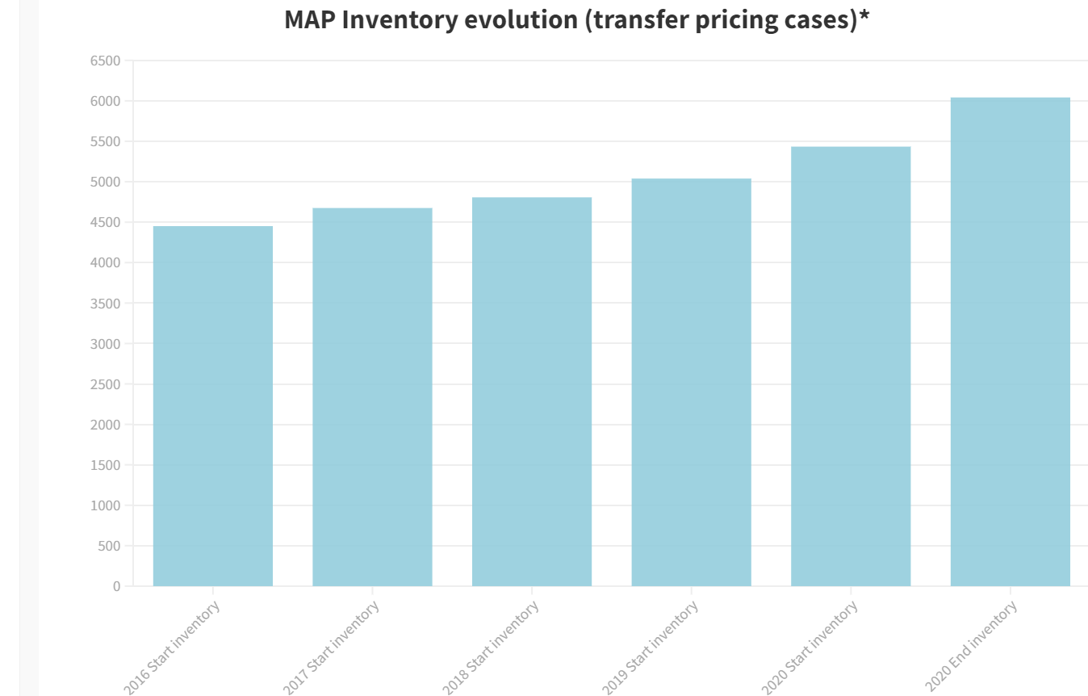
2016-2020 OECD MAP Statistics (Global)
Continued increase in number of transfer pricing cases in inventory
Increases in closures have not offset new open cases
Challenges in resolving cases due to COVID-19
Source: OECD

Slide 38
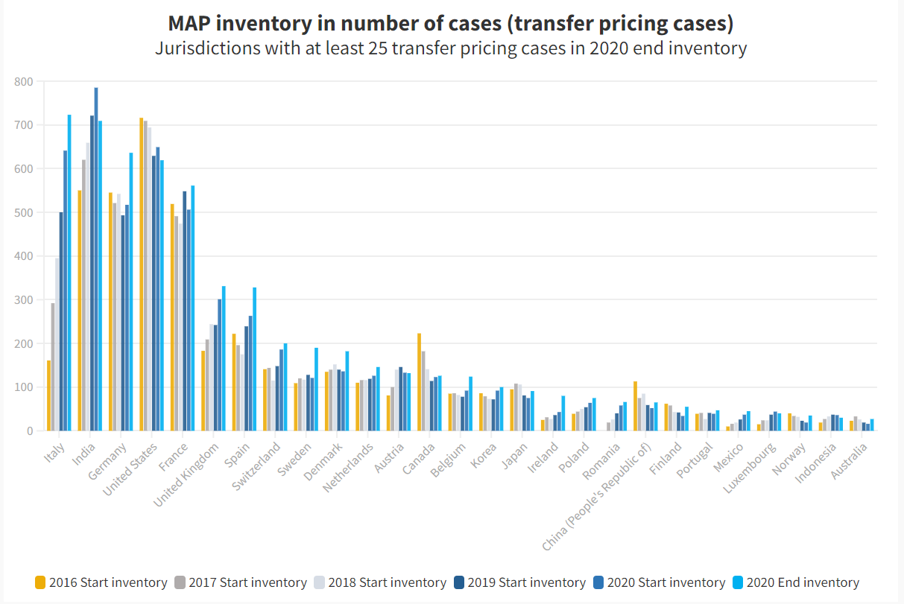
2016-2020 OECD MAP Statistics By Country
Overall trends point to continuing high transfer pricing case inventory
Most jurisdictional trends indicate unfavorable increasing inventory levels
Source: OECD
Source: OECD

Slide 39
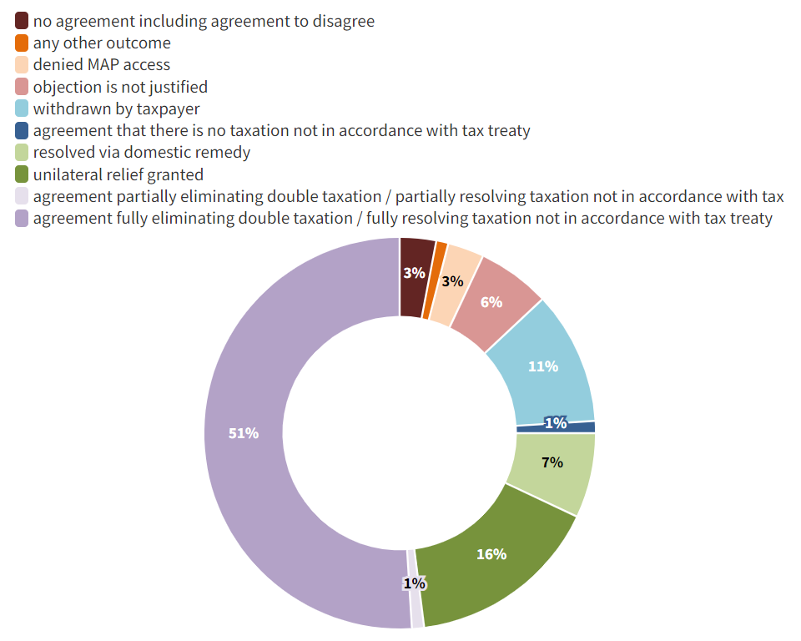
2020 OECD MAP Statistics (Global)
Approximately 74% of the cases concluded in 2020 were fully resolved (77% in 2019), although fewer were resolved via agreement fully eliminating double taxation in 2020 (51%) compared to 2019 (57%)
Approximately 3% of MAP cases were closed with no agreement in 2020 compared to 2% in 2019
The volume of cases withdrawn by taxpayers nearly doubled in 2020 (11%) compared to 2019 (6%)
2020
2019
Source: OECD

Slide 40
MAP and APA Procedures – Irish Experience
Two way street
Effort and resources required from both Competent Authorities and taxpayers
Information sharing
Clear description of the business, the supply chain, the functions, assets, risks
Assume no knowledge - Taxpayers know their business but Competent Authorities may not, or may have misunderstandings about the value drivers
Financial information – have financial information available (quantification of risk is a key focus area for the Competent Authorities)
What is the ask?
Make the ask as clear as possible
Communication
Maintain frequent and open dialogue with Competent Authority
Building relationships
Persistence…..

Slide 41
Changing Role of Profit Split Methods in Resolving Transfer Pricing Disputes

Slide 42
Profit Split: Blessing or a Curse?
TP IS NOT AN EXACT SCIENCE = DIFFERENT VIEWS

Slide 43
Unique / Valuable vs. Integrated
Business model
Data centres / infrastructure
Corporate culture
Goodwill
Technology platform
Supplier and distributor relationships
Marketing intangibles
Trademarks, patents, designs and copyrights
Corporate strategy
Business know-how and best practice
Data/users and network effects
(sum vs. parts)
Training / show-how
Customer
lists
Decision making and direction
Customer relationships
Trade secrets
Quality control
Employee relationships
Employee know-how and innovation

Slide 44
Where Could It Go Wrong?
Licensing: WHT
Franchise: WHT -complicated / not recognized in laws
Profit sharing: same as above
Agency/commissionaire: PE
Services arrangement: possibility to argue for cost plus
Two sided business view
Two sided tax team view
Two sided advisor view
Two-sided tax authorities view
Determining profit to be split
Reconciling differences in accounting standards
Proper and timely adjustments
Keeping up to date
So what should be done then?

Slide 45
US Profit Split Experience
IRS APMA’s desire to use profit split methods
Selected issues in applying profit split methods
Identification of non-routine intangibles
Data derivation and reliability
Accounting adjustments (e.g., local GAAP vs. IFRS)
Non-routine intangibles investment lag and life
Addressing “income and loss creation” concerns
Third country transfer pricing adjustments

Slide 46
Practical issues with COVID-19 impact on transfer pricing and year-end adjustments

Slide 47
COVID-19 Impact on Transfer Pricing – Dutch Experience
Scope - what drives bad results?
The impact of government grant on TP results (APAs)
Confirmation by an audit firm
Routine entities
Guaranteed remuneration (some flexibility - lower quartile)
Force majeure clause
Commercial books vs. tax books differences

Slide 48
COVID-19 Impact on Transfer Pricing – Brazilian Experience
Brazilian TP Rules and protection against Brazilian currency devaluation:
Local rule: Exceptional treatment granted by law and regulations and addressed to Brazilian exporters, to couple with the devaluation of the BRL vis-a-vis foreign currency in the year of 2005: export revenues multiplied by 1,35%
Remedy provided under Brazilian law since 2005, not a COVID-19 crisis protection measure
Brazilian claim to join OECD and the consequences towards Brazilian TP Rules:
Potential adjustments to fixed margins approach, towards a greater alignment to OECD TP Guidelines
Difficulties to implement functional analysis and exchange of information
Difficulties to implement MAP and APA under the context of forbidden tax reduction/waiver
Measures to avoid economic double taxation over the flow of royalties and technical services aiming at increasing legal certainty
Further developments and enforcement of double tax treaties (for both source taxation over service income and correlative TP adjustments)

Slide 49
COVID-19 Impact on Transfer Pricing – US Experience
Role of arm’s length principle in COVID-19 adjustments (e.g., OECD Guidance on the transfer pricing implications of the COVID-19 pandemic (Dec. 18, 2020))
Experience in developing and presenting COVID-19 adjustments to IRS and other tax authorities
Relevance of industry-specific, sector-specific, and company-specific issues in adjusting for COVID-19 impact
Companies within same sectors or industries can experience markedly different outcomes
Need for company-specific treatment
Treatment of government subsidies
Scope of COVID-19 impact (e.g., scope, duration)

Slide 50
Q&A Thank you!

