Slide 1
Cloud Computing and Contractual Arrangements
James Harper
Director, Global Legal, LexisNexis
IBA ICDC Conference, Milan, 18 November 2021

Slide 2
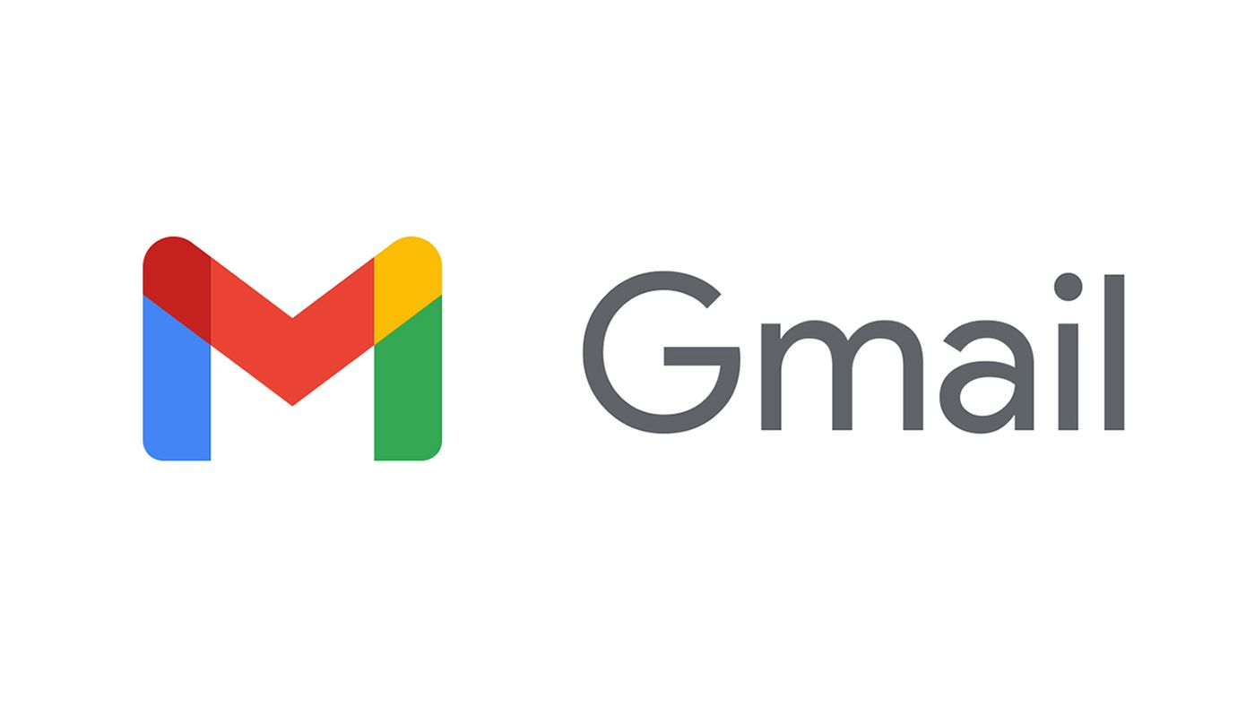
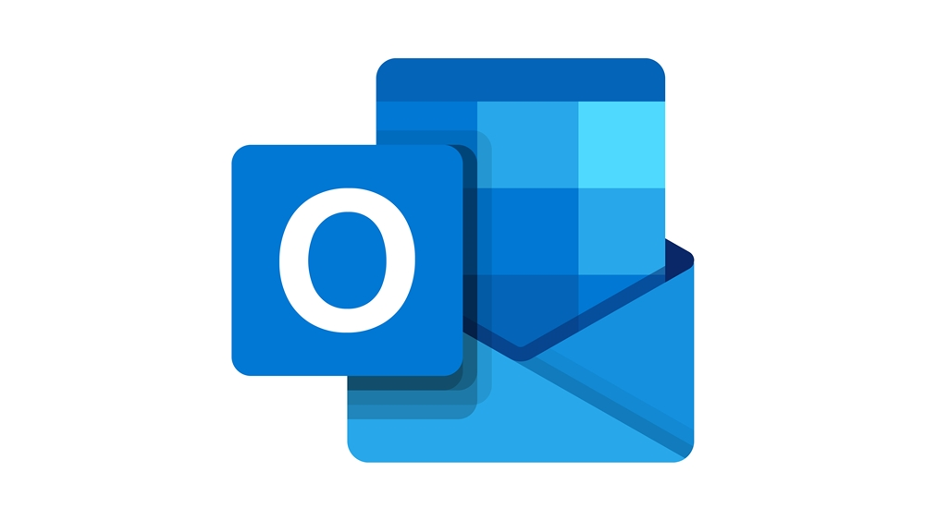
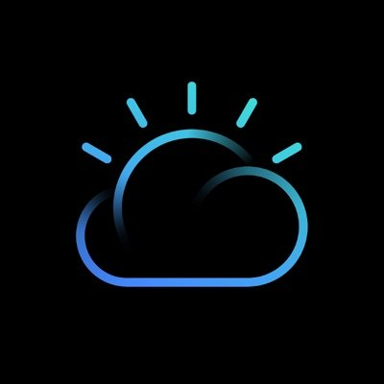
Do You Use Cloud?

Slide 3
What is Cloud?
Cloud = Moving software or infrastructure away from the customer and into a location controlled by a third party, which is then accessed through the internet or a private network.

Slide 4
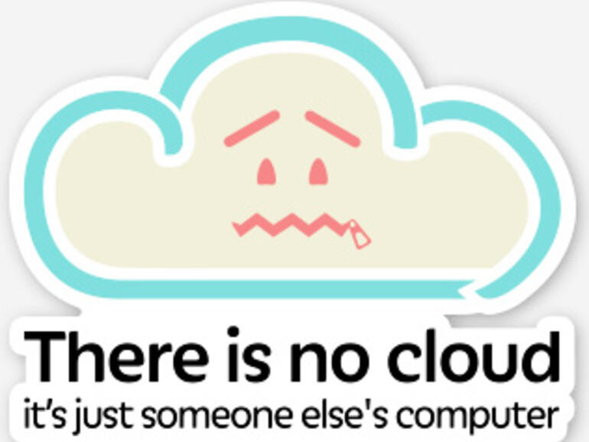
What is Cloud?

Slide 5
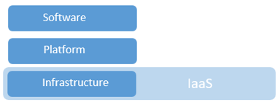
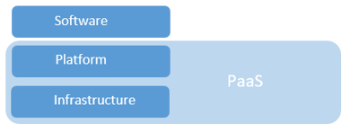
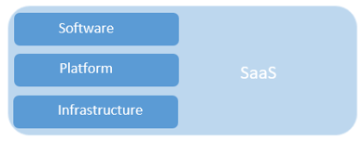
What is Cloud?
Infrastructure as a Service
Platform as a Service
Software as a Service

Slide 6
Cloud Benefits
Flexibility
Costs and Economies of Scale
Speed of Adoption
Access to Tech
Updates and Upgrades
Security

Slide 7
Cloud Risks
Data Flows and Compliance
Reliability and Availability
Inflexible Contract Terms…

Slide 8
Legal Considerations: Negotiating Terms?
Bargaining in commoditised contracts
Low cost/high volume
Logistical challenges

Slide 9
Legal Considerations: Warranties
Range of warranty positions:
“As Is” (i.e. none!)
SLA/Supplier documentation
“Reasonable care and skill”
Look for:
conform to description
reasonable care and skill by qualified and experienced personnel
comply with all applicable laws
data not shared or disclosed
no IPR infringement
free from viruses and other destructive or malicious software

Slide 10
Legal Considerations: Liability
Range of liability positions:
Cap to fees
Heads of loss excluded
Exclude all indirect loss
Look for:
Financial cap of all services?
Remove some categories from heads excluded (especially data!)
Don’t forget customer liability.

Slide 11
Embrace the inevitable?

Slide 12
Thank you.

