Slide 1
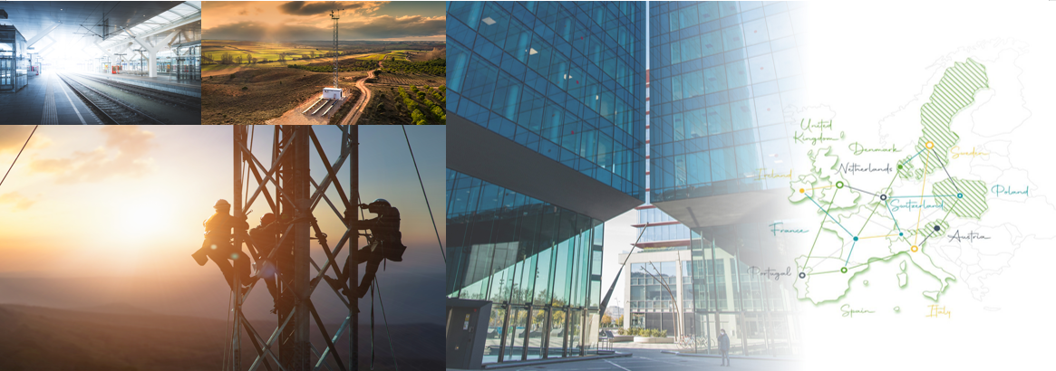
Introducing Cellnex Group
April 2022

Slide 2
Cellnex’s Growth Story
Cellnex’ European consolidation: 2014 – April 2022
x18
2014
Apr. 2022
c. 7,000 sites
c. 130,000
sites (*)
26,740 sites
5,876 sites
+40
agreements
25,549 sites
5,200 sites
20,390 sites
4,900 sites
14,720 sites
4,314 sites
11,050 sites
2,399 sites
6,118 sites
1,900 sites
(*) Including transactions not yet closed

Slide 3
Cellnex’s Growth Story
Revenues by business line and EBITDA by country
Contribution of income by business lines
Contribution to EBITDA by country
15%
4%
20%
Broadcasting
infrastructure
9%
€2.5Bn
45%
Other network
services
87%
€1.9Bn
2021
2021
20%
Telecom
Infrastructure
Services (TIS)

Slide 4
Cellnex’s growth drivers
5G and the challenges of permanent connectivity
1
3
An explosion of "connectivity"
Until
2
100
Data traffic
growth
4
Around 2022 we will have
Densification
29^{Bn}
faster
up to x10
Global data traffic
times
than 4G
connected objects
in mobility
Each urban
will grow more than
“macrocell”
Latency
Source: Ericsson
in 5
1
600%
will complement
years
with 10
millisecond
“small cells”
“
”
We need shared telecommunications infrastructures (...) Tower companies serve the
needs of mobile access providers
Sunil Bharti Mittal, President of GSMA. Barcelona, MWC’17
18

Slide 5
Cellnex in a nutshell
Innovation, entrepreneurial culture and leadership
First independent neutral operator in Europe
First independent neutral operator in Europe
Capacity to harness synergies from integrating new assets
Industrial model and long-term commitment with our customers
Industrial model and long-term commitment with our customers
Anticipation: Bringing value to the 5G ecosystem
Know-how in small cells, indoor systems, FTTA, Edge Computing
19

