Slide 1
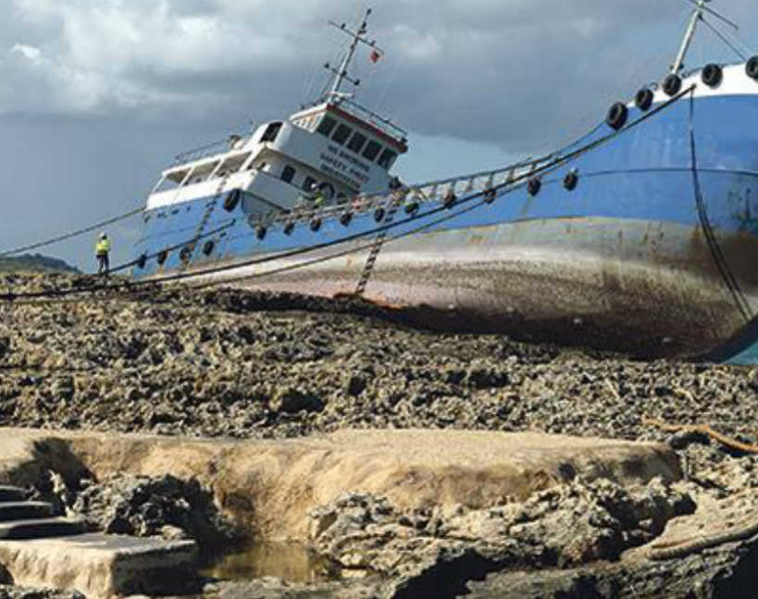
Insurance Coverage Issues: The United States Perspective
General Average and Salvage

Slide 2
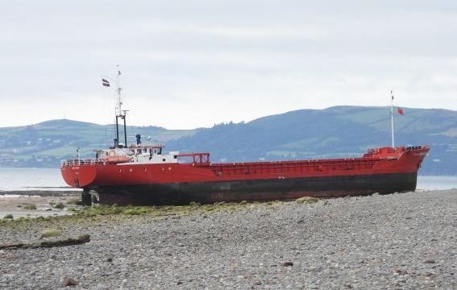
Potentially Applicable Coverages
Hull and Machinery Coverage
Protection and Indemnity Coverage
Cargo Owners’ Legal Insurance / Charterers’ Liability Insurance

Slide 3
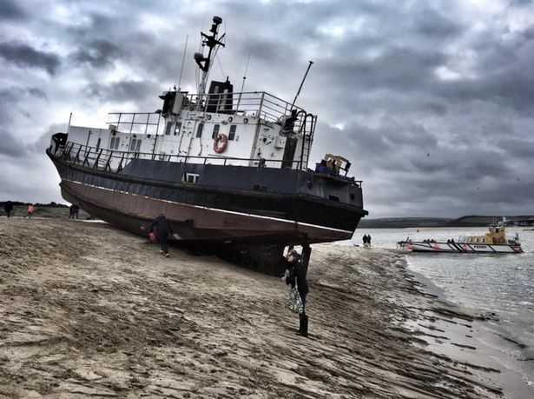
Hull & Machinery Coverage: “First Party” Insurance for Loss or Damage to Insured Vessel
Main Operative Clauses
Named Perils and Expanded Named Perils
General Average and Salvage
Sue and Labor Clause
Excludes risks covered by P&I Coverage

Slide 4
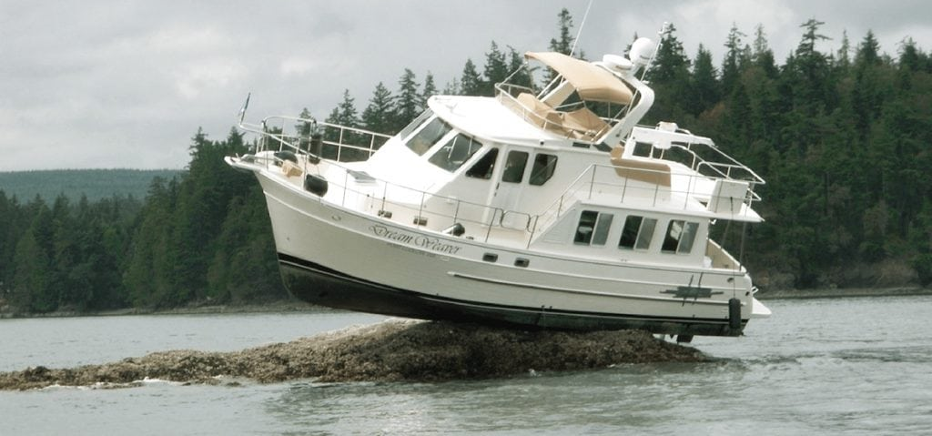
Named Perils
“The Adventures and Perils which the Underwriters are contented to bear and take upon themselves, they are of the Seas, Men-of-War, Fire, Lightning, Earthquake, Pirates, Rovers . . . and all other like Perils, Losses and Misfortunes that have or shall have come to the Hurt, Detriment or Damage of the Vessel, or any part thereof, excepting, however, such of the foregoing perils as may be excluded by provisions elsewhere in the Policy or by endorsement thereon.”
American Institute Hull Clauses (Sept. 29, 2009) (“AHIC”), ll. 99-105.
War and Strikes Risks typically excluded or “bought back” via endorsement
Ordinary wear and tear not covered

Slide 5
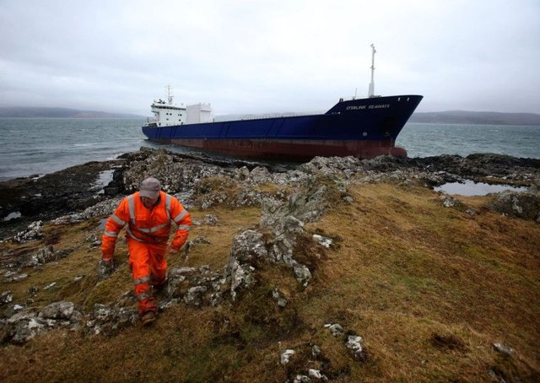
General Average and Salvage
General Average and Salvage shall be payable as provided in the contract of affreightment, or failing such provision or there be no contract of affreightment, payable at the Assured’s election in accordance with York-Antwerp Rules 1974 or 1994, or as agreed, or with the Laws and Usages of the Port of New York.
AHIC, ll. 183-86.

Slide 6
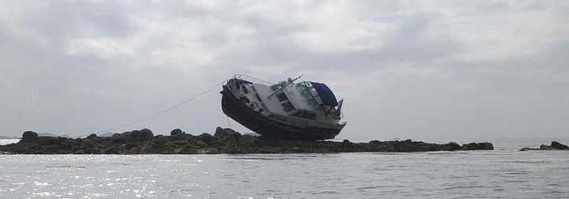
General Average and Salvage
Salvage of insured Vessel by vessels belonging in part to same Owners / Charterers – value of such services determined by arbitration either by a single Arbitrator (agreeable to both parties) or a panel of three Arbitrators (one chosen by Owners, one chosen by Underwriters, third chosen by agreement of the other two Arbitrators)
AHIC, ll. 187-90.

Slide 7
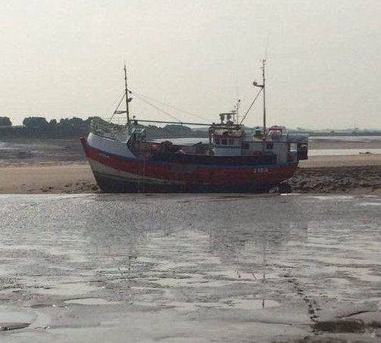
General Average and Salvage
When contributory value of the vessel is greater than Agreed Value, liability of Underwriters for General Average or Salvage is in proportion to the amount insured bears to contributory amount.
If value of vessel is reduced because of Particular Average for which Underwriters are liable, the amount of such Particular Average shall be deducted first from amount insured, and then Underwriters shall be liable only for proportion of which that net amount bears to the contributory value.
AHIC, ll. 191-96.

Slide 8
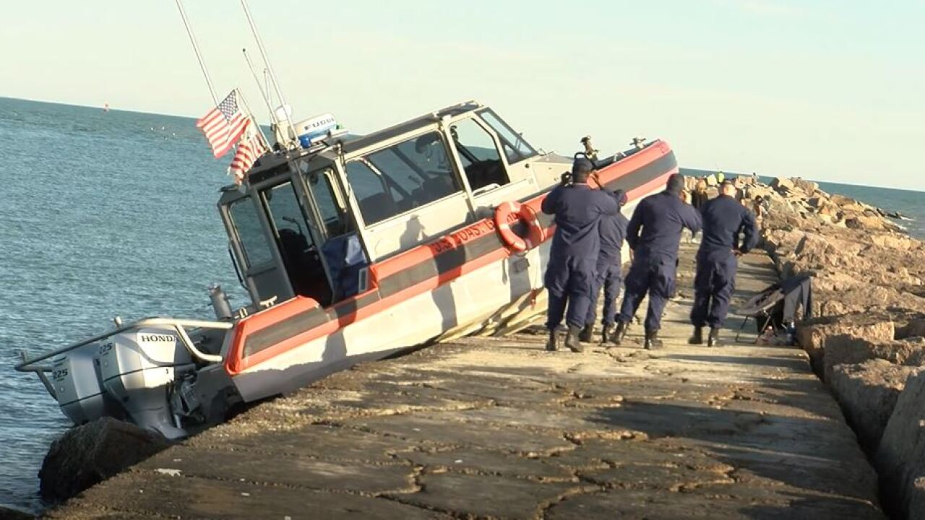
Sue and Labor
And in case of any Loss or Misfortune, it shall be lawful and necessary for the Assured … to sue, labor and travel for, in and about the defense, safeguard and recovery of the Vessel, or any part thereof, without prejudice to this insurance, to the charges whereof the Underwriters will contribute their proportion as provided below.
AHIC, ll. 209 – 23.
Costs and expenses must be incurred to prevent or lessen damage to the vessel for which Hull Underwriters would be liable

Slide 9
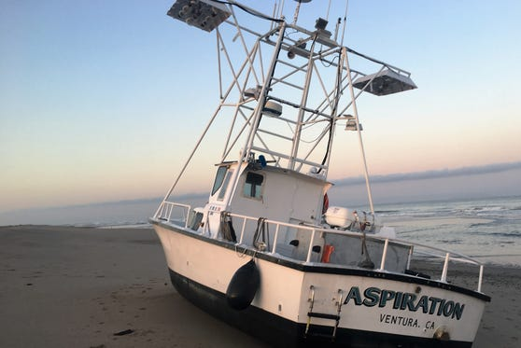
Sue and Labor
Considered by many U.S. courts to be separate insurance and supplementary to the Underwriters’ agreement to pay for loss or damage to the vessel.
Typically expenses of sue and labor are not subject to any deductible because Underwriter is reimbursing insured for efforts taken in an attempt to reduce liability of Underwriter (even if policy provides differently).

Slide 10
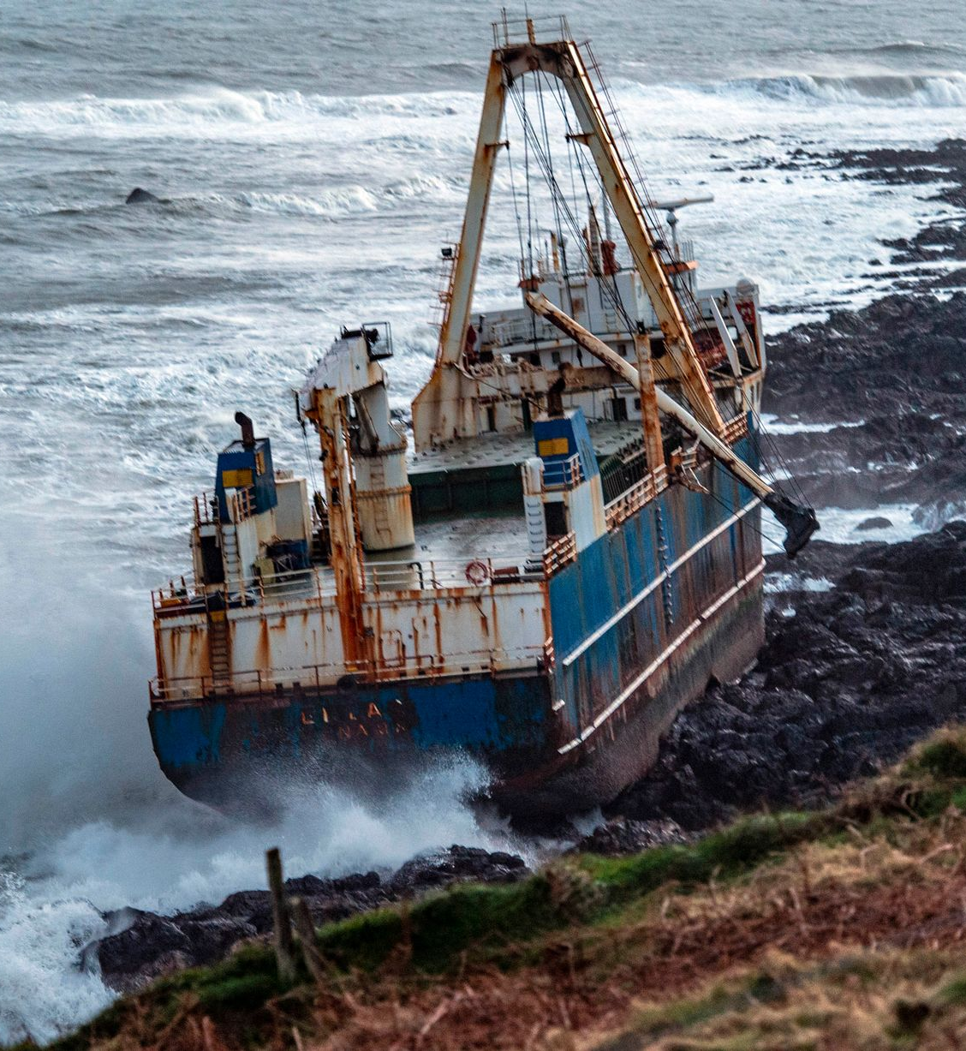
Protection and Indemnity Coverage: “Third party” insurance coverage for Owners’ liability to others
Loss of or damage to property of others caused by the Vessel
Wreck removal and/or marking
Cargo’s portion of General Average that is uncollectible
Excludes coverage for risks insured by Hull & Machinery Coverage

Slide 11
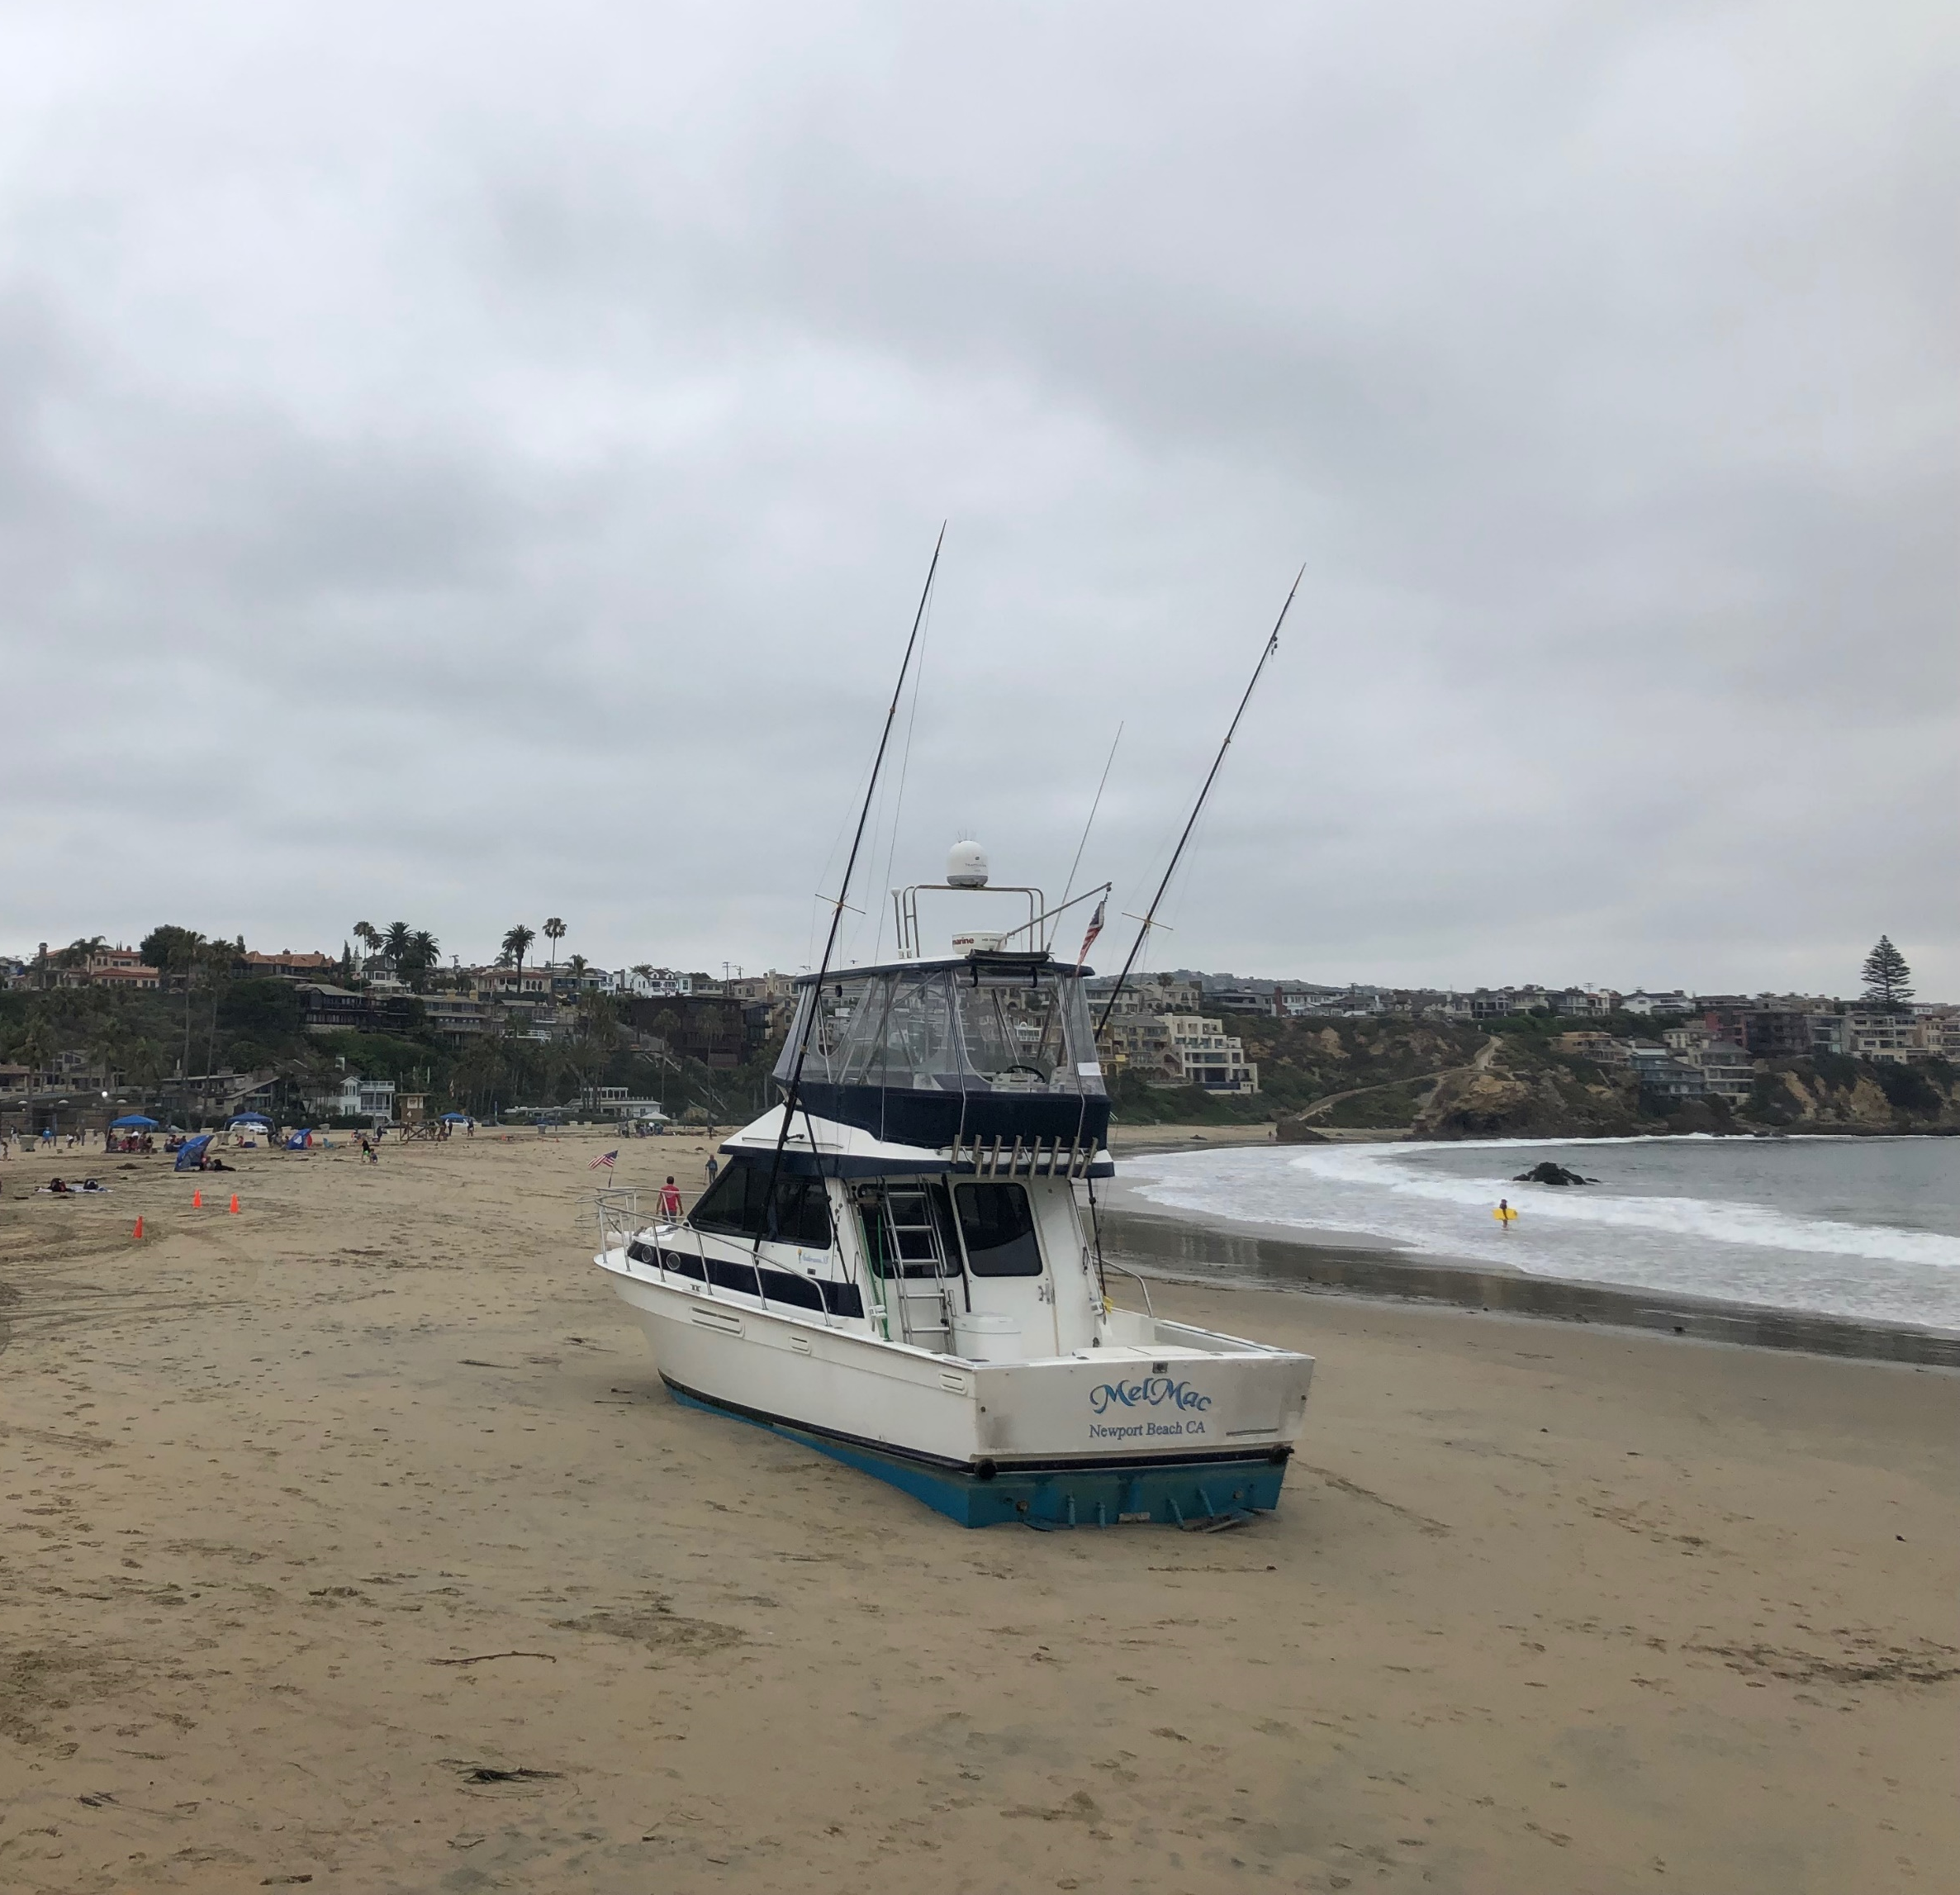
Loss of or Damage to Property
Loss of or damage to third party vessels.
Class I Rules, American P&I Club, Rule 2, § 3 (2022); 2022 Rules, Japan P&I Club, Rule 23
Loss of or damage to property of others – docks, piers, land, etc.
Class I Rules, American P&I Club, Rule 2, § 5 (2022);2022 Rules, Japan P&I Club, Rule 24(1)

Slide 12
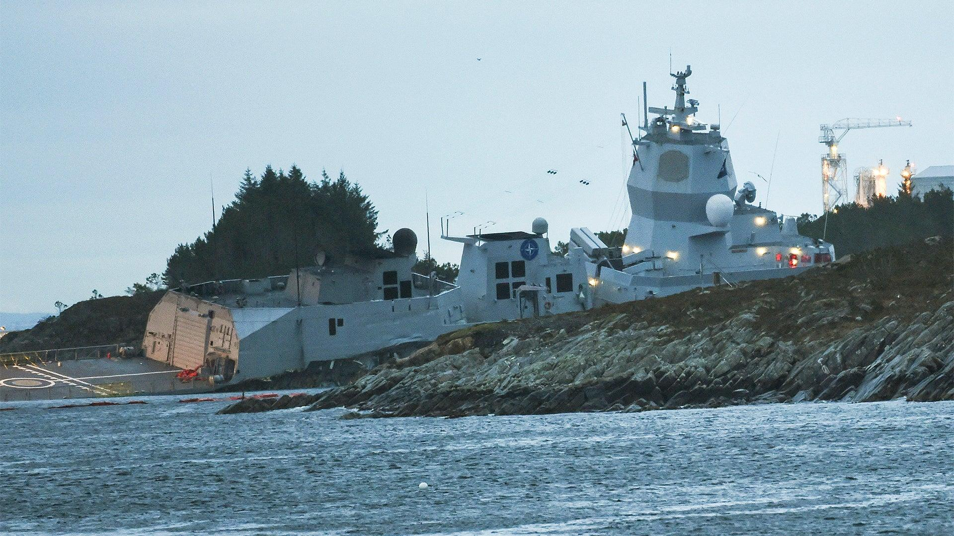
Wreck Removal
Underwriter or Club will reimburse Assured for costs incurred to mark and/or remove a wreck -
where compulsory by law – lass I Rules, American P&I Club, Rule 2, § 7 (2022);
which laws or ordinances require a Member to pay – 2022 Rules, Japan P&I Club, Rule 24(3)

Slide 13
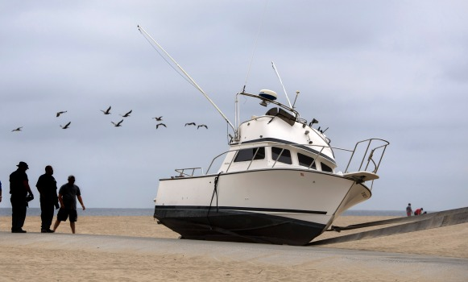
Cargo’s Portion of General Average
Underwriters or Club will reimburse Assured for cargo’s proportion of general average which are not legally recoverable solely by reason of Vessel’s breach of the contract of carriage.
Class I Rules, American P&I Club, Rule 2, § 13 (2022);
2022 Rules, Japan P&I Club, Rule 30(1)

Slide 14
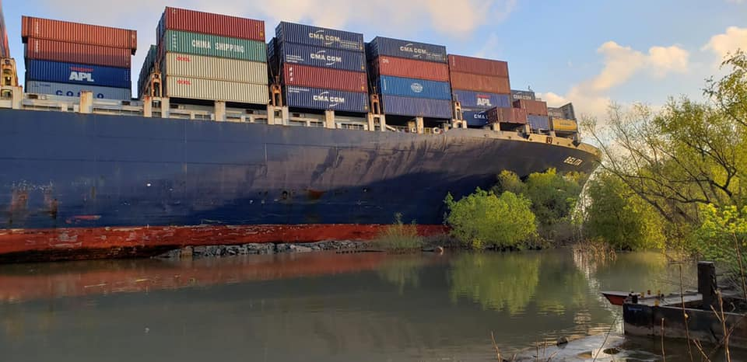
Cargo Legal Liability / Charterer’s Legal Liability Coverage
Charterer’s Legal Liability Coverage pays contribution to general average where all cargo carried is owned/possessed by the charterer
Cargo Legal Liability coverage will pay in the event your portion of cargo arrives safely but is subject to a claim to contribute towards general average

Slide 15
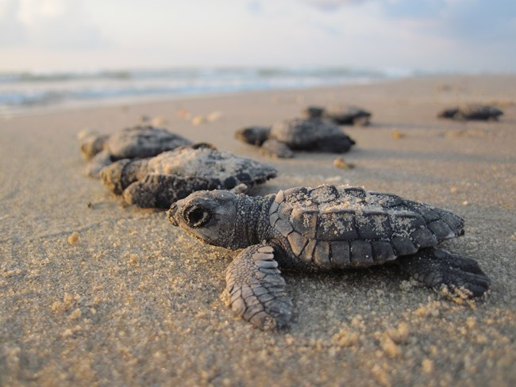
Not So Hypothetical Example
In the future, Hurricane Omega leaves your or your client’s vessel high and dry on an island owned by companies controlled by a wealthy, politically connected family.
The island is also designated a “wet-land” by U.S. government and is the nesting spot for sea turtles.
After all local, state and federal permits are obtained, the plan is to cut through existing sand dunes, to pull vessel overland and into nearby waters, and to tow it via navigable waters to yard for repairs. Afterwards, the dunes are to be restored to the way they were before stranding.

Slide 16
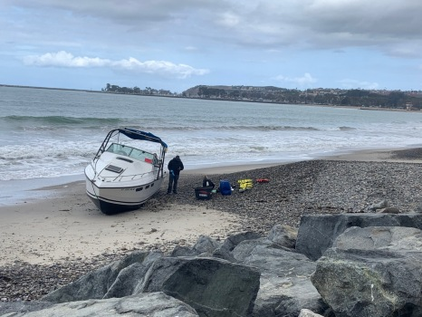
Not So Hypothetical
Available Insurance coverages –
Hull and Machinery coverage subject to a 20% deductible
Primary P&I Coverage limits exceeded by costs of defense and preliminary settlement of property damage claim
Excess P&I coverage had follow form provisions and contributed towards preliminary settlement of property damage claim
No cargo on board – no general average concerns

Slide 17
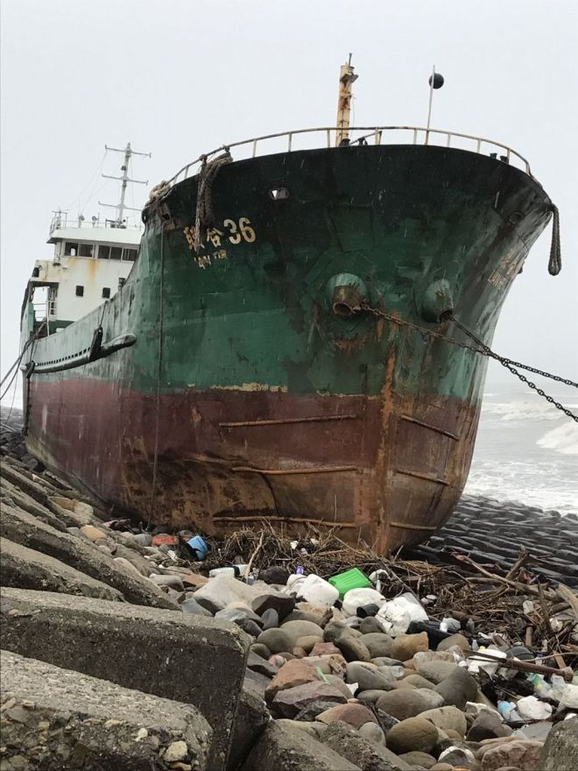
Not So Hypothetical
Are the costs to pull vessel across island and into the water covered by “Sue and Labor” under hull policy or “Wreck Removal” under P&I policy?
Depended on if vessel floated when returned to the water
Sank – Wreck removal
Floated – Sue and Labor – ultimately floated

Slide 18
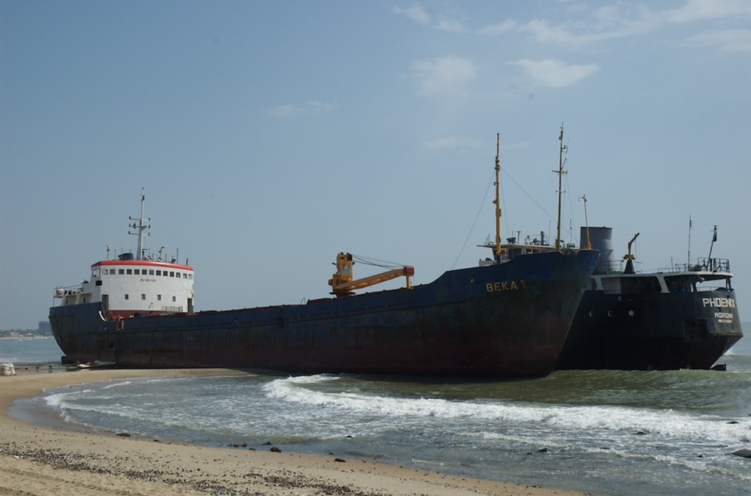
Not So Hypothetical
Dune cutting and remediation – covered by “Sue and Labor” or damage to third party
Dune cutting – Sue and Labor
Dune remediation – damage to third party

Slide 19
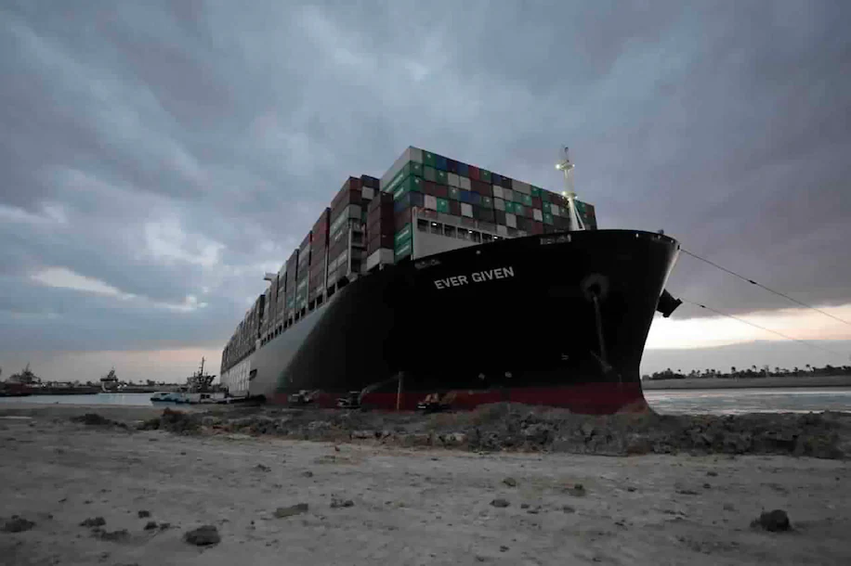
Not So Hypothetical
Topside deterioration and engine issues – initially excluded by Hull Underwriters as “wear and tear”
Vessel lay dormant for years on an island exposed to marine elements in which normal maintenance could not be performed
Photographs taken shortly after grounding of vessel showed it to be in reasonably good condition persuaded underwriters to pay for replacement of extremely deteriorated portions of vessel in dry dock

