Slide 3
The New Era of Taxation Environmental taxes: PPT, carbon tax and ‘green’ tax credits 15 September 2022 Session Co-Chairs Jisun Choi Skadden, Arps, Slate, Meagher & Flom, London Francesco Gucciardo Aird & Berlis, Toronto, Ontario; Vice Chair, IBA Taxes Committee Speakers Manuel Alcalde Carey, Santiago Laura Duglio Chiomenti, Milan Antti Lehtimaja Krogerus, Helsinki Enric Moret Plumé RocaJunyent, Barcelona

Slide 4
Discussion topics
Policy & Direction
Commitment to Clean Energy vs Current Macro-Economic Reality
Green Tax Incentives

Slide 5
EU Green Deal & Directives
EUROPEAN GREEN DEAL is a package of policy initiatives, which aims to set the EU on the path to a green transition, with the ultimate goal of reaching climate neutrality by 2050.
CLIMATE NEUTRALITY* is crucial to reach the objectives of the Paris Agreement
*Achieving zero greenhouse gas (GHG) emissions by balancing those emissions so they are equal than the emissions that get removed through the planet’s natural absorption
Wide range of initiatives included in the EUROPEAN GREEN DEAL:
European climate law
Fit for 55 package
EU strategy on adaptation to climate change
EU biodiversity strategy for 2030
European industrial strategy
Circular economy action plan
Clean, affordable and secure energy
…
1. Policy & Direction

Slide 6
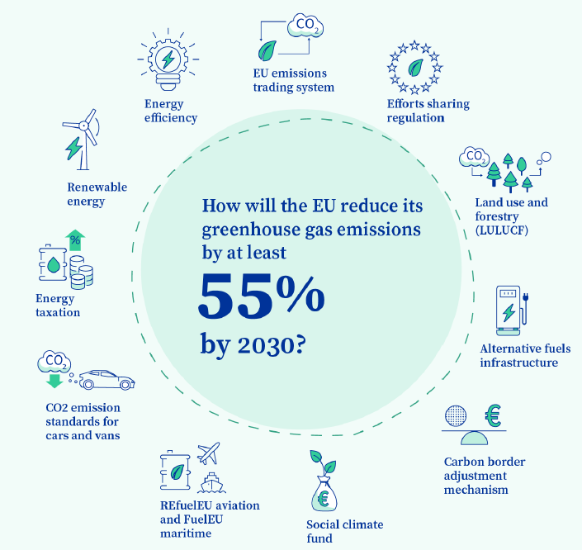
EU Green Deal & Directives
Fit for 55 package: set of proposals to revise and update EU legislation with the aim of aligning EU policies with the climate goals
The proposals are aimed at providing a framework for reaching EU’s climate objectives which:
ensures a socially fair transition
maintains and strengthens innovation and competitiveness of EU industry vs third country economic operators
1. Policy & Direction

Slide 7
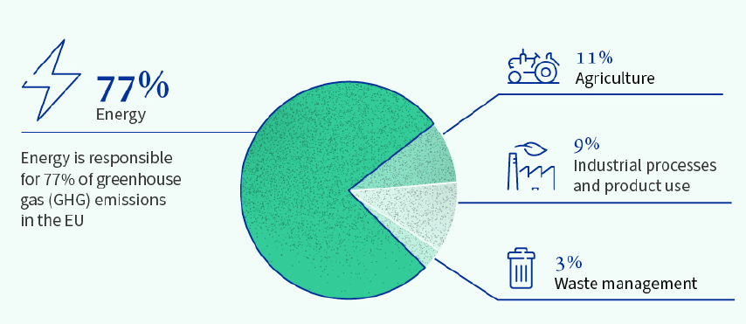
EU Green Deal & Directives
EU energy taxation directive (EU ETD)
Most polluting fuels (coal, oil, gas) will be taxed the highest
Aviation and maritime fuels will be subject to taxation
Switching from volume to energy content based taxation, eliminating incentives for fossil fuel use, taxing according to environmental performance.
1. Policy & Direction

Slide 8
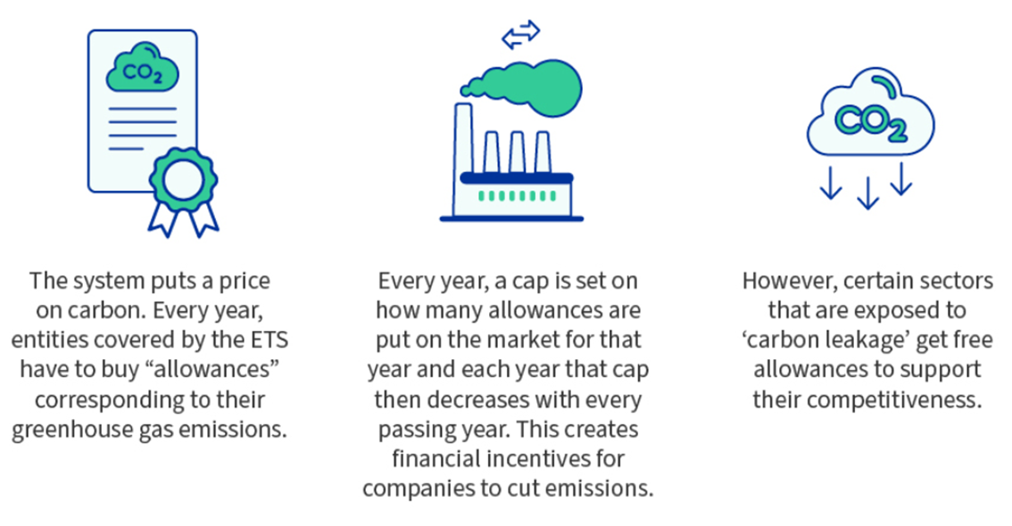
EU Green Deal & Directives
EU emissions trading system (EU ETS)
Currently covered sectors: electricity and heat generation, energy-intensive industry sectors (oil refineries, steel, cement glass and paper industry and commercial aviation)
New sectors to be covered: maritime transport, building and road transport
More ambitious emission reduction goals by faster reduction of the cap (fewer allowances to the market)
1. Policy & Direction

Slide 9
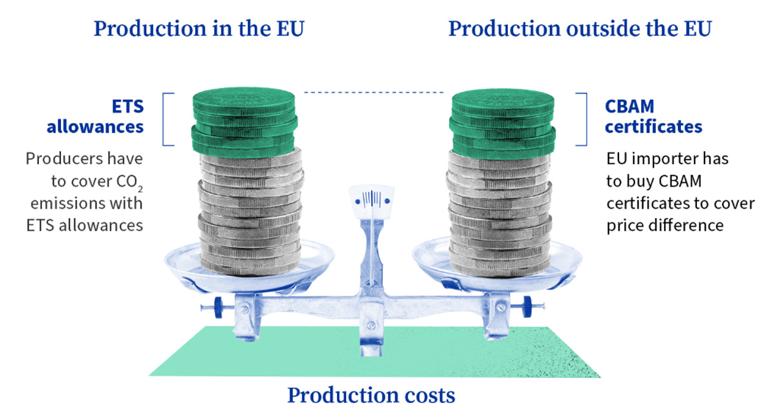
EU Green Deal & Directives
EU carbon border adjustment mechanism (EU CBAM)
New regulation so that non-EU producers are incentivised to reduce emissions
EU importer will have to buy CBA certificates based on carbon products’ content
Sectors to be covered: iron and steel, cement, fertilisers, aluminium and electricity
1. Policy & Direction

Slide 10
Chilean assessment and recommendations on corrective taxes by the OECD/IMF
In the framework of a joint OECD/IMF review of Chile’s tax expenditure methodology and corrective excise taxes, these institutions addressed the current status of certain environmentally related taxes:
 |  | Description | OECD / IMF recommendation | Tax Reform Proposal
FUEL TAX (base component) [specific charge per quantity of fuel] | Gasoline | US$ 370/m³ | Eliminate distortions: Include the corresponding fuel tax in the VAT base. Close the gap between diesel and gasoline excises. Move both motor fuels excises closer to efficiency levels. | Increase of the fixed component to US$ 435/m³. Elimination of exemptions / tax credits.
 | Diesel | US$ 90/m³ Multiple benefits, e.g.: VAT taxpayers and exporters are exempt as long as they use the diesel for purpose other than motor vehicles VAT credit for diesel used for industrial purposes | N/A | N/A
1. Policy & Direction

Slide 11
Chilean assessment and recommendations on corrective taxes by the OECD/IMF
 |  | Description | OECD / IMF recommendation | Tax Reform Proposal
GREEN TAX on stationary sources of emissions¹ | Carbon tax | US$ 5/ton of CO₂ | Significant increase of its amount | Gradual increase to US$ 40/ton Inclusion of excluded sources of emission
 | Local pollutants (particulate matter, NOx, SO₂) | Depends on: Amount of emissions Assigned value to the contamination of each pollutant Amount of people living in the emissions geographic zone Air quality of geographic zone | N/A | N/A
¹ Until December 2022, the tax is levied if the emissions are produced by establishments whose turbines or boilers, individually or as a whole, add up to a thermal power greater than or equal to 50MWt, i.e., it is based on installed capacity.
As of January 2023, the tax will be levied if the emissions are produced above a certain threshold (100 tons per year for CO2, 25.000 tons per year for particulate matter), regardless of the installed capacity of taxpayers.
1. Policy & Direction

Slide 12
Carbon taxes - Jurisdictional Comparison
Country | CBAM | ETS | Excise regimes
Italy | No specific action taken awaiting EU CBAM discussions. | Italian Legislative Decree No. 47/2020 implementing amendments to EU Directive 2003/87 provided for by EU Directive 2018/410 | Several excise duties applicable in Italy, following EU Directives (e.g., energy products, natural gas, alcohol products, electric energy, etc.). In contrast to many other Countries, the excise tax also applies to generation of electricity, although at a substantially lower rate.
Spain | No specific action taken awaiting EU CBAM discussions. | EU ETS Directive transposed into domestic law (Ley 1/2015) | Excise Duty on energy products used as motor and heating fuels (hydrocarbons) Excise duty on electricity and coal.
1. Policy & Direction

Slide 13
Carbon taxes - Jurisdictional Comparison
Country | CBAM | ETS | Excise regimes
Finland | No specific action taken awaiting EU CBAM discussions. Finnish government is supporting the EU CBAM initiatives. | Part of EU ETS Approximately 600 enterprises belong to the scope of the system Proposed changes to EU ETS generally favoured, although possible unreasonable cost rise due to Finland’s northern location raise concerns | Implemented EU ETD (with some exceptions): Liquid fuels (carbon dioxide tax and energy content tax) Coal Natural gas Fuel peat Electricity Non-reusable plastic packaging Waste Motor vehicles.
Chile | N/A | Certain emission reduction projects being discussed but not currently developed. Newly enacted Law No. 21,455 (Framework Law on Climate Change) establishes emission standards. | Green tax on stationary sources of emissions (global and local pollution levies) Fuel taxes (gasoline, diesel) Green tax on the sale of new motor vehicles
1. Policy & Direction

Slide 14
Carbon taxes - Jurisdictional Comparison
Country | CBAM | ETS | Excise regimes
UK | CBAM initiatives (separate to the EU post-Brexit) being discussed. Environmental Audit Committee has called on Government to develop plans for CBAM | Exit from the EU ETS post-Brexit. Standalone UK ETS replacing EU ETS on 1 January 2021. | Excise duties chargeable on various products, including alcoholic beverages, tobacco, hydrocarbon oil, biofuels Climate Change Levy Landfill Tax Aggregates Levy Plastic Packaging Tax
Canada | Consultation launched in August 2021 with a view to coordinating with International partners, particularly the US and EU. Current objective to realize a 40-45% reduction in emissions below 2005 levels by 2030 and focus on reducing risk of carbon leakage, maintain competitiveness, support the climate ambition and drive international action. | Establishment of the Federal Greenhouse Gas Offset System contemplating a market based approach supporting a domestic carbon trading market under Canada’s carbon price for industry: the Output Based Pricing System, where regulated facilities who exceed limits can purchase federal offset credits. | Fuel taxes (charge) and surcharges, taxes on inefficient vehicles, taxes on inefficient energy sources (petroleum products), air conditioners
1. Policy & Direction

Slide 15
Spain: more than minimum standards
State level taxes | Regional level taxes
Tax on the value of electric energy production | Tax on carbon dioxide emissions by motor vehicles
Tax on fluorinated GHG | Tax on gases and particulate pollutants emissions to the atmosphere produced by industry
Tax on the storage/production of spent nuclear energy and radioactive waste | Tax on nitrous oxide emissions to the atmosphere by commercial aviation
Tax on the value of gas, oil and condensation extraction | Tax on environmental risk of radiotoxic elements
Tax on landfill, incineration and co-incineration of waste | Tax on installations that has environmental effects
Tax on non-reusable plastic packaging | Tax on large commercial establishments
Road tax | water canon/surcharge
Tax on certain means of transportation (registration tax) | Tax on single use plastic bags
Excise duty on energy products and electricity | *Tax on wind energy
 | (…) around 50 other taxes on air emissions, water, waste management and resources
1. Policy & Direction

Slide 16
Spain: more than minimum standards
Only carbon tax in force in Spain at state level is tax on fluorinated GHG
At regional level:
Tax on GHG/polluters released to atmosphere
Tax on nitrous oxide emissions of commercial aviation
Tax on CO2 emissions by motor vehicles
New taxes (April 2022)– entry into force 1/1/2023
Tax on non-reusable plastic packaging
Tax on landfill, incineration and co-incineration of waste
Other specific taxes:
Tax on the storage/production of spent nuclear energy and radioactive waste
Tax on the value of electric energy production
1. Policy & Direction

Slide 17
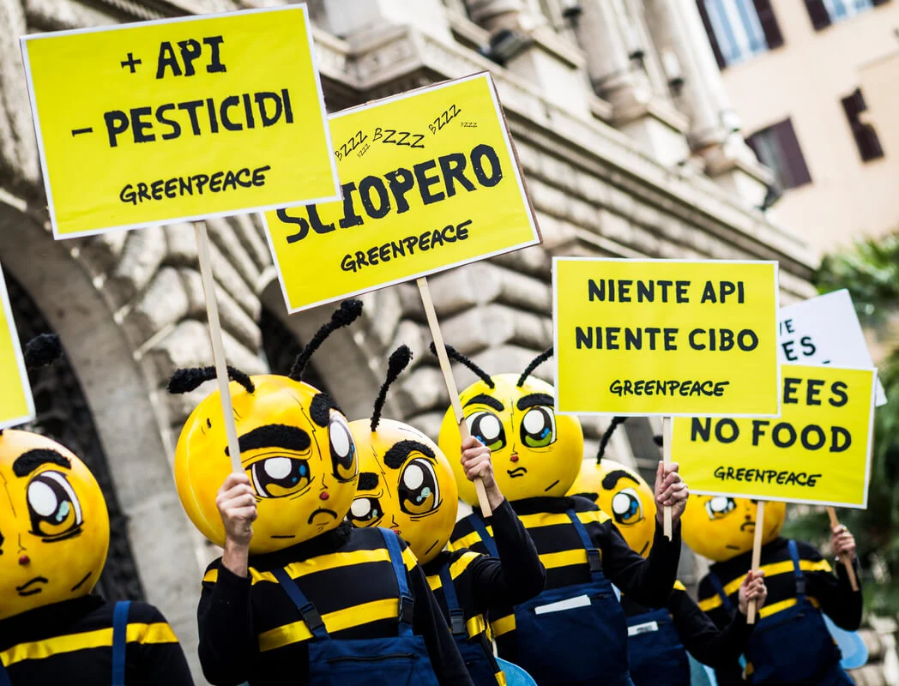
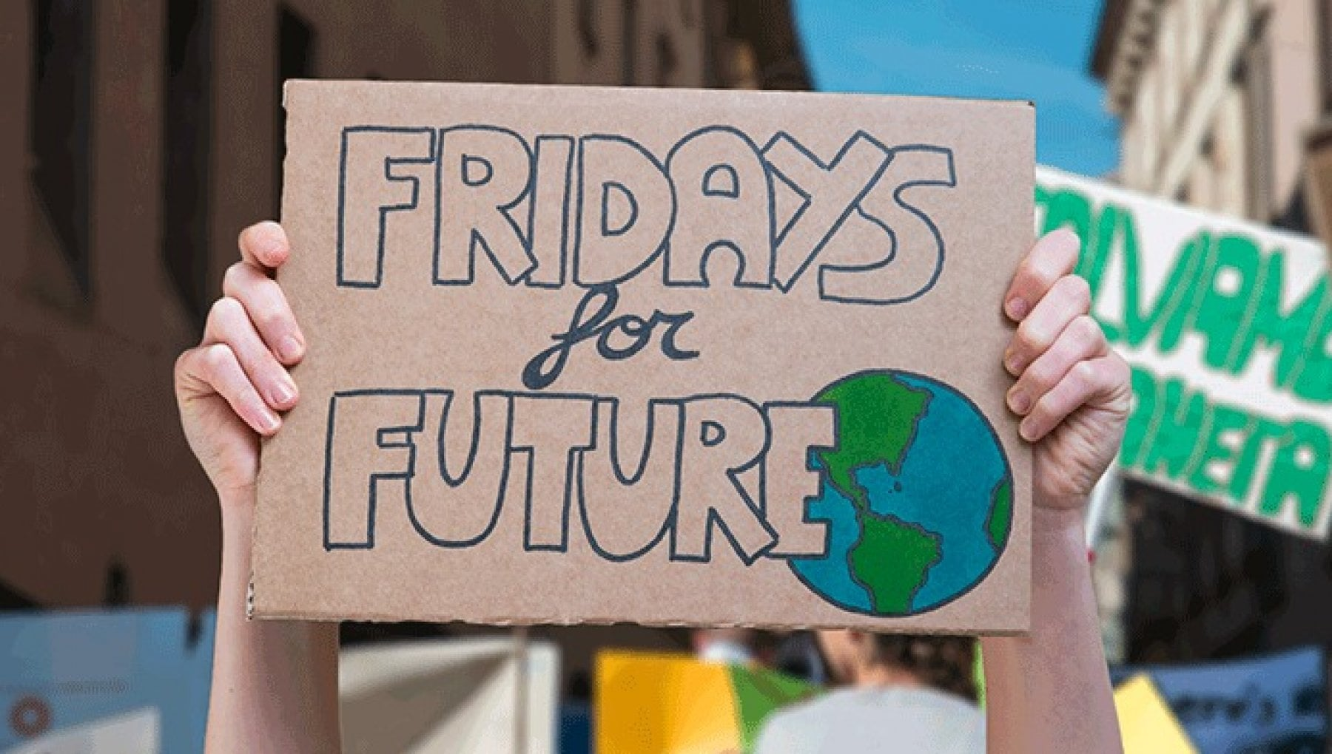
The ESG Movement – Shall we say, “movement”?
ESG: 290 million results if typed on Google (!!!)
Environmental: need to favour production processes that are less energy-intensive and have a lower impact on the environment;
Social: labour relationships, inclusion, community welfare and respect for human rights;
Governance: company’s leadership, executives’ remuneration, internal controls and stakeholder engagement.
1. Policy & Direction

Slide 18
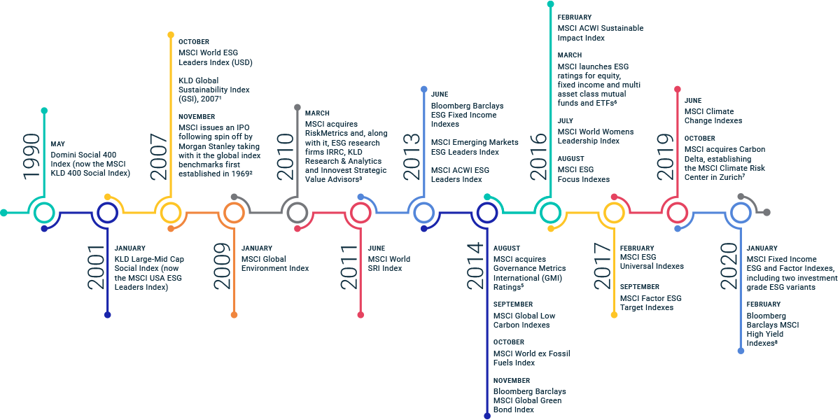
The ESG Movement – ESG linked indexes
The key milestones in the evolution of ESG indexes since 1990
Source: https://www.msci.com/our-solutions/indexes/esg-indexes
1. Policy & Direction

Slide 19
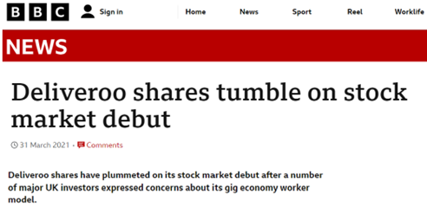
The ESG Movement – The current landscape
ESG driven decisions are pivotal for stakeholders: companies, banks, institutional investors, law firms.
Sample of ESG policies adopted by law firms: environmental policy; diversity and inclusion policy; anti-sexual harassment policy; corporate governance and corporate social responsibility policies, creation of Partners’ internal committees.
Are we sure about ESG accountability? The McDonald’s case.
1. Policy & Direction

Slide 20
The ESG Movement – Can taxes be an effective tool?
Corporate tax policies play a key role in measuring the company’s social and environmental impact.
Taxes have both a financial impact an and impact on climate and society.
Environmental
Environmental taxes (e.g., carbon and plastics taxes);
Green incentives (e.g., for budlings renovations, heating systems, cars, agriculture, renewable resources, etc.).
Social
Social insurance, health care, pensions;
Technology, hiring incentives, global mobility;
Equal payment, minimum compensation, remuneration policies, unemployment benefits.
Governance
Tax reporting and stakeholder communication, tax transparency reports;
Internal control process;
Cooperative compliance with tax authorities.
1. Policy & Direction

Slide 21
The ESG Movement – Country Focus Italy
The majority amongst the largest Italian companies (FTSE MIB) have taken action.
List of the 200 Italian Sustainability Leaders in 2022, amongst which there are many companies from the most regulated sectors, starting with banks (14.5% of the entries), energy companies (11%) insurance and industry companies, together with the state-owned subsidiaries. The list includes also a number of Italian SMEs.
Many companies are reporting their ESG performance in Sustainability Reports (or in Non-Financial Statements attached to the financial statements), although regulatory compliance is currently mandatory only for the largest or public interest companies.
The sign of a turning point is the linking of managers’ remuneration, bond issuance, or interest rates on loans to ESG objectives.
1. Policy & Direction

Slide 22
Windfall profit taxes
Windfall Profits:
Large unexpected gains resulting from “lucky” circumstances
Generally above historical norms
May occur due to temporary or longer price spike or supply shortage
Resulting from:
a sudden change in market structure
new legislation
government order
court ruling
dramatic change in trade policy
military conflict
natural disaster
Concern usually a certain industry sector
Typical examples when the price of crude oil, natural gas or electricity have suddenly increased dramatically in a short period of time due to events like OPEC oil embargo or military conflicts in the middle east
Non-volatile demand of energy results in significant profits for enterprises operating in the energy sector when the prices of energy products peak
2. Commitment to Clean Energy vs Current Macro-Economic Reality

Slide 23
Windfall profit taxes
Taxing Windfall Profits:
Historically special tax regimes in addition to normal corporate income taxation.
Australia – taxation of refunds of unconstitutional state taxes
UK – taxation of bank deposits and profits of privatised utility companies
US – Crude Oil Profit Windfall Tax
Sweden – taxation of hydro- and nuclear energy companies
Norway - taxation of hydro electronic power plants
EU Commission proposal 2022:
Due to current high prices, member countries should introduce windfall profit tax regimes to electricity producers
Proceeds used to secure the electricity network capacity and support certain vulnerable consumers and enterprises
2. Commitment to Clean Energy vs Current Macro-Economic Reality

Slide 24
Windfall Tax - Finland
A windfall profit tax to nuclear and hydro power plants proposed in 2009 but never introduced
Currently, Finland is favoring EU Commission’s proposal for EU wide windfall tax regime for electricity producers
No domestic measures are enacted so far
The government stated recently, that it will start preparing a windfall profit tax to finance other measures to combat rise of electricity prices
2. Commitment to Clean Energy vs Current Macro-Economic Reality

Slide 25
Windfall Tax - Italy
Law Decree no. 21 of March 21, 2022, introduced in Italy a special contribution on extra profits realized by Italian energy industry companies (the “Italian Windfall Tax”) to finance the reduction of energy prices for enterprises and consumers.
A one-time 25% (initially 10%) “solidarity” tax surcharge applicable to entities carrying out one or more of the following activities in the Italian territory in FY 2022:
production of electricity for subsequent sale and/or (ii) sale of electricity;
production and/or sale of methane gas;
extraction and/or sale of natural gas;
production, distribution and trade of oil products; and
import or purchase from other EU countries of electricity, methane gas, natural gas and oil products for subsequent resale.
Companies which organize and manage platforms for the exchange of electricity, gas, green bonds and other fuels are not subject to the windfall tax.
Further clarifications provided by the Italian tax authorities by means of Circular letter no. 22 of June 23, 2022.
The Italian Windfall Tax adds on to the Italian plastic tax and taxes on polluting vehicles.
2. Commitment to Clean Energy vs Current Macro-Economic Reality

Slide 26
Windfall Tax - Italy
The Italian Windfall Tax applies to entities realizing an increase in net-sales values as reported for VAT purposes in the period between 1 October 2021 to 30 April 2022, compared to the same period of the previous year;
the increase coincides with the taxable base as long as it is at least equal to €5m or alternatively, is higher than 10%;
25% rate;
the calculation of the relevant net-sales shall not include transactions that do not fall within the scope of application of VAT due to the lack of either of the three main VAT conditions.
The windfall tax is deductible neither from the corporate income taxes (IRES) nor from the regional tax on productive activities (IRAP).
Payment terms are as follows (i) an advance payment of 40% of the tax due shall be paid by 30 June 2022, and (ii) the balance shall be paid by 30 November 2022.
2. Commitment to Clean Energy vs Current Macro-Economic Reality

Slide 27
Windfall Tax - Italy : Pitfalls and remarks
Is windfall tax compliant to the Constitution? – Precedent concerning the constitutional unlawfulness of the s.c. “Robin Hood Tax” (see, inter alia, Italian Supreme Court, decision No. 10 of 11 February 2015).
The taxable basis does not capture (only) the windfall profits generated by the increased O&G prices as the increase in sales may be influenced by several factors unlinked to price fluctuations (e.g., M&A transactions, sale of buildings, start-up or crisis phasis of the company, etc.).
The periods to be compared are generally uneven in terms of economic trends (recession vs expansion). The inevitable effect is to tax a “recovery share”.
Exemptions for companies operating in the renewables sector?
2. Commitment to Clean Energy vs Current Macro-Economic Reality

Slide 28
Windfall Tax - Spain
On July 25th Spanish ruling coalition introduced a draft bill into parliament to create a temporary “tax” on power utilities and banks.
Main features:
Applies to principal operators of energy sector (electricity, gas, oil) whose turnover is not lower than €1,000 M
1,2% levy on the previous’ year turnover
It is not deductible for corporate income tax purposes
The levy cannot directly or indirectly be charged to the costumers
3. Green Tax Incentives

Slide 29
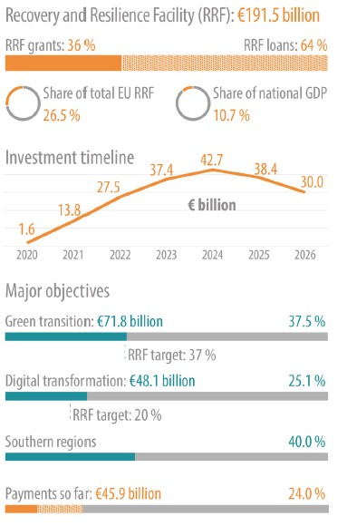
The Italian Recovery and Resilience Plan
The Italian Recovery and Resilience Plan (“RRP”) initially presented to the EU Parliament and Commission in April 2021 – which is the largest national plan in the EU – provides that 37.5% of total allocations financing the RRP are destined to green revolution and environmental transition (accounting for Euro 71.8 billion).
Relevant measures relate to sustainable mobility, the production and use of renewable energy, energy efficiency of private and public buildings, the circular economy, and management of water and waste as well as hydrogeological risks.
Funds will be used to follow up and increase existing tax measures promoting the reduction of environmental impacts: e.g., the Ecobonus and Sismabonus up to 110% for energy efficiency and building safety and the tax credit for firms investing in technology 4.0 aimed at reducing environmental acts of productive processes.
3. Green Tax Incentives

Slide 30
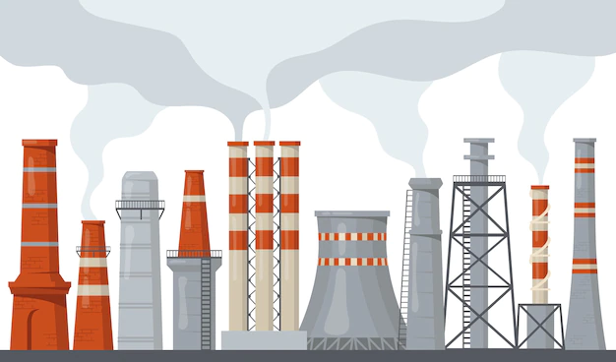
Where is Waldo?
3. Green Tax Incentives

Slide 31
Where is Waldo?
Buildings have a dirty secret: they are among the planet’s worst climate offenders.
Approximately 27% of global energy-related carbon-dioxide emissions arise for heating, cooling, and powering existing offices, homes, and factories.
Constructing new buildings involves the use of a high quantity of steel and cement and combined with demolition accounts for another 10% of the global CO2 emitted each year. Building debris generates 1/3 of the European Union’s annual waste by weight.
Incentivizing homeowners to make existing properties more energy-efficient: Italy introduced tax credits granted for energy requalification works in buildings (Ecobonus) and for works for the renovation of the building heritage, including earthquake-proof interventions (Sismabonus).
3. Green Tax Incentives

Slide 32
Italian Superbonus 110%: a virtuous example(?)
In 2020, Italy introduced the s.c. Superbonus 110% strengthening the incentives provided by the Ecobonus and Sismabonus (which still remain applicable if the conditions for the application of the Superbonus 110% are not met).
With the Superbonus 110% homeowners can claim the full cost of “green” home renovations, plus an extra 10%, through generous tax credits (up to a maximum amount per home) to be offset against income taxes due over a 4-year period (or, as an alternative, through invoice discount or tax credit assignment).
Examples of green renovations granting the tax credit include installing insulation systems, heat pumps and solar panels or replacing an old boiler, building charging infrastructure for electric vehicles, or undertaking works that reduce the risk of damage from seismic activity.
Employment increase in the construction sector.
GDP increase.
Improvement of energy and structural characteristics of old buildings.
Time constraint: the incentive will be gradually reduced in size before ending in 2025.
Insufficient controls lead to evasion and frauds.
Bureaucratic fulfillments.
No zero-carbon emissions.
3. Green Tax Incentives

Slide 33
What about Chile?
Offsets in the green tax on stationary sources of emissions
Taxpayers may offset their taxable emissions through projects to reduce CO2, particulate matter, NOx or SO₂ emissions.
These projects are subject to the authorization of the Ministry of Environment.
Introduced by the latest tax reform law (2020), and effective as of February 2023.
Environmental expense deductibility rules
Allows the deductibility of environmental related expenses, incurred by virtue of:
Requirements imposed by the authority for the execution of a project or activity.
Voluntary commitments made in environmental impact assessments or statements.
Introduced by the latest tax reform law (2020), which confirmed previous administrative pronouncements on the matter.
3. Green Tax Incentives

Slide 34
What about Chile?
Energy Efficiency Law
Accelerated depreciation regime (1 year) for electric vehicles, hybrid vehicles with external recharging and other vehicles qualified as zero emissions by the Ministry of Energy.
Effective until February 2031.
Tax reform proposal
R&D projects that have a direct positive environmental impact would be able to benefit from a 50% tax credit against the corporate income tax, instead of the 35% general rule.
Projects with direct positive environmental impact = those related to conducting or executing R&D aimed at creating technologies that allow less use of fossil fuels, less waste generation, less use of raw materials, or that facilitate or allow the mitigation, adaption or resilience to climate change.
3. Green Tax Incentives

Slide 35
Government spending on green incentives in Finland
Reduced levies on energy at Consumer Level
New electric cars exempted from car tax since October 2021
The “distribution obligation” of liquid fuel reduced since July 2022
Previously gasoline sold to consumers had to include 19.5% of biofuel
New reduced obligation is only 12%.
Reduction of consumer prices, as biofuel has a higher production cost
Increased excise duty accrual as biofuel is exempted from excise tax.
Temporary VAT reduction of electricity from 24% to 10% between December 2022 and April 2023
Temporary VAT exemption of public transport between January-April 2023
Temporary income tax deduction based on high electricity costs
3. Green Tax Incentives

Slide 36
Government spending on green incentives in Finland
Grants available for:
Municipalities for costs relating to zoning of wind power plant projects
Certain wind power projects to be able to sell electricity with certain price level (feed-in-tariff system)
Individuals and enterprises for acquisition of solar power panels
Individuals and enterprises for purchasing new electric cars
Tax Credits available for installing solar power panels or otherwise having renovation work to permanent or recreational homes.
Relating to VAT Finland, has not so far used the possibility to apply zero, super reduced or reduced rates to the supply of certain environmentally friendly goods and services as enabled by the recent change in EU VAT Directive.
3. Green Tax Incentives

Slide 37
How is Spain incentivising green initiatives?
Temporary measures to reduce electricity price hike in force from 3Q FY21 until 31/12/2022:
Tax on the value of electric energy production was suspended
Excise duty on electricity rate was reduced from 5,11% to 0,5%
VAT rate applicable on the electricity supply to certain customers was reduced from 21% to 10% and from 1/7/2022 until 31/1/2022 a further reduction to 5% has been implemented.
Temporary measures to reduce the fuel’s price hike from 30/3/2022 to 31/12/2022:
Government bonus of €0,20 per litre of certain energy products (petrol, gas, oil, biodiesel, etc.)
The government pretends to temporarily (from beginning of October to 31/12/2022) slash the VAT rate on the supply of natural gas from the current 21% to 5% to reduce customers' heating bills during the next cold season.
3. Green Tax Incentives

Slide 38
How is Spain incentivising green initiatives?
Tax credits to foster energy efficiency and the green energy transition:
Personal Income Tax (PIT) deduction for works on individual’s residence or any other housing aimed at reducing heating and cooling demand: 20% of the works with a cap of €5k (up until 1/1/2023)
PIT deduction for works to reduce non-renewable primary energy consumption: 40% of the works with a cap of €7,5k (up until 1/1/2023)
PIT deduction for energy renovation works: 60% on the works with a cap of €5k (up until 1/1/2024)
3. Green Tax Incentives

Slide 39
How is Spain incentivising green initiatives?
Grants to foster green energy transition (Spanish Strategic plan for the green transition FY22-24):
Electrical mobility projects (improve energy efficiency and reduce CO2 emissions on transport sector)
Electrification of vehicle fleet (improve energy efficiency and reduce CO2 emissions)
Moves III plan: incentivise acquisition of electric, hydrogen (€7k) and hybrid vehicles (€5k) (reduce CO2 emissions)
R+D projects for energy storage
Renewable hydrogen projects (increase in the use of green energy and reduce emissions)
Thermal renewable in industry (increase in the use of green energy and reduce emissions)
Energy efficiency projects for agricultural holdings
Shifting to renewable energy for household heating systems – acquisition of solar panels (increase in the use of green energy)
R+D projects for energy storage and efficiency
3. Green Tax Incentives

Slide 40
Interaction with Pillar II
Do green tax incentives fall within “qualified refundable tax credits” for the purposes of Pillar II ETR calculations?
US research credits X
US environmental incentives for investments in green energy X
UK Patent Box X
UK Research & Development Expenditure Credit
Others? X
Possible move towards incentivising green initiatives in the form of grants or subsidies rather than tax credits?
3. Green Tax Incentives

