Slide 1
Leschaco
Lost in Transport: Repercussion of Document Mismanagement
IBA Maritime and Transport Law Committee Mid-Year Conference_6-8 June 2022
Product Management Sea Freight Sea Freight
www.leschaco.com

Slide 2
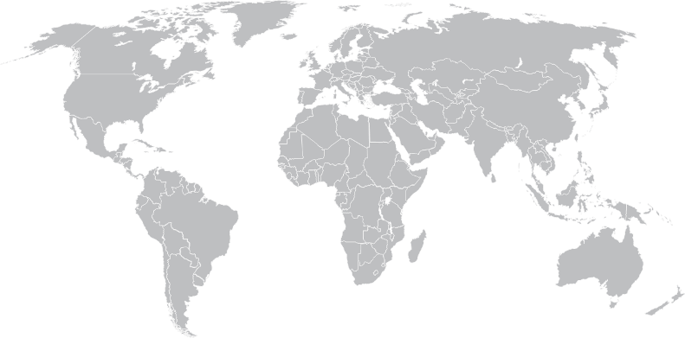
Leschaco – Global Know-how and Local Customer Focus
Sea Freight
FCL
Rail Solutions
LCL
Consolidation Services
Co-Load Services
Tank Container
Own TC Fleet
SOT Fleet Operation
Project & Plants
Contract Logistics
Warehousing
Domestics Services
Air Freight
Air Freight
Full Charter
Consolidation
5.706 Chattogram
3.012
Jakarta
LESCHACO
10.004
Santos
2.497
Nhava Sheva
Own offices
Network partner
Total Sets OBL issued
69.018
Anytime – on all continents

Slide 3
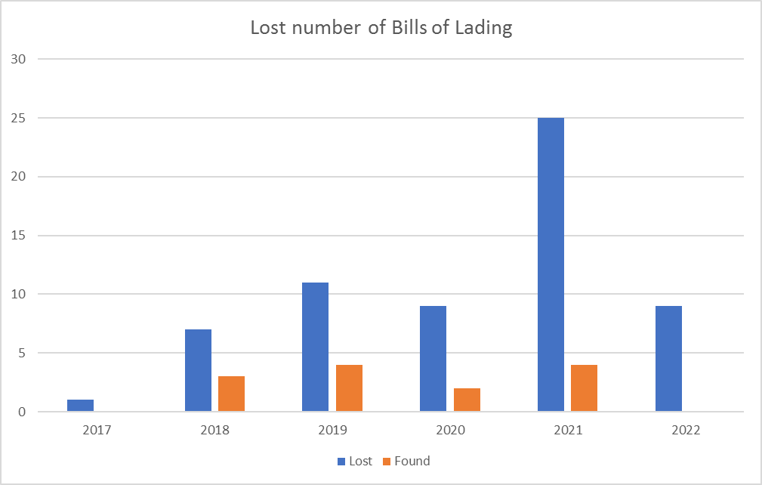
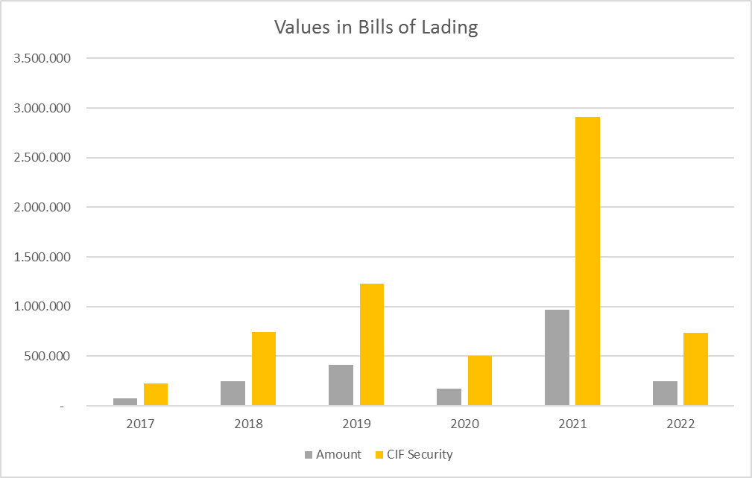
Loss of Original Bills of Lading (full set)
LESCHACO
Pandemic times increases the number of lost bills but also the risk amount for customer and shipping lines
Summarised Financial Risk 2017 to 2022 = USD 6.4 mio

Slide 4
Repercussions
Lost or misplaced documents
Courier Service driver not available
Warehouse burned down, truck burned down, driver assaulted
Ban on Road
Customer - no reception anymore
Home Office - responsible colleagues do not come to pick up documents
Someone else takes all envelops and does not know what's in there
Delayed delivery of documents
Cargo is discharged and cannot be customs cleared due to missing documents
Consignee need to absorb storage costs, demurrage, detention and late declaration fines
Import licenses jeopardized
2nd Set Challenge – Angry customer
Police Report required
No person available entitled to sign Letter of Indemnity or internal company guarantee
Bank staff in home office and bank guarantee cannot be issued
Bank guarantee must be recognized in the company balance sheet
LESCHACO

Slide 5
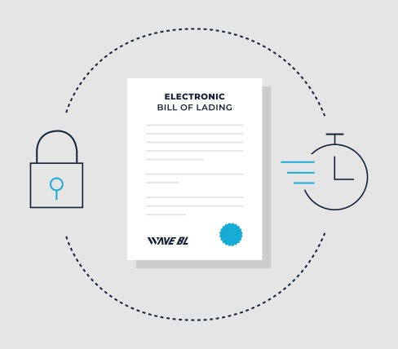
Solutions
Costs Savings
Courier Costs
Printer / Ink Costs
Risk Management & Compliance
No separate Printing Agreements necessary (Compliance can be granted)
Surrender & Switch BLs under full control of NVOCC
Increase of productivity
Direct API or WebAccess
No „empty floor walks“
BL Paper Costs
No financial risk due to lost BLs
No fraudulent acts anymore
Environmentally friendly
Full usage of SCT
Issuance
Distribution
Surrender
Exchange
Remote Access
Vendor Relationship
Bank accept
Customer accept
Risk Minimization
LESCHACO

Slide 6
LESCHACO
Disclaimer
Please note that all information reported in the newsletter is to the best of our knowledge at the time of writing, but we cannot guarantee its correctness or accuracy. Should you require any further information or have any questions or comments, please feel free to contact us at: productseafreight@leschaco.com.
Our "General Terms and Conditions for the communication via email" apply.
If you no longer wish to receive our Customer News, please send a message to productseafreight@leschaco.com
Privacy Statement
Silke Fischer
Head of Global Product Management Sea Freight
www.leschaco.com

