Slide 1
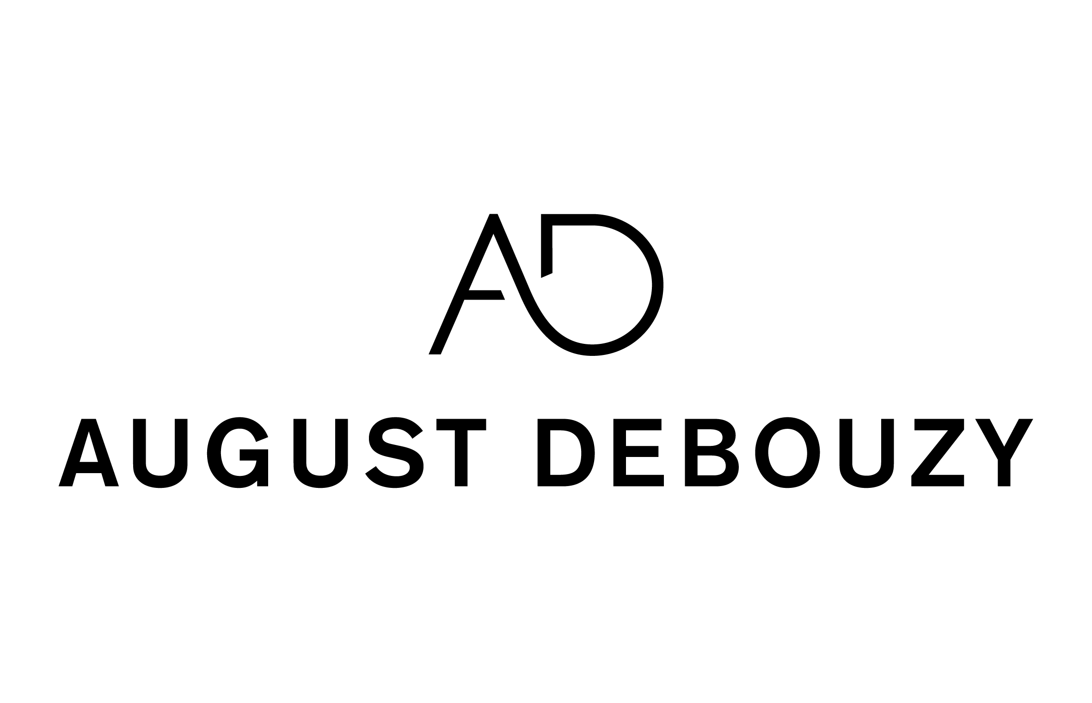
Legal privilege in an era of increasing cross-border information sharing
The panel will discuss how to best maintain and defend legal privilege and professional secrecy in cross-border investigations given the increased information sharing between government agencies, and the ever-expanding coordination between prosecuting authorities. It will also discuss harmonisation of rules and practices through various jurisdictions (ie, in-house counsel legal privilege).
Session Chair
Astrid Mignon Colombet, August Debouzy, Paris, former Co-Chair, IBA Criminal Law Committee ;
Panellists
Paul Feldberg, Jenner & Block, London
Saverio Lembo, Bär & Karrer, Geneva, Individual Defence Counsel Officer, IBA Criminal Law Committee
Jason Linder, Mayer Brown, Washington DC, Treasurer, IBA Business Crime Committee
Riccardo Lucev, Cagnola & Associati Studio Legale, Milan, Publication and Newsletter Editor, IBA Criminal Law Committee
Helena Prieto, Garrigues, Madrid
What is the status of legal privilege & professional secrecy within your jurisdiction? What are the main exceptions to the protection for attorney-client communications? Is there any ‘work-product doctrine' in your jurisdiction ?
In your jurisdiction, is there any relevant differences regarding attorney-client communications protection between the status of external lawyers and in-house counsels ?
When internal investigations are conducted by external lawyers, are they protected by legal privilege and professional secrecy? What happens when investigations are conducted by in-house counsels ?
When the prosecuting authorities ask for i) the communication of the investigation report ; ii) the employees interviews conducted by external lawyers, under which conditions can legal privilege be waived in your jurisdiction ?
In a cross-border investigation, when a document that is privileged is requested by your domestic prosecuting authority, can you invoke a foreign concept of legal privilege to refuse to share the privileged document ?

