Slide 2
Mobility of HNWI after the pandemic: Tax preferential regimes and application of tax treaties
Co-Chairs
Claudia Suter, Homburger, Zürich
Tiago Cassiano Neves, Kore Partners, Lisbon
Speakers
Blanca Vicens Novell, Lener, Barcelona
Tanja McSchienke-Ohletz, Flick Gocke Schaumburg, Frankfurt
Eva Stadler, Wolf Theiss, Vienna
Barry McGettrick, Matheson, Dublin
Pedro J Miranda-Sadurní, Sanchez Devanny, Querétaro

Slide 3
Our 5 goals for this session
Mobility of HNWI
1. Not describe you the preferential tax regimes available…
2. Not teach you how to avoid tax for your HNWI clients…
3. Discuss impact of preferential tax regimes on tax treaties
4. Focus on real situations from residence and source perspective
5. Reach some preliminary conclusions but not solutions

Slide 4
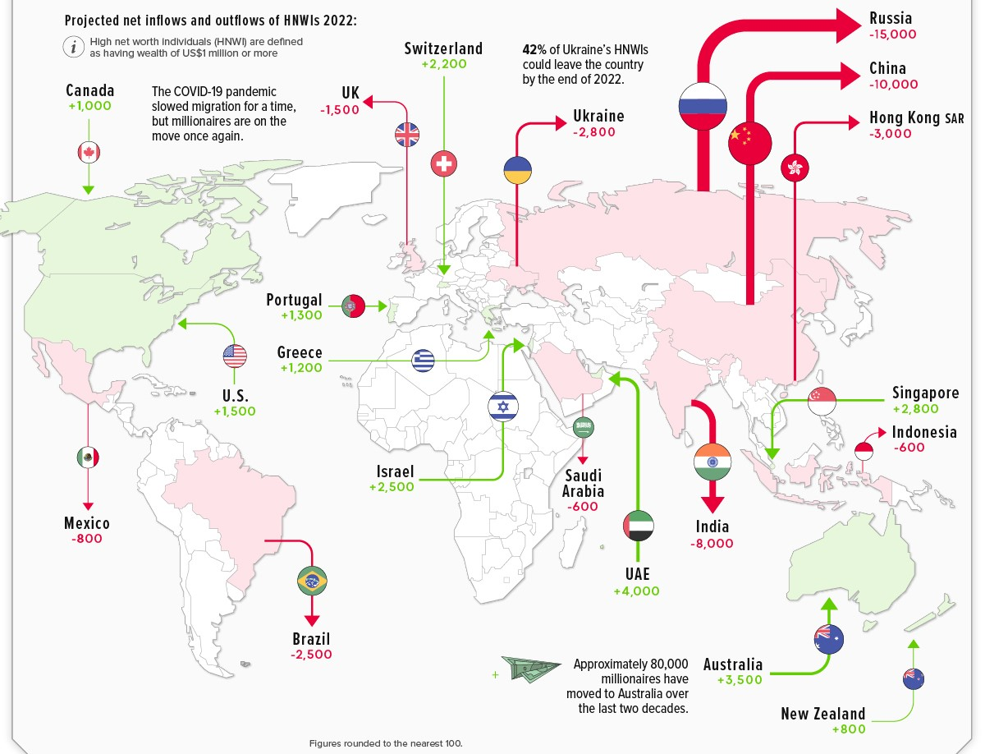
Migration Trends, Outflows and Inflows
Mobility of HNWI

Slide 5
Setting the Scene
Mobility of HNWI
Residence for treaty purposes
Art. 4 OECD MC
(1) For the purposes of this Convention, the term "resident of a Contracting State" means any person who, under the laws of that State, is liable to tax therein by reason of his domicile, residence, place of management or any other criterion of a similar nature […]. This term, however, does not include any person who is liable to tax in that State in respect only of income from sources in that State or capital situated therein.
(2) Where by reason of the provisions of paragraph 1 an individual is a resident of both Contracting States, then his status shall be determined as follows:
a) he shall be deemed to be a resident only of the State in which he has a permanent home available to him; if he has a permanent home available to him in both States, he shall be deemed to be a resident only of the State with which his personal and economic relations are closer (centre of vital interests);
b) if the State in which he has his centre of vital interests cannot be determined, or if he has not a permanent home available to him in either State, he shall be deemed to be a resident only of the State in which he has an habitual abode;
c) if he has an habitual abode in both States or in neither of them, he shall be deemed to be a resident only of the State of which he is a national;
d) if he is a national of both States or of neither of them, the competent authorities of the Contracting States shall settle the question by mutual agreement.

Slide 6
Setting the Scene
Mobility of HNWI
"Liable to tax" versus "subject to tax"
UK Tax Chamber, Weiser v. HMRC (2012) TC/2010/3902
Relevant provision: Art. XI para. 2 of the 1962 UK-Israel income tax treaty:
Any pension […] derived from sources within the United Kingdom by an individual who is a resident of Israel and subject to Israel tax in respect thereof, shall be exempt from United Kingdom tax.
Tax Chamber:
"liable to tax" v. "subject to tax"
liable to tax = abstract liability; being in a country's fiscal jurisdiction
subject to tax = effective liability; actually paying tax

Slide 7
Setting the Scene
Mobility of HNWI
Residence for treaty purposes – case law on UK remittance taxation
Art. 4 para. 1 OECD MC
For the purposes of this Convention, the term "resident of a Contracting State" means any person who, under the laws of that State, is liable to tax therein by reason of his domicile, residence, place of management or any other criterion of a similar nature […]. This term, however, does not include any person who is liable to tax in that State in respect only of income from sources in that State or capital situated therein.
UK resident non dom taxed on remittance basis – resident of the UK for treaty purposes?
French Conseil d'État, Ragazzacci, 27 July 2012, no. 337656:
resident of the UK under art. 4 para. 1 of the treaty
however: subject to tax provision > no refund of French dividend withholding tax
Spanish Tribunal Económico Administrativo Central, 11 July 2017, no. 6469/2013/00/00:
resident of the UK and of Spain under art. 4 para. 1 of the treaty
however: ultimately resident of Spain due to center of vital interests in Spain
Italian Corte Supreme di Cassazione, Tiziano Ferro, 8 October 2020, no. 21695-2020:
not resident of the UK as a consequence of sentence 2 of art. 4 para. 1 of the treaty

Slide 8
Case Study 1 – The Residence Perspective
Mobility of HNWI
Tax preferential regime
Spain
Portugal
Switzerland
HNWI
Company
Will tax treaty benefits be important?
Will the HNWI secure tax treaty benefits?
Rental
Income
Portfolio
Dividends
Interest
Gains qualified
participation

Slide 9
The Spanish Perspective - Special inbound regime
Mobility of HNWI
In order to qualify for the special regime, certain conditions must be met.
It is NOT required to pay any annual forfeit.
Relevant amendments to this regime may be introduced as of 01/01/2023. Still pending to be passed.
BUT → the regime has been modified since it was first introduced:
Before 2015
“Employment income arising as a consequence of the employment or directorship relationship would be taxed in Spain”.
“Income obtained abroad cannot exceed the 15%/30% of the total remunerations obtained”.
From 2015 - currently
“The total amount of employment income received by the individual would be considered as obtained in Spain”
It applies the year of acquiring the tax resident + 5 years
PIT: 0% taxation of foreign source income (except employment income tax 24% up to 600k; 47% exceeding.
WT: only levied on net Spanish situs assets.
No disclosure of assets held abroad.
Tax years of application of the regime are disregarded for exit tax obligations.
IGT: no specific provisions.
Which are the benefits of being taxed under this regime?

Slide 10
The Spanish Perspective – Practical approach
Mobility of HNWI
Article 114 PIT Royal Decree (from 2015 onwards).
Binding rulings V0554-22, V0610-22
What about a tax residence certificate?
Article 120 PIT Royal Decree.
Binding rulings V0599-22, V1167-19, V2918-17, V1935-16.
How to avoid doble taxation?

Slide 11
The Spanish Perspective – Outbound cases
Mobility of HNWI
Article 4 ODCE: “a person is not to be considered a resident of a contracting state in the sense of the convention if he is considered to be a resident according to the domestic laws but it is subject ONLY to a taxation limited to the income from sources (…)”.
Paragraph 108 article 1 ODCE: “under the domestic law of some States, persons who qualify as residents but who do not have what is considered to be a permanent link with the State (sometimes referred to as domicile) are only taxed on income derived from sources outside the State (..).”
BUT… is the STA accepting tax residence certificates issued abroad?
Individuals under NHR in Portugal might NOT be regarded as tax residents in such country as per the DTT (binding rulings V3553-19, V3379-19).
Certificates corresponding to individuals taxed under the “remittance basis” in the UK would be accepted by the STA (SAN 15-06-20; TEAC 11-07-17) for DTT purposes.

Slide 12
Mobility of HNWI
The Portuguese Perspective – Non-habitual resident
NHR Regime is a “tertium genus” (not forfeit, not remittance basis, not income exclusion)
10 Years of NHR regime – Limited questionings on tax residence (until now)
Certificate of tax residence (with mention to tax treaty and to NHR status)
Initial focus on pension income (exemption until 2020 and now 10% flat rate)
French and Spanish disputes – Beyond Tie-Breaker discussions
Termination of Swedish and Finnish tax treaties – the “nuclear bomb” approach
Reference to OECD Model in the NHR Regime – Brazilian Source and US Nationals
Interaction of blacklisted jurisdictions with tax treaties with Portugal

Slide 13
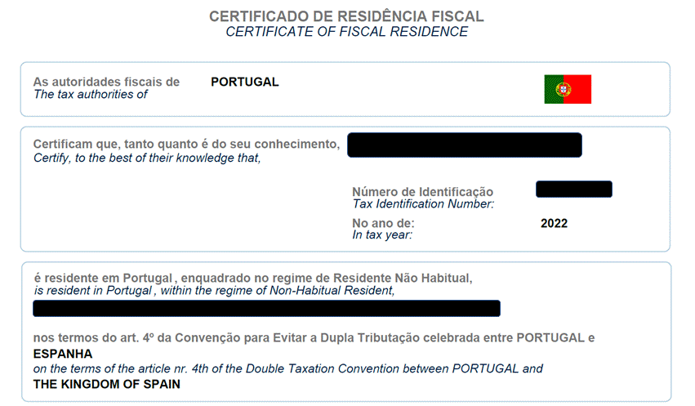
Mobility of HNWI
The Portuguese Perspective – Non-habitual resident
What about the domestic residence test?
Day count (183 days)
Dwelling available with intention to use as habitual residence

Slide 14
Lump-sum taxation and residence
Mobility of HNWI
Lump-sum taxation (forfait regime)
Does not impact Swiss tax residence: treaty application
Eligible for treaty relief (requires declaration in Swiss tax return [comparative tax calculation])
Modified lump-sum taxation
Exceptions: Austria, Belgium, Canada, Germany, Italy, Norway, United States
Modified lump-sum taxation as a prerequisite for the application of treaty relief
All sources of income from respective state are included in Swiss tax return (not only those for which treaty relief is requested)
Individual tax resident for the purposes of treaty application.
No Swiss income / wealth tax on foreign income / assets (for so long as no double tax treaty is applied).

Slide 15
Lump-sum taxation and treaty relief
Mobility of HNWI
Impact on double tax treaties’ access:
Article 27 para. 1 Swiss-UK double tax treaty (outbound)
Article 4 para. 5 Swiss-US double tax treaty (inbound)
Dual residencies
Principle goal is to avoid double taxation
Dual residencies may be acceptable for tax planning purposes
“Voluntary” double taxation to enjoy treaty benefits?

Slide 16
Lump-sum taxation and information exchange
Mobility of HNWI
Information exchange
Tax residency of individuals subject to the forfeit regime often challenged by foreign tax authorities
Taxation based on forfait regime as foreseeably relevant information
Lump-sum taxation does not preclude tax residency
No employed activity in Switzerland
Not foreseeably relevant information
Tax basis (i.e. deemed taxable income amount based on which Swiss income tax is levied)
Notes:
In der Antwort auf die wesentliche Frage des ersuchenden Staates betreffend der Bemessungsgrundlage der Beschwerdegegner in der Schweiz hat die Steuerbehörde informiert, dass sie nach Aufwand besteuert wurden.
Durch diese Information hat die Steuerverwaltung bekanntgegeben, dass die Beschwerdegegner nicht auf ihren Einkünften besteuert wurden.
Diese Angabe ist für den ersuchenden Staat erheblich, da sie wissen möchte, ob
die Beschwerdegegner ihren steuerlichen Wohnsitz in der Schweiz hatten;
die Beschwerdegegner in der Schweiz einer Erwerbstätigkeit nachgeganqen sind.
Demgegenüber ist es nicht ersichtlich,
Gemäss bisheriger bundesgerichtlicher Rechtsprechung ist es zulässig, ein Amtshilfegesuch zur Klärung des steuerlichen Wohnsitzes einer Person zu stellen. Die Tatsache, dass diese Person in der Schweiz unbeschränkt steuerpflichtig ist, verhindert eine solche Anfrage nicht per se (2C_625/2018 E. 2.2.2). Wenn ein Amtshilfegesuch einen Steuerpflichtigen betrifft, den beide Vertragsstaaten als einen Steueransässigen betrachten, beschränkt sich die Rolle der Schweiz als ersuchter Staat im Stadium der Amtshilfe darauf, zu überprüfen, ob das Kriterium der Steuerpflicht, auf das der ersuchende Staat greift, sich unter denjenigen befindet, die in der die Bestimmung des Steuerwohnsitzes betreffenden Abkommensnorm festgelegt sind. Der Schweiz obliegt es nicht, im Rahmen des Amtshilfeverfahrens selbst über das Bestehen eines tatsächlichen Wohnsitzkonflikts zu entscheiden
Matteotti_Weingeier_Analyse-der-bundesgerichtlichen-Rechtsprechung-zur-internationalen-Amtshilfe-in-Steuerangelegenheiten-aus-dem-ersten-Halbjahr-2019_ASA-88_527-540.pdf (taxpartner.ch)
inwiefern der durch die schweizerische Veranlagungsbehörde festgelegte Betrag für die ersuchende Behörde erheblich sein sollte.
Diese Information sagt über die realisierten Einkünfte der Beschwerdegegner nichts aus.

Slide 17
Case Study 2 – The Source Perspective
Mobility of HNWI
Source
Intermediate
Residence
HNWI
Company
What about source perspective on migration?
Will the HNWI secure tax treaty benefits?
Will the NHWI suffer exit tax?
Rental
Income
Portfolio
Dividends
Interest
Gains qualified
participation

Slide 18
Mobility of HNWI
The Irish Perspective
Irish tax landscape for HNWIs
Do Irish HNWI stay or leave Ireland? Any exit tax?
Ireland as a ‘go to’ location for foreign HNWIs?
Non-Dom regime (remittance basis of taxation)
Special Assignee Relief Programme (SARP)
HNWI structuring investments in Ireland
Key market for export financials products
Two main product offerings:
Investment Funds (retail & alternative investment classes)
Insurance Products (eg, investments via life insurance wrapper)

Slide 19
Mobility of HNWI
Structuring investments in Ireland
Taxation of Export Financial Products in Ireland
Investment funds (eg, retail or alternative - UCITS, ETFs, QIFs)
Taxation at fund level in Ireland
Irish tax treatment of distributions to foreign HNWI
Foreign tax treatment of return to HNWI in jurisdiction of residence
Insurance products
Taxation at policy level in Ireland
Irish tax treatment of distributions / returns to foreign HNWI
Foreign tax treatment of return to HNWI in jurisdiction of residence
Special rules – where underlying investments are in Irish land / real estate

Slide 20
Mobility of HNWI
Case Study
Irish
Investment
Fund
Investment (eg, MNE shares)
Investment
(eg, currency)
Investment (eg, non-Irish property)
Investment (eg, loans)

Slide 21
Mobility of HNWI
THE MEXICO PERSPECTIVE – HNWIs Mobility Overview
Mexico - Residence Test (facts-and-circumstances test)
Available permanent home (Domestic Rule)
Centre of Vital Interest (Domestic Rule)
Professional Activity or more than 50% of income from Mexico (Domestic Rule)
Habitual Abode (DTA)
MAP (DTA)
Change of Tax Residency
Change of tax residency notice
Tax Residency Certificate
Mexican Tax Resident appointment as Legal Representative (5 years)
Joint and several liability
Tax preferential regime (less than 75% of the income tax to be paid in Mexico)
Continue as Mexican Tax Residency for 5 years
Exception: Jurisdictions with (i) Tax information exchange agreements and (ii) Convention on Mutual Administrative Assistance in Tax Matters
Doble Tax Residency & Doble taxation / Treaty Override with jurisdictions with a DTA?
Mexico nationals presumed Mexico tax residents

Slide 22
Mobility of HNWI
Mexico’s HNWIs Structuring investments abroad and Migration tax issues
Outbound typically structures
Migration Tax Issues
No exit tax in Mexico for HNWI
Doble Tax Residency & Doble taxation issues
For the fiscal year of the migration
For the next five years (tax preferential regimes)
Treaty override?
Source of taxable income in Mexico and DTA Benefits
i.e., 25% Estate tax on Mexico direct shares or indirect real-estate shares, and real estate (*no DTA benefits)
Residence jurisdiction issues
Estate and Wealth taxes (i.e., USA, Spain, France, etc.)
Spain - Beckham Law for Expats / Adequations to Trust structures
Tax regimes for individuals, tax rates, CFC Rules, etc.
International corporate reorganizations and capital gains
etc.
US Trust
Mexico
Corp
GP
Spain Corp
Can LP
Financial Assets
(Qualified Equity)
Real Estate
US-Montana LLC
Corp
US-Delaware LLC
Corp
Real Estate
PE & VC (equity)
Financial Assets (Debt and non-qualified equity)

Slide 23
The new German exit taxation | Overview
Mobility of HNWI
Para. 1 | Basic facts and legal consequence No. 1: Termination of unlimited tax liability by giving up the domicile or habitual abode No. 2: gratuitous transfer to a person not subject to unlimited tax liability No. 3: Exclusion or restriction of Germany's right of taxation = Equivalent to sale at fair market value
Para. 2 | Personal scope of application Individuals who were subject to unlimited tax liability for at least seven of the last twelve years; attribution of the period of unlimited tax liability of the legal predecessors in the case of gratuitous transfer
Para. 3 | Temporary absence (intention to return) Obtain for non-application in the event of intention to return within seven years; renewable for a further five years provided the intention to return remains unchanged
Para. 4 | General application-linked instalment payment concept Non-interest-bearing distribution of payment of tax over seven years; balance due immediately if harmful event occurs (sale or similar events).
Para. 5 | Obligation to cooperate in the case of deferral
Move abroad
Share in a corporation
of at least 1% (!)
Corporation
Notes:
Keine Notwendigkeit, da ATAD für KöSt Subjekte und § 6 AStG bereits bestand.
Veräußerungsfiktion evtl. problematisch für ErbSt (§ 13a Abs. 6 Nr. 4 ErbStG) innerhalb von 5 oder 7 Jahren bzw. der UmwSt (§ 22 UmwStG -> 7 Jahre) Fristen
Abs. 2: eine deutliche Verbesserung, man muss nicht mehr „bis zur Geburt“ zurückgehen dafür bereits 7 statt 10 Jahre ausreichend.
Abs. 3: Finanzverwaltung wird weiterhin den Begriff der vorübergehenden Abwesenheit subjekt auslegen (d.h. Rückkehrabsicht muss bei Wegzug vorhanden sein), so auch FG Münster vom 31.10.2019 – Revision beim BFH anhängig Az: ). Aa: Objektive reicht aus = Rückkehr innerhalb der Frist. Nun auch Beschenkte begünstigt.
Weiterhin unerheblich ob Zuzugstaat niedrig besteuert.

Slide 24
Optimization strategies| Management Holding
Mobility of HNWI
Requirements:
Consequences:
Establishment of a management holding company
Contribution of shares to a limited partnership (KG), which exercises management holding functions vis-à-vis subsidiary companies, e.g:
Influence on business and personnel policy (guidelines, written instructions, contractual obligations).
Coordination and control of work processes
Financing
Appropriate material and personnel resources (substance!)
"active" investment management within the meaning of German income tax law requires at least two subsidiaries for which management functions are provided.
No exit tax
No other taxation (realization of built-in-gains) as the German taxation right remains
Functional attribution to the German permanent establishment

Slide 25
Alternative strategy | Foundation
Mobility of HNWI
Requirements:
Consequences:
Natural person transfers shares to foundation (best case: tax-privileged)
If applicable, the foundation sells shares tax-exempt after the end of the lock-up periods for inheritance tax
Natural person moves abroad.
Foundation distributes without capital gains tax pursuant to Art. 21 DTT to the former shareholder resident abroad (disputed, Art. 10 DTT may be applicable, e.g. Austria).
But gift tax in tax class III (30 or 50%) in case of partial liquidation!
No exit tax because the beneficiary of the foundation does not hold any shares and the foundation does not move away
Foundation is subject to foundation supervision, dissolution not possible without further ado
Take into account the qualification of the domestic foundation according to the respective law (transparent foundation?)

Slide 26
Preliminary conclusions
Mobility of HNWI
1. Increasing relevance of jurisdictions with preferential tax regimes / taxpayer friendly approach for migrating HNWI
2. No denial of treaty benefits for individuals subject to preferential tax regimes
3. Pressure towards creation of international level playing field for taxation of HNWI
Mobility of HNWI entails
(a) to bear different interpretations in source and residence country in mind, and (b) not only to look at preferential tax regimes for HNWI but also at options for alternative wealth holding structures

Slide 27
Mobility of HNWI: Appendix (Spain, Portugal, Switzerland)

Slide 28
Spain – special tax regime
In order to qualify for the special regime, the following conditions must be met:
Tax payers must notify the Spanish tax authorities that they opt for the regime within 6 months (Social Security dates are considered for this purpose). Proper link between migration and beginning of the labor/directorship relationship.
It applies to the year of migration + 5 years.
0% taxation of foreign source income (except employment income at 24% up to euros 600,000; 47% on the exceeding employment income). Wealth tax only levied on net Spanish situs assets.
No disclosure obligations of assets held abroad (form 720). The tax years of application of the regime are ignored for exit tax obligations.
It does NOT cover spouses. It does not cover IGT.
Also special tax treatment to:
The individual Should become a Spanish tax resident as a consequence of the migration.
The individual cannot have been a tax resident in Spain during the ten years prior to moving to Spain.
The transfer of residence must be due to an employment contract or to the appointment as director of a company that the taxpayer is not related to (i.e. stake below 25%).
The taxpayer cannot obtain income through a permanent establishment in Spain.
Stock Options granted abroad
Foreign pension plans

Slide 29
Portuguese NHR regime
Non habitual tax residence regime
According to the NHR regime rules, an individual may qualify as NHR if he/she:
Qualifies as Portuguese tax resident in a certain tax year under the domestic residency criteria; and
Has not been considered as Portuguese tax resident in any of the previous 5 years.
The individual meeting the two conditions above may benefit from the special regime for NHR for a 10-year period (consecutive).
The status of NHR becomes effective upon registration with the Portuguese Tax Authorities. The application for registration should be made by no later than 31 March of the year following the one the individual becomes tax resident in Portugal.
A NHR is resident in Portugal for domestic and tax treaty purposes and therefore in all tax issues not covered by NHR regime (next slide), the general rules will apply.
As a rule, income is subject to Portuguese personal income tax on a cash-receipt basis. A few exceptions apply, in particular if the Controlled Foreign Company (CFC) legislation may apply.
Another general feature is that Portugal offers the possibility to pass wealth or estate without inheritance or gift taxes in most cases.
Income from cryptoassets, art or collector items not subject to tax unless obtained within a business activity.
No tax reporting obligations on financial assets (except reporting of foreign bank accounts)
There is also no wealth tax or general exit tax in Portugal

Slide 30
Portuguese NHR regime
Non habitual tax residence regime
NHR Tax regime
The NHR regime establishes:
A special tax rate of 20% applicable to employment and self-employment income from a Portuguese source derived from “high value-added activities”, as per a list published by the PTA; and
A tax exemption (with progression) for foreign-sourced income (employment income, self-employment income, rental income, capital gains, interest, dividends, etc.), provided certain conditions are met, as detailed below.
Foreign sourced employment income (Category A) is exempt provided that one of the following conditions is met:
The income is taxed at source under the provisions of tax treaty: or;
The income is effectively taxed at source State and is not deemed as having its source in Portugal under domestic law in cases where there is no tax treaty in force.
Foreign sourced investment income (Category E), rental income (Category F) and capital gains (Category G) is exempt provided that one of the following conditions is met:
The income may be taxed at source State under the provisions of a tax treaty; or
The income may be taxed in another no-treaty state, territory or region according to the provisions of the OECD Model Convention, as interpreted in accordance with the observations and reservations made by Portugal and is not derived from a blacklisted jurisdiction, paid by a Portuguese resident entity or attributable to a Portuguese permanent establishment.
Practical Note: In almost all tax treaties, capital gains from the sale of shares are only taxable in resident state (Portugal). This means that in practice, most capital gains of financial portfolios falls outside the exemption and is taxed at 28%.
For Foreign Pension income, since 1 April 2020, a 10% flat tax applies foreign pension income (Category H) and for elimination of the option for exemption.
The definition of pension includes expressly not only pension in annuities but also other similar payments – e.g. lump sum – to the extent they are not sourced or territorially linked to Portugal.
The 10% flat tax rate for foreign pensions will be applicable to new Portuguese tax residents – i.e. becoming tax residents after 1 April 2020.
The 2020 amendment includes a grandfathering rule for prior tax residents – residents before 1 April 2020 may benefit from the exemption method unless they choose to apply the 10% rate.
The NHR exemption method in respect of foreign sourced income is an exemption with progression. Accordingly, if the taxpayer derives any other income taxable in Portugal (not subject to flat rates), some of the income exempt under the NHR rules will be considered to determine the progressive rates applicable to the remaining taxable income.
Whenever the exemption method does not apply (or NHR opts to apply the credit method), a tax credit for the elimination of international double taxation is granted for foreign withholding taxes up to the amount of tax that would be due in Portugal.

Slide 31
Lump-sum taxation in Switzerland
Mobility of HNWI
Conditions for lump-sum taxation:
Non-Swiss citizen
Dual nationality: no lump sum taxation if one of the nationalities is Swiss
Residence or domicile in Switzerland for the first time or after an absence of at least 10 years
Tax residence (residence / domicile) in Switzerland
Person resides in Switzerland with intention of remaining on a long term basis
No gainful activity in Switzerland
All activity derived from any kind of profession in Switzerland (dependent / independent)
Gainful activity outside Switzerland permitted
Compliance with conditions for lump sum taxation by every family member individually
Procedure
Negotiations with the cantonal tax authorities regarding relevant tax basis and confirmation by issuing a tax ruling
Filing of annual tax return for lump sum taxation, incl. asset statement
For every taxable year, the tax resulting from the calculation agreed on in the tax ruling must be higher than the taxes determined by a control calculation

Slide 32
Calculation of lump-sum tax basis
Mobility of HNWI
Calculation of taxable income
The highest of the following:
Effective standard of living
Minimum tax basis
Lump sum standard of living
Deductions
property maintenance costs, normal administration costs (movable assets)
No foreign tax credits
Application of ordinary tax rates
Comparative tax calculation
Income from Swiss sources
Foreign sourced income with double taxation relief
Tax credits are granted with respect to income from countries with treaty relief
Caveat: modified lump-sum taxation (e.g. Austria, Belgium, USA, Germany, Italy, Norway, Canada)

