Slide 2
The First Global Stocktake Under the Paris Agreement
16 May 2022
Kaveh Guilanpour

Slide 3
Overview
The Paris Agreement
The Global Stocktake
Non-Parties and The High Level Climate Champions
Emerging asks
Key takeaways

Slide 4
The Paris Agreement
It is a treaty!
It contains provisions that are binding in international law!
Article 4.2:
“ Each Party shall prepare, communicate and maintain successive nationally determined contributions that it intends to achieve. Parties shall pursue domestic mitigation measures, with the aim of achieving the objectives of such contributions”.
Article 4.9
“Each Party shall communicate a nationally determined contribution every five years in accordance with decision 1/CP.21 […] and be informed by the outcomes of the global stocktake referred to in Article 14”.

Slide 5
Paris Agreement ambition cycle
The five year cycle​ ambition cycle
Article 14 ​
“[…] periodically take stock of the implementation of this Agreement to assess the collective progress towards achieving the purpose of this Agreement and its long-term goals […] considering mitigation, adaptation and the means of implementation and support, and in the light of equity and the best available science”. (Art. 14.1), ​
“[…] first global stocktake in 2023 and every five years thereafter […]” (Art 14.2)
“The outcome of the global stocktake shall inform Parties in updating and enhancing, in a nationally determined manner, their actions and support […]” (Art. 14.3). ​
Decision 19/CMA.1​
“conducted in a transparent manner and with the participation of non-Party stakeholders…” (para. 10)
​“Submissions from non-Party stakeholders and UNFCCC observer organizations” as source of input (para. 37 i))

Slide 6
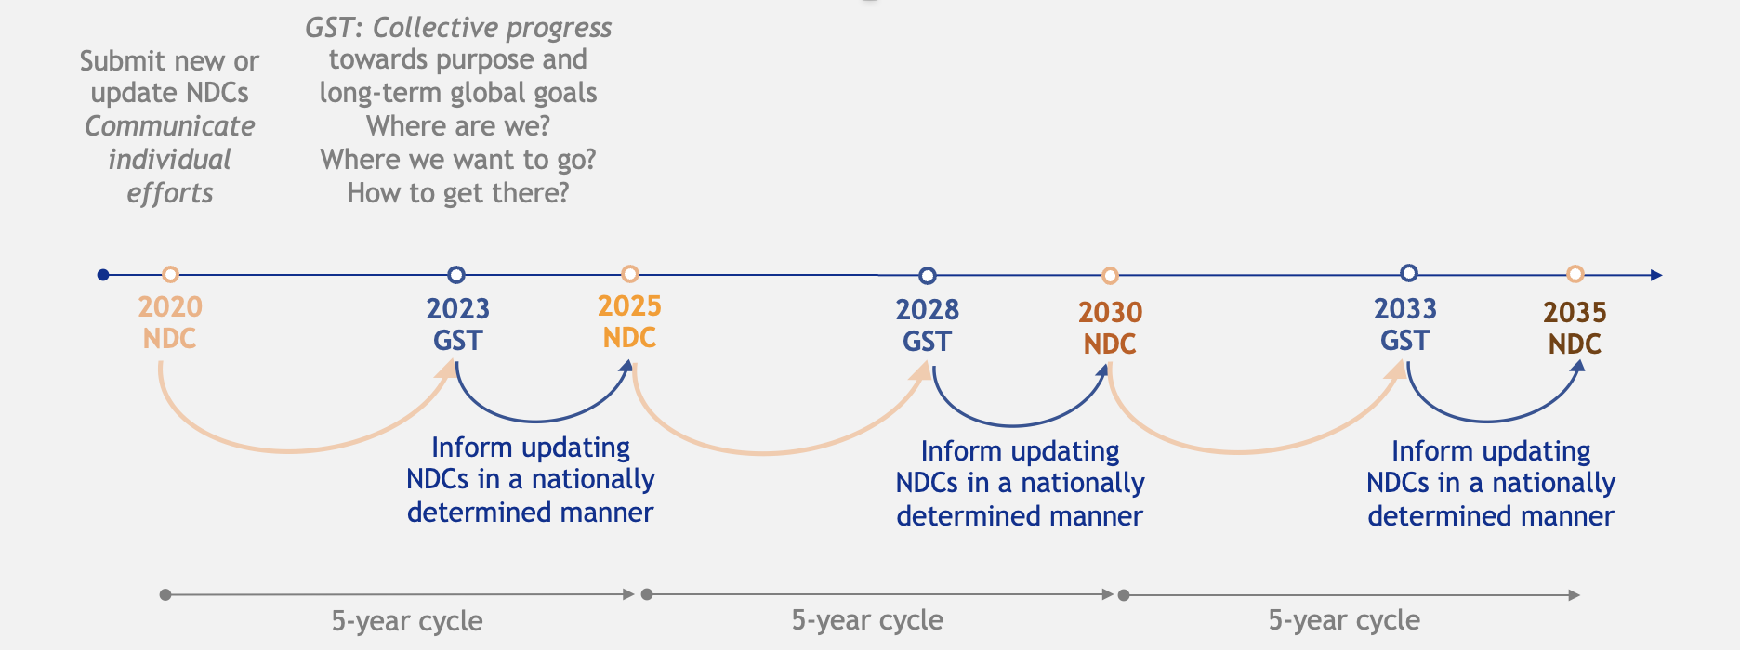
Global Stocktake process
(Source: UNFCCC Secretariat)

Slide 7
GST process
Source: UNFCCC Secretariat

Slide 8
Non-Parties
Glasgow - Decision 1/CMA.3​
Para 76. “Welcomes the start of the global stocktake, and expresses its determination for the process to be comprehensive, inclusive and consistent with Article 14 of the Paris Agreement and decision 19/CMA.1, in the light of paragraph 5 above” ​
Para 77. “Encourages the high-level champions to support the effective participation of non-Party stakeholders in the global stocktake​”

Slide 9
The work of C2ES
Major project on the Global Stocktake
Overall design
”environmental effectiveness”
Opportunities framework
Mitigation
Adaptation
Finance
Convenings
Heads of Delegation
Key stakeholders

Slide 10
Six emerging asks of the global stocktake
Focus on solutions to:
enhance ambition
implement existing promises
Foster an atmosphere of collaboration
Break down silos and offer systemic solutions - sectors
Include a regional approach
Effectively involve non-Party stakeholders
Generate clear signals – speak to domestic policy makers and non-Parties

Slide 11
Some takeaways
The heartbeat of the Paris Agreement is the five year ambition cycle
The culmination of the first global stocktake in 2023 will be a major political moment to drive ambition
To be effective, the global stocktake must:
be solutions orientated
generate clear signals
break down silos – sectoral approach
speak to domestic policy makers and non-Parties
Non-Parties have an opportunity to help make the global stocktake effective
Submissions
Technical Dialogues

Slide 12
guilanpour@c2ES.org

