Slide 2
Keeping the lights on – oil and gas development in a low-carbon world
Moderators
Claudia Santos Cruz, Morais Leitão, Lisbon; Diversity & Inclusion Officer, IBA Oil and Gas Committee
Maria Cristina Breida Environment, Climate Change & Sustainability Leader, EY SLT, Milan; Programme Officer, IBA Environment, Health and Safety Law Committee
Speakers
Leonardo Sempertegui General Counsel, Organization of the Petroleum Exporting Countries (OPEC), Vienna; Oil and Energy Regulation Officer, IBA Oil and Gas Committee
Jaine Miller General Counsel, Cheiron Petroleum Corporation, Egypt
Andrea Forabosco Energy Transition Counsel, Shell International, The Hague; Energy Transition Officer, IBA Oil and Gas Committee
Emanuela Gallo Legal Affairs, Head of HSE, Sustainability and Climate Change legal assistance, Eni, Milan

Slide 3
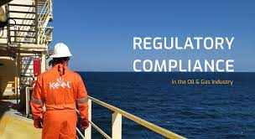
Regulating Oil and Gas in Energy Transition
Leonardo Sempertegui
GENERAL LEGAL COUNSEL
OPEC

Slide 4
Objectives of a “right-paced” energy transition
Global cooperation
Environment
Development Goals
Energy
Economic Adaption
Financial support is needed for compensating losses of incomes
Energy Access and Security:
Poverty can only be eliminated with an affordable energy supply
Reduction of GHG Emissions
Only then can the Paris agreement goals be reached
Development objectives
All human beings have right to achieve a goo standards of living

Slide 5
What to consider in the regulatory space
Legal sources
Emerging in multiple jurisdictions
Softlaw
Initiated by non-state entities
Net-Zero pledges
Expression of political will
Oil and gas are here to stay because it is needed to sustain development

Slide 6
Some legislative developments
Asia
China's Emissions Trading System (2021)
Constitutes the single largest global climate policy
EU
Fit for 55 (2021)
Set of proposals to revise and update EU legislation
Americas
The Securities and Exchange Commission rules for climate disclosure (2022)
Registrants are required to include climate-related disclosures and periodic reports

Slide 7
What could future regulation take into consideration
Employment
Legislation to consider jobs losses
Public Resources
Efficient use of funds generated by taxes
Technology Neutral Legislation
All emission reducing technologies to receive similar treatment
Energy Efficiency
Energy efficiency to be privileged
Total carbon Impact
The full supply chain to be taken into consideration

Slide 8
Conclusions
Net-Zero 2.0 Pledges
Development
Give neede attention to the SDGs
Climate
Climate actions are essential
Inclusion
The energy transition is an exercise of collaboration

Slide 9
The SEERIL Regulation of the ET project
2021:
Project Launch and Definition of Scope
2022:
Reviewing legislation, finding trends and creating a report
All of you are invited to join this effort

Slide 11
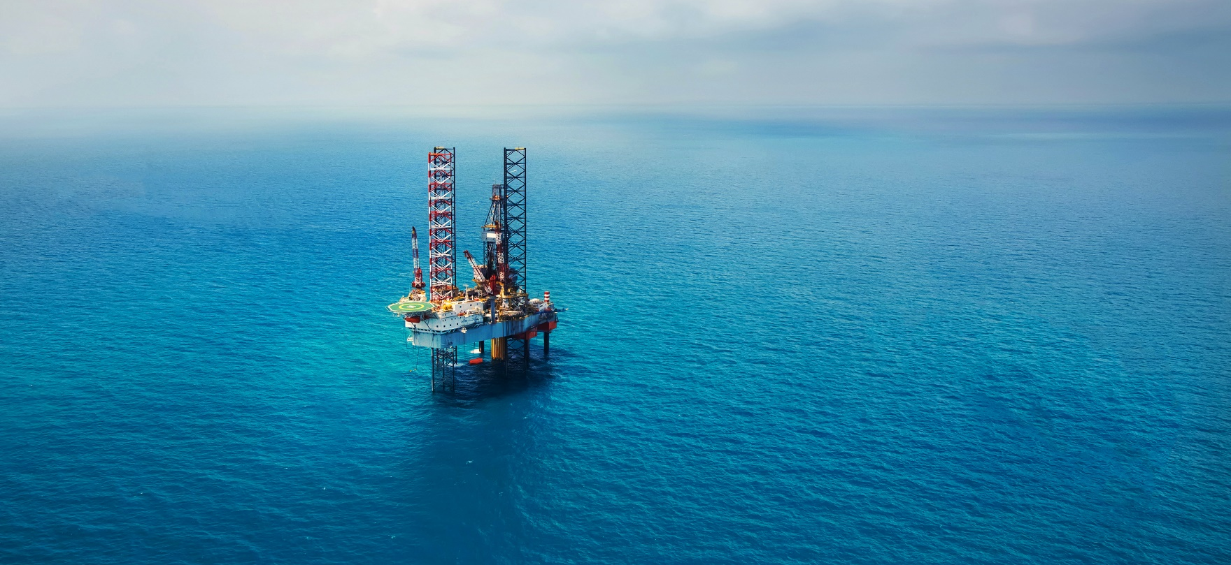
A View from Upstream Oil and Gas
The Role of Oil and Gas in Energy Transition
Milan, 16th May 2022
Jaine Miller, General Counsel, Cheiron Energy Group

Slide 12
Looking Back – The Look Forward to Transition
2019/20 – feeling like the unwanted guest:
COP 25
Difficulty in attracting younger generations to the work force, no longer abundant sources of finance, M&A and asset deals, finding previously attractive assets becoming uneconomic
Renewables projects, carbon capture & underground storage, green energy were in the spotlight
Lenders (multilaterals, commercial, Export Credit Agencies) abandon oil & gas
Governments slow licensing/extensions as major oil and gas companies kick off green projects
2021 – oil & gas price lower than $30/bbl Brent and then hurtling up to $100/bbl on post COVID recovery, demand for gas through the roof, and a supply crunch on European markets to a 20 year high at the end of 2021. Power prices soared affecting households and business.

Slide 13
Looking Back – The Look Forward to Transition
Forbes in October 2021 “Energy Crisis 2021: How Bad Is It, And How Long Will It Last?” contended:
The ESG and carbon divestment craze has so demonized fossil fuels (and nuclear power) that institutional investors and governments have cut them out of portfolios entirely, and have instead been flowing capital to more socially acceptable low-carbon alternatives. Blackrock announced last year it would no longer finance fossil fuel development (though it still owns a lot). Wall Street gurus like Jim Cramer have called the oil industry “uninvestable” and “a perma-short”.
2022 – Russia invades Ukraine prompting sanctions and withdrawals, supply constraints, COP 26 focus on need for energy transition, OPEC hesitancy, awakens interest in oil and gas, governments start to incentivise oil and gas investments, lenders coming back to the market
The oil price looked like this…

Slide 14
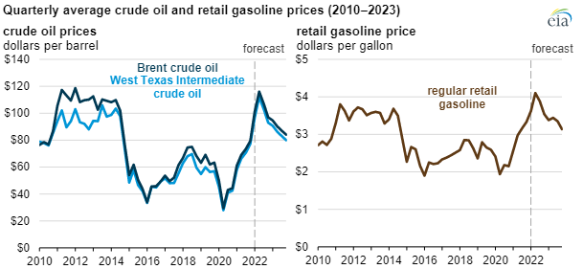
Looking Back – The Look Forward to Transition
The oil price looked like this…

Slide 15
The need for Sustainable Energy MIX
Security of Supply
Manage high costs of transition
CLIMATE GOALS
Sustainable Energy Source
MIX
Affordability - cost of supply
Reduce reliance on imports – build domestic supply

Slide 16
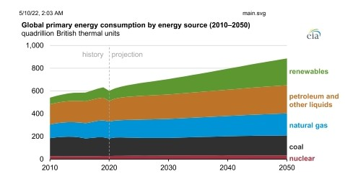
Renewed Government Interest in Oil & Gas
Not inconsistent with Governments’ Net Zero goals, eg:
In USA Government focus on incentivising new projects
In UK new licensing round and Secretary for Business confirms Gov backing to reduce reliance on Russian gas, improve access to affordable sources
In Egypt Government confirms export LNG focused on supporting European gas supply
Governments around the world have insatiable demand for crude oil for domestic industrial use

Slide 17
Renewed Government Interest in Oil & Gas
Oil/Gas as Bridge to Energy Transition
Governments are starting to acknowledge the role of oil & gas in order to get to Net Zero.
Significant investment is needed until renewables has increased capacity and more projects come on stream
Several renewable technologies rely on some sources of non renewable power
Focus must be had on affordable and reliable supply sources.
Oil and gas has a part to play in energy transition

Slide 18
Legal Challenges for Oil & Gas Towards Transition
Increased reporting/scrutiny on sustainability targets
Liability for shortfalls on those targets
Obtaining Gov consents on divestments/acqns
Permitting– emphasis on sustainability
Work activities & supply chain scrutinised for CSR, environmental, sustainability
Increased “soft greener policies” ie environmental, CSR, biodiversity, community and personnel)
New greening regs imposing expenditure commitments
Government/regulatory
Smaller/private companies although less visible from risk perspective may have difficulty in accessing opportunities as SPT work obligations/projects are likely to be affordable by larger companies rather than small niche players
Listed/ large companies will have higher risk – regulatory reporting, shareholder activism, m sensitive to reputational impactors & litigation

Slide 19
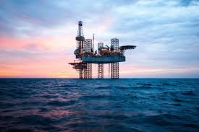
Legal Challenges: Financing & Lenders
Funding for oil and gas is in line with energy transition objectives – oil and gas are essential to support the transition to lower-carbon alternatives and to sustain production of materials derived from hydrocarbons.
But… underpinning the lending are enhanced sustainability performance targets (in addition to CSR, social performance & environmental). This infers:
Greater DD and ongoing scrutiny/disclosure
Higher cost borrowing (lenders have their own scrutiny/disc obs)
Review & auditing against common framework/benchmark
Events of default – litigation
The lending market has changed in recent years:
Public equity markets - DD & reporting stringency, disclosures, audits
Debt for equity: bonds, notes, credit lines, convertible loans – ESG stringency, conversion issues, value dilution risk
Sovereign wealth funds: Gov/regulatory obligations on ESG, local goods & services, performance obligations
RBLs and Offtake lending: as public equity & performance obligations
Sustainability Linked Loans: available only where project includes a sustainability element project eg CCUS

Slide 20
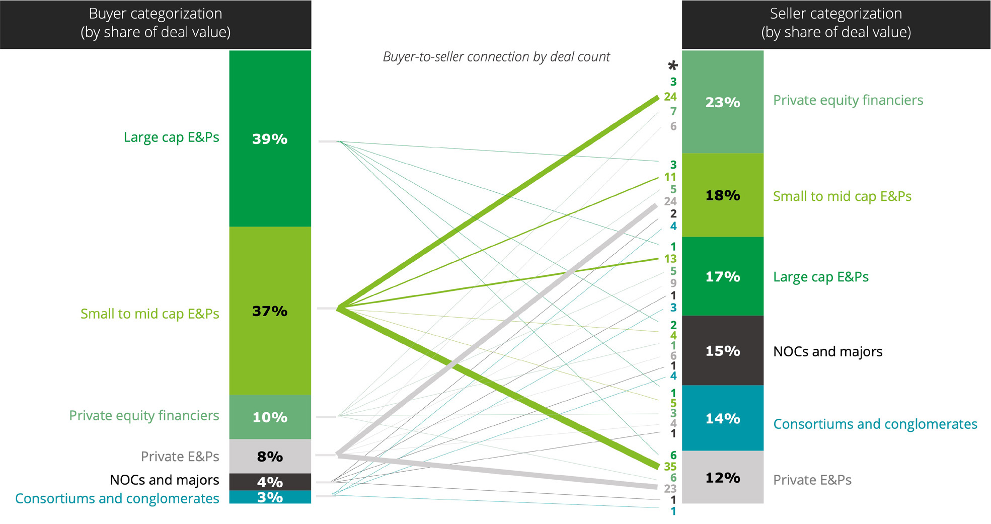
M&A Opportunities
Wealth of deals in high oil price market with big companies selling off assets in favour of green projects
Huge rebound after 2021 – lowest M&A level for 10 yrs
Pricing reflecting liability limitations of Sellers
Role of contingent upside payments
Larger companies are well positioned for jv’s and other combinations accessing renewables projects
Smaller companies are well positioned for sell-offs by majors
Source: Deloitte M&A Oil & Gas 2022

Slide 21
M&A Legal Risks
Bigger company sellers may impose post transaction ESG obligations on buyers to protect their reputation with host government
Sellers are less likely to want to give a full set of reps & warranties, especially HSE, ESG, SP and may exclude material adverse change, pre effective date liabilities, restrict claims & indemnities etc.
Post deal disputes may increase on eg pre completion/interim period activity, changes in condition and seller non-disclosure in light of limited reps & warranties etc.
Likely trend will be increased competition/antitrust review, reporting & break-ups as buyer start to consolidate targets under one roof
Account for higher liability through lower purchase price?
Increased DD on targets necessary, include Seller
support obligations post deal.

Slide 22
Other Legal Risks
New ESG regulations with benchmarking, reporting etc likely in the short term.
Larger, public companies face both regulatory risk as well as more public focus on their reputation
Smaller, private companies face increased costs and difficulties in adapting often streamlined workforce to cope with additional reporting, audit requirements
Shareholder activism increases risk of scrutiny/legal action for eg ESG issues.
Directors’ duties eg UK Companies Act, sec 172 obligation to act in good faith to promote company success [including] with regard to …. impact on community & environment…
Cost & unavailability of insurance likely to increase….
Account for higher liability through lower purchase price?

Slide 24
A fast-moving environment
The oil and gas sector and the ESG challenge - The role of ESG lawyers
Milan, 16th May 2022
Emanuela Gallo, Legal Affairs, Head of HSE, Sustainability and Climate Change legal assistance, Eni
Andrea Forabosco, Energy Transition Officer, IBA Oil and Gas Committee

Slide 25
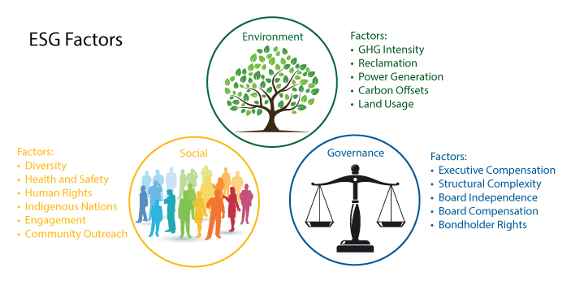
Energy transition & ESG challenges
Need for a holistyc approach
to social, environmental and corporate governance instances

Slide 26
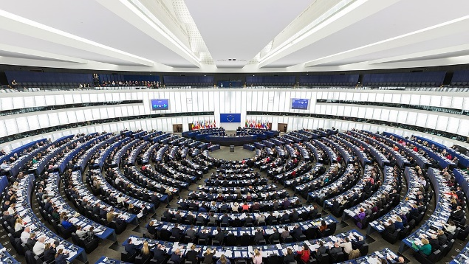
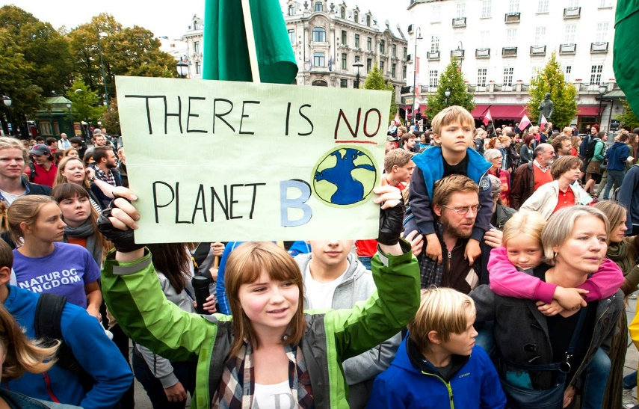
Energy transition & ESG challenges
Legislators and politics, at different speeds, on their path to regulate the ESG matters…
The Paris Agreement and subsequent COPs;
Regulation (EU) 2020/852 on Sustainable Finance Taxonomy;
Proposal for a Corporate Sustainability Reporting Directive;
Proposal for a Directive on Corporate Sustainability Due Diligence;
SEC Proposed Rule on climate related disclosure for investors
…but the society expectations move faster!
Increasing pressure on companies from investors and shareholders
Jurisprudence filling the gaps of regulation (e.g. Milieudefensie vs Shell case)

Slide 27
Energy transition & ESG challenges
The future responsibility of companies goes towards an increasingly important duty of prevention/mitigation
Beyond regulatory constraints, self-assessment and voluntary initiative remain crucial

Slide 28
Energy transition & ESG challenges
Samples of voluntary ESG initiatives
Adhesion to soft law standards through public commitments and internal corresponding policies/tools (e.g. Eni Declaration on Human Rights; Eni’s due diligence on human rights; Stakeholder Management System platform; Eni’s decarbonization plan and related GHG targets)
Developing tools to measure ESG performances (e.g.: Eni’s use of sophisticated technologies to detect and measure GHG emissions; proprietary «ELCE Model» to quantify local impacts of Eni’s activities on economy and labour market)
Sustainability reporting (e.g.: Eni for annual reports of Just Transition and Carbon Neutrality)

Slide 29
The oil & gas sector and climate change
Societal aspirations for decarbonization
Pressure to demonstrate resilience
Climate change resolutions & Climate litigation
Expectations for greater disclosures
…. Demand for action

Slide 30
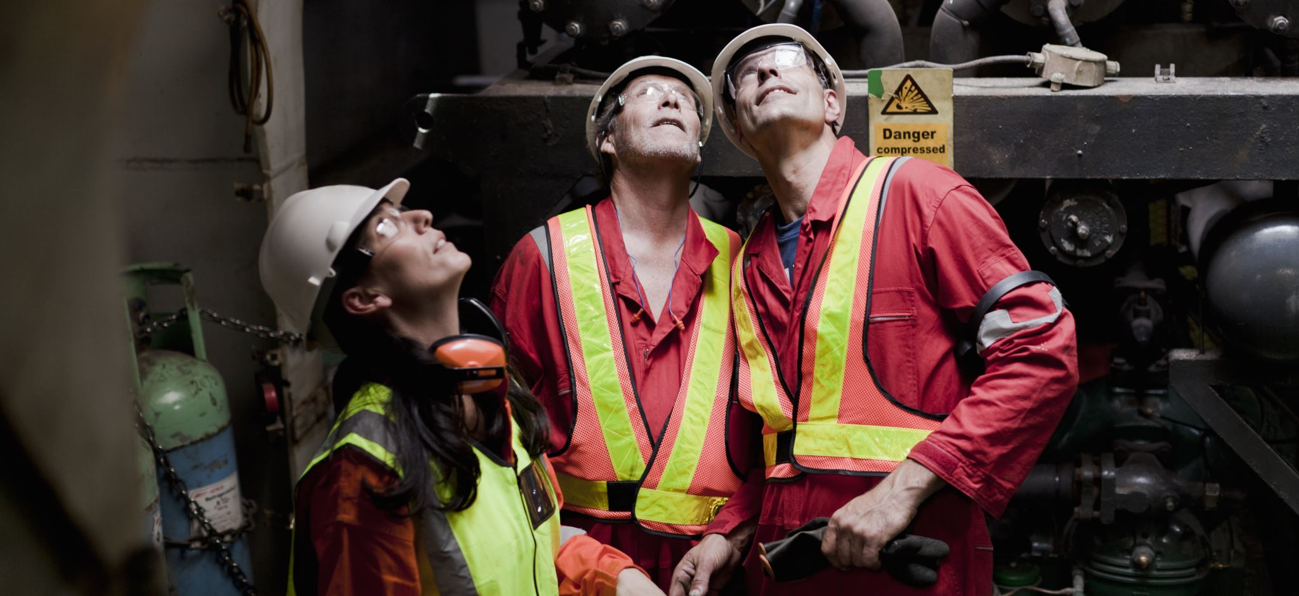
The oil & gas sector and climate change
How are oil & gas companies responding to this?

Slide 31
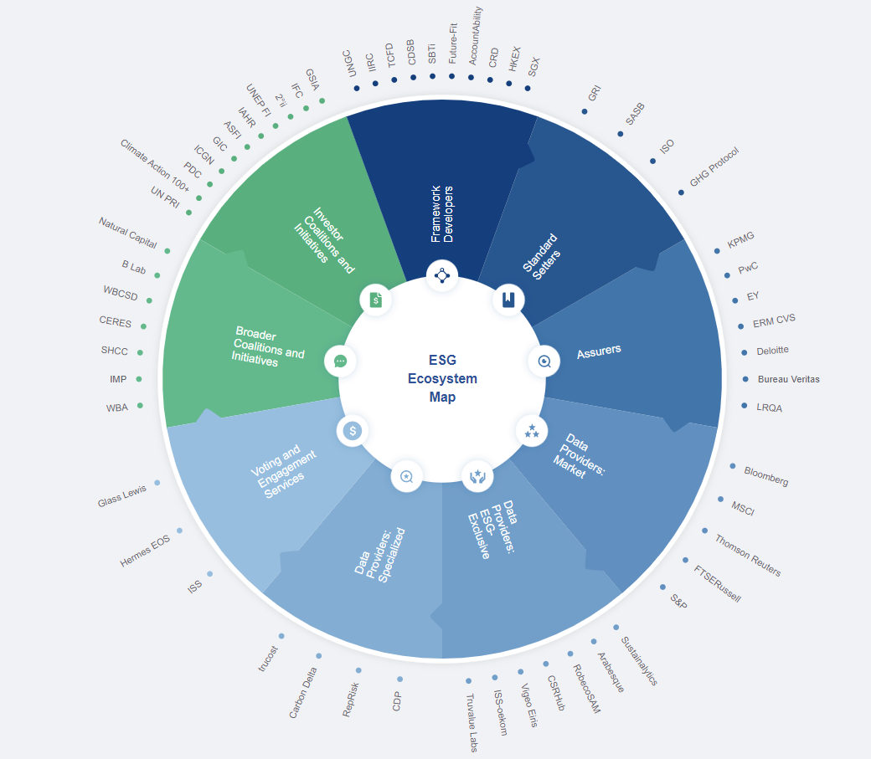
Proliferation of Reporting Schemes
Source: WEF

Slide 32
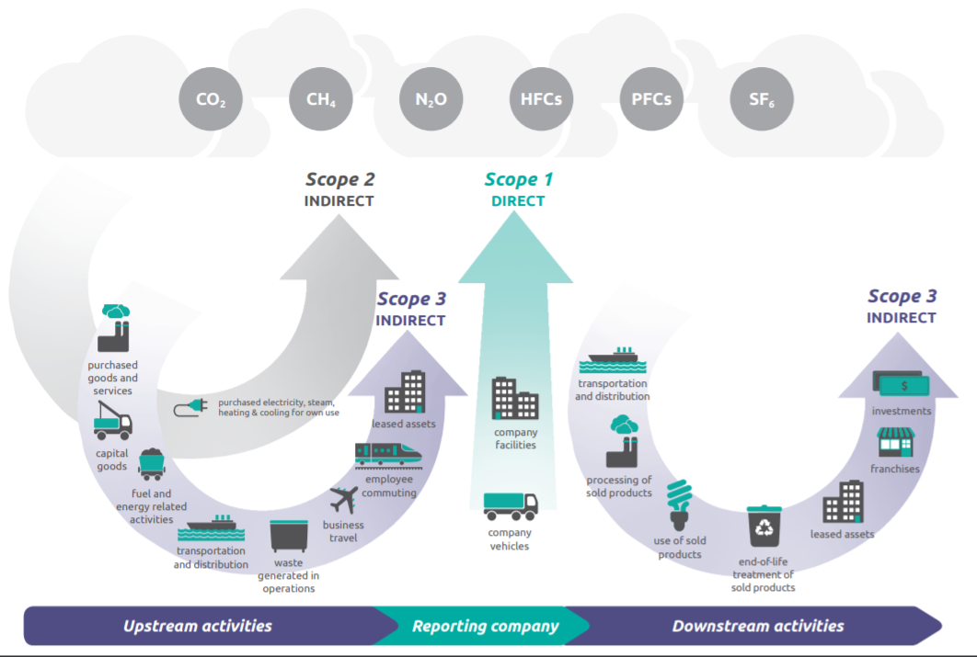
Carbon Accounting
Source: GHG Protocol

Slide 33
The role of ESG lawyers
Manage the Risks
Support the Transition

Slide 34
ESG in-house counsel: proactive risk identification
Global monitoring of ESG trends to support:
The continuous self-assessment and improvement of the company's policies and strategies;
Mitigation of litigation risk;
Mitigation of reputational risk

Slide 35
Climate change & human rights monitoring
Main monitored areas:
Global jurisprudence trends (civil & criminal law)
Petitions
Public investigations and hearings
Cease and desist letters, seeking for changes to the decarbonization strategy and threatening a claim in court
Claims to the National Point of Contact established pursuant to the OECD Guidelines for multinational enterprises
Developing regulation (hard & soft law)
Associations’ positioning on developing regulations
Legal risk
Reputational risk
A negative decision in an extra-judicial proceeding (e.g. the acknowledgement of a moral responsibility), although not legally binding and enforceable, may inter alia stimulate new claims globally
Parties’ behaviour in respect of a non contentious engagement is evaluated when a subsequent judicial claim is started
Litigations may lead to unbearable consequences for business continuity

Slide 36
Other forms of ESG-related legal support
Management of climate-related litigations and actions
Support to new businesses (e.g. REDD+ and circular economy projects), including contract negotiations, development of standard tools, monitoring of the relevant regulation (hard law & soft law)
Support in respect of non-financial reporting, drafting of public statements, internal policies
Support in dealing with investors on ESG-related matters.
Promotion of internal working groups for stimulating continuous debate and improvement on ESG-related matters
Organization of internal webinars and newsletters
Taking an active role in external working group, seminars, associations

Slide 37
Lawyers support the transition
The transition of the sector will need legislation and regulations
Interactions between companies and individuals rely on contracts
Lawyers are in key positions in companies, private practice and in governments
.. We play a key role

Slide 38
We support the Transition
The transition of the oil and gas sector and the mission of our Committee
Model clauses and contracts in the energy transition of the oil and gas sector
Our joint project on Energy Transition Model Clauses
.. Model contracts and clauses
… Streamlining processes
… Ensuring balance

Slide 39
We support the Transition
A Collaboration for Credibility
Working Across Generations
A Call for Participation

Slide 40
Q&A

