Slide 1
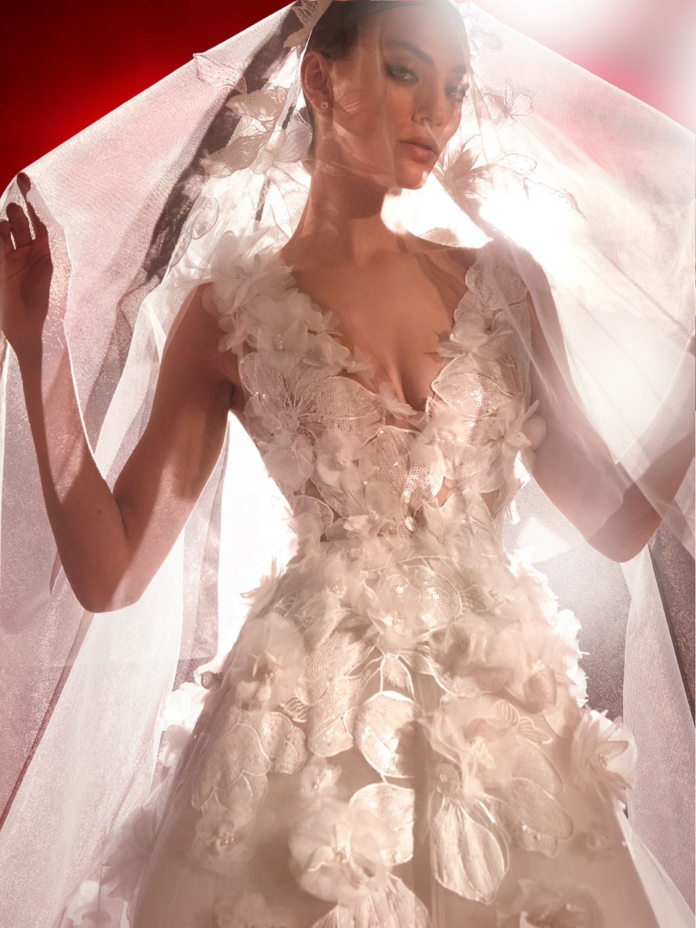

THE FIRST GLOBAL BRIDAL GROUP,
SHAPING THE FUTURE OF OUR INDUSTRY
FOR EVERY BRIDE.

Slide 2

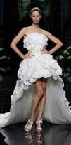
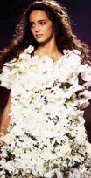
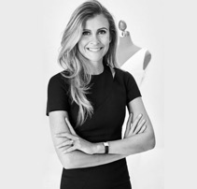

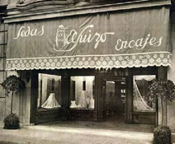
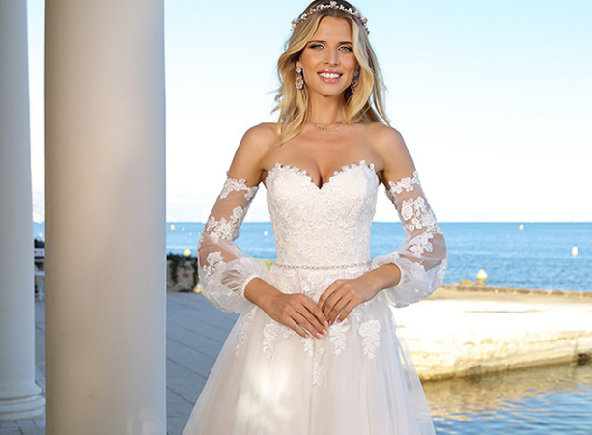
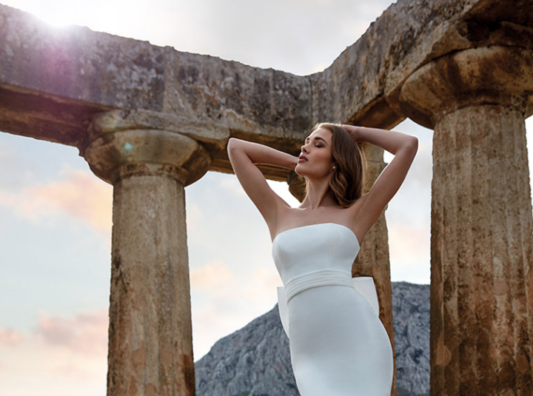

In 2017 private equity group BC Partners acquires Pronovias and marks a new era to accelerate the internationalization in the digital age and strengthen the brand portfolio.
2018 and 2019 are years of geographical retail expansion in the USA, China, Latin America and Europe, as well as portfolio growth with the acquisitions of Nicole Milano & Ladybird.
In 1964, Pronovias was born. Alberto Palatchi Ribera, pioneered the creation of the first prêt-à-porter bridal gowns, a revolution at the time, which made wedding dresses accessible to all women.
1922
1964
2017
2018
2019
It all started with a family business.
“El Suizo” was a prestigious Barcelona store founded by Alberto Palatchi Bienveniste in 1922, specializing in lace, embroidery and high-quality silk fabrics.

Slide 3

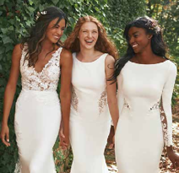
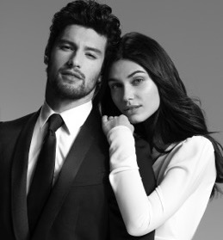

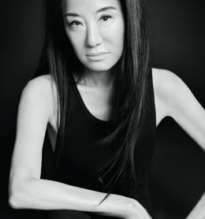

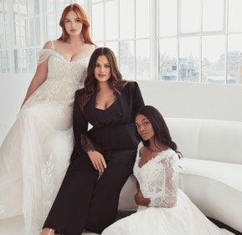
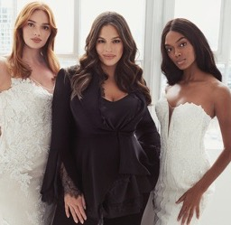

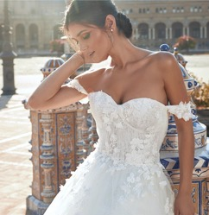
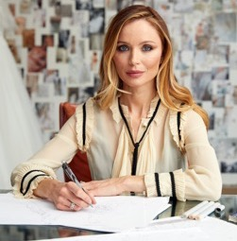

A new era in bridal fashion is born with Vera Wang Bride. The visionary fashion icon brings her unique, artisanal, and alluring creations to fashion-loving brides all over the world.
Pronovias Group leads the way towards a more sustainable bridal industry with the launch of #WeDoEco, and plastic-free offices and stores.
The group also signs an exclusive licencing agreement with Carlo Pignatelli to create the menswear brand “Pronovias by Carlo Pignatelli”.
2019
2020
2021
The company collaborates with renown Couture house Marchesa to drive Pronovias’ international appeal in bridal and occasion wear even further.
Pronovias Group establishes a unique collaboration with Influencer Ashley Graham to create a collection of glamorous dresses for all body shapes.

Slide 4


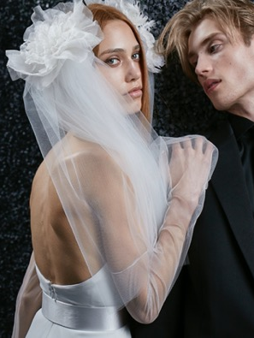
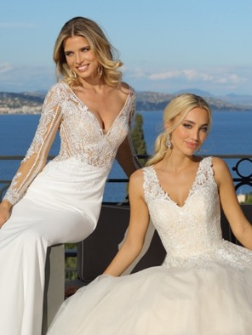



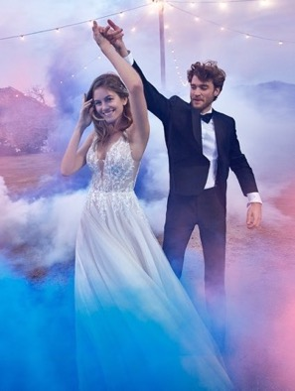
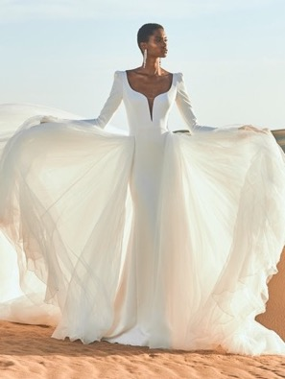
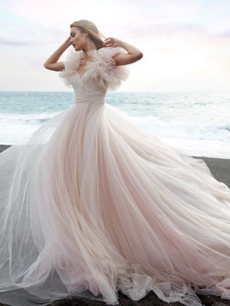
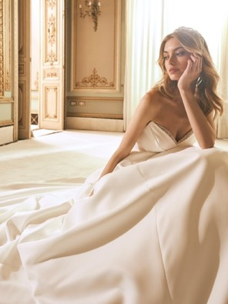

Slide 5
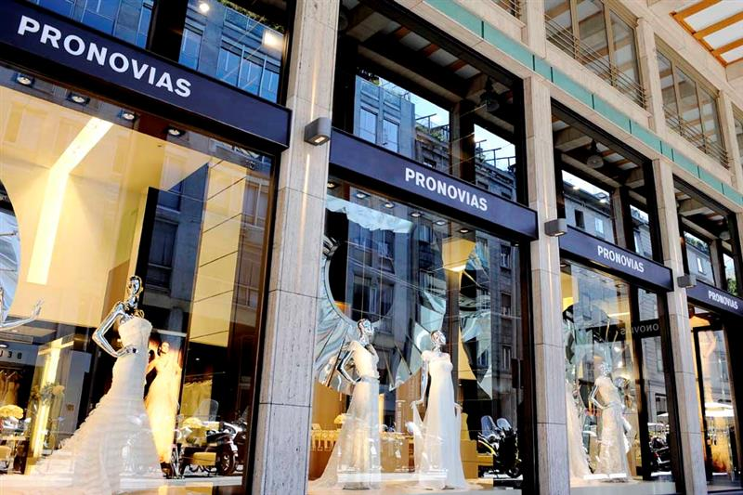
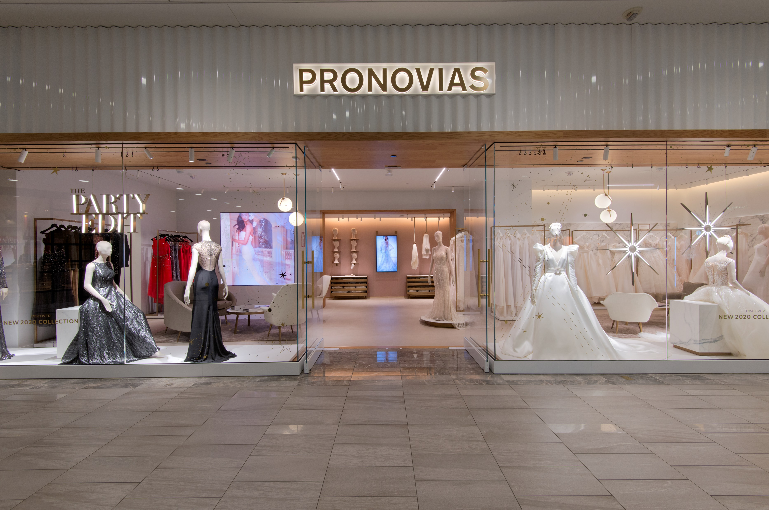
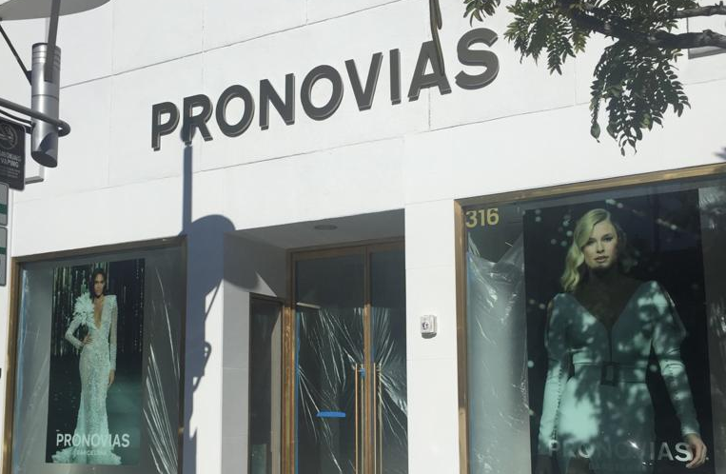
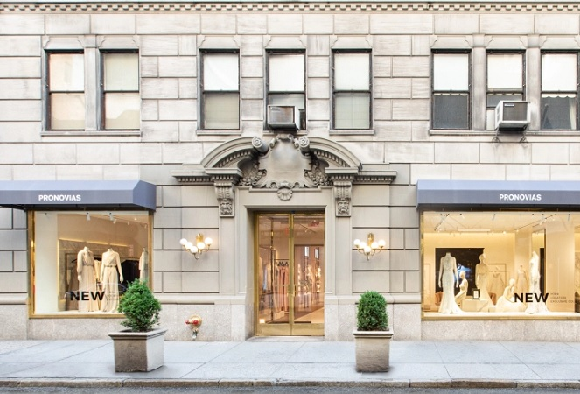
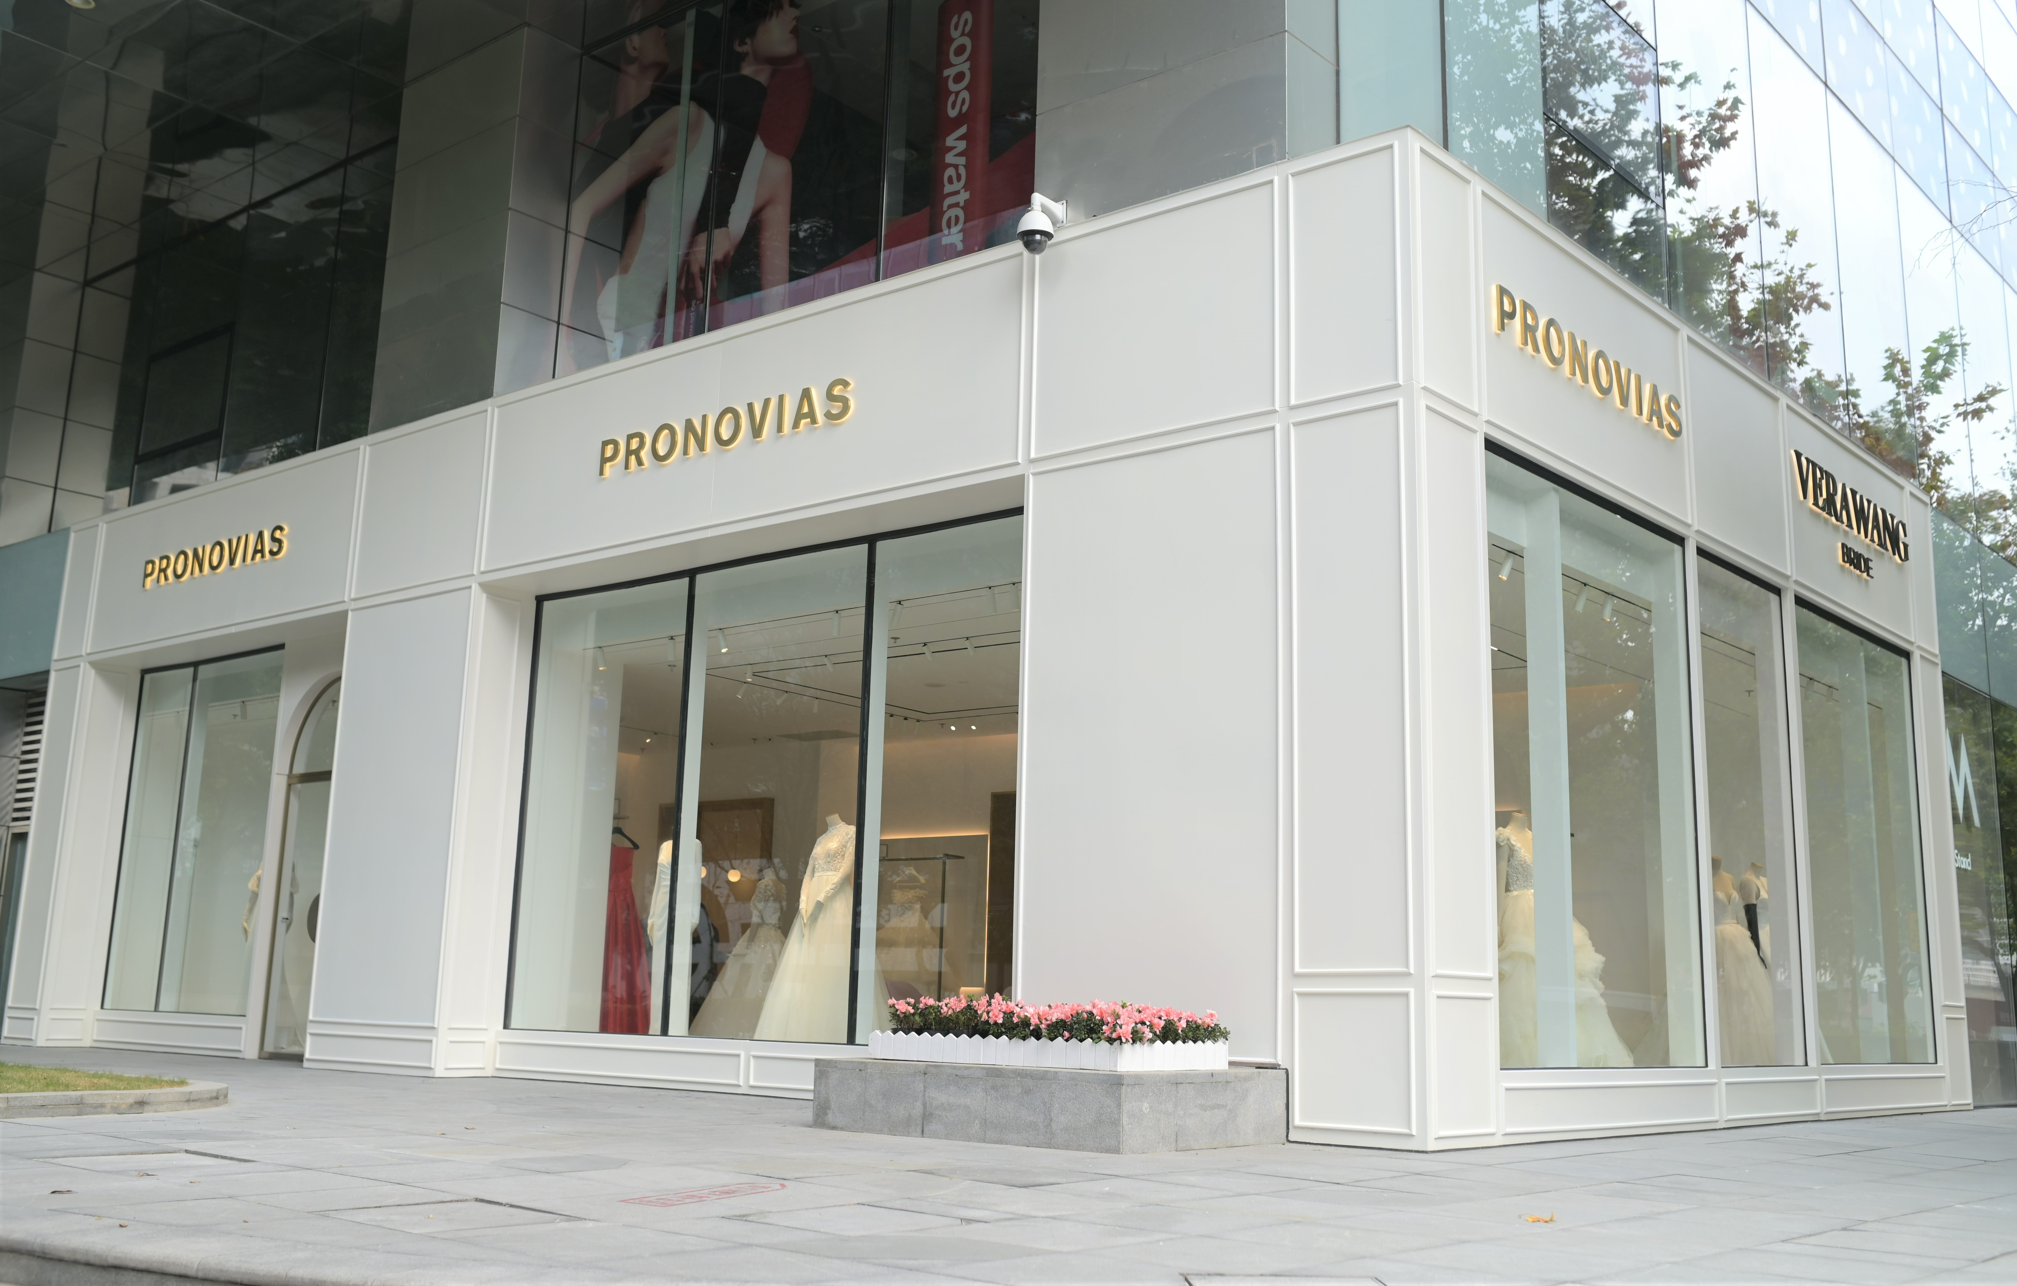
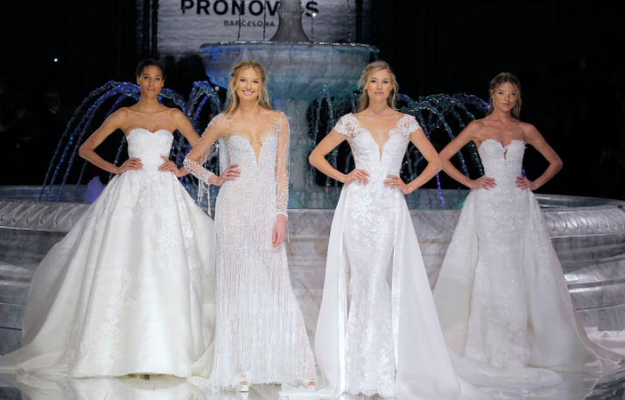
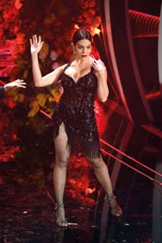
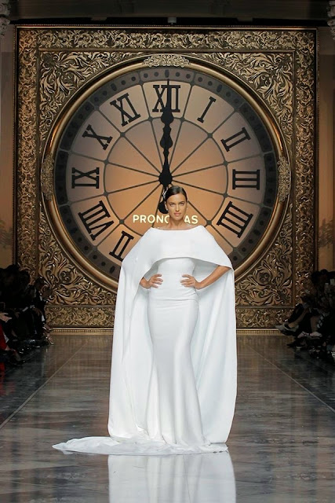
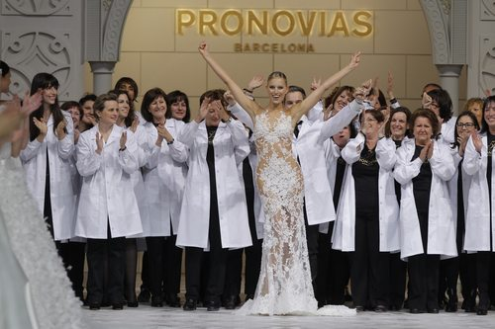
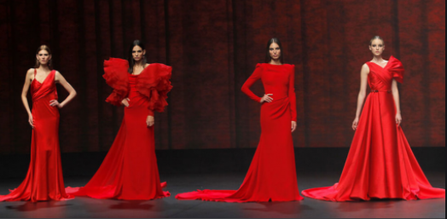
GLOBAL REACH WITH LOCAL PRESENCE
5 REGIONAL OFFICES
5 DISTRIBUTION CENTERS
60 STORES
40 FRANCHISES
3000 AUTHORIZED RETAILERS
EVENTS AND SHOWS

Slide 6

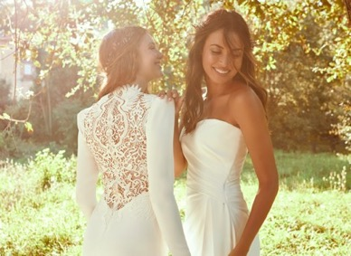
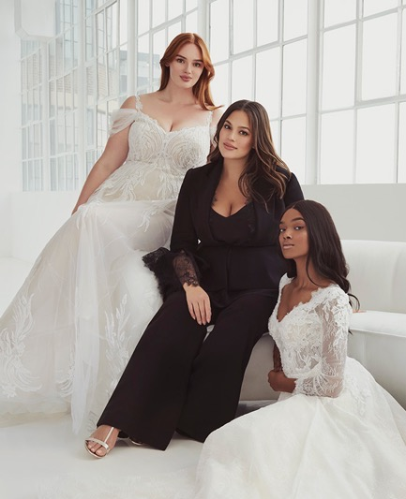

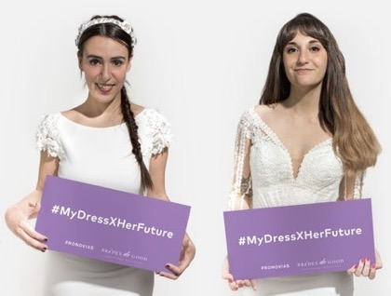
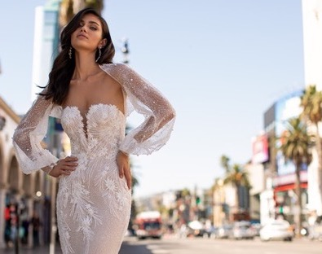
OUR ESG STRATEGY: MAKING THE WORLD A HAPPIER PLACE
SUSTAINABILITY
WOMEN EMPOWERMENT
COMMUNITY IMPACT
#WeDoEco
#LOVECONQUERSALL
#DIVERSITY #BODYPOSITIVITY
#MYDRESSXHERFUTURE
#PRONOVIASPINK

