Slide 1
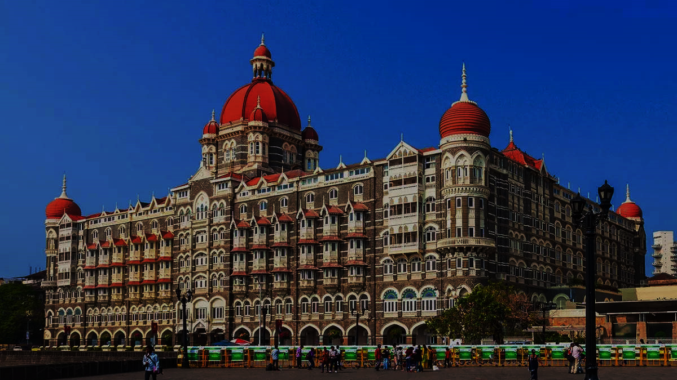
Is India the last oasis of hope in a world that is slowing down?
A conference presented by the IBA Corporate and M&A Law Committee
#IBAMA23
Session Co-Chairs
Rabindra Jhunjhunwala Khaitan & Co, Mumbai
(Membership Officer, Corporate and M&A Law Committee)
Chris Parsons Herbert Smith Freehills, London

Slide 2
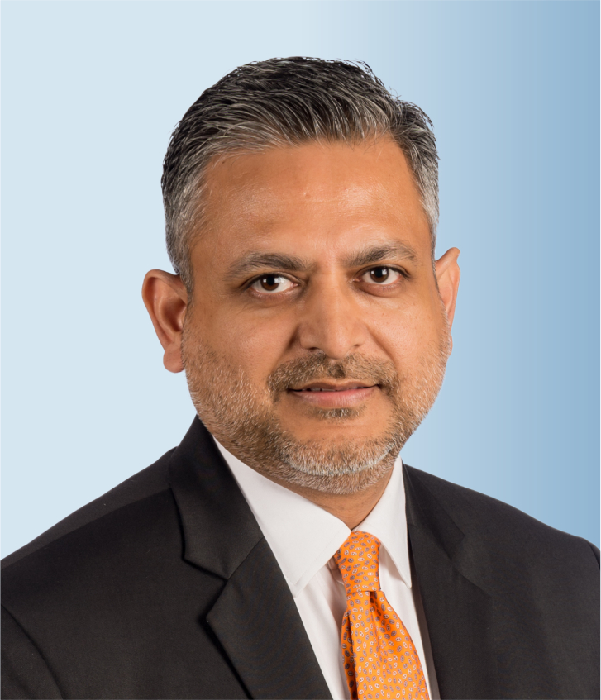
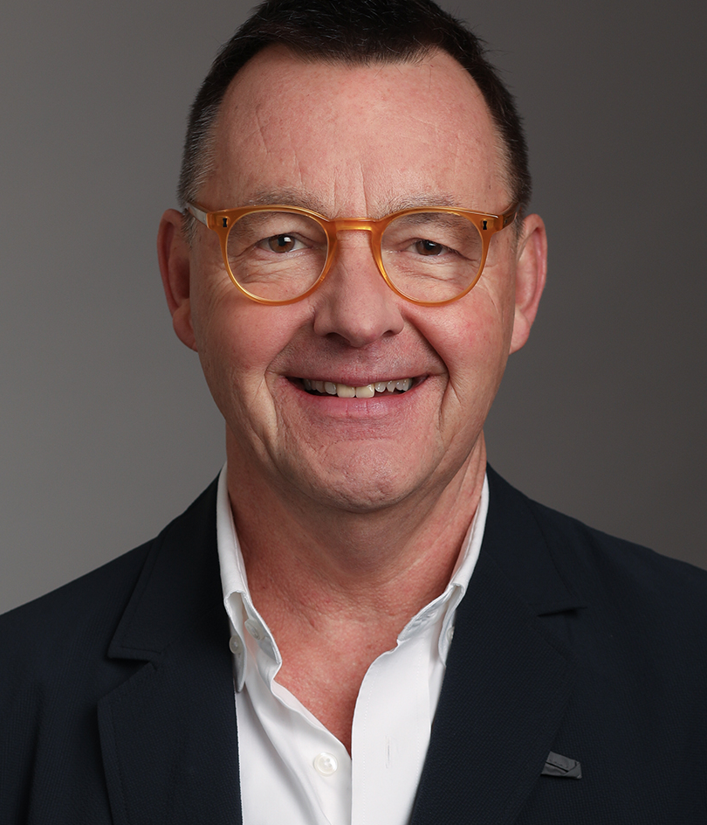
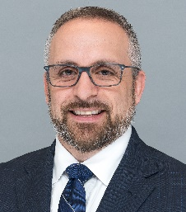
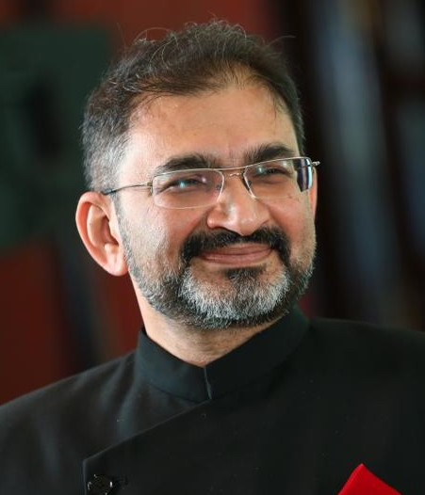
SESSION’S PaneL
Rabindra Jhunjhunwala
Chris Parsons
Padmaja Chakravarty
Rajiv Gupta
Mark Pflug
Pramod Rao
Khaitan & Co
Mumbai
Herbert Smith Freehills London
Citi India Mumbai
Latham & Watkins
Singapore
Simpson Thacher & Bartlett,
New York
Securities and Exchange Board of India
Mumbai
(Co-Chair)
(Co-Chair)
(Panellist)
(Panellist)
(Panellist)
(Panellist)

Slide 3
Dealmaking in India
01
Growth of 139% in overall M&A deal size and deals worth $138 billion in 2022.
02
Public M&A in India has been a busy space and is expected to continue its bull run this year. Robust deal activity coupled with strong regulatory initiatives is likely to support larger and more complex listed company deals.
03
There is a buzz in the market about potentially game-changing amendments to the IBC. This will provide great impetus to distressed investing in India.

Slide 4
What is working in India’s benefit?

Slide 5
What is working in India’s benefit?
India’s unique setting
Promoter driven companies
GDP growth
India is a top 3 country by GDP
Unicorn success story
Growing startup base, means more investment opportunities

Slide 6
What is working in India’s benefit?
Demographic story
Young population, change in spending habits and increasing consumerism
Indian century at CXO level
CXOs at top MNCs native Indian
Investment style
PE investors with dry powder to invest, and M&A trends of IPOs for exit and franchising

Slide 7
What is working in India’s benefit?
Political stability
Arguably one major party, 2024 general elections unlikely to change the dynamics
Geopolitics
Right from Ukraine to Taiwan to India’s border issues with China
Proactive regulators
MCA digitising for EODB, RBI liberalising, CCI revised regime and SEBI at governance forefront with 20+ consultation papers in 2023

Slide 8
Future of deal making in India

Slide 9
Future of deal making in India
Changes palatable for investment
01
02
What a foreign investor should bear in mind while investing in India?
03
04
Up and coming sectors ripe for investment
Changes that India should adopt to continue its growth story?

Slide 10
Thank you!
Rabindra Jhunjhunwala
Chris Parsons
Padmaja Chakravarty
Rajiv Gupta
Mark Pflug
Pramod Rao
Khaitan & Co
Mumbai
Herbert Smith Freehills London
Citi India Mumbai
Latham & Watkins
Singapore
Simpson Thacher & Bartlett,
New York
Securities and Exchange Board of India
Mumbai
(Co-Chair)
(Co-Chair)
(Panellist)
(Panellist)
(Panellist)
(Panellist)

