Slide 1
Corporate governance and activism: the Asian lens
Presented by the IBA’s Corporate and M&A Law Committee
Asia Pacific Mergers & Acquisitions Conference
The Peninsula Tokyo
10-11 July 2023

Slide 2
Speakers
Moderators: Nicola Charlston - King & Wood Mallesons, Melbourne, Victoria Shruti Rajan - Trilegal, Mumbai, Maharashtra Panellists: Gen Goto - The University of Tokyo, Tokyo Seung Hyo (Sam) Baek - Lee & Ko, Seoul Bonnie Kong - Anderson Mori & Tomotsune, Tokyo Laura Muñoz – Garrigues, Barcelona Toby Myerson - Chairman & CEO, Longsight Strategic Advisors, New York

Slide 3
Agenda
Topics | Topics
1 | Corporate governance in Asia: impact of culture
2 | Governance: impacts on business culture & activities
3 | External stakeholders: spheres of influence
4 | Governance of unlisted companies: does it matter and to whom?

Slide 4
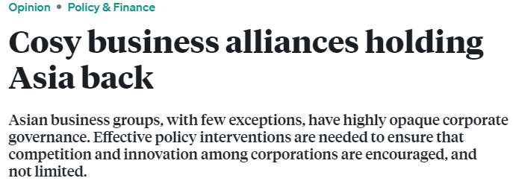
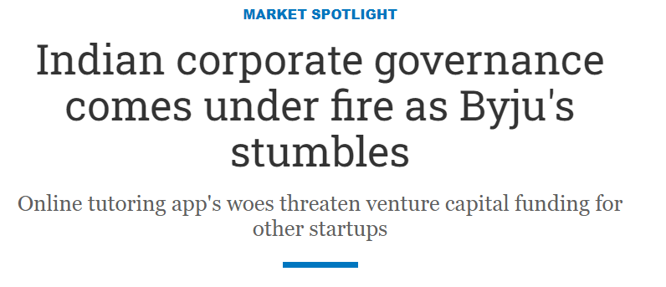
1. Corporate governance in Asia: impact of culture

Slide 5
2. The role of governance in impacting business culture
Notable governance developments in the US context
US observations and application to Asia
Universal proxy rules
Governance, ESG and executive compensation focus
Recent governance reforms in Japan: possible influence on M&A
Revisions of the Companies Act 2014/2019 (independent directors)
Japanese Corporate Governance Code 2015/2018/2021 (IDs, cross-shareholdings)
Japanese Stewardship Code 2014/2017/2020
METI Guidelines for Fair M&As (2019) (on MBO & squeeze outs by controller)
METI Draft Guidelines for Corporate Takeovers (2023) (on unsolicited offers)
Hokuetsu Paper (2006, Oji Paper v Mitsubishi Co & Nippon Paper)
Unizo (2019-2020), Shimachu (2020, Nitori v DCM)
Kansai Supermarket (2021, OK Supermarket v H2O Retailing)

Slide 6
2. The role of governance in impacting business culture (cont.)
New EU regulations: impacting governance
Investor participation / engagement
Increasing transparency
Korea: unique governance regulations
Designated auditor system
Separate election system and the 3% Rule
Multi-step derivative lawsuit claims

Slide 7
3. External stakeholders: spheres of influence
Activism: US impact and developments in Japan
2nd largest number of activist proposals in the world after the US in 2022
Tokyo Stock Exchange requests for companies to explain capital efficiency policies
10-fold increase in activist funds operating in Japan since 2014
340 shareholder proposals to more than 90 companies submitted for the June 2023 meeting season (most commonly around capital returns, governance and ESG)
Japan: Case studies
2023: Dai Nippon Printing / Elliott Management
2023: Toyota Motor Corporation / Glass Lewis and State pension funds – Chairman re-election battle
2023: Canon - CEO narrowly re-appointed
Warren Buffet: $8 billion investment in 5 large Japanese trading companies

Slide 8
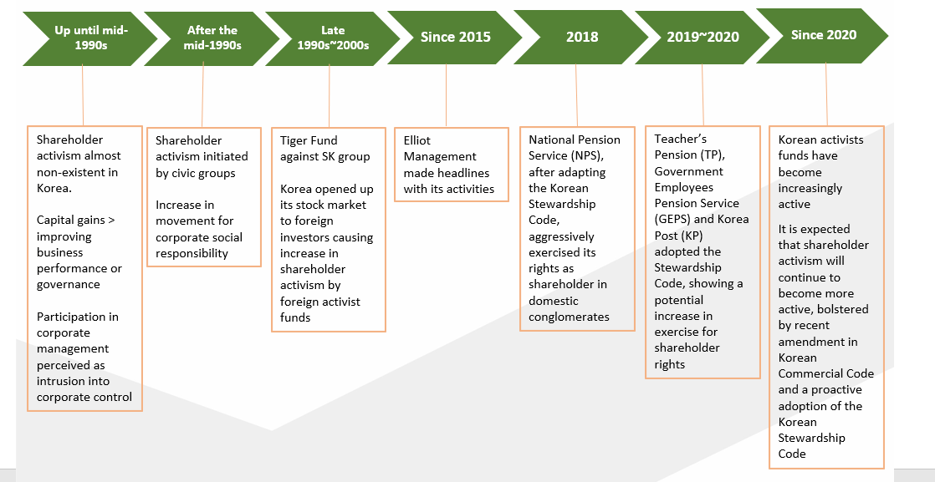
3. External stakeholders: spheres of influence (cont.)
History and recent trends of activism in South Korea
Case Study: U.S.-based activist hedge fund Elliott Management’s objection to Samsung C&T and Cheil Industries’ merger

Slide 9
3. External stakeholders: spheres of influence (cont.)
Activism: EU developments
2020 Capital Markets Union Action Plan: Action 12 aims at facilitating shareholder engagement in listed companies
Use of new digital technologies for:
shareholder-company communication
to eliminate or reduce the chain of intermediaries (or the use of omnibus accounts)
to facilitate real-time information transmission and direct communication, and identification of shareholders
electronic participation and voting
especially for cross-border investors
temporary emergency legislation during Covid-19 and subsequent enactment of permanent legislation regulating the possibility for hybrid or purely virtual general meetings.
blockchain used in the Spanish company Iberdrola to encourage shareholders to vote

Slide 10
4. Governance of unlisted companies: does it matter and to whom?
Extension of corporate governance measures to unlisted companies for greater transparency
Shareholder control on directors’ remuneration (“say on pay”) and related parties’ transactions: subject to voting at general meetings
Shareholder participation facilitated through remote attendance and voting at general meetings
After Covid-19: if foreseen in the articles of association.
ESG Investing trend: corporate governance as a new decisive factor when making investment decisions

