Slide 1
Dealmaking after the storm: developments in PE
Asia Pacific Mergers and Acquisitions Conference, Tokyo, 10 July 2023
Roxanne Anderson, Partner, AZB & Partners, Mumbai
Katsuya Baba, Partner and CAO, Advantage Partners, Tokyo
Raku Raku, Partner, Anderson Mōri & Tomotsune, Singapore
Betty Yap, Partner, Linklaters, Hong Kong
Moderators:
Prof. Dr. Hans-Jörg Ziegenhain, Partner, Hengeler Mueller, Munich
David Patrick Eich, Partner, Kirkland & Ellis, Hong Kong

Slide 2
Agenda 1) Panelist introductions 2) Market update: PE trends 3) Interview: Sponsor’s perspective 4) Panel discussion 5) Q&A

Slide 3
Panelists Roxanne Anderson, Partner, AZB & Partners, Mumbai Katsuya Baba, Partner and CAO, Advantage Partners, Tokyo Raku Raku, Partner, Anderson Mōri & Tomotsune, Singapore Betty Yap, Partner, Linklaters, Hong Kong

Slide 4
Global PE Trends

Slide 5
Capital raised by PE funds by geo focus, ’01-Q3 ‘22
LPs’ appetite for new investment decreased; PE funds globally raised $405B through Q3 ‘22, down 41.8% on full year ‘21
North Am-focused funds decreased 31.1% from ‘21
APAC: steepest decreases by amount and % (-66.9%), driven by risk aversion toward China-focused funds
Source: Preqin

Slide 6
Annual value of PE-backed deals by region, ‘06-Q3 ‘22
PE-backed deals decreased most in Europe through Q3 ’22; (38.5% ‘21 deal value), followed by N. America (53.3% ‘21)
Total deal value in Asia through Q3 ‘22 was $61.1B (59.3% ’21)
Source: Preqin

Slide 7
LP‘s PE cap comms next 12 v. last 12 mo, ’15-’22
Investors are holding back
Investor sentiment changes: reacting to denominator effect
Preqin’s semi-annual investor survey: change in PE investor sentiment for first time in years
% of investors expecting to allocate more to PE has declined from 43% in the Nov ‘21 survey to 31% in Nov ‘22
the % of investors expecting to allocate less has increased to 13% from 12%
Source: Preqin

Slide 8
German and European PE Trends

Slide 9
German PE market Comparison of HY 2023 with HY 2022
German PE market
Analysis
Both analyses show a significant drop (-28%; -31%) in the number of transactions in HY 2023 compared with HY 2022. However, the number of transactions is still higher than in the pre-Covid-19 years.
Looking at the transaction value, the value of German target transactions dropped by 52% in comparison with the same period in 2022, while the value of transactions with any German involvement dropped by 39%. In contrast to the number of transactions, the (disclosed) deal value has not reached pre-pandemic levels yet.
German target¹
 | HY 2019 | HY 2020 | HY 2021 | HY 2022 | HY 2023
Number of transactions | 166 | 162 | 465 | 404 | 289
Value (in USDm) | 26,000 | 28,497 | 24,607 | 30,833 | 14,714
Any German involvement²
 | HY 2019 | HY 2020 | HY 2021 | HY 2022 | HY 2023
Number of transactions | 312 | 290 | 770 | 843 | 585
Value (in USDm) | 44,932 | 43,602 | 61,760 | 62,071 | 38,072
(1) Only transactions with a German target (2) Transaction with either a German bidder or seller or target.
Source: Mergermarket; PE: Buyout or Exit or Buy and build, any German involvement/German target, including lapsed deals. As of 5 July 2023.

Slide 10
European PE market Comparison of HY 2023 with HY 2022
European PE market
Analysis
The trend for European PE transactions mirrors the one for Germany, showing a significant drop (-25%; -30%) in the number of transactions in HY 2023 compared with HY 2022. The number of transactions still surpasses pre-pandemic levels.
The value of European target transactions and transactions with any European involvement dropped by a staggering 70% and 67% respectively in comparison with the same period in 2022. In contrast to the number of transactions, the (disclosed) deal value has not fully reached pre-pandemic levels yet but still surpasses the value for 2020.
European target¹
 | HY 2019 | HY 2020 | HY 2021 | HY 2022 | HY 2023
Number of transactions | 1,351 | 1,209 | 2,997 | 3,313 | 2,487
Value (in USDm) | 185,126 | 118,289 | 379,835 | 408,533 | 124,519
Any European involvement²
 | HY 2019 | HY 2020 | HY 2021 | HY 2022 | HY 2023
Number of transactions | 1,651 | 1,488 | 3,766 | 4,386 | 3,070
Value (in USDm) | 274,367 | 172,884 | 569,263 | 578,231 | 189,279
(1) Only transactions with a European target (2) Transaction with either a European bidder or seller or target.
Source: Mergermarket; PE: Buyout or Exit or Buy and build, any European involvement/European target, including lapsed deals. As of 5 July 2023.

Slide 11
PE transactions involving a German target ‘13-’23(HY)
Source: Mergermarket, PE: Buyout or Exit or Buy and build, German target, including lapsed deals. Illustration by Hengeler Mueller. As of 5 July 2023.

Slide 12
PE transactions involving a European target ‘13-23(HY)
Source: Mergermarket, PE: Buyout or Exit or Buy and build, European target, including lapsed deals. Illustration by Hengeler Mueller. As of 5 July 2023. .

Slide 13
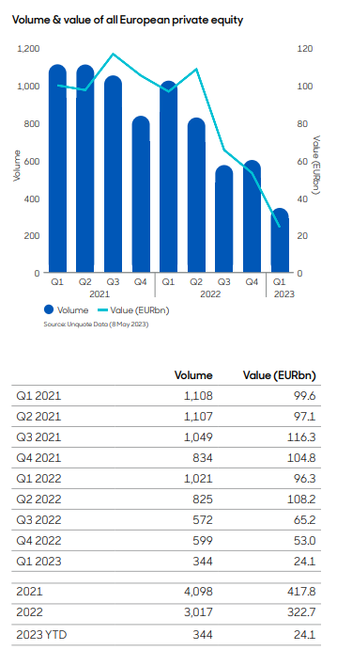
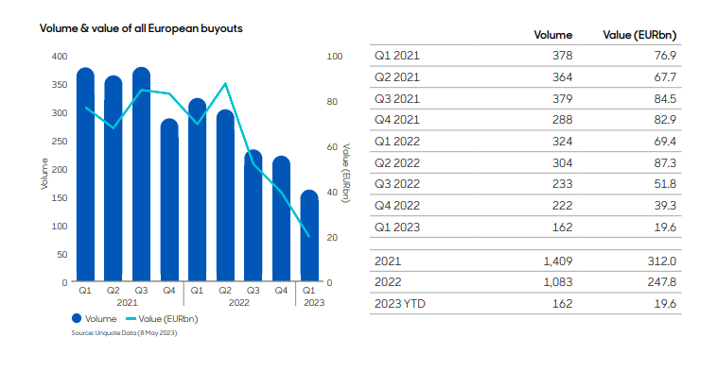
Volume and value of all European PE / European buyouts abrdn private equity barometer Q1 2023 based on data from Unquote*
*Specialist private equity information provider.

Slide 14
APAC PE Trends

Slide 15
Annual value of APAC PE deals by country ’10-Q3 ‘22
Total Asia deal value by Q3 ‘22 was $61.1B (59.3% ’21)
Shortfall mainly China (51.2% of ‘21), Japan (24.1%)
India deals also contracted
S. Korea relatively stable at $12.4B (annualized, > ’21)
Australia: $11B
MENA: $12.3B (> by 3Q ‘22 than any single prior year)
Source: Preqin

Slide 16
APAC PE deal value, exit value, fund-raising ’16-’22
Asia-Pacific private equity investments ($B)
Deal count
3,000
354
Asia-Pacific private equity exits ($B)
Exit count
Asia-Pacific-focused closed funds, by close year ($B)
APAC PE funds: turned cautious in ‘22, after two record years
GPs retrenched; APAC deal value down 44% to $198B
Exits, fundraising below ‘21
Factors: decreased economic growth, consumer confidence, manufacturing output; increased inflation, geopolitical tensions
Relaxation of Covid restrictions failed to reverse trend
199
1,000
$352B ₃₄₇
130 ₁₅₈
283
201
$109B
249
2,000
132
163
190
198
91
179
184
$147B
177
92
500
1,000
105
2016 17 18 19 20 21 22
0
2016 17 18 19 20 21 22
0
2016 17 18 19 20 21 22
Source: Preqin, Bain Report

Slide 17
Factors: change in total deal value ($B), ‘22 v. ‘21
$354B
After 2 years of growth, APAC deal value declined to $198B ‘22, -44% from ‘21 and -9% the previous 5 year average
Deals fewer and smaller
Depreciating currencies diminished the average deal size in USD
–75
–88
–44%
22
198
–14
–103
Exchange-rate impact
2021 deal value
Deal volume impact
Average deal size impact
Other factors
2022 deal value
Notes: Excludes real estate deals; deal value includes deals with a transaction value greater than or equal to $10 million; deal volume reflects all deals (including those without a transaction value)
Source: Bain Report, AVCJ

Slide 18
APAC PE investment value ($B) by market
-38%
$150B
‒53%
100
+29%
Deal value fell in every APAC market in ’22 with declines 25-53%
Greater China: share down to 31%, 9 year low
India: share up to 23%
The average deal size in Australia-New Zealand fell 57%
+23%
‒48%
‒25%
+36%
+1%
‒21%
50
‒28%
‒39%
‒52%
0
Greater China
India
Australia–New Zealand
Japan
South Korea
Southeast Asia
2017‒21 average
2021
2022
Notes: Excludes real estate
Share of APAC private equity deal value
100%
$106B
217
198
Southeast Asia
Japan
South Korea
Australia–New Zealand
India
Greater China
80
60
40
20
0
Average deal size ($M)
2012–16 $109M
2017–21 133
2022100
Notes: Average deal size is based on a simple average; excludes real estate
Source: Bain Report, AVCJ

Slide 19
Share of APAC investment value by deal type ‘17-’22
2021–22
Growth deals > buyouts in ’22: 54% of deal value (50% in ’21)
But total value of growth deals >$200 million decreased 45% in ’22 from ’21 (deal value had risen nearly every year since ’14)
Start-up/early-stage deal value: +3%
Average size of buyouts/growth deals declined to $486M and $88M, (-39% and -15%)
Average size of growth deals dropped to the lowest level since ‘15
$177B
190
163
201
354
198
change
–75%
–99%
–51%
3%
100%
Other Turnaround/restructuring PIPE
Start-up/early stage
80
60
40
20
0
Growth deals $50M or less Growth deals $50M–$200M
–24%
–36%
Growth deals $200M or more –45% Buy-out –51%
2017 | 18 | 19 | 20 | 21 | 22
39% | 59% | 56% | 56% | 50% | 54%
$112M | 138 | 101 | 96 | 104 | 88
$527M | 302 | 309 | 318 | 792 | 486
Growth deals’ share of total value
Average growth deal size ($M)
Average buyout deal size ($M)
Notes: Excludes real estate; PIPE is private investment in public equity; start-up/early stage investments use financing for product development and initial marketing, the company may be in the process of being organized or may have been in business for a short time, but hasn’t sold its product commercially; growth includes expansion, growth, mezzanine, and pre-IPO capital deals; series are sorted with biggest on bottom based on 2022 shares
Source: Bain Report, AVCJ

Slide 20
Global PE Forecast

Slide 21
PE AUM by primary region of focus ’10-’27F
Global macroeconomic deterioration over the course of ‘22 – post-COVID-19 monetary and fiscal stimuli have fueled inflationary pressures as global supply chains face disruption; Ukraine war adds to investor uncertainty and increases food and fuel prices
Stronger US inflation and monetary policy response have widened interest rate gap between US and leading economies
Stronger USD exports inflation to other markets through higher import prices in local FX, straining emerging economies
Cost of servicing USD-denominated debt is significantly higher in local FX
Such factors contribute to muted outlook for the APAC region (and Latin America), particularly
10.22%
14.52%
5.37%
Source: Preqin

Slide 22
Global PE AUM by strategy ’10-’27F
Expect global PE dry powder will continue to climb to record highs (but decline as % of AUM)
Total dry powder expected to climb by 61.3% ’21-’27, rising from $1.19T to $1.92T
Despite challenges, strong growth of the global PE market is forecast, with AUM growing at a 10.2% CAGR from ‘21 to reach $7.6T in ‘27
AUM ($bn)
Source: Preqin

Slide 23
Regional PE historic/forecast performance by strategy
Performance | CAGR 2015-2021 | CAGR 2018-2021 | CAGR 2021-2027F
North America - private equity - buyout | 16.7% | 20.4% | 14.5%
North America - private equity - growth | 17.4% | 22.1% | 12.8%
North America - private equity - other | 11.3% | 14.8% | 10.0%
Europe - private equity - buyout | 14.9% | 17.4% | 14.3%
Europe - private equity - growth | 15.0% | 16.5% | 15.0%
Europe - private equity - other | 14.2% | 17.6% | 13.1%
APAC - private equity - buyout | 12.2% | 16.9% | 11.2%
APAC - private equity - growth | 13.9% | 17.1% | 12.6%
APAC - private equity - other | 10.5% | 12.4% | 10.1%
Rest of World - private equity - buyout | 19.4% | 24.0% | 18.0%
Rest of World - private equity - growth | 14.5% | 19.4% | 12.7%
Rest of World - private equity - other | 9.2% | 9.8% | 8.1%
Diversified multi-regional - private equity - buyout | 15.0% | 18.2% | 12.0%
Diversified multi-regional - private equity - growth | 6.6% | 7.0% | 11.5%
Diversified multi-regional - private equity - other | 16.7% | 23.2% | 9.9%
US remains strong relative to global economy
Geopolitics pose continued risk to Europe
Macro factors weigh heaviest on APAC PE performance
Source: Preqin

Slide 24
Sponsor’s Perspective: Katsuya Baba, Advantage Partners

Slide 25
Developments in PE Panel Discussion Roxanne Anderson, Partner, AZB & Partners, Mumbai Katsuya Baba, Partner and CAO, Advantage Partners, Tokyo Raku Raku, Partner, Anderson Mōri & Tomotsune, Singapore Betty Yap, Partner, Linklaters, Hong Kong Moderators: Prof. Dr. Hans-Jörg Ziegenhain, Partner, Hengeler Mueller, Munich David Patrick Eich, Partner, Kirkland & Ellis, Hong Kong

Slide 26
Developments in PE Q&A

