Slide 1
23rd Annual UBA Transnational Crime Conference
Madrid, November 4th 2021

Slide 2
How will you dispose of it? Environmental crimes in transnational context and the impact of the COVID-19 epidemic

Slide 3
Session Co-Chair Filippo Ferri Cagnola & Associati Studio Legale, Milan; Secretary, IBA Business Crime Committee Panellists Javier de Cendra Larragan University Francisco de Vitoria, Madrid; Co-Chair, IBA Health and Safety Law Committee Patricia Leandro Vieira da Costa Urìa Menéndez, Madrid Enide Perez Sjocrona – Van Stigt, The Hague Emmanuel Moyne Bougartchev Moyne Associés, Paris; Conference Quality Officer, IBA Criminal Law Committee Janusz Tomczak Raczkowski Paruch, Warsaw; Treasurer, IBA Criminal Law Committee Carl Newman Whithers LLP, London

Slide 4
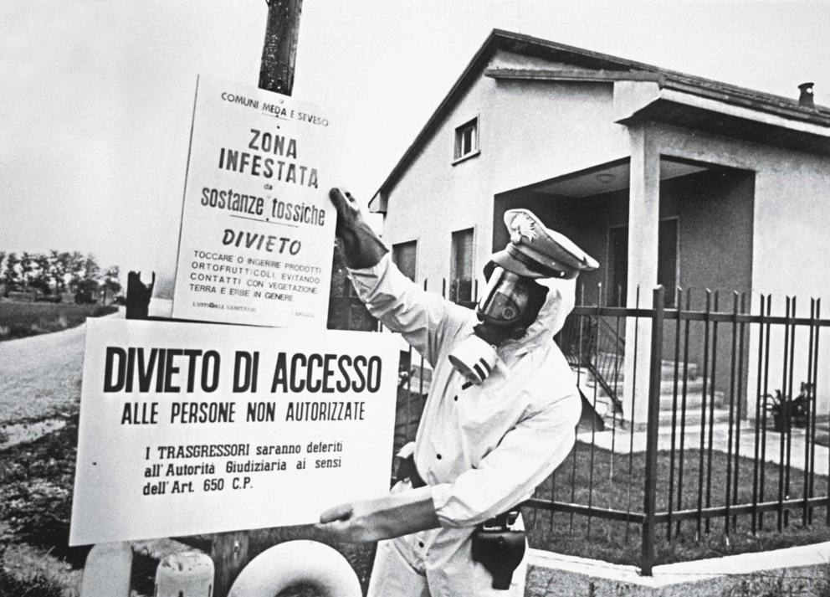
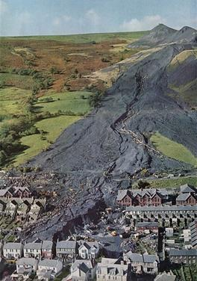
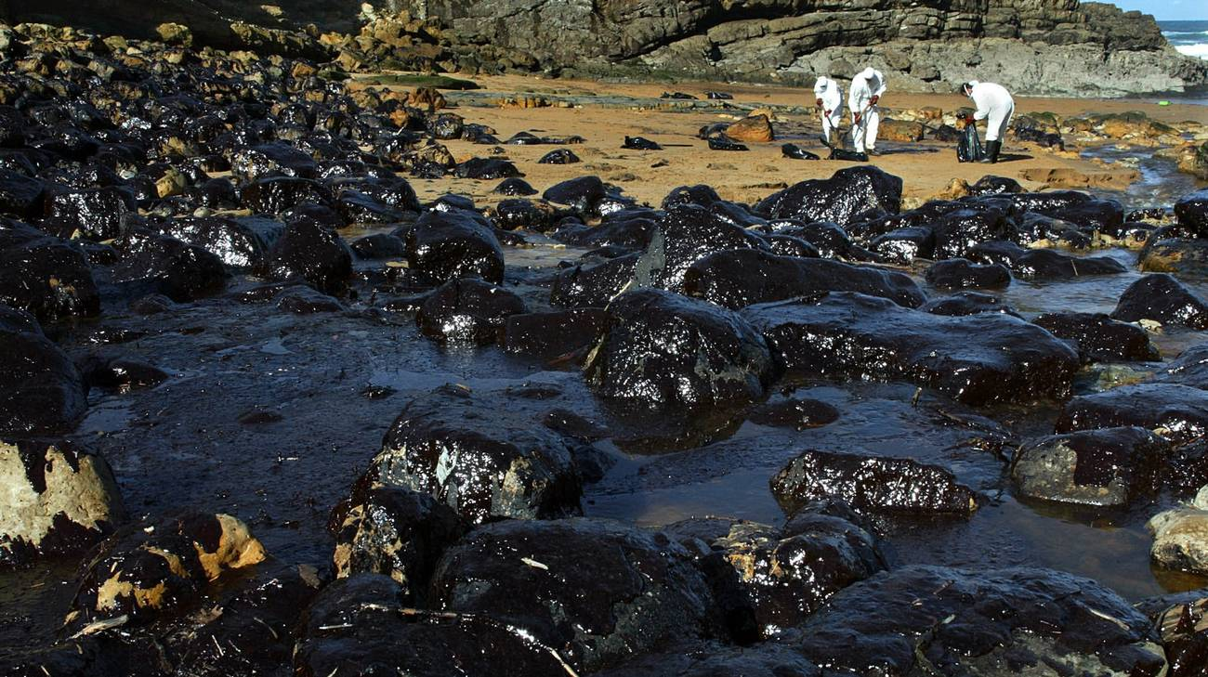
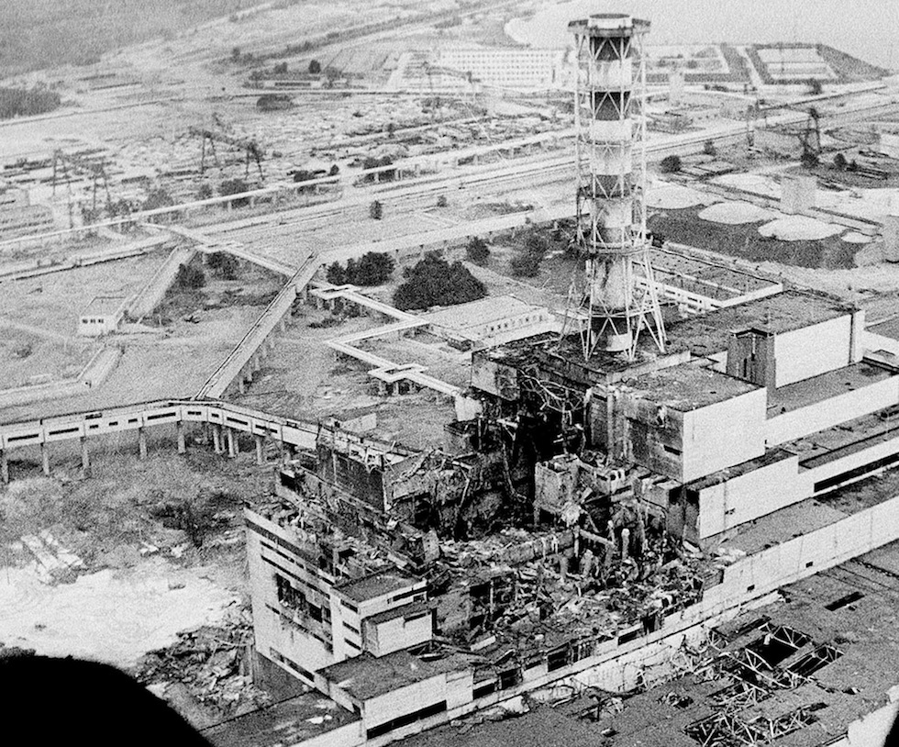
Icmesa disaster
July 10th 1976
Seveso - Italy
Aberfan disaster
October 21st 1966
Aberfan - UK
Prestige disaster
November, 19th, 2002
Galizia - Spain
Chernobyl
April, 26th, 1986

Slide 5
Icmesa disaster
July 10th 1976
Seveso - Italy
Explosion of the security system of the factory, that caused the highest known exposure to TCDD dioxin in history
Milan Court of Appeal verdict:
3 acquittals and 2 convictions
(sanctions: up to 4 years of detention)
Aberfan disaster
October 21st 1966
Aberfan - UK
catastrophic collapse of a colliery spoil tip (more than 100 victims – 116 children)
The NCB (National Coal Board) paid out £160,000 in compensation: £500 for each fatality, plus money for traumatised survivors and damaged property.
Prestige disaster
November, 19th, 2002
Galizia - Spain
Catastrophic spill of more that 60.000 tonnes of heavy fuel oil
Almost full acquittal at the end of the first instance trial (different ruling by the Supreme Court)
Chernobyl
April, 26th, 1986
The Paris Court of Appeal ruled the dismissal of the case against Mr. Pierre Pellerin, head of the French National Protection Service against nuclear radiation

Slide 6
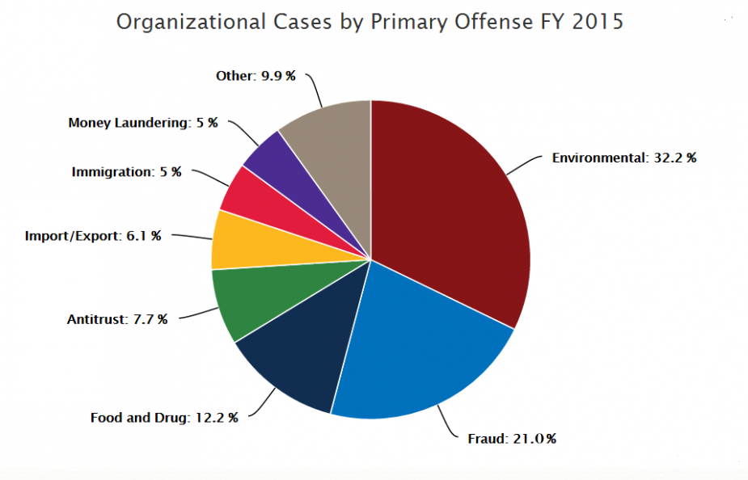
Source: U.S. Courts

Slide 7
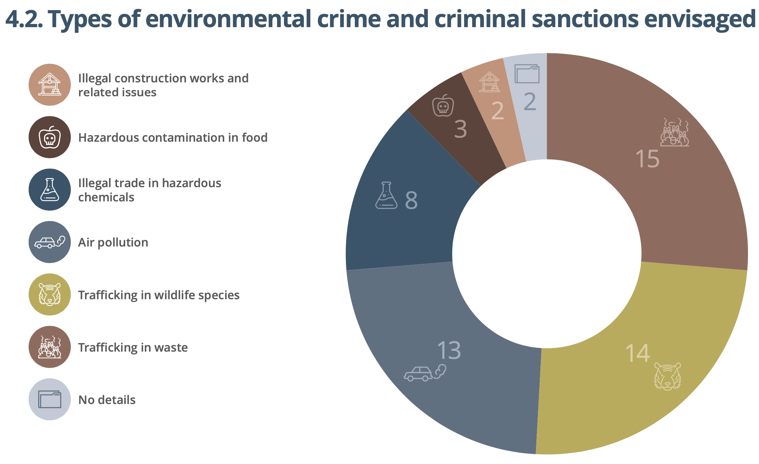
Source: Eurojust report on Environmental Crime – January 2021

Slide 8
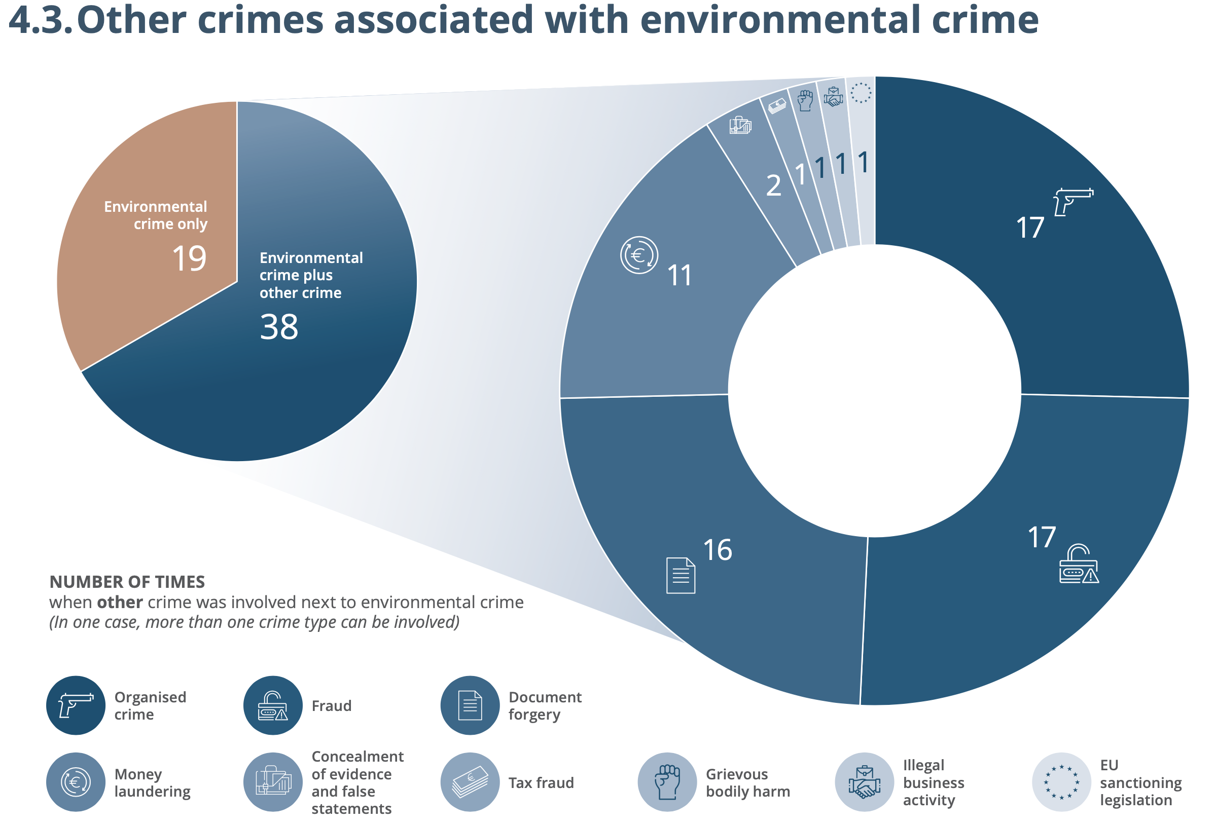
Source: Eurojust report on Environmental Crime – January 2021

Slide 9
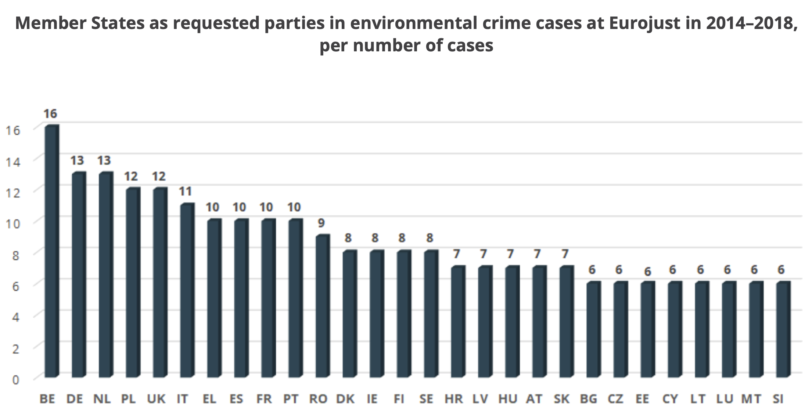
Source: Eurojust report on Environmental Crime – January 2021

Slide 10
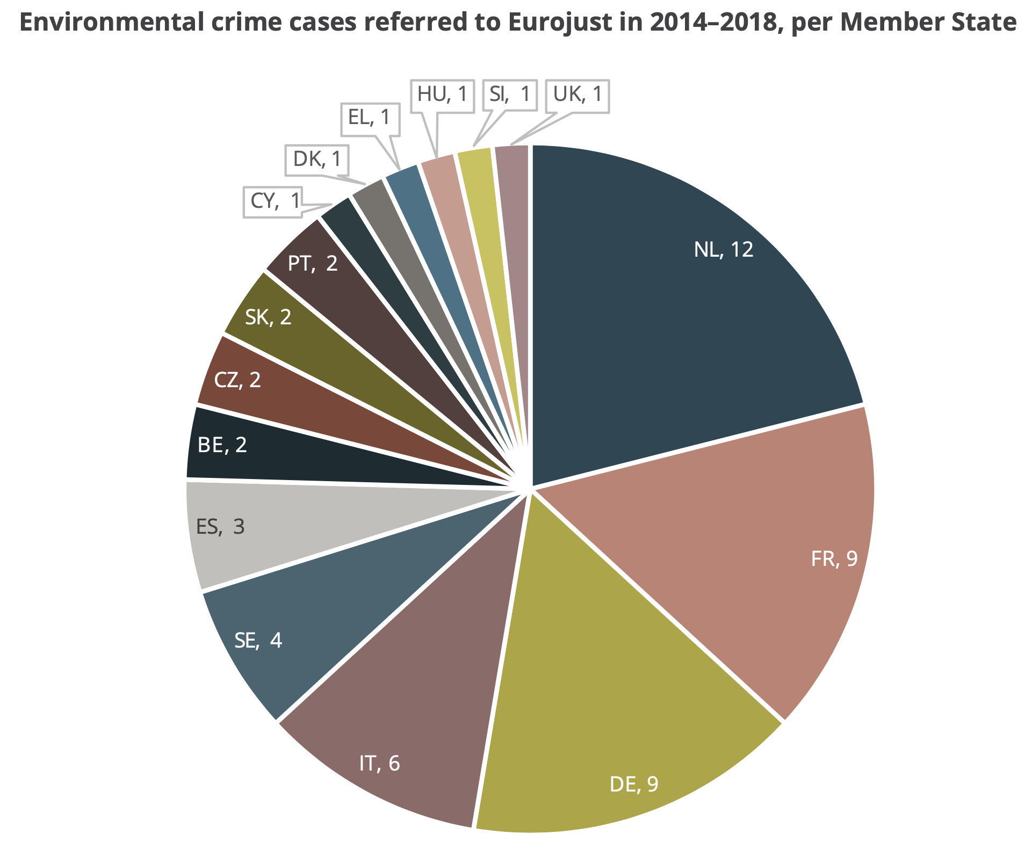
Source: Eurojust report on Environmental Crime – January 2021

Slide 11
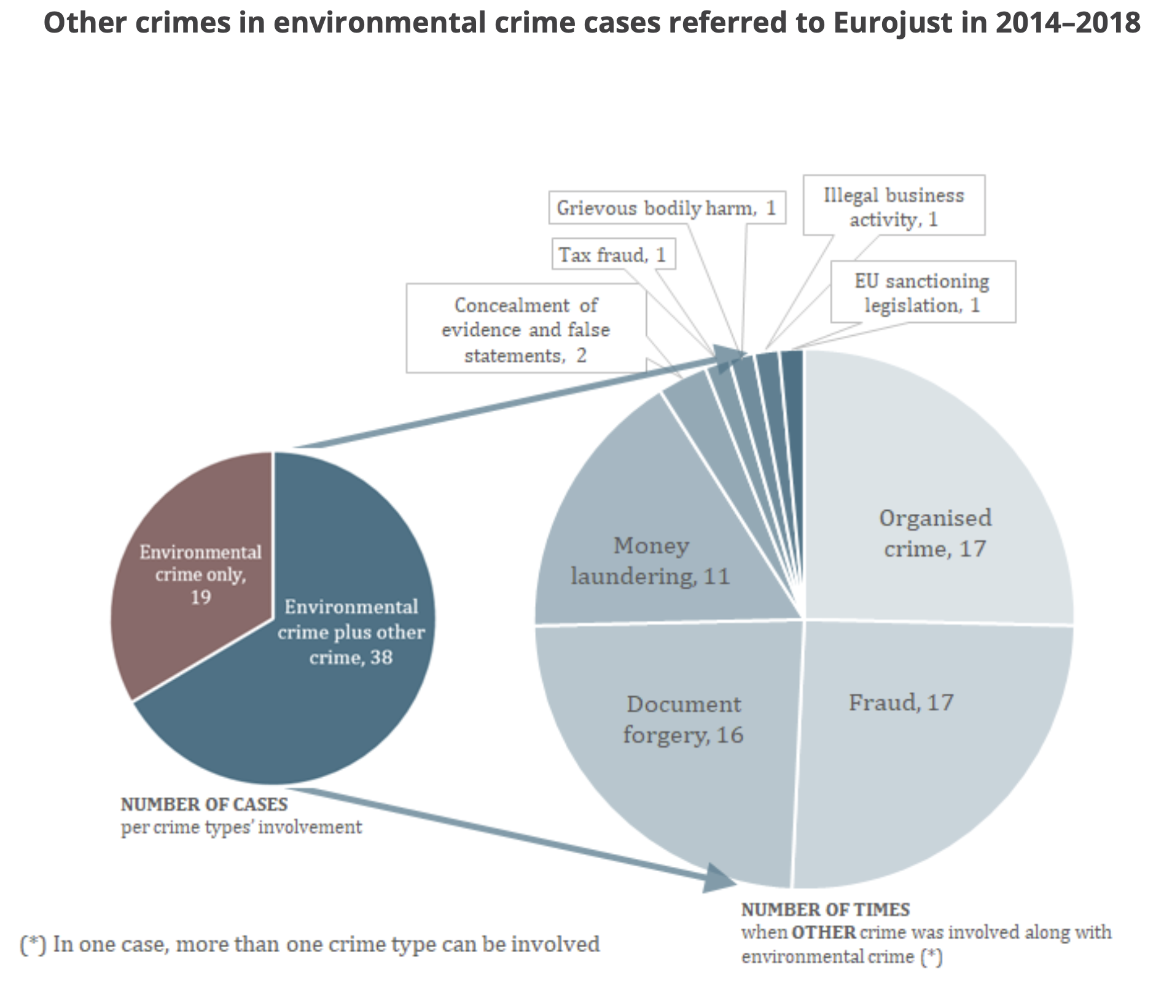
Source: Eurojust report on Environmental Crime – January 2021

Slide 12
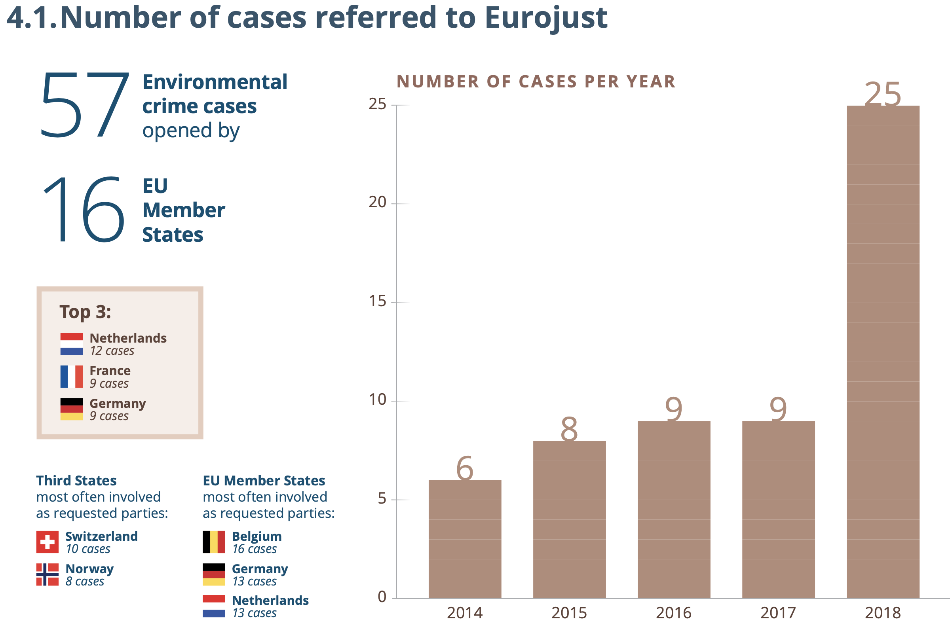
Source: Eurojust report on Environmental Crime – January 2021

Slide 13
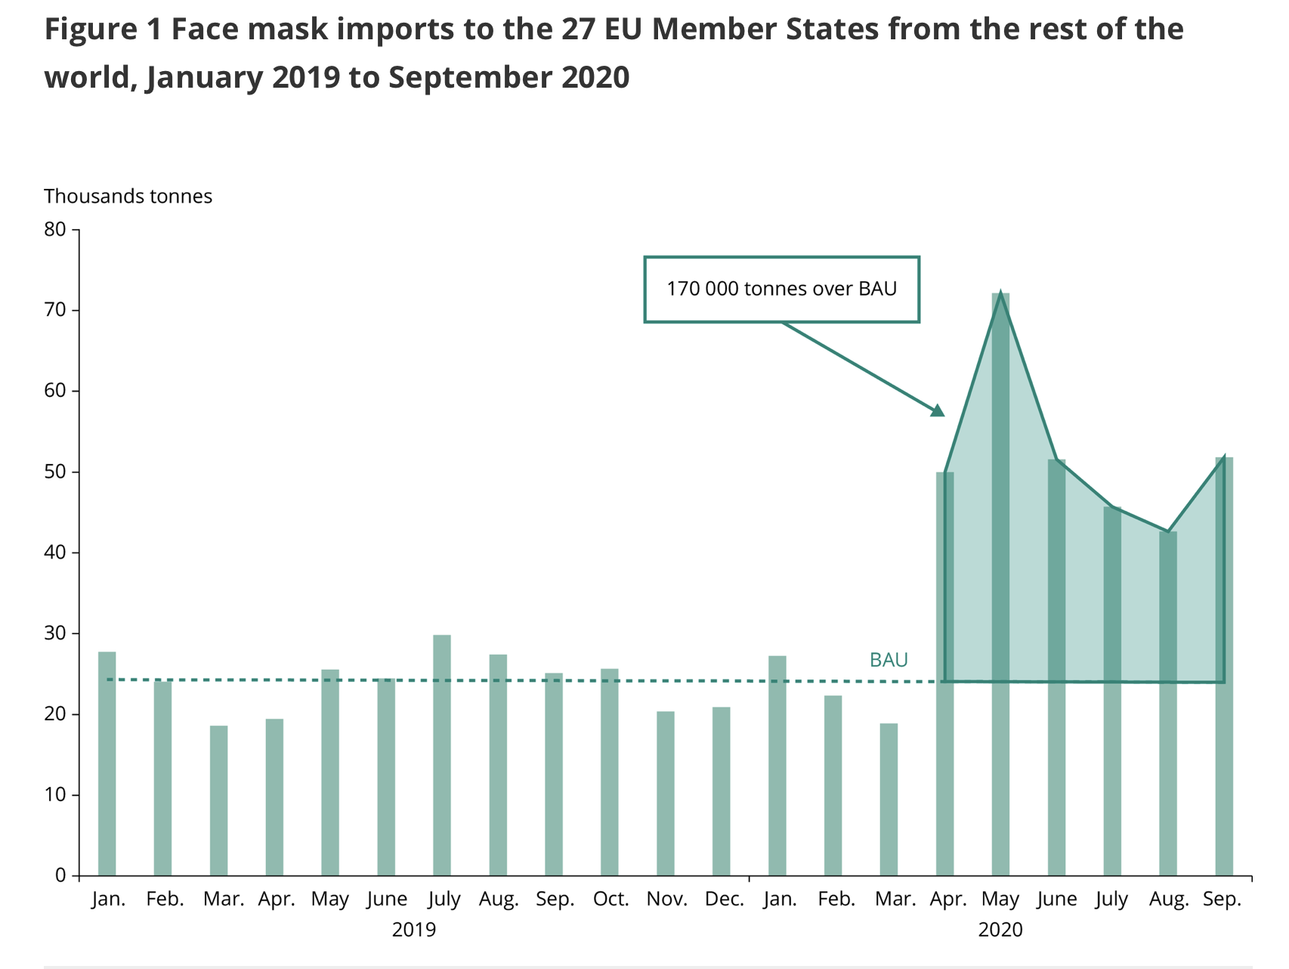
Source: European Environment Agency

