Slide 1
Which Jurisdiction Should Regulate Blockchain Technology and Smart Contracts?
22 February 2023
Chua Tju Liang
Director, Drew & Napier LLC
Head, Blockchain & Digital Assets

Slide 2
What are Blockchains?

Slide 3
What are Blockchains?
First developed in 1991 to secure documents
A system of cryptographically recording information in a way that makes it difficult to change, hack, or cheat the records
Blockchain is:
A digital record (“ledger”) of changes in information (“transactions”)
That is duplicated and distributed across a decentralized network of computer systems (“nodes”)
where the definitive ledger is determined by a system of rules-based voting among the nodes (“consensus protocols”)
Main legal issues are around public blockchains (e.g. Bitcoin, Ethereum)
anyone can participate in reading/writing/auditing/being a node on the blockchain, simply by downloading freely-available software (“permissionless”)

Slide 4
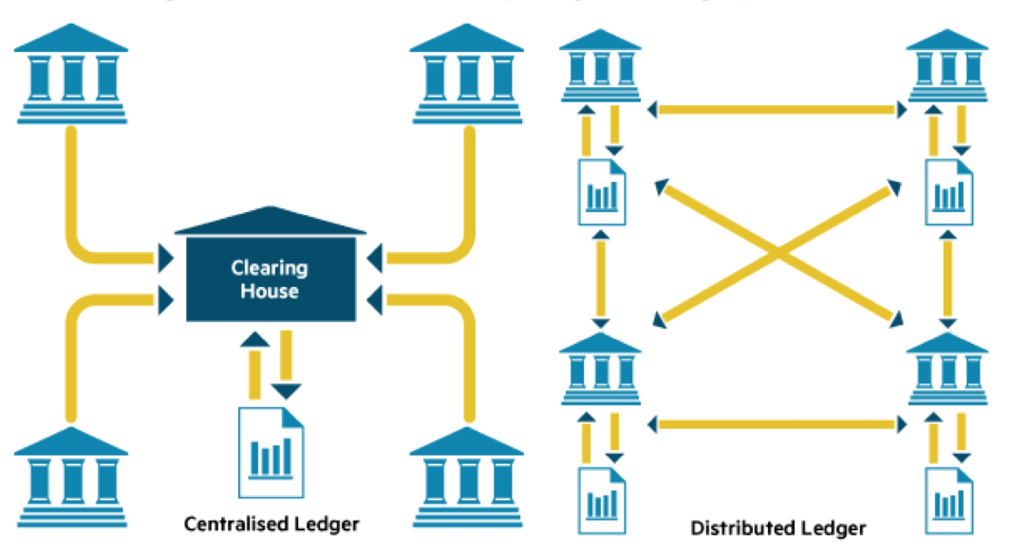
What are Blockchains?
Traditional Records
Centralized Database
Blockchain
Distributed Ledgers

Slide 5
What are Smart Contracts?
The term “smart contract” was first coined in 1994 by Nick Szabo
Programs stored on a blockchain that run when predetermined conditions are met
“To be clear, at this point I quite regret adopting the term "smart contracts". I should have called them something more boring and technical, perhaps something like "persistent scripts“” – Vitalik Buterin (2018)

Slide 6
Who Uses Blockchains and Smart Contracts?
Node Operators / Miners / Validators
Users / Traders / Investors
Centralized Exchanges
Protocol Developers
Software Developers
Other service providers (e.g. staking services, OTC trading desks, wallet software providers, custodians, oracles, etc.)

Slide 7
What Do They Do (With or On the Blockchain?)
Node Operators / Miners / Validators – run mining/validating software that secures the blockchain
Users / Traders / Investors – hold, buy and sell cryptocurrencies and NFTs
Centralized Exchanges – provide a platform for users to hold, buy and sell cryptocurrencies and NFTs
Protocol Developers – develop freely-available software that helps run the blockchains
Software Developers - develop software (typically comprisinthat runs *on top* of the blockchains
Other service providers – provide a variety of services to other participants on the blockchain

Slide 8
Who should regulate blockchains?

Slide 9
Challenging the Question
What are we seeking to regulate?
Concept vs. specific activities

Slide 10
Challenging the Question
What do we mean by “regulation”?
Licensing regimes
General laws of contract, tort, etc.

Slide 11
SG Court regulating specific activities on the Blockchain
Cases based on traditional principles of jurisdiction
Quoine Pte Ltd v. B2C2: contract between exchange and user
CLM v. CLN: proprietary injunction and worldwide freezing injunction
Injunction re Bored Ape Yacht Club NFT (BAYC No 2162): worldwide proprietary injunction against “chefpierre”

Slide 12
MAS licensing specific activities on the Blockchain
Technology-agnostic approach
Payment Services Act: licensing regime for conducting certain activity in Singapore relating to digital payment tokens and e-money
Securities and Futures Act: licensing regime relating to capital markets products in Singapore (including if they are conducted via blockchain)
Financial Markets and Services Act: licensing regime for Virtual Asset Service Providers based in Singapore, for conducting digital token services outside Singapore

Slide 13
Illinois Bill SB1887
Section 15. Enforcement of warrants and court orders; penalties.
(a) Upon a valid request from the Attorney General or a State's Attorney made pursuant to the substantive or procedural laws of this State, a court may order any appropriate blockchain transaction for digital property or for the execution of a smart contract.
(b) A blockchain network that processes a blockchain transaction originating in this State at any time after the effective date of this Act shall process a court-ordered blockchain transaction without the need for the private key associated with the digital property or smart contract.
(c)(1) Each blockchain operator that has mined, validated, or otherwise participated in processing a blockchain transaction on the blockchain network which originated in this State at any time after the effective date of this Act is liable to this State for a violation of subsection (b).
(2) Upon a petition by the Attorney General or a State's Attorney, the court shall assess a civil penalty of between $5,000 and $10,000, as adjusted by the Federal Civil Penalties Inflation Adjustment Act of 1990, 28 U.S.C. 2461 note, Public Law 104–410, for each day that the blockchain network fails to comply with the order.
(d) The fact that a blockchain network has not adopted reasonable available procedures to comply with subsection (b) shall not be a defense to an action under subsection (c).

Slide 14
Which Jurisdiction(s) Should Regulate?
All of them already do
Courts have applied well-established principles to cases involving blockchain-based digital assets
Ultimately a question of examining what specifically is in dispute

Slide 15
Questions?

Slide 16
Contact Details
Chua Tju Liang
Head, Blockchain & Digital Assets
Tel: +65 6531 4101
Email: tjuliang.chua@drewnapier.com
Drew & Napier LLC
10 Collyer Quay, #10-01 Ocean Financial Centre, Singapore 049315
D: +65 6531 0733 | F: +65 6536 4906 | www.drewnapier.com

