Slide 1
The resources needed for the green transition
Shifting demands for natural resources and how the OECD is helping
Alain de Serres, Director, OECD Environment Directorate

Slide 2
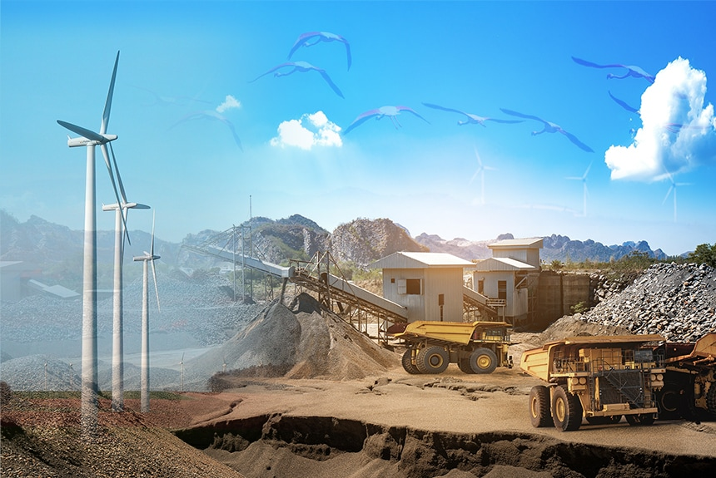
The resources needed for the green transition

Slide 3
The climate challenge
The climate challenge
Global CO₂ emissions, gigatonnes
40
Where we are going
Historical
COP26 saw a ramp up of climate ambition, but near-term actions still insufficient and not well coordinated globally to avoid negative spillovers
To achieve global net zero by 2050 a comprehensive set of well-designed, better coordinated well implemented climate plans is needed
While this will involve a mix of policy approaches in line with national circumstances, over time, increased global coherence & convergence on pricing carbon is desirable
30
Announced pledges
(COP26)
20
10
Where we aim to go
0
2000 2010 2020 2030 2040
Source: IEA, 2021
Note: Limiting warming to 1.5ºC requires -45% GHG emissions by 2030 compared to 2010.
2050
3

Slide 4
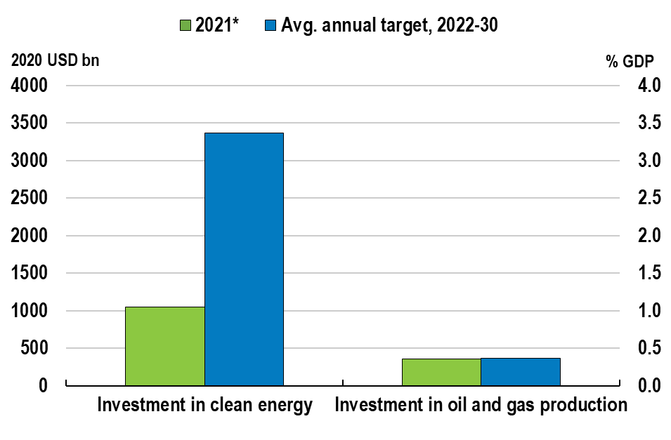
Insufficient shift in investment from fossil fuels to renewables
Green investment needs to be
ramped up globally
Global investment by sector
Investment in oil and gas is where it should be but investment in renewables falls well short of what is needed for the net-zero path
Note: The ‘Annual Target’ refers to the Net Zero Goal (NZE) by the International Energy Agency (IEA). The NZE includes the projected average annual investment required in order to bring global energy-related CO2 emissions to net zero by 2050 and limit global temperature rise to 1.5 °C. *IEA estimation.
Source: World Energy Outlook 2021, IEA; and OECD calculations.

Slide 5
Minerals and metals required for the green transition
Source: IEA, 2022

Slide 6
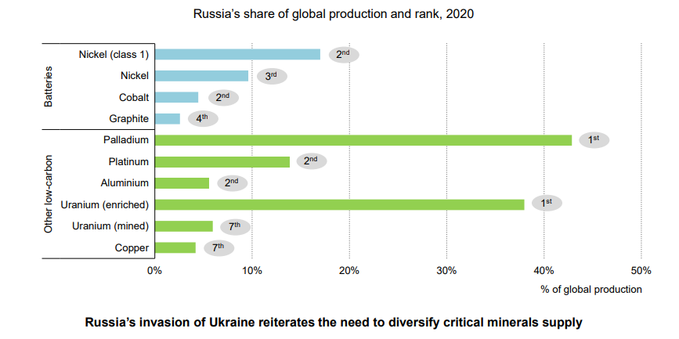
Many critical minerals are concentrated: example of Russia
Source: IEA, 2022

Slide 7
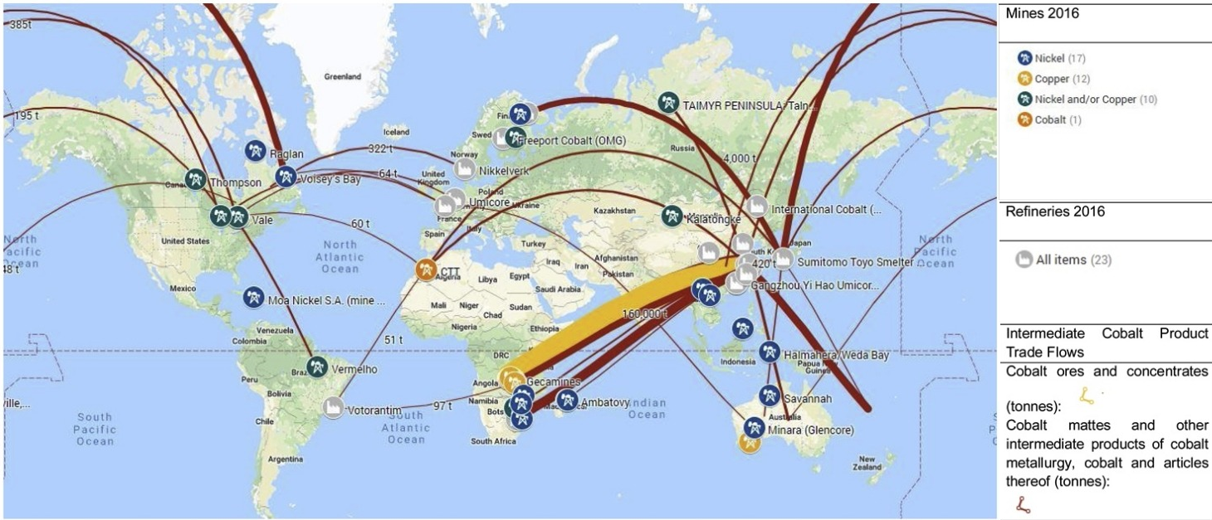
Supply chain stability

Slide 8
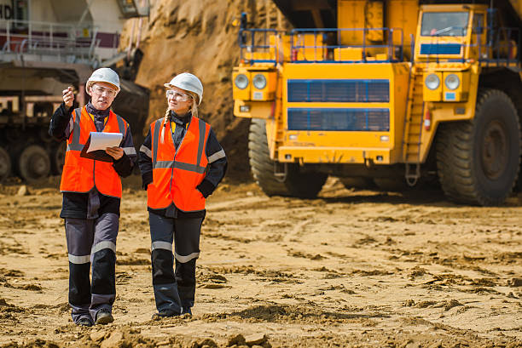
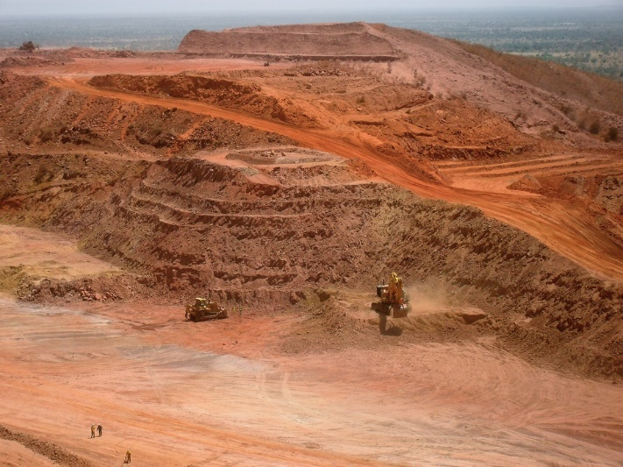
How can we ensure that the green transition has the resources and that they are sustainably extracted?
Soil, air and water
Human health
Biodiversity
Climate change

Slide 9
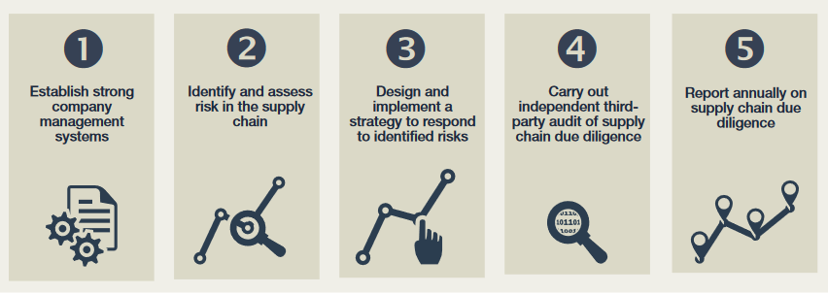
How can we improve the performance of mining companies?

Slide 10
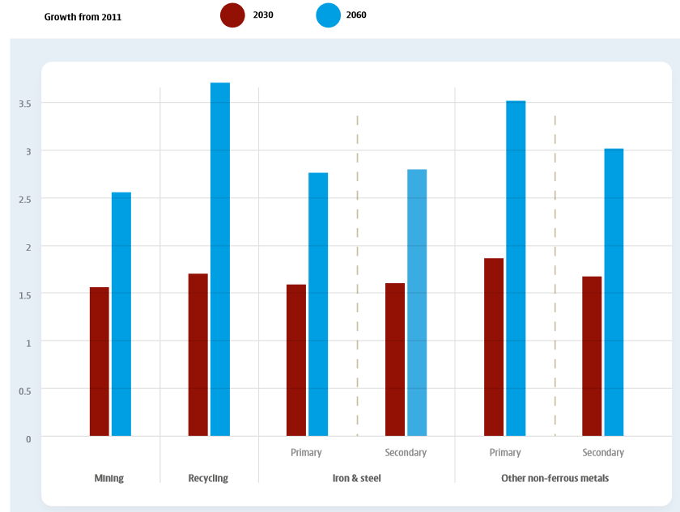
Supporting circular economy approaches

Slide 11
Mining is global, but sustainability questions are local

Slide 12
As well as broader environmental issues

Slide 13
Environmental Policy Stringency in 2020 and 2000

Slide 14
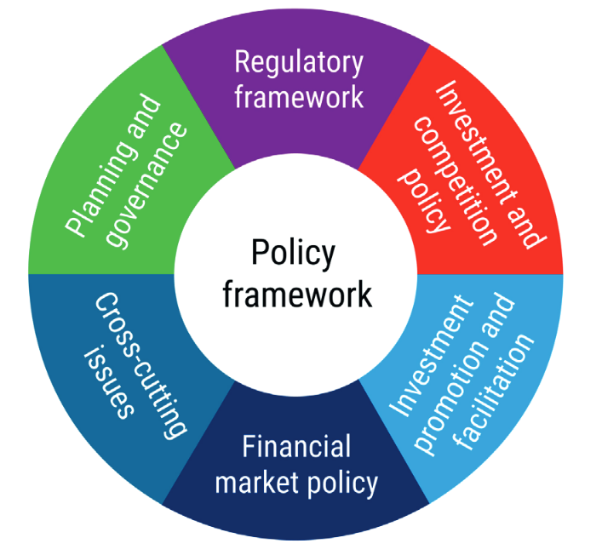
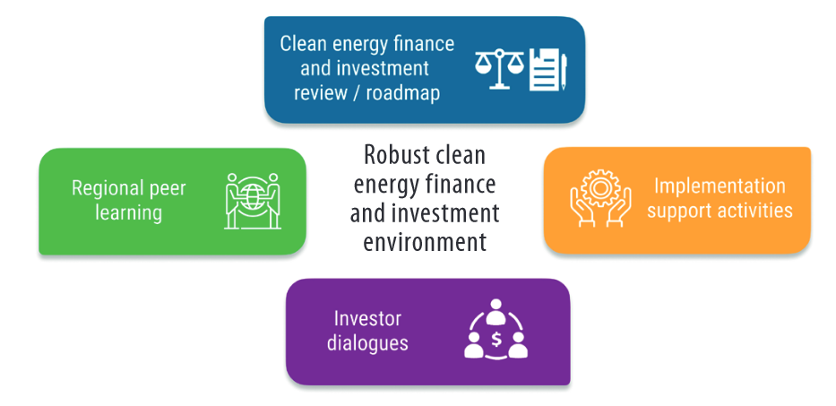
Investment in renewable energy and infrastructure

Slide 15
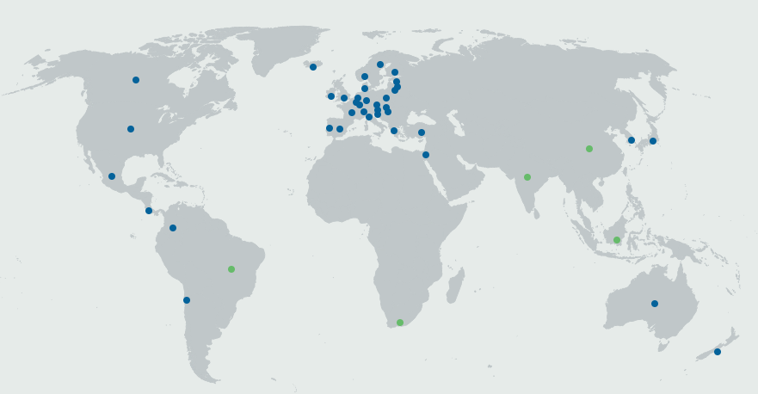
OECD Member Countries and Key Partners

Slide 16
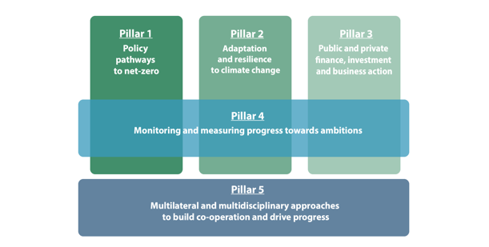
OECD’s holistic approach to climate change

Slide 17
Time for action

