Slide 2
Can mining be a sustainable business?

Slide 3
Sustainability topics for the mining industry
Casper Herler

Slide 4
nature of the MINING business model
Linearity
Commodity

Slide 5
A) LINEAR business model
1000 units of exploration
1 feasible project
Project development risks
Financing
Governmental relations
INPUT
SOCIAL COSTS
Ore
Water
Energy
Biodiversity
Social relations
Mining operation
Waste 99%
Wastewater
CO2
Dam risk
Biodiversity loss
Social conflict
SOCIAL GAINS
Taxes
Wages
Purchases
1% metal product

Slide 6
B) ”COMMODITY”
“In economics, a commodity is an economic good, usually a resource, that has full or substantial fungibility: that is, the market treats instances of the good as equivalent or nearly so with no regard to who produced them.”
Commodity = no brand value

Slide 7
KEY sustainability themes

Slide 8
1) WASTE: Will it remain acceptable to produce 99.9999% of waste to get 0.0001% of product?
An opportunity for thinking beyond what is percieved as possible.

Slide 9
2) What DOES circular economy mean in mining?

Slide 10
3) Climate change
From being part of the problem to being part of the solution.

Slide 11
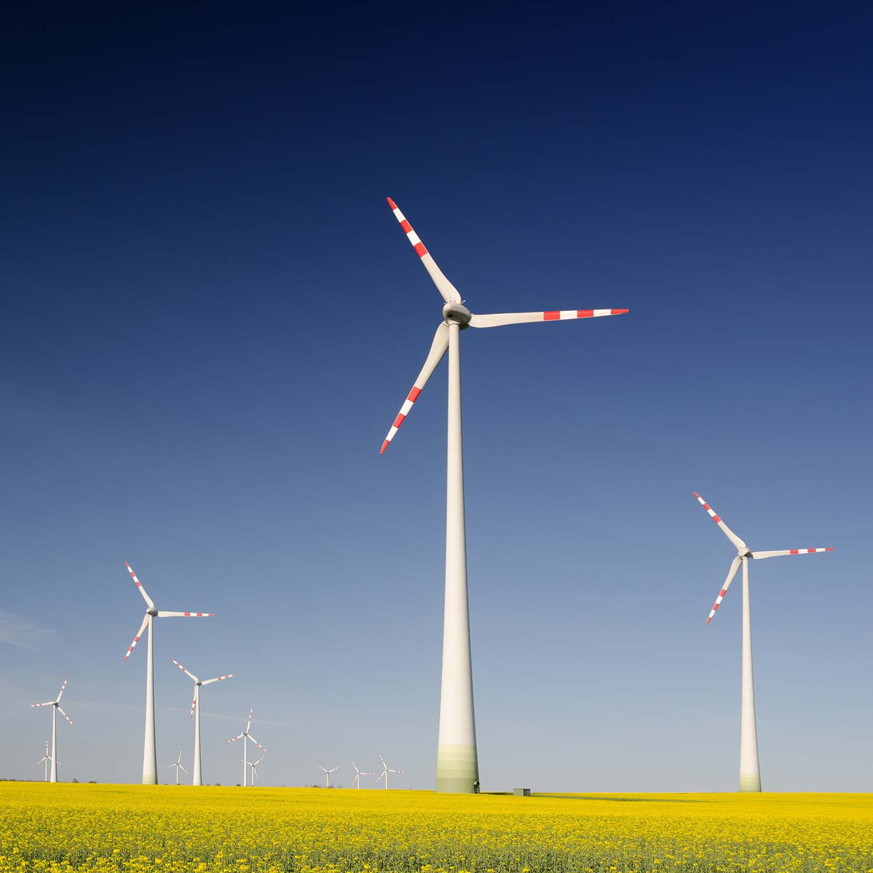
4) CaRBON footprint
Being part of someone’s footprint –
is a new dimension also for the mining industry.

Slide 12
5) Hydrogen economy
Revolutionizing the way to produce steel, chemicals, fuels and store energy.
Green, blue & turquoise H₂

Slide 13
6) Mining Dams
Brumadinho: 7 bn USD compensation to victims
Insurance industry reducing exposure to mining

Slide 14
7) Social acceptance of mining
What if people keep wanting the metals, but not the mining?
How will the EV and renewable energy demand of metals be met?

Slide 15
8) The Biodiversity challenge
No-net loss: what will the operating models look like when the requirement for projects are to be net positive for the biodiversity?

Slide 16
No net Loss (NNL) vs NET POSITIVE IMPACT (NPI)

Slide 17
Rethinking Mining will be about innovation, sustainability, value chains
Mining companies are including innovation as key targets in their strategies.
Unsustainable mining will not be supported by the investor community & society.
Capturing the value of mining will likely change the business models.

