Slide 2
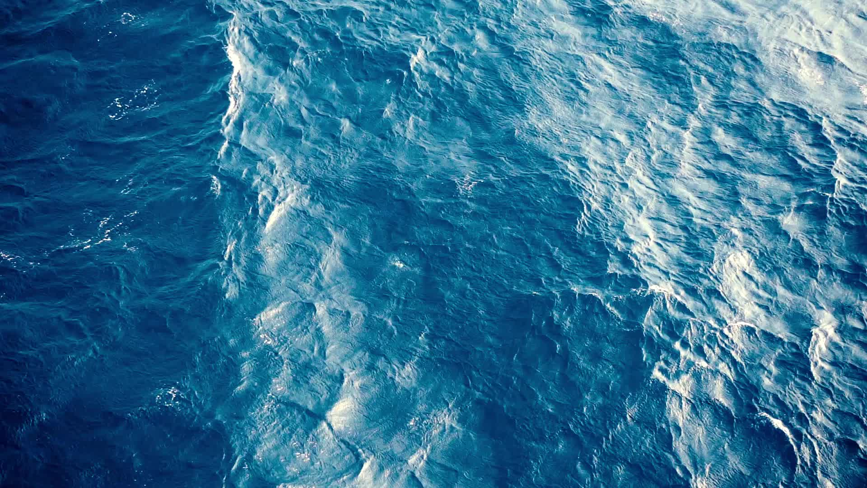
Marine ecosystems and their services as Blue Carbon
Dr Nathalie Hilmi
Centre scientifique de Monaco
EHS COMMITTEE SESSION
Supercharging Ecosystems: Are Conservation Parks to become key in the future economic recovery?
SEERIL BIENNIAL CONFERENCE

Slide 3
What are ecosystem services?

Slide 4
Global ecosystem services were classified in four categories
by the Millennium Ecosystem Assessment (MEA, 2005)
Service | Definition | References
Provisioning | This service relates to any product derived as a result of | Millennium
 | the presence of the ecosystem. Examples of provisioning | Ecosystem
 | services include food, fresh water, wood etc. | Assessment
 |  | (2005)
Regulating | The regulating service relates to all the benefits resulting | Millennium
 | from the ecosystem regulating other ecosystems. | Ecosystem
 | Climate change mitigation, fresh water production, | Assessment
 | carbon sequestration are examples of regulating | (2005)
 | services.
Supporting | The supporting services have an indirect impact on the | Millennium
 | people that rely on certain ecosystems. Examples of | Ecosystem
 | supporting services are primary production, production of | Assessment
 | atmospheric oxygen, water cycling, etc. | (2005)
Cultural | This service is defined by a nonmaterial approach. It | Millennium
 | includes the aesthetics, the spiritual enrichment and | Ecosystem
 | recreation due to the ecosystem. A major focus lies on | Assessment
 | cultural, religious and educational values. These values | (2005)
 | can differ between communities and are therefore harder
 | to value.
Millennium Ecosystem Assessment. (2005). Ecosystems and human well-being (Vol. 5). Island press United States of America.
http://www.bioquest.org/wp- content/blogs.dir/files/2009/06/ecosystems-and-health.pdf

Slide 5
The ocean plays a key role in global climate regulation through uptake and storage of heat and carbon dioxide
© Belén Benitez
Mediterranean Sea
© Belén Benitez
Mediterranean Sea
Notes:
The ocean plays a central role in climate change mitigation and adaptation. Ocean and climate systems are inextricably linked, and ocean-based action will strengthen climate action and vice versa. The ocean moderates global warming by absorbing ∼93% of the excess heat and ∼26% of the excess CO2 from the atmosphere. However, ocean ecosystems suffer the consequences of this buffering capacity with ocean acidification, ocean deoxygenation and many other complex changes in ocean dynamics. Following COP21, interest in mainstreaming the ocean into climate negotiations grew.

Slide 6
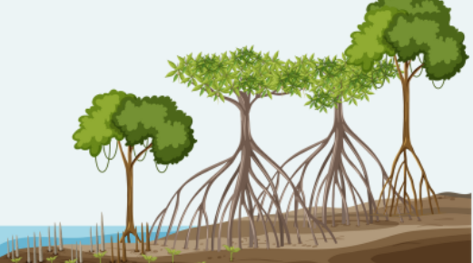
WHAT IS BLUE CARBON…?
The term “blue carbon” refers to the carbon captured in coastal and marine ecosystems. This includes coastal vegetated ecosystems, such as mangroves forest, salt marshes, and seagrasses meadows as well as the open ocean from the surface to the deep-sea.
NATURE-BASED SOLUTIONS…
Nature-based Solutions (NBS) are defined by the IUCN (2016) as “actions to protect, sustainably manage, and restore natural or modified ecosystems”, as strategies for simultaneously solving both socioeconomic and environmental problems.
They address societal challenges effectively and adaptively, alongside providing human well-being & biodiversity benefits. NBS are cost-effective and helping to build resilience.
Notes:
Nature-based solutions can help manage human impacts and tackle climate change to preserve ecosystems, their functions and the services they provide for human well-being.

Slide 7
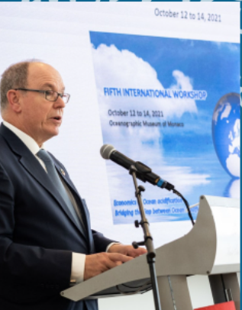
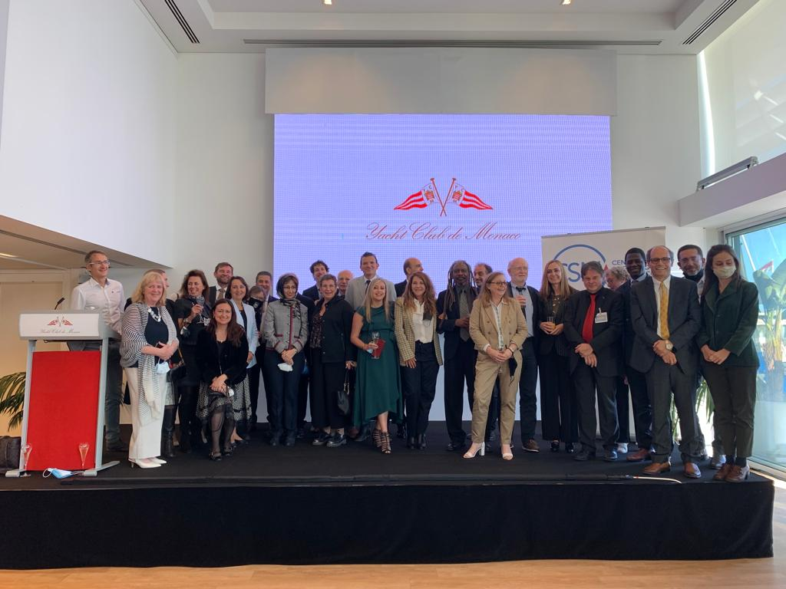
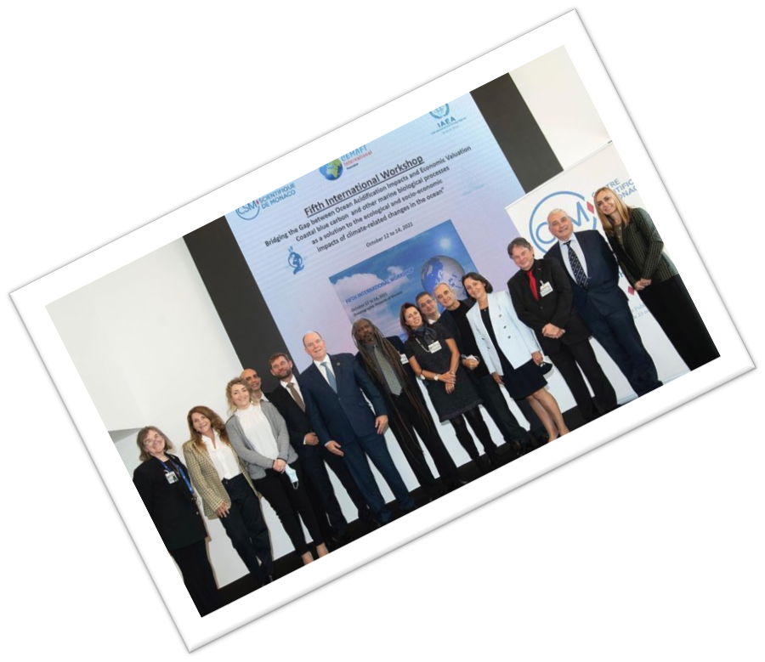
THE FIFTH INTERNATIONAL WORKSHOP ON THE ECONOMICS OF OCEAN ACIDIFICATION: SUMMARY FOR POLICY MAKERS Bridging the Gap between Ocean Acidification Impacts and Economic Valuation
PARTICIPANTS
Denis Allemand- Scientific Center of Monaco-Monaco
Maria Belén Benítez- Scientific Center of Monaco-Monaco
Claude Berthomieu- CEMAFI INTERNATIONAL- France
Fabio Berzaghi-Laboratory of Climate and Environmental Sciences-France
Laurent Bopp-Dynamic Meteorology Laboratory- France
Sandra Cassotta- Department of Law , , Aalborg University Aalborg-Denmark
Ralph Chami-International Monetary Fund-USA
Mine Cinar-Loyola University Chicago-USA
Francisca Cortés Solari-Filantropía Cortés Solari (FCS)-Chile
Florence Descroix-Comanducci- International Atomic Energy Agency (IAEA)- Monaco
Salpie Djoundourian-Lebanese American University, Byblos – Lebanon
Laura Elsler-World Maritime University-Sweden
Ekkehard Ernst-Geneva Macro Labs-Switzerland
Shehoofeh Farahmand- University of Isfahan-Iran
Christine Ferrier- Pagès- Scientific Center of Monaco-Monaco
Françoise Gaill-Ocean Climate Platform-France
Lionel Guidi - Sorbonne University, CNRS, Villefanche Laboratory of Oceanography-France
Jason Hall-Spencer-University of Plymouth -School of Biological and Sciences-UK, and University of Tsukuba, Shimoda Marine Research Center - Japan
Nathalie Hilmi- Scientific Center of Monaco-Monaco
Yunne-Jai Shin-IPBES- IRD-MARBEC-France
Lara Lebleu-Ocean Climate Platform-France
Lisa Levin- Scripps Institution of Oceanography, University of California, San Diego – USA
Samir Maliki-Faculty of Economics and Management, University of Tlemcen - Algerie
Pere Masqué-International Atomic Energy Agency (IAEA)- Monaco
Ana Maria Molina- MERI Foundation-Chile
Patricia Morales Errázuriz- Filantropía Cortés Solari (FCS)-Chile
Dinah Neuburg-Blue Green Future-USA
Hans Pörtner- Alfred-Wegener-Institute- Germany
Astrid Claudel-Rusin- Environment Department, Monaco Government-Monaco
Alain Safa-Skill Partners-France
Wassim Shahin-Lebanese American University, Byblos-Lebanon
Lars Stemann-Villefranche-sur-Mer Oceanography Laboratory-France
Michael Sutherland- University of The West Indies- Trinidad &Tobago
Mohamed Trabelsi-International Monetary Fund-Kuwait
Jeroen Van de Water- Scientific Center of Monaco-Monaco
Mary Wisz-Sasakawa Global Ocean Institute, World Maritime University, - Sweden

Slide 8
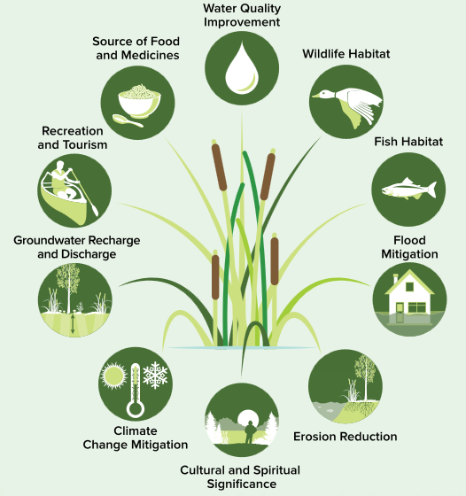
TROPICAL & TEMPERATE COASTAL ECOSYSTEMS
Marine tropical & temperate ecosystems include mangroves forests, tidal marshes, seagrasses meadows, kelp beds, rocky coastlines, sandy, muddy, and cobble shores.
Coastal vegetated ecosystems have been and are still currently being lost or degraded worldwide. Up to 67% of mangrove forests, 29% of seagrass meadows and 50% of tidal salt marshes have already been lost
These ecosystems sequester and store large quantities of carbon in both plants biomass and in sediments
© Belén Benitez
Mediterranean Sea
Source: Ontario Ministry of Natural Resources and Forestry. 2017

Slide 9
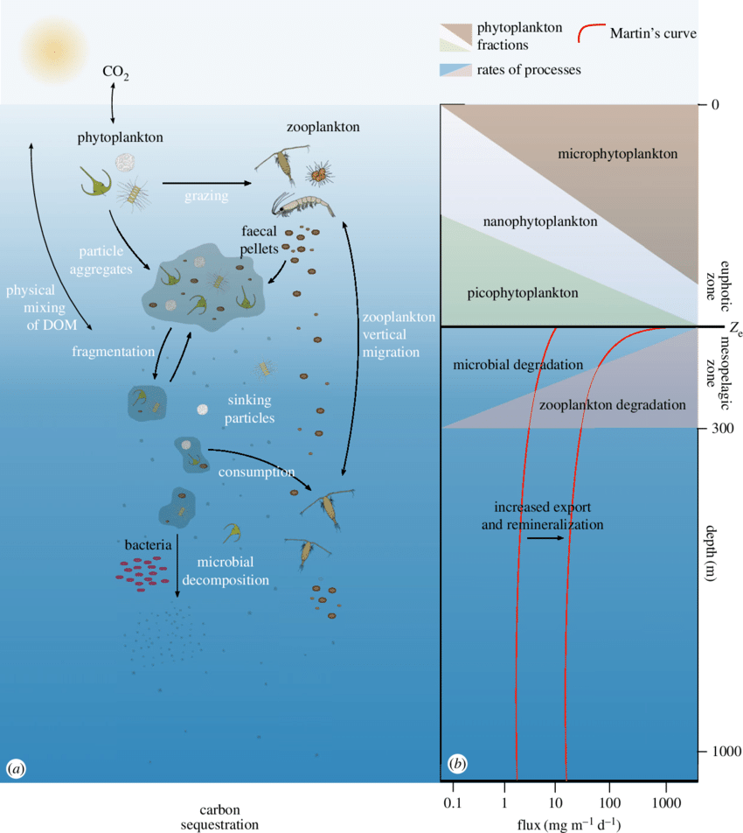
OPEN WATER & DEEP-SEA ECOSYSTEMS
The deep sea is vast and remote. It includes areas within and beyond national jurisdictions covering over 85% of the ocean floor.
The open ocean and deep-sea ecosystems:
-Are essential to the human-perturbed carbon cycle
-Are the largest stores of anthropogenic carbon after the atmosphere
Play a crucial role in maintaining anthropogenic carbon in the Deep Ocean, thanks to the biological carbon pump
The sequestration occurs in two ways:
one physical which is dissolution of CO2 in the surface water and the biological carbon pump. Both have different impacts and at different scales
Benoiston, Anne-Sophie et al. (2017)

Slide 10
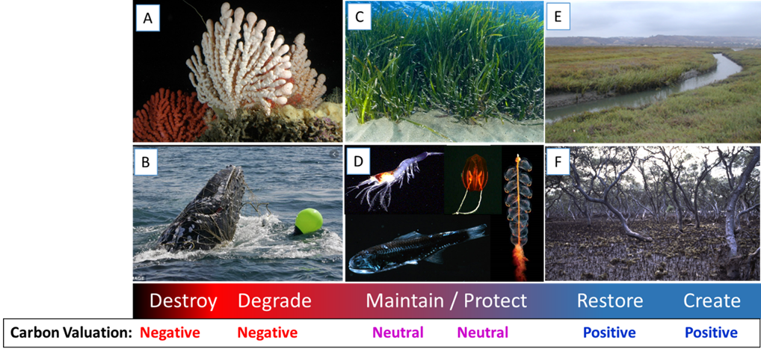
Examples of ecosystems and processes along a gradient of actions that can have negative, neutral or positive effects on carbon storage.
Hilmi N, Chami R, Sutherland MD, Hall-Spencer JM, Lebleu L, Benitez MB and Levin LA (2021) The Role of Blue Carbon in Climate Change Mitigation and Carbon Stock Conservation. Front. Clim. 3:710546. doi: 10.3389/fclim.2021.710546
Notes:
A) Demersal fishing gear has destroyed many ancient deep-sea coral reefs in the past 30 years, and none have been restored (photo credit JAGO-Team/IfM-GEOMAR). B) Whale populations have been decimated by hunting, ship strikes or entanglement in plastic fishing nets, lowering their ability to transfer carbon from the surface ocean to the deep-sea. C) Seagrass beds can store large amounts of carbon but have been in decline worldwide, requiring protection for those that remain (credit C Vasapollo). D) Pelagic animals such as mesopelagic fish draw carbon down from the shallows to great depths, their populations need to be maintained to protect this ecosystem service. Coastal developments have removed most saltmarshes (E) and mangrove forests (F) worldwide, requiring efforts to restore or recreate these important natural carbon stores.

Slide 11
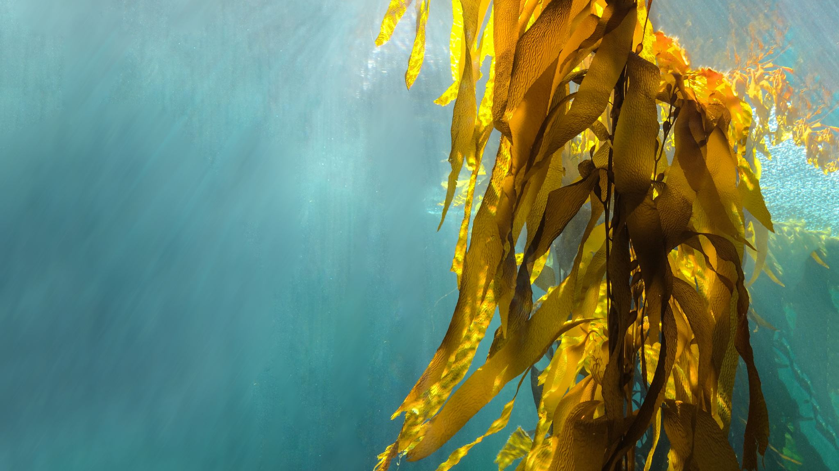
Coastal Ecosystem Services of Blue Carbon

Slide 12
Mangrove Ecosystem
Timber, Fuelwood & Charcoal
Harvesting wood has been identified as the main driver to mangrove deforestation in Western Africa (1.4) and parts of South Asia (1.5)
$ 744,000 per annum in the Sundarban reserves in India and Bangladesh
Flood, storm and erosion control, prevention of saltwater intrusion, carbon sequestration
Global mangrove coastal protection was valued at US$ 69.9billion (2009)
Carbon sequestration → carbon credits →
Voluntary Carbon Markets → revenue to communities
Breeding spawning and nursery
Act as critical habitats and have been observed to improve nearby coral reef fish abundance
Estimated that 1 hectare of mangroves improved commercial fisheries output by1.86 tonnes per year
Annual economic value can range anywhere between US $ 42- 37,500
Tourism, education, worship
Tourist attractions revolve around mangrove
Education and research are important cultural services of these ecosystems
Malaysian and Iranian mangrove estimated at an added tourism value of US $ 1 million and $ 7 million per year
Provisionary Services
Regulating Services
Supporting Services
Cultural Services
Adanguidi et al., (2020)
Islam and Bhuiyan (2018)
Uddin et al., (2013)
Barbier (2006); Locatelli et al., (2014)
Mazda et al., 2006; Plan Vivo (n.a)
Sanford (2009); Ullman et al., 2013
Verra (n.a)
Anneboina and Kavi Kumar (2017);
Carrasquilla-Henao et al., (2019);
DebRoy and Jayaraman (2012); Rönnbäck (1999)
Ahmad (2007); Dehghani et al., (2010)
Friess (2016); Spalding and Parret (2019); Uddin et al., (2013)
Notes:
Mangroves have a global coverage of approximately 4.06 billion hectares (FAO,2020A).
Provisionary:
They are recognised to have several provisionary services which include provision of timber, fuelwood and charcoal to local communities. Consequent, overharvesting has been identified as the main driver of deforestation in parts of Western Africa (Adanguidi et al., 2020) and South Asia (Islam and Bhuiyan, 2018), and through its provisionary services adds value to local economies, eg. annual revenue of US $744,000 in the Sundarban reserves in India and Bangladesh (Uddin et al., 2013).
Regulatory:
Global mangrove coverage provides protection from floods, storms, erosion, saltwater intrusion (Mazda et al., 2006), which have been valued globally at US $ 69.9 billion (Sanford, 2009). Awareness on mangroves role in coastal protection was popularised after the 2004 tsunami as it could have drastically mitigated the negative effects of the tsunami with sufficient mangrove maintenance (Mazda et al., 2006; Sanford, 2009). The estimation of mangrove value over 20 years of coastal protection and stabilisation service was approximated at US $12,263/ha and the cost of damages of a 1 km² loss in mangroves was around $1879/ha in Thailand (Barbier, 2006). Using the Voluntary Carbon Markets, mangrove ecosystems have been used to generate income for local communities using sale of carbon credits corresponding to carbon sequestration services (Verra, n.a, Plan Vivo, n.a) and have been identified as strong candidates for payment for ecosystem services (PES) (Locatelli et al., 2014). These mechanisms help fund conservation, protect mangroves and sequester carbon. However, there are only a few blue carbon projects generating carbon credits as it requires further climate market mechanisms (Ullman et al., 2013).
Supporting:
Mangrove ecosystems provide critical supporting functions as feeding grounds and spawning grounds, and as a consequence decrease predation risk for many fish species and have been observed to improve nearby coral reef fish abundance (Carrasquilla-Henao et al., 2019). In India, it was estimated that the marginal effect of 1 hectare of mangroves on fisheries output is 1.86 tonnes per year towards commercial marine fisheries (Anneboina and Kavi Kumar, 2017). Annual economic value addition to the local fisheries for one hectare of mangrove can range anywhere between US $42-US $37,500 depending on the location, species value, proximity to fisheries from the mangrove etc (DebRoy and Jayaraman, 2012). Additionally, annual economic value addition per hectare for penaeid shrimp (most economically viable fisheries associated with mangrove) ranges from US $91- US $5292.
Cultural:
Finally, mangroves through tourism (Spalding and Parret, 2019), education (Friess, 2016) and cultural practices (worship) adds further value. It was estimated to add US $1 million and US $7 million annually to the Malaysia and Iranian tourism revenue (Ahmad, 2007; Dehghani et al.,2010) and US $42,000 annually in the Sundarban reserves in India and Bangladesh (Uddin et al., 2013).

Slide 13
Saltmarsh Ecosystem
Raw materials and food to livestock
GBP 15.27/ha/year* net income as a result of livestock grazing in the UK
*1995 values, likely appreciated
Coastal protection, rainwater absorbance, water filtration, carbon sequestration
Acts as a carbon sink and has recently been monetised using carbon credits
Salt marshes absorb excess nutrient runoff and pollutants from the coast and prevent eutrophication
Dissipates wave action thereby protecting the coast.
Shelter, breeding and nursery ground to fisheries
Act as critical habitat- it naturally keeps out large predators as it is oxygen depleted
Contribution of US $ 6471/acre* and US $ 982/acre* to east and west coast recreational fisheries respectively in the US
*1997 values, likely appreciated
Tourism, recreation, education, and research
Bird watching and educational tours often revolve around this ecosystem
Estimated annual benefits of USD338/acre for commercial tourism and recreational activities
Supporting Services
Cultural Services
Provisionary Services
Regulating Services
King and Lester, 1995 cited in Barbier et al., (2011)
Barbier et al., (2011); Breaux et al., 1995 and Costanza et al. 2008 cited in Barbier et al., (2011); Saltmarsh guide (n.a);.Verra (n.a)
Bell (1997) and Freeman, (1991) cited in Barbier et al., (2011)
Saltmarsh guide (n.a)
Barbier et al., (2011); Saltmarsh guide (n.a)
Notes:
Provisionary Services
Salt Marshes provide raw materials and food to livestock with approximately GBP 15.27/ha per annum generated as net income in the UK as a result (King and Lester, 1995 cited in Barbier et al., 2011).
They also provide various regulatory services through coastal protection (Barbier et al., 2011) with a value addition of US $8236/ha per year in terms of hurricane protection in the USA (Costanza et al. 2008 cited in Barbier et al., 2011); carbon sequestration which has recently been monetised using carbon credits (Verra, n.a); rain water absorbance and water filtration by absorbing excess nutrient runoff and pollutants from the coast and preventing eutrophication in larger water bodies (Saltmarsh guide, n.a) and thereby prevent additional costs of approximately additional US $785-15,000/acre cost for replacement water purification services in the US (Breaux et al., 1995 cited in Barbier et al., (2011).
Salt marshes support other ecosystems by providing sheltering, breeding and nursery grounds (Saltmarsh guide (n.a) and contribute US $6470/acre to east coast recreational fisheries and US $982/acre to west coast recreational fisheries in the US (Bell, 1997 cited in Barbier et al., 2011); and US $0.19-1.19/acre to blue crab fisheries in the Gulf Coast, USA (Freeman, 1991 cited in Barbier et al., 2011).
Cultural:
Also, with cultural services like tourism and educational activities (Saltmarsh Guide, n.a), it was estimated that annual benefits were approximated at US $338/acre for commercial tourism and recreational activities (Barbier et al., 2011).
One concrete example concerning the salt marshes is Purcell et.al (2021) analysis of South Carolina’s coastal marshes and wetlands. According to the authors, the supporting services, provisioning services, regulating services, and cultural services made possible by coastal marshes and wetlands offer market and non-market goods and services for billions of dollars of economic output annually.

Slide 14
Seagrass Ecosystem
Bait collection ground, substrate for seaweed cultivation, traditional medicine, generation of biological productivity and diversity
Food provisioning service & pharmaceutical material for drugs
Economic value of Posidonia oceanica in Europe = 284-514 €/ha/year →
25.3 million - 45.9 million €/year
Stabilise sediments, coastal protection, carbon sink, mitigation of acidification, and water purification
Seagrass increases the pH and aragonite saturation necessary for coral growth ; retains particles of pollutants therefore purifying the water
Loss of seagrass approximately costs USD 1.9-13.7 billion/year globally due to release of ^{CO}₂
Carbon sequestration value addition estimated at US $ 394/ha/year
Acts as a critical habitat and shelters fish, produces large amounts of organic carbon to marine food webs
Fish abundance, growth and survival are higher in seagrass beds than unsheltered habitats.
Protect calcifying organisms from destructive effects of ocean acidification.
Value addition of nutrient cycling was estimated at US$19,004/ha/year
Regulating Services
Supporting Services
Provisionary Services
Ambo-Rappe et al. (2019); Barbier et al., (2011); Campagne et al. (2015); Cullen-Unsworth and Unsworth (2013); Dewsbury et al. (2016); Vasarri et al. (2021); Yuvaraj et al. (2012)
Barbier et al., (2011); Cullen-Unsworth and Unsworth (2013); Duarte et al., 2005; Pendleton et al., (2012)
Cullen-Unsworth and Unsworth (2013); Costanza et al., 1997 cited by Dewsbury et al., (2016)
Notes:
Provisionary Services:
The provisioning services of seagrass range from food services to pharmaceutical material for drugs (Ambo-Rappe et al., 2019; Cullen-Unsworth & Unsworth, 2013). The endemic mediterranean species Posidonia oceanica is estimated to have an economic value of around 284 to €514 /ha/year in Europe which is around €25.3 to 45.9 million / year (Campagne et al., 2015). This is due to the fact that Posidonia oceanica hosts about 20 to 25% of all species living in the Mediterranean Sea (Vasarri et al., 2021). In Australia, the contribution of seagrass beds is even higher. It is estimated that the market value of potential shrimp fishery catches linked to seagrass beds in Western Australia is between US $684 and US $2511/ha/ year. The overall contribution of seagrass beds to the Australian economy is estimated to US $103.74 million. (Barbier et al., 2011; Dewsbury et al., 2016)
Regulating Services
Besides all the provisioning services, Seagrass also engages in ecosystem regulations like the stabilisation of sediments and the prevention of coastal erosion among others. Furthermore, Seagrass acts in a way that purifies the water due to its retention of particles and deposition of pollutants. (Cullen-Unsworth & Unsworth, 2013; Barbier et al., 2011) Due to photosynthesis, seagrass sequesters carbon and is then partially stored in the sediment on its mortality as refractory detritus. This detritus has been estimated to store half of the total carbon burial in the ocean. (Cullen-Unsworth & Unsworth, 2013; Duarte et al., 2005) Due to the loss of seagrass the stored carbon dioxide is being released which causes approximately US $1.9 to 3.7 billion/ year in global economic cost (Cullen-Unsworth & Unsworth, 2013).
Supporting Services
Regarding the supporting services, seagrass acts as a critical habitat for shelter to several hundreds of species of fish. Furthermore, the fish abundance, growth and survival are much higher in seagrass beds than unsheltered habitats. (Cullen-Unsworth & Unsworth, 2013) and it was estimated that nutrient cycling in seagrass ecosystems provide services valued around 32 000 $/ha/year in 2018.

Slide 15
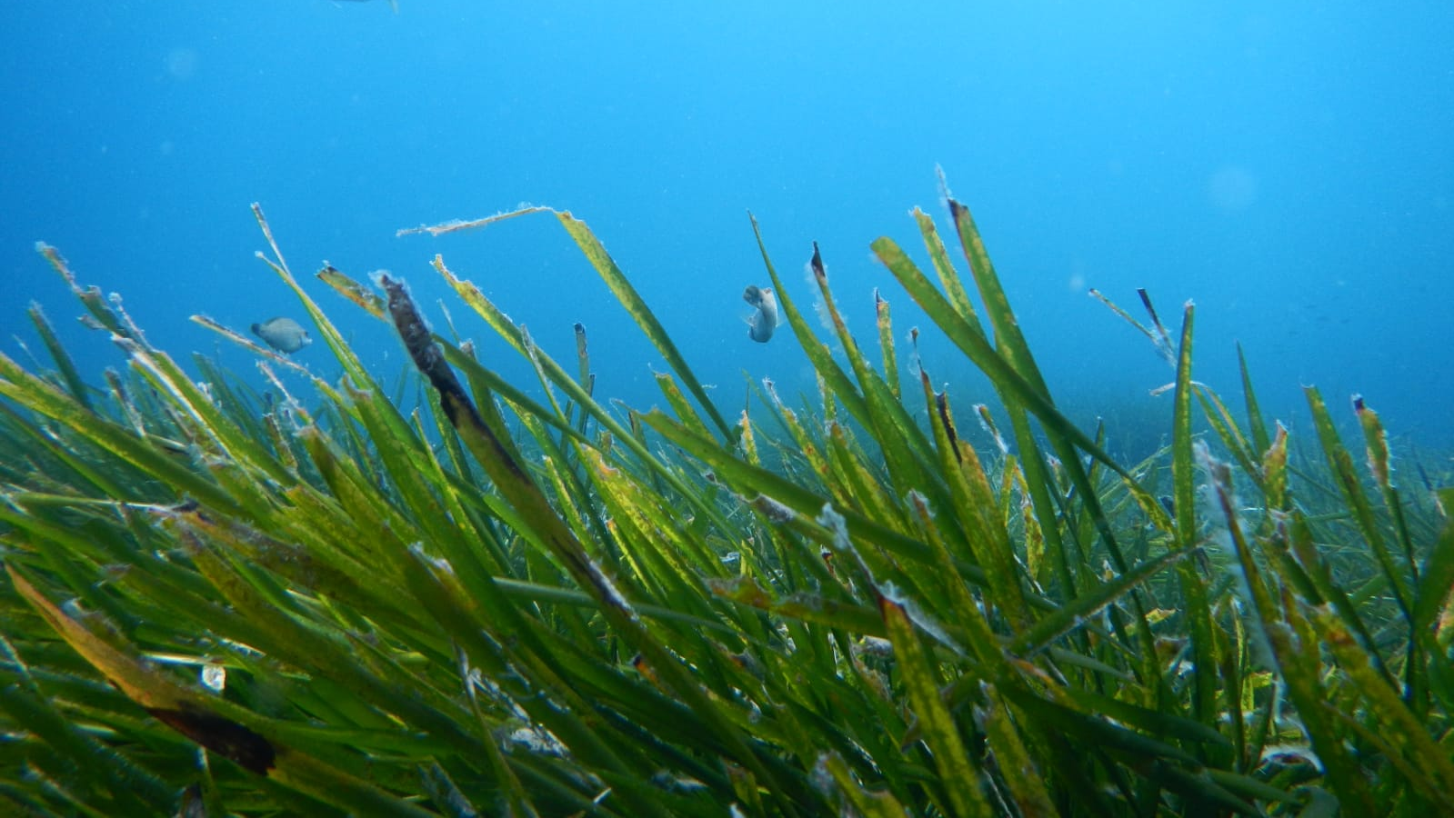
Thank You

Slide 16
Seaweed Ecosystem: Wild & Farmed
Food source for humans and animals, chemicals, biofuel, renewable products, etc.
28.5 million tonnes annual production globally
54,000 tons of cultivation in Americas and Europe worth $51 million
2014 Global Estimations
Kelp: $1.4 billion ; Kappaphycus & Eucheuma: $1.9 billion;
Sargassum: $80 million
Carbon and Nitrogen sink:
65,000 tons of nitrogen p.a
760,000 tons of carbon p.a
^{CO}2 Sink→ immediate refuge from ocean acidification → benefit to calcifying organisms
Benefits of co-culture of bivalves and seaweed aquaculture
uptake of toxic substances like Nitrogen and Phosphorus → Fisheries improvement
Habitat to fisheries and potential biofuel
habitat for fish and small mobile species and immobile species → impact on fishing
due to potential use for biofuel production → potential CO2 mitigation in terms of avoided emissions from fossil fuels = 1,500 tons ^{CO}2/ km²
Business opportunities , research, biodiversity affected due to seaweed farms
Negative impact on recreational values: i) impact on aesthetic values, ii) disturbing temporary activities
Positive impact on water quality, which benefits recreational fishing
Regulating Services
Supporting Services
Cultural Services
Provisionary Services
Kim et al. (2017);
Mac Monagail et al. (2017)
Hasselström et al. (2018)
Kim et al. (2017)
Xiao et al. (2021)
Duarte et al. (2017)
Hasselström et al. (2018)
Cabral, P. et al. (2016)
Hasselström et al. (2018)
Notes:
p.a = per annum
Provisionary Services:
Both wild and farmed seaweeds provide incredible provisioning ecosystem services, since they are widely used as a food source for both humans and animals. Furthermore, seaweeds are economically used to create biofuel and other renewables. (Kim et al., 2017) In 2014 the annual global production was estimated at about 28.5 million tonnes, from which 1.2 million tonnes are wild and 27.3 million tonnes are farmed aquaculture seaweed. Regarding the global brown seaweed harvesting, Chilean and Norwegian kelp accounts for 60% of the global wild seaweed. (Mac Monagail et al., 2017)
In financial terms kelp accounted for US $1.4 billion and the genus Kappaphycus and Echeuma for $1.9 billion in 2014 globally. Regarding the cultivation of seaweed, the Americas and Europe amounted to about 54,000 tons in 2014 with a value of US $51 million. As a comparison, South Korea exported a value of US $67 million to the United States in the same year. (Kim et al., 2017)
Regulating Services:
Seaweed has an immense potential for regulating ecosystem services like the uptake of toxic substances. The uptake of substances like Nitrogen and Phosphorus also improves the fisheries situations due to an increase in water quality. (Hasselström et al., 2018) According to Kim et al. (2017), Seaweed acts as a Carbon and Nitrogen sink with an estimated amount of 65,000 tons of Nitrogen and 760,000 tons of Carbon per year. As seaweed acts as ^{CO}2 sinks though net primary production, it mildly reduces the effects of ocean acidification (at rates of 0.017-0.027 unit per decade) which benefits calcifying organisms. Also, benefits of co-culture of bivalves and seaweed aquaculture protects bivalves from predation and mitigate impacts associated to bivalve nutrient release.
Supporting Services:
Hasselström et al. (2018) argue that seaweed also acts as an important habitat for fish and small mobile and immobile species, which has a significant impact on the fishing industry. Seaweed farms established through artificial reef anchoring methods can benefit lobster and Crab populations. Another supporting service is the potential CO2 mitigation in terms of avoided emissions from fossil fuels, if Seaweed can be used in biofuel production in the long run. This can potentially avoid emissions in an amount of 1,500 tons CO2/ km². (Duarte et al., 2017)
Cultural Services:
Culturally speaking both wild and farmed seaweed contribute to active coastal villages and provide research inspiration, business ideas and sustainable solutions in general. However the impact is not always as positive as an improved water quality, but can also be seen as negative. Several recreational values like aesthetics and disturbing temporary activities have to be taken into account. (Hasselström et al., 2018) Furthermore, Cabral et al. (2016) see the affected biodiversity due to seaweed farms as an impact on cultural services.

Slide 17
Fish and Fisheries
Aquaculture production and wild catch
→ 53.4 million tonnes in 2017 ($139.7 billion)
→ 67 million tonnes of wild caught fish traded in 2018 ($164 billion)
Regulation of food web dynamics, nutrient recycling, maintenance of sediment processes, maintenance of genetic biodiversity
→ release of ^{CO}2 (0.73 billion Mt) since 1950
→ Carbon in faeces, respiration contribution to marine snow
→ nutrients and byproducts generated by finfish mariculture used for polyculture
Daily, yearly migration patterns; linkage of different ecosystems due to consumption
→ enhancement of primary production in nutrient poor environments due to distribution of energy
→ mariculture facilities as small-scale protected areas to exclude or restrict fishing activities
Materials, techniques and symbolic in the artisanal fisheries of some communities
Provisionary Services
Regulating Services
Supporting Services
Cultural Services
FAO (2020)
Konar et al. (2019)
Tacon (2020)
Alleway et al. (2019)
Holmlund & Hammer (1999)
Mariani et al. (2020)
University of Southampton (2021)
Alleway et al. (2019);
Holmlund & Hammer (1999)
Fish et al. (2016)
Notes:
Provisioning Services:
Regarding the ecosystem services of fish, the most important ones are the provisioning services with a total aquaculture production value of US $139.7 billion in 2017 with an amount of 53.4 million tonnes (Tacon, 2020) and a wild caught fish export value of US $164 billion in 2018 with an amount of 67 million tonnes (FAO, 2020B). Small pelagic fish is estimated to provide US $18.7 billion per year (Konar et al., 2019).
Regulatory Services:
Fish are also important in terms of food web dynamics regulation, nutrient recycling, the maintenance of sediment processes and the maintenance of genetic biodiversity (Holmlund & Hammer, 1999). Relatively new studies also investigate a more specific role of their regulating service. Mariani et al. (2020) for example argue that commercial fisheries have released around 0.73 billion metric tonnes of CO2 in the atmosphere since 1950 with a 37.5 metric tonnes emission after the fish consumption and processing. This blue carbon would have technically been sequestered, since the majority of dead fish sinks to the bottom. Therefore, fish possess a reversed regulating service.
Culturally speaking, fishing can be seen as a production and caring activity and mostly refers to the materials, techniques and symbolism in the artisanal fisheries of some communities. (Fish et al., 2016)
Conclusion
In a nutshell, these examples can show the wide variety of market-based (carbon compensation, or production based methods for fishes) and no-market valuation techniques (diverse approaches such as travel cost, avoided damage cost, substitute cost, hedonic pricing, and contingent valuation for instance, etc.) available in order to estimate the value of ecosystem services, according to their types. These valuations always depend on context where they are implemented. However, the global methodological knowledge curve could be accelerated with better cooperation and exchanges.
In order to share experiences and provide concrete examples that would be beneficial to researchers, NGOs, economic sectors and deciders, an online platform could be created to gather results, methods and references at a global level. With a constant dialogue on indicators and approaches, this would foster cooperation between countries and facilitate new projects in favour of conservation, restoration and protection, in direct line with sustainable development goals and UNFCCC objectives.

