Slide 1
Understanding Construction Contracts
Hadef & Partners – June 2022

Slide 2
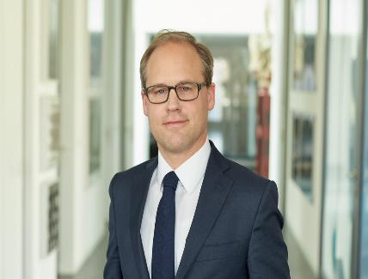
Your Speakers
R SPEAKERS
Romain Berthon
LPA-CGR Avocats, Casablanca
Matthew Finn
Ankura, London
Moderators
Stefach Gerlach
SGP Legal, Munich
Head of Legal In-house
Scholarship Officer, IBA Real Estate Section
Johane Murray
Partner, Brodies, Glasgow
Scholarship Officer, IBA Real Estate Section
Michael Lunjevich
Partner & Head of Commercial & Property
Hadef & Partners LLC
Dubai, UAE
Co-Chair, IBA Real Estate Section

Slide 3
What to look out for when buying an under construction project?
Type of Construction Contract.
FIDIC / JCT / VOBB / Other Templates.
Applicable Law.
3

Slide 4
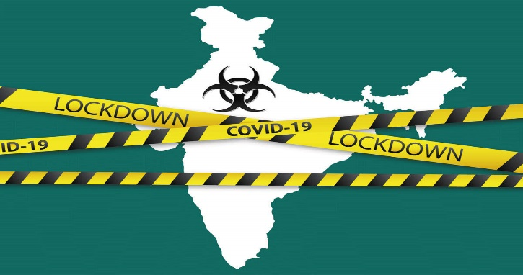
Price?
Fixed price, cost plus, provisional sums.
Price re-openers:
Variations
Delays.
Supply chain issues
Covid.
Inflation.
Geopolitical Risks – labour shortages, wars, Brexit etc.
4

Slide 5
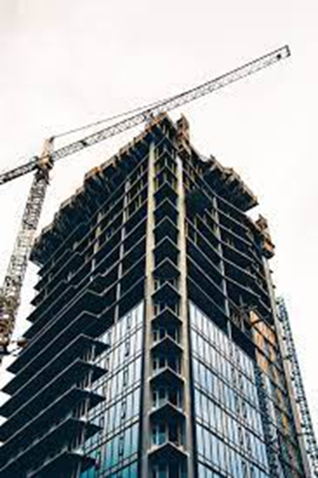
Performance Bonds and Advance Payment Guarantees
What are these?
What are the key issues to look out for?
Type of Bond - On-demand versus Default Bonds.
Value of the bond.
Assignment/Novation.
Hadef & Partners – June 2022
5

Slide 6
Construction Insurance
.
What are the main issues to identify?
Coverage Limits.
Allocation of risks. Exclusions/Extensions.
Premium payments, Claims history.
How to ensure your client is covered by the insurance and becomes the loss payee?
6

Slide 7
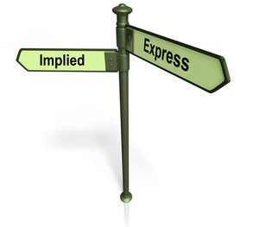
Defects liability and Warranties
Statutory Protections versus Contractual
Workmanship vs Structural – Are they treated differently?
Consultant, Contractor, and Key Sub-Contractors? Collateral Warranties?
Records and importance relating to contra charges/abatements.
In the event of termination – replacement contractor (delay and quantum issues).
Recovery of cost – rectification/cost to complete.
7

Slide 8
Don’t Forget About the Consultants Contracts
Design Contracts
Supervision Contracts
What are the big ticket items to look out for?
8

Slide 9
Questions?
THANK YOU!
Hadef & Partners – June 2022
9

