Slide 1
GROWING IMPORTANCE OF ESG FOR PRIVATE INVESTORS’ M&A AND INVESTMENT STRATEGIES
Tuesday 1 November (14:30 - 15:45)

Slide 2
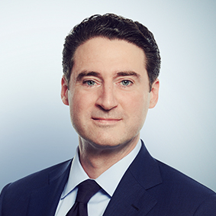
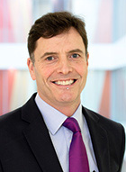
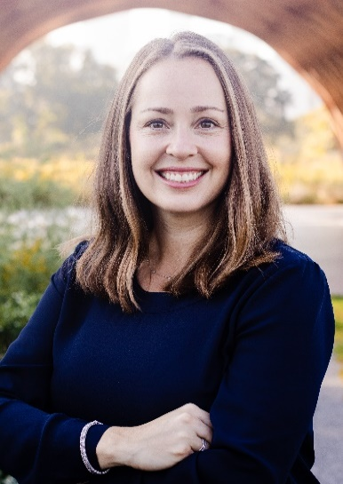
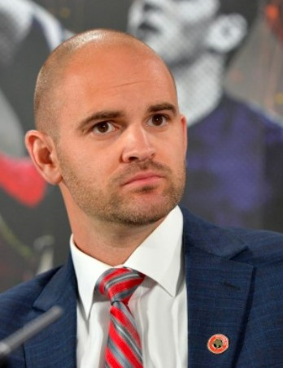
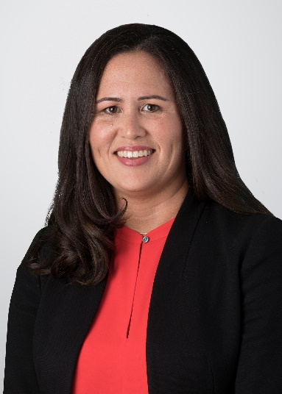
Session Co-Chairs
Damien R. Zoubek
Richard Spink
Lisa Forbes
Benjamin Boycott
Danielle Price

