Slide 2
ESG Financing

Slide 3
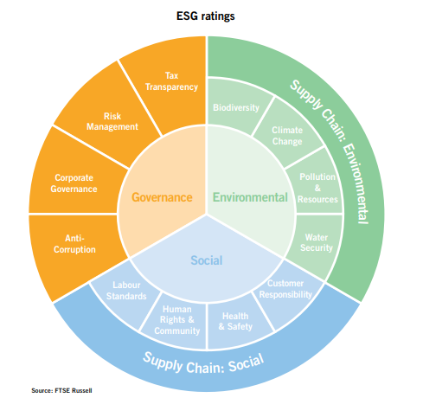
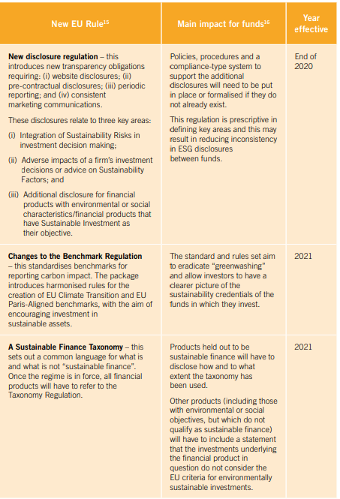
ESG – what is

Slide 4
Green Loan/Bond Principles
Green loans are any type of loan instrument made available exclusively to finance or re-finance, in whole or in part, new and/or existing eligible Green Projects.
Core components:
USE OF THE PROCEEDS
PROCESS FOR PROJECT EVALUATION AND SELECTION
MANAGEMENT OF PROCEEDS
REPORTING
There are a number of financial instruments available to project companies engaged in ESG activities. These include green, social, and sustainability bonds, whose proceeds are linked to ESG activities, as well as sustainability-linked bonds, whose financial terms are linked to ESG metrics.

Slide 5
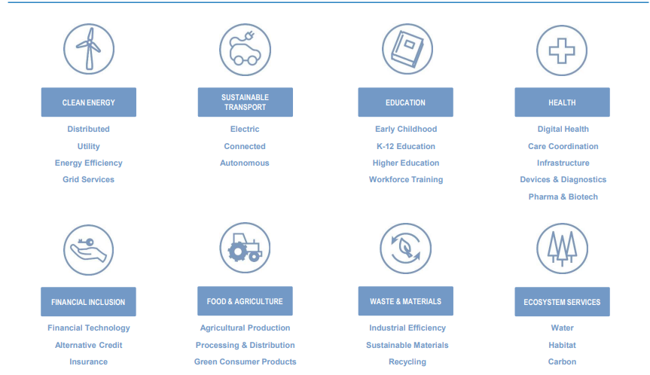
ESG Investment field

Slide 6
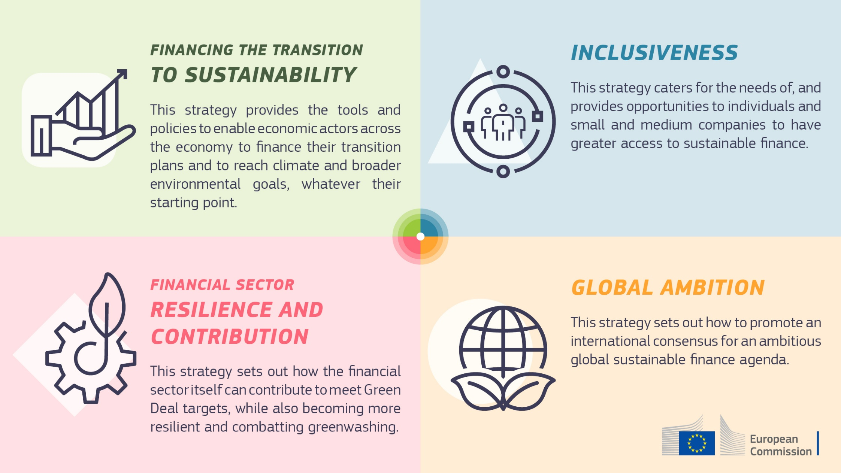

Slide 7
Thank you

