Slide 1

The future of infrastructure delivery
Nasir Khan MBE
May 2022
Notes:
0 - MSJ

Slide 2

Contents
Introductions | 3
Infrastructure | 10
ESG Factors | 12
Management of infrastructure | 16
When things go wrong | 17
Dispute Causation | 18
Dispute avoidance or risk management | 21
Management of projects | 22
Recommendations | 23

Slide 3
Who we are
Business
We are one of the world’s leading physical assets management consultancies, dedicated to advising clients in respect of the management and utilisation of their physical assets.
Scale and service
  With around 2,000 members of staff in over 60 offices worldwide, we have global reach with a local delivery ethic. We are recognised for our exceptional quality of service, close, long-term client relationships and sustainable added value.
Reputation
We are recognised for our excellent client service and our clients benefit from our continuous focus on innovation and dedication to pioneering new techniques.
Key regions
Americas
Asia Pacific
Europe and UK
India
Middle East
Notes:
With a combination of people, services, dynamic software and processes Currie & Brown has the expertise to assist clients at all stages of the project lifecycle from concept through FEED, engineering design, procurement, construction, commissioning and asset management, to decommissioning.

Slide 4




About Currie & Brown
Currie & Brown is unique. Over the years we have grown our services, expertise and capabilities to meet the needs of our clients, while also providing added value at every opportunity.
The continued success of Currie & Brown is due to our ability to maintain focus on and a disciplined approach to supporting clients in the key service areas of:
100+
Years in business
60+
Global locations
2,000~
Staff worldwide
Cost management
Project management
Building surveying
Advisory services
Notes:
Currie & Brown are one of the world’s leading physical assets management consultancies, dedicated to advising clients in respect of the management and utilisation of their physical assets. With around 2,000 members of staff in over 60 offices worldwide, we have global reach with a local delivery ethic. We are recognised for our exceptional quality of service, close, long-term client relationships and sustainable added value.

Slide 5















Our experience
By focusing our business on strategic market sectors, we can target our expertise and experience on projects and clients to allow us to maximise added value. Our aim is to use the knowledge of our sector leaders, supported by our network of offices, to provide a national and local service.
Commercial property
Defence
Education
Funding institutions
Government
Healthcare
High-tech
Hospitality and leisure
We are able to use the knowledge of our dedicated sector leaders in conjunction with our local offices to lever expertise and relationships.
Industrial
Nuclear
Oil and gas
Pharmaceuticals and life sciences
Residential property
Retail
Transportation and logistics
Utilities and renewables
Notes:
Nuclear: Currie & Brown has been continuously involved with the nuclear industry throughout all the restructuring that has taken place over the last two decades and we have earned a reputation for understanding the special requirements of the nuclear sector and for being able to deliver project and commercial services to a range of challenges.
We have experience at the following stages of a nuclear programme:
New build
Enrichment cycle
Upgrading operational support and maintenance
Decommissioning
Our clients in the nuclear industry appoint us to provide our full range of services, including risk and opportunity analysis. We operate with clients on some key nuclear projects like Flamanville in France, Hinkley Point in the UK and also on decommissioning projects in the UK.
Oil & Gas: With a combination of people, services, dynamic software and processes Currie & Brown has the expertise to assist clients in the oil and gas industry at all stages of the project lifecycle from concept through FEED, engineering design, procurement, construction, commissioning and asset management, to decommissioning.
The continuing impacts of economic upheaval, fluctuating oil prices, global mergers and a converging industry mean that the oil and gas sector will continue to face challenging times, which Currie & Brown is well placed to adapt to.
Utilities & Renewables In supporting our clients to realise their development ambitions, Currie & Brown’s experienced multidisciplinary teams will apply over 80 years of worldwide experience and appreciation of the gas, water, wastewater, electricity and telecommunications industries to support your needs.
Currie & Brown has worked with national and international utility operators, developers, contractors and their teams of specialist designers, engineers, lawyers, funders, national regulators and insurers in all aspects of capital investment, construction, operations and ongoing assets management.
Our qualified project managers, surveyors and engineers will focus on the programme and efficiency drivers that assist clients to shape their long-term high quality lifecycle assets management and business efficiency requirements.

Slide 6

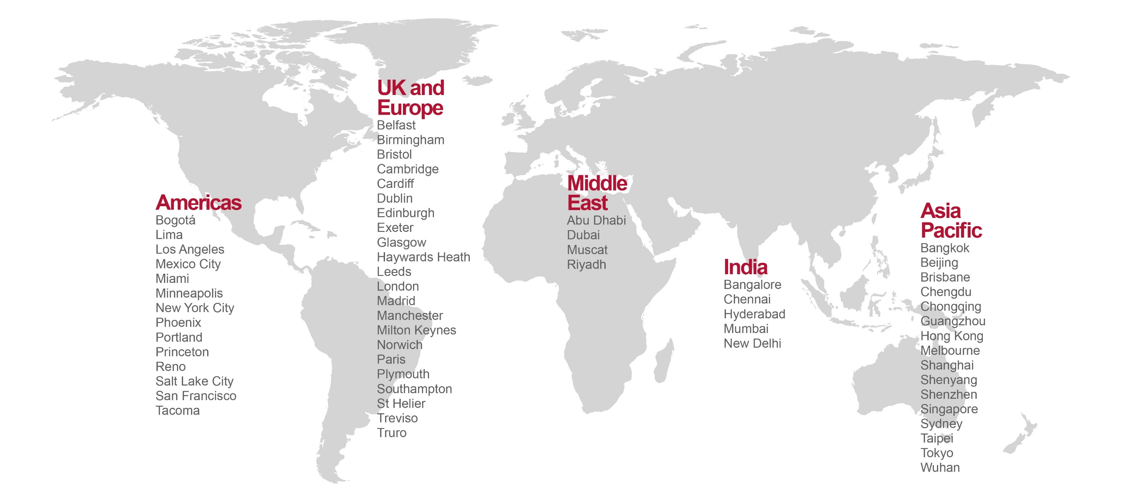
Our global locations

Slide 7
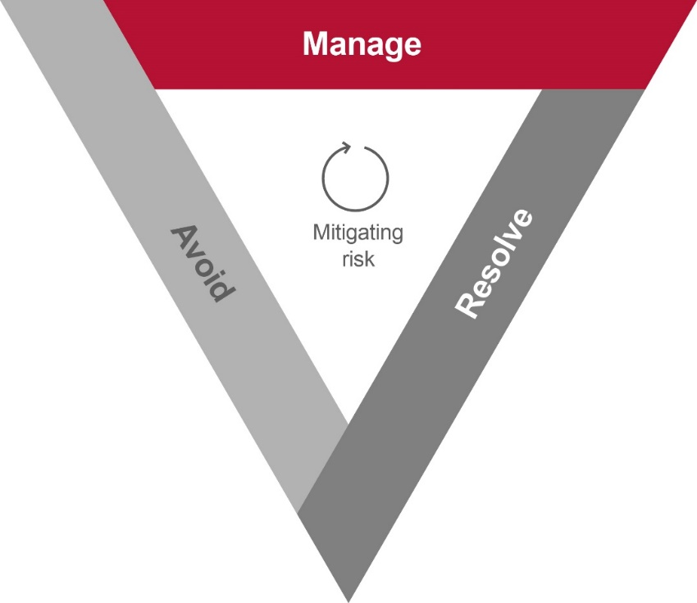




Contract solutions
Avoidance is better than cure
Contract solutions allow clients to understand and manage their contractual risk with effective pre-contract procurement advisory and resilient post-contract dispute avoidance, management and resolution throughout the project lifecycle.
Our vision is to be the leading consultancy known for its integrity, objectivity and fairness acting as a partner of choice for our clients.
The values that form the foundation of our business include:
Resolve
Resolve
Avoid
Avoid
Clients
We treat clients the way we would want to be treated
Excellence
We strive for excellence
People
We care for our people through a challenging and supportive working environment
Sustainability
We care about the effect we have on the environment

Slide 8
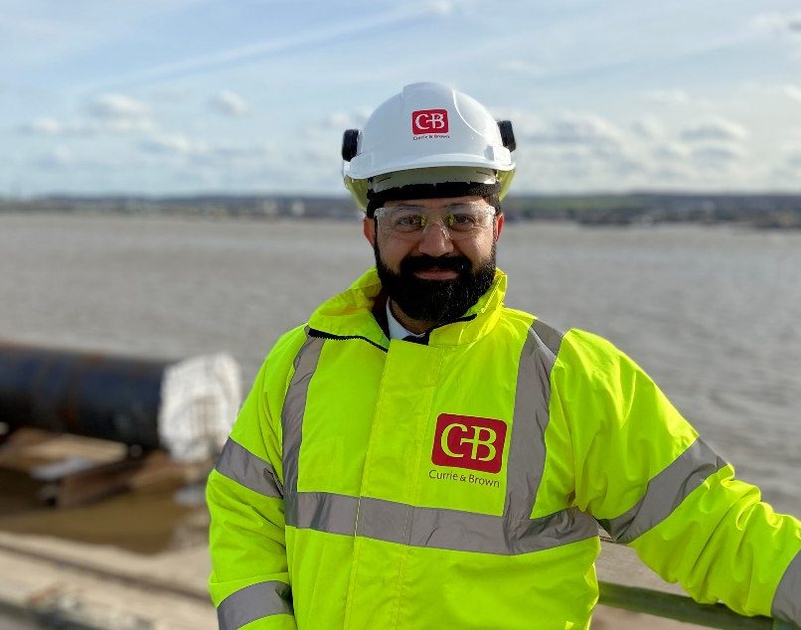
Nasir Khan MBE FCIArb FCIPS FCInstCES PE BEng LLB MSc (PM) MSc (Law)
Nasir is a skilled and dynamic leader with just under 20 years of proven capacity to provide total solutions of estimating, procurement, commercial, dispute avoidance, management and resolution through effective pre & post contract management.
Versatile and well-versed in successful delivery on major projects including energy, utilities, commercial property, oil & gas, manufacturing, ports, highways and rail infrastructure.
Nasir has led large and complex claims on quantum, delay and engineering issues. Nasir is an engineer, chartered surveyor, chartered procurement director, and legally qualified.
He has Fellowship of various institutions and acts as an expert, mediator, adjudicator and arbitrator.

Slide 9
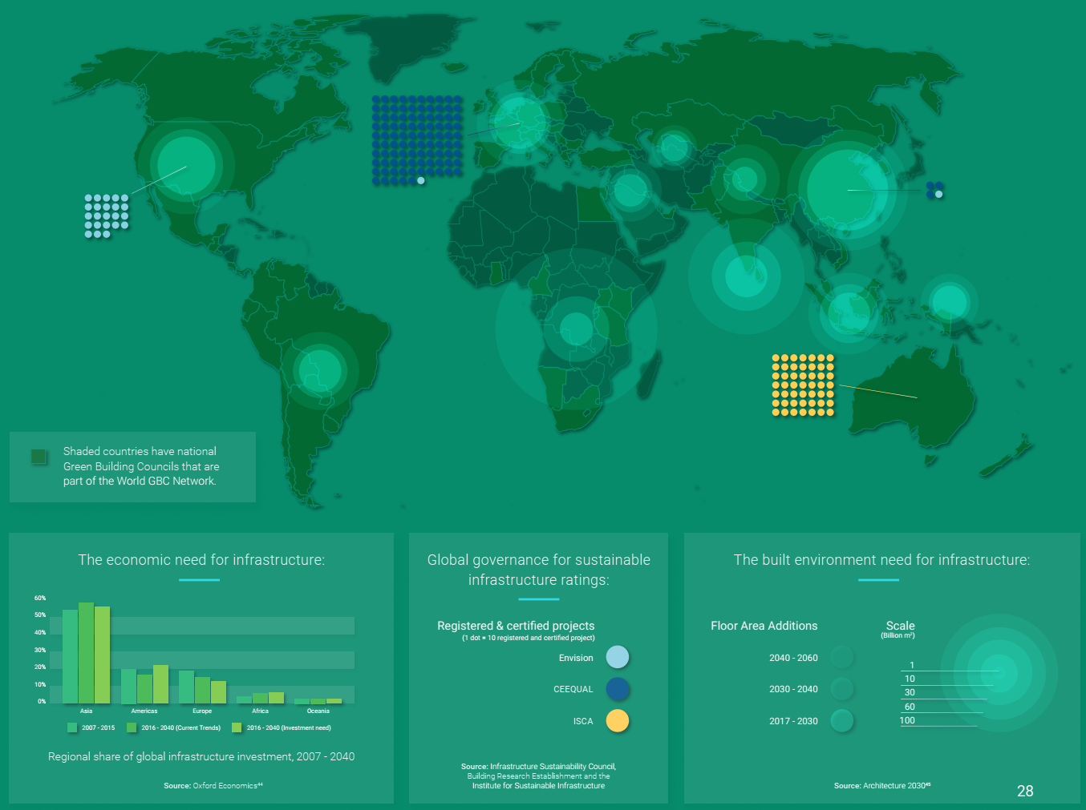

Infrastructure
Notes:
The construction sector is being challenged like never before by a range of issues that, taken together, have the potential to radically change the way the industry works. A combination of sustainability requirements, cost pressures, skills scarcity, digitalisation and a new breed of player entering the sector, looks set to transform construction businesses in the years ahead.
Global construction market to grow $8 trillion by 2030: driven by China, US and India.
— US construction market to grow faster than China over next 15 years
— Despite size, China powerhouse to drop to historic low of construction growth in 2016
— India to provide a new engine of global growth for construction in emerging markets, growing at almost twice as fast as China
— Europe will not recoup its ‘lost decade’ but the UK will be continental Europe’s stand-out growth market, overtaking Germany to become the world’s sixth largest construction market by 2030
A new – Global Construction 2030 – forecasts the volume of construction output will grow by 85% to $15.5 trillion worldwide by 2030, with three countries – China, US and India – leading the way and accounting for 57% of all global growth.
The benchmark global study - the fourth in a series from Global Construction Perspectives and Oxford Economics - shows average global construction growth of 3.9% pa to 2030, outpacing that of global GDP by over one percentage point, driven by developed countries recovering from economic instability and emerging countries continuing to industrialize.
When it comes to Europe, whilst it won’t recover to reach pre-crisis levels until 2025, the UK is a stand-out growth market, overtaking Germany to become the largest in Europe and the world’s sixth largest construction market by 2030.

Slide 10
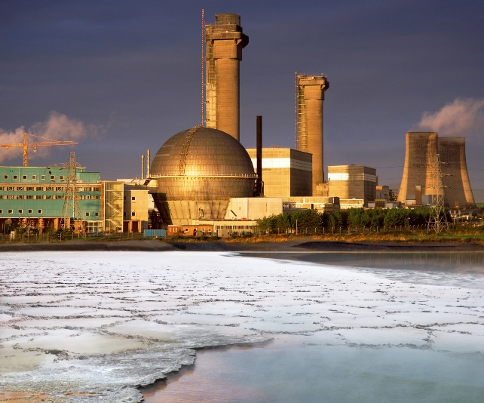
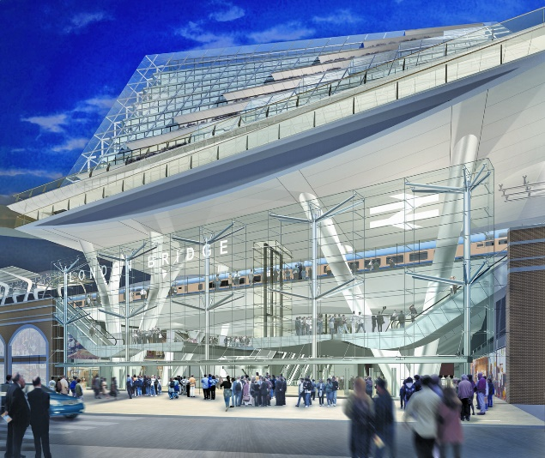
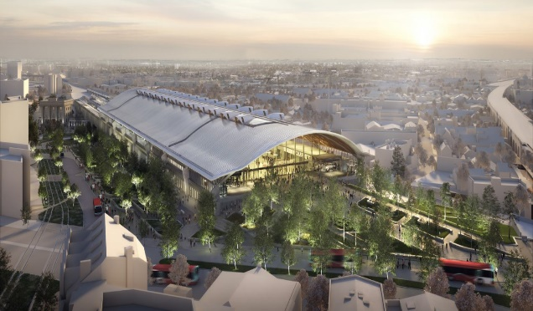
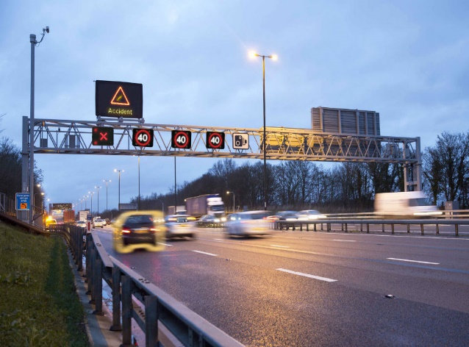
Infrastructure Projects
32 years
Sellafield
20 years
Thameslink Programme
Sellafield
Thameslink Programme
10 years
High Speed 2
12 years
Highways England
High Speed 2
Highways England
Notes:
Infrastructure underpins the economy. Transport, digital, energy and utility networks are vital for jobs, businesses and economic growth. But they also have a profound impact on people’s daily lives. The government wants to deliver an infrastructure revolution: a radical improvement in the quality of the UK’s infrastructure to help level up the country, strengthen the Union, and put the UK on the path to net zero emissions by 2050.
This Strategy sets out the government’s plans to deliver on this ambition. It is the first of its kind: rooted in the expert advice of the highly respected National Infrastructure Commission (NIC) and responding to its ground-breaking 2018 assessment of the country’s infrastructure needs.
Infrastructure is long-term. Decisions taken today on new rail lines, power plants, or road upgrades, will affect lives and livelihoods for decades to come. But infrastructure investment also has an important short-term role to help support jobs and stimulate the economy. This Strategy brings together the government’s long-term goals with the short-term imperative to rebuild the economy following the COVID-19 pandemic
As the government helps the economy to recover it will also seek to address the long-term issues that have held back UK infrastructure. These issues include ‘stop-start’ public investment, insufficient funding for regions outside of London, slow adoption of newtechnology, policy uncertainty that undermines private investment, and project delivery plagued by delays and
cost overruns.

Slide 11
Characteristics of large infrastructure projects
Return on Investment not as planned or promised
Inflexible due to size
Mostly delayed and over budget
Technological Advancement
Industry Leading
Transformational
Public Good
Claims & disputes
Sustainability
Social Value
High Level Economic Objectives
Infrastructure Projects
(mining, road, port, energy etc)
Risk Allocation
[Alliance, Partnering]
Ownership / Funding Public, PFI, debt or private investment
Complex Engineering, Technology & Innovation
Benefits / Economy / Public good
Complex Environment & Regulatory Framework
Procurement Route / Commercial Pricing
Notes:
UK projects and programmes that are planned to go out to market for procurement throughout the 2020/21 financial year.
The procurements contained within the pipeline have an estimated total contract value of
between £29bn and £37bn.
As the pandemic underlines, the wellbeing and prosperity of everyone in
the UK depend critically on how we build our economy and transform our
infrastructure and public services for the future. Delivering major projects
successfully and consistently has never been so importan

Slide 12
ESG Factors
External Sources
Industry Dynamics
Operational Factors
Increasing project and site complexities, Net Zero Targets
Extensive regulation, land fragmentation, and the cyclical nature of public investment
Informality and potential for corruption distort the market
Bespoke or suboptimal owner requirements, Carbon Neutral
Construction is opaque and highly fragmented
Contractual structures and incentives
Industry underinvests in digitization, innovation, and capital
Project management and execution basics Competency and skills at all levels
Design processes and investment security, Sustainability and Environment
Notes:
External factors consist of the external influences affecting the project, such as economic environment, social environment, political environment, physical environment, industrial relation environment and level of technology advanced.
The variables within each category are interrelated and intrarelated. This means that a variable in one group can affect a variable in another group and vice versa.
Give COVID-19 change of statute example and lockdown that caused extensive delays.

Slide 13
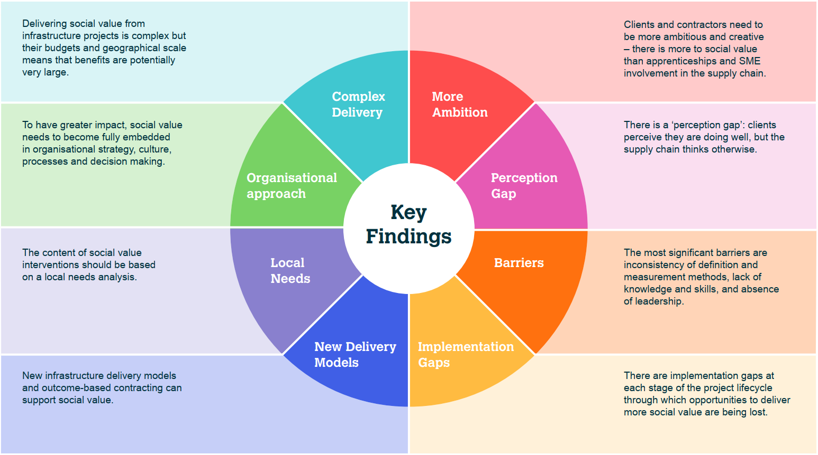
Social Value through Infrastructure Projects
Source: Maximising Social Value from Infrastructure Projects
Notes:
Infrastructure’s purpose is to meet fundamental societal needs; such as roads, public transport, low carbon energy supply, clean water and flood protection.The societal benefits that infrastructure projects can generate are not, however, limited to delivering this basic functionality. By focusing on delivering broader social outcomes, not just engineering outputs, infrastructure projects can create additional ‘social value’. For example, they can help address local socio-economic issues and inequalities; create jobs for previously unemployed people;provide opportunities for Small and Medium Enterprises; and ultimately increase the quality of life of people involved in, or impacted by, an infrastructure project.

Slide 14
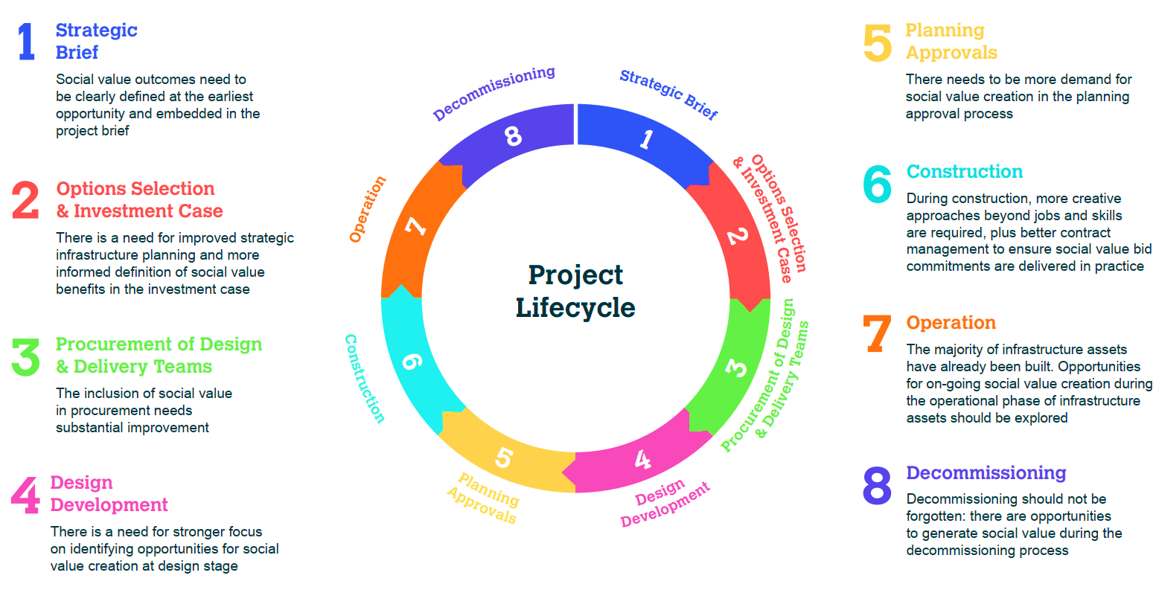
Social Value Project Lifecycle
Source: Maximising Social Value from Infrastructure Projects
Notes:
Broadly speaking, high value or complex infrastructure projects tend to be procured one of four ways:
under an EPC/Turnkey construction contract, with the contractor assuming single point responsibility for the project
under a form of construction contract where the owner retains some project risk, eg by splitting the design and works packages or retaining significant design, cost, timing or facility performance risk
by letting multiple works packages with contractor(s) managed by an Engineering Procurement Construction Management (EPCM) contractor
under a partnership arrangement.

Slide 15




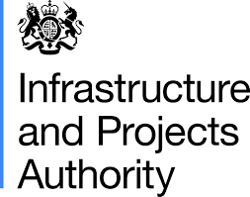

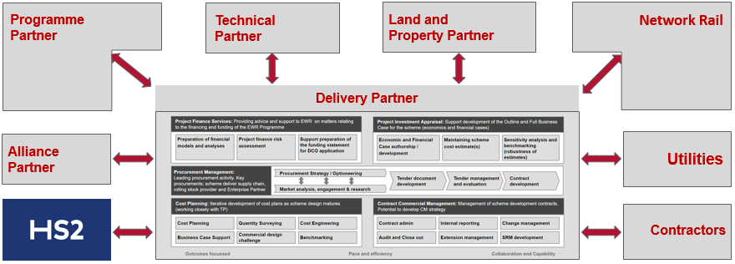

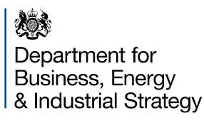
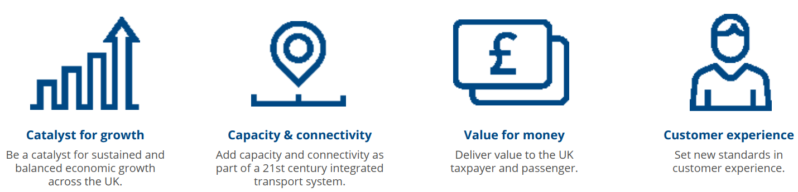
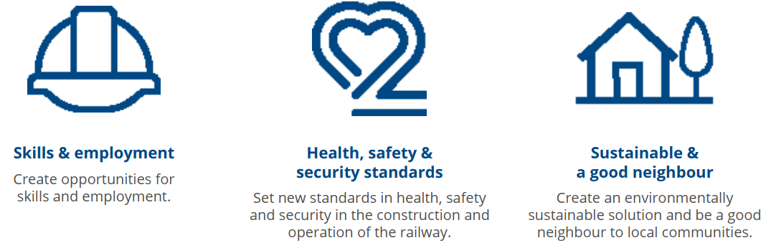
Public influences and circumstances
Customers and communities
Local Enterprise Partnerships
Supply Chain and UTAs
Local Authorities & Regional Bodies
Notes:
Be open to collaborations with government agencies / Supply Chain in managing crisis
Compliance with all government directives for the wellbeing of the society is a must. Tough times like this are drivers of change and we must work together
to create value for the society and economy at large. Let’s do our part in creating public bodies of the future that are adaptive to circumstances and ready to
deliver its defined purpose in the face of a world that is constantly changing.
HS2 is more than a railway. It is the most important economic regeneration project in Britain for a generation.
Authorities are already acting to capitalise on HS2’s liberating potential with plans to create half a million new jobs and 100,000 new homes
HS2 is one of the most demanding and exciting transport mega-projects in Europe. There will be thousands of opportunities within the HS2 supply chain.

Slide 16
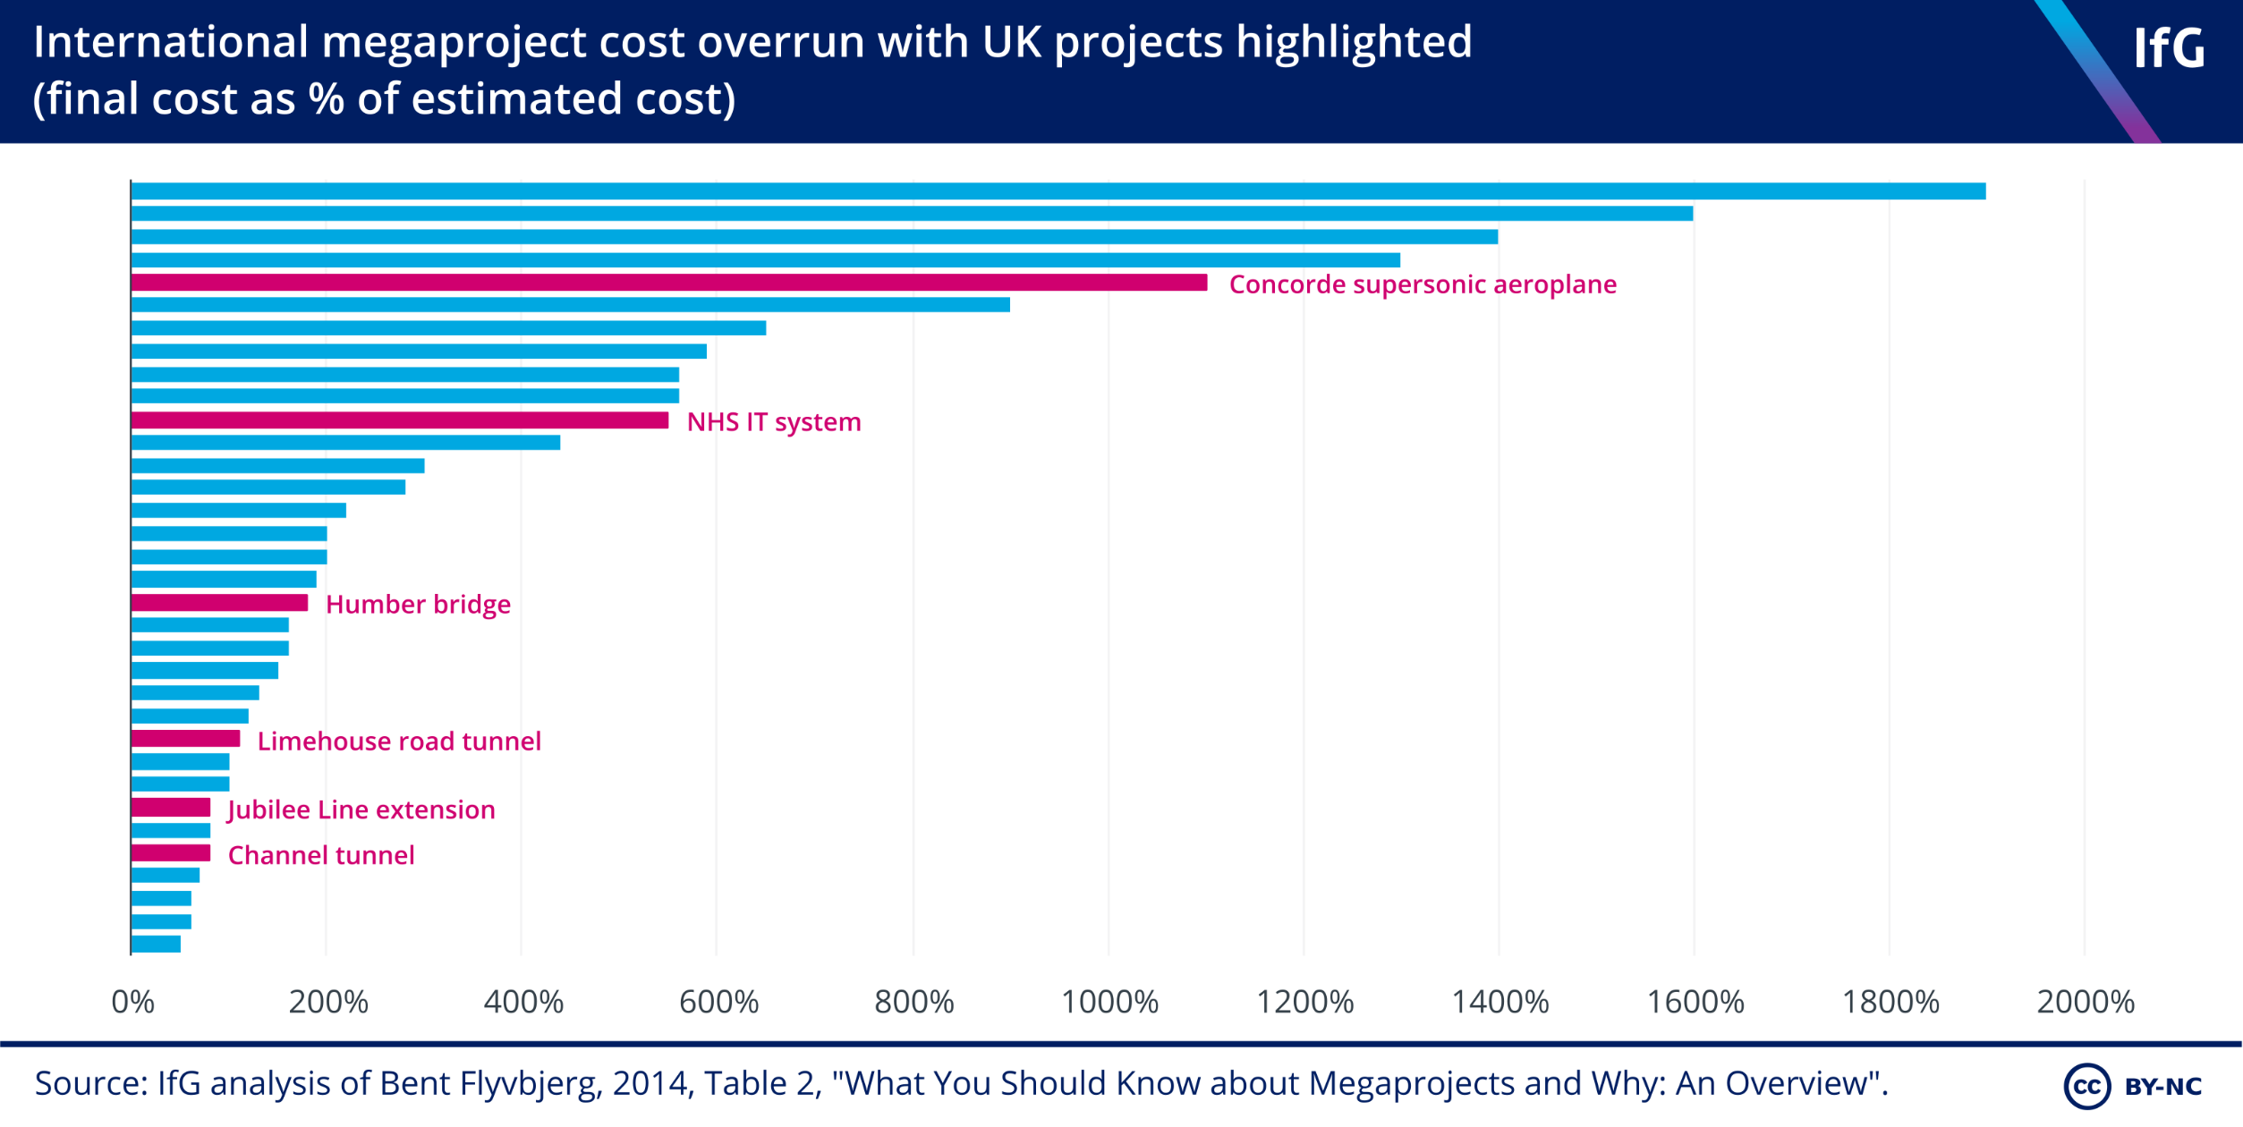
What happens when things go wrong?
80% of large infrastructure projects globally experience cost or programme overruns
98% of mega projects experience cost overruns of more than 30% and 77% are at least 40% late
Notes:
The sector faces a twin market failure; unforeseeable cost increases driven by external and project risk and low margins enforced not by high confidence to deliver at low cost, but by a fear of not gaining a contract which stifles innovation, skills and sustainability.
Examples of delays and cost overruns on other projects in the UK include the London Jubilee Line extension project, which went 80% over budget and opened nearly two years late in 1999, and the Channel Tunnel that opened one year late in 1994 and had a final cost of £9.5 billion, twice the original budget. More recently, the Aberdeen Western Peripheral Route (AWPR) in Scotland opened in February, one year later than initially planned and the overall cost of the project rose from £745 million to more than £1.0 billion. Even smaller projects such as the Sheffield to Rotherham tram-train opened three years late in October 2018 and went 401% over budget.
Indeed, delays and cost overruns on major infrastructure projects is by no means a UK problem, but a global phenomenon. According to Mace, 80% of large infrastructure projects globally experience cost or programme overruns. Similarly, McKinsey estimated that 98% of mega projects experience cost overruns of more than 30% and 77% are at least 40% late. A research paper published by Professor Bent Flyvbjerg also revealed that nine out of ten mega projects experience cost overruns. He added that overruns of up to 50% in real terms are common, and over 50% are not uncommon. The paper also highlighted that overruns have remained high and constant for the past 70 years and provided a list of examples. So why do infrastructure projects persistently go over budget and delivered late?

Slide 17
Main causes of disputes
Rank | Overall cause of dispute
1 | Poorly drafted or incomplete and unsubstantiated claims
2 | Failure to make interim awards on extensions of time and compensation
3 | Parties failing to understand and/or comply with its contractual obligations
Rank | Most important factors in the mitigation/early resolution of disputes
1 | Owner/contractor willingness to compromise
2 | Accurate and timely schedules and reviews by project staff or third parties
3 | Contractor transparency of cost data in support of claimed damages
Rank | The most effective claims avoidance techniques
1 | Risk management
2 | Contract and specification reviews
3 | Third-party schedule reviews
Rank | Most common methods of alternative dispute resolution
1 | Party-to-party negotiation
2 | Mediation
3 | Arbitration
ARCADIS 10th Global Disputes Report
Notes:
I specialise and am/an expert within the construction sector. I would like to give some examples in this regard.
Disputes in the construction industry continue to be proliferate due mainly – poorly drafted or incomplete and unsubstantiated claims, failure to make interim awards, and parties failing to comply with their contractual obligation.
As for the most used methods of dispute resolution, arbitration continues to be the most used adjudicative method. Only in continental Europe does litigation make the top three list. In all regions, the top one dispute resolution method is party-to-party negotiation. The only one exception
is the United Kingdom, where the top one method is adjudication.
The effect of COVID-19 is, and will be, inevitably, significant for the industry and for dispute resolution. It has been a year and parties are still debating in some jurisdictions whether it is a change of law, force majeure or frustration.
However, the encouraging point is that, parties are looking for collaborative solutions to early risk identification and management and dispute avoidance. They should persist in this direction.
ADR Key Features
Allows for a custom-made win-win outcome on all or part of the issues
Focuses on consensus-building and is future-oriented
Aims to determine the parties' interests
Involves the participation of a neutral and impartial alternative dispute resolution practitioner, selected or agreed upon by all parties, to facilitate participants' negotiations and discussions
Voluntary participation, except where court-appointed, and participants can withdraw from process at any stage
Usually informal, less structured and flexible
Emphasizes mutuality over self-interest and reconciliation over termination
Litigation Key Features
May result in an “all-or-nothing” decision
Focuses on the facts and is past-oriented
Aims to determine the parties' legal rights
Determines winners and losers
Usually involves a judge who is appointed by the court to determine the outcome based on the law and legal precedents
Mandatory participation once legal action is initiated
Formalized and highly structured
Costly and long delays

Slide 18
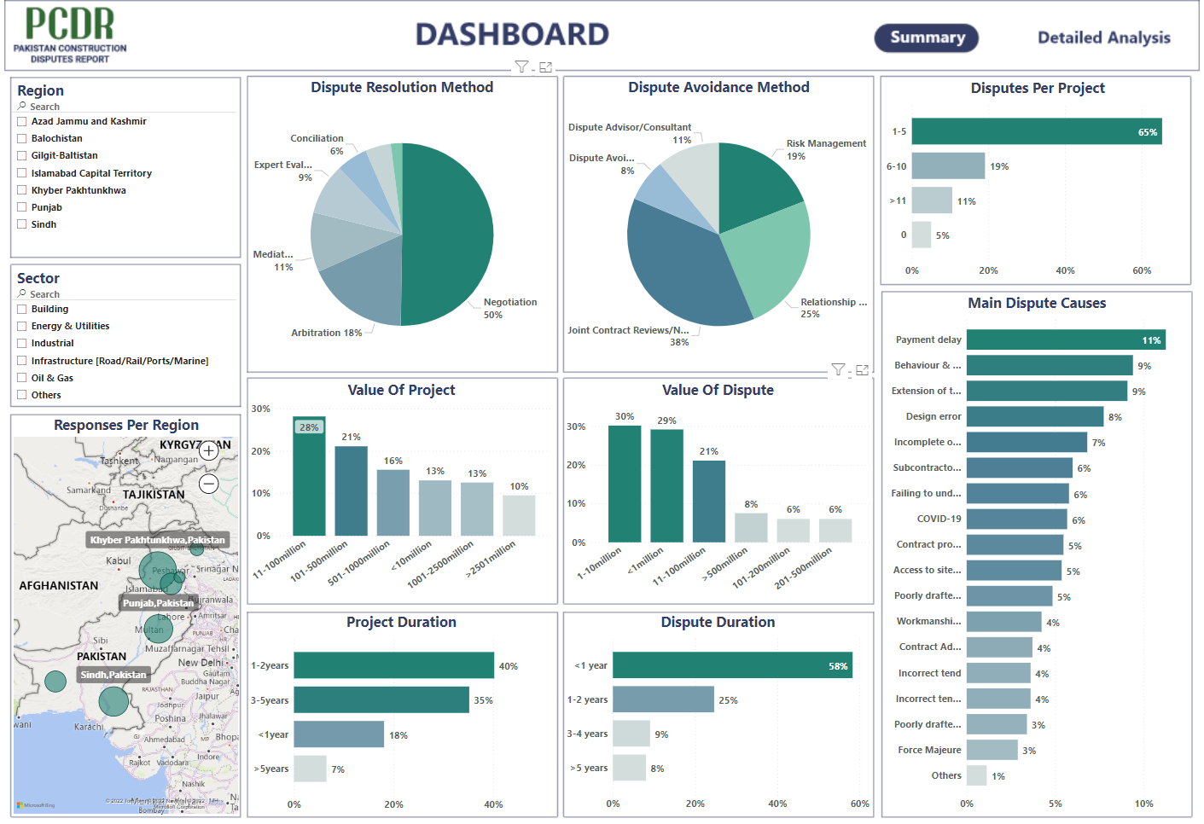

Slide 19
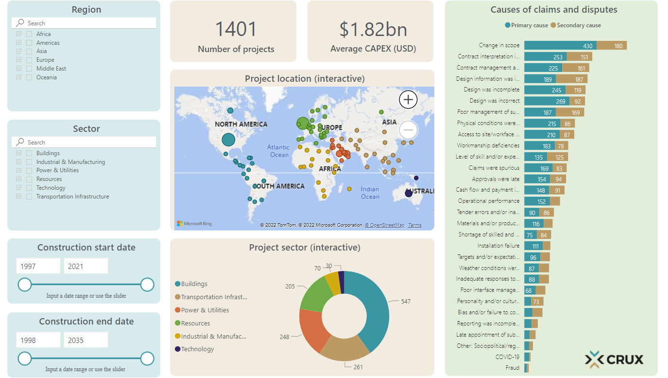
HKA CRUX Dispute Causation Report

Slide 20
Dispute avoidance or risk management
Projects under procurement
Projects under construction
Assets in operations
Workforce
Health & Wellbeing, welfare protection especially of those living in affected territories
Operations
Reduced resilience in key functions, infrastructure and services, or locations become unavailable
Disputes
Claims causation elements and lessons learnt
Supply Chain
Pandemic disputes, MAPS, shortage, logistics, war.
Sales
Decline in sales leading to cash flow and covenant issues
Inflation
Regulation
ESG Compliance challenges in certain sectors
Goals & Objectives of the Project
(Execution Plan)
Realistic Cost Plan & Program development. Total cost of ownership
Diverse teams, upskilling, training & behavioural cultural development. Inspirational leadership.
Open & honest conversations with all stakeholders.
Effective contract administration, governance and assurance.
Relationship management / partnering / collaboration / conflict avoidance
Benchmarking , knowledge transfer / Added value generations. BIM
Proactive risk & opportunity management. Total cost of ownership.
Notes:
Currie & Brown provides integrated project and commercial management services which are underpinned by a specialist risk and opportunity management team. All projects incorporate elements that either import risk or present opportunity; our approach is to address these risks and opportunities as early as possible, in a proactive way. This will certainly ease the entire process of project and contract management, provide financial benefits and a positive contribution to business performance.
As the international response towards the COVID-19 pandemic continues to develop, we know that capital projects, infrastructure owners and stakeholders are faced with potentially significant challenges to which they need to respond rapidly. The interconnectedness, complexity and global nature of the construction industry’s supply chains and workforce affect the cost and schedule of infrastructure projects. Any slowdown across infrastructure investments due to, for example, uncertainty of demand or access to financing could have an impact on project start dates or stall construction progress, with potential longer-term economic repercussions for host countries.

Slide 21
Management of Projects
Project Execution Plan
Contract Management Objectives
Monitoring contractual obligations
Monitoring cost control
Assured self certification
Understanding of scope
Contract management objectives
Protocols and Systems
Stakeholder Management, Contract administration, Risk management
Performance monitoring
Forecast to completion
Assurance plan
Contract management strategy model
Roles and responsibilities
Developing RACI Matrices
Reporting KPIs
Cost control using earned value management
Integrated whole-life commercial services
Assurance process
Contract forms, pricing and payments
Risk management or dispute avoidance
Audit and cost verification

Slide 22
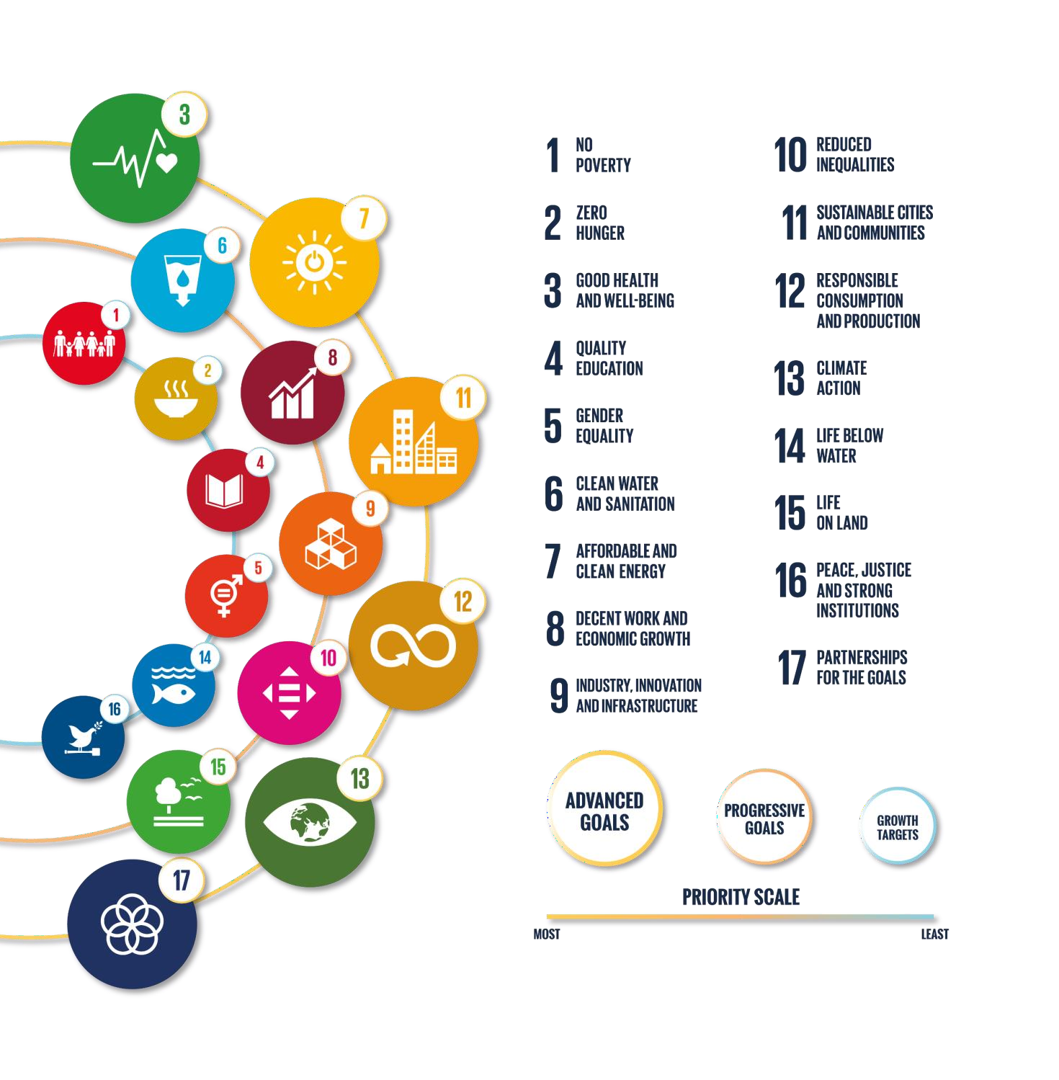
What must we do
Decarbonize the entire built environment of embodied and operating emissions everywhere.
Make built assets resilient to the impacts of climate change.
Mitigate the extraction and consumption of resources and achieve circular urban economies.
Support the health and wellbeing of people in the built environment.
IEA net zero road map for the global energy sector.
Enable collaboration, and promote dispute avoidance and amicable resolution.
Notes:
In 2015, the member states of the United Nations adopted the 17 Sustainable
Development Goals17(SDGs), our global priorities for a sustainable future. 11 of the
17 Goals directly relate to the built environment. All goals must be met by 2030.
• That same year, the Paris Agreement was signed, committing to limit global
warming to well below 2°C, and preferably to 1.5°C. This is known
as the 1.5°C trajectory.
• In 2018, this pathway was defined18 for the built environment as:
By 2030;
– All new buildings must be net zero carbon in operation and embodied carbon
must be reduced by at least 40%, with leading projects achieving at least
50% reductions in embodied carbon;
– With widespread energy efficiency retrofit of existing assets well underway.
By 2050;
– All new and existing assets must be net zero across the whole life cycle, including
operational and embodied emissions.19
• The last five years have been focused on setting commitments in place across the
globe (e.g. Europe to become net zero by 205020, China to become carbon neutral
by 206021, and the USA to halve greenhouse gas emissions by the end of the
decade22).
• The International Energy Agency (IEA) prepared a net zero by 2050 roadmap
for the global energy sector23. It has major implications for decarbonisation
in buildings and infrastructure. It identifies major transition in building systems,
transportation and electricity generation that are consistent with Net Zero by 2050.
The implications of this roadmap should be aligned with common principles for the
delivery of buildings and infrastructure projects.
The UN’s Sustainable Development Goals
According to WorldGBC’s Strategy ‘Sustainable
Buildings for Everyone, Everywhere

Slide 23
Recommendations
Strategic
closing
the implementation gap
Supporting
Invest in the right project
Government Level
Define Need and Delivery Optioneering
Minimise adverse social impacts
Broader benefits case
Business case based on social value outcomes
Work with other institutions and industry bodies to develop a common definition of what ESG means for the future of infrastructure
Embrace a broad view of social value
Aim to create social value at all
stages of the project lifecycle
Raise the profile of socio economic benefits
Use social value interventions
on a Local Needs Analysis
Client Level
Project investment case to include social value monetisation
Social Value strategy with targets
Collaborative delivery models to promote joint working
Design brief and specification
Outcome based procurement
Social value embedded in contract deliverables
Local community partnerships
Support upskilling and developing competent people
Incorporate social value into
standard contract models and part of procurement evaluation
Seek continuous improvement
Early Contractor Involvement
Consistency of approach
Collaboration as a value
Support SMEs / innovators
Supply Chain
Proactively identify and implement opportunities
Go Beyond provision of jobs, apprenticeships
Capture and report on the delivery of outcomes – both quantitative and qualitative
Source: Maximising Social Value from Infrastructure Projects
Notes:
Across all sectors and asset classes worldwide, we have seen some project owners reap the full benefits of collaborative contracting. But to facilitate the
effective delivery of large and complex projects, and to break the construction productivity curse, more owners must embrace true collaboration in
contracting.
The energy and resources sector isn’t widely recognized as highly collaborative, but responding to COVID-19 required new collaboration approaches and overcoming a fear of “unfair” risk–reward distribution. Amid the crisis, how can owners and contractors in the sector collaborate to improve execution,
efficiency, and resilience and deliver mutually beneficial outcomes?
Execute projects through partnerships, not contracts.
Engage suppliers earlier
Develop collaborative relationships with executive engagement
Take time to build trust and long-term strategic relationships
Harness the benefits of remote work and digital tools.

Slide 24
Nasir Khan MBE
Director and Head of Contract Solutions
07565 681 235
nasir.khan@curriebrown.com
40 Holborn Viaduct
T | +44 (0)1534 720 326 F | +44 (0)1534 601 827 E | enquiries@curriebrown.com
www.curriebrown.com

