Slide 1
Shell ITALIA POWERING PROGRESS
Marco Marsili
Country Chair Shell Italia

Slide 2
CAUTIONARY NOTE
The companies in which Royal Dutch Shell plc directly and indirectly owns investments are separate legal entities. In this presentation “Shell”, “Shell Group” and “Group” are sometimes used for convenience where references are made to Royal Dutch Shell plc and its subsidiaries in general. Likewise, the words “we”, “us” and “our” are also used to refer to Royal Dutch Shell plc and its subsidiaries in general or to those who work for them. These terms are also used where no useful purpose is served by identifying the particular entity or entities. “Subsidiaries’’, “Shell subsidiaries” and “Shell companies” as used in this presentation refer to entities over which Royal Dutch Shell plc either directly or indirectly has control. Entities and unincorporated arrangements over which Shell has joint control are generally referred to as “joint ventures” and “joint operations”, respectively. Entities over which Shell has significant influence but neither control nor joint control are referred to as “associates”. The term “Shell interest” is used for convenience to indicate the direct and/or indirect ownership interest held by Shell in an entity or unincorporated joint arrangement, after exclusion of all third-party interest.
This presentation contains forward-looking statements (within the meaning of the U.S. Private Securities Litigation Reform Act of 1995) concerning the financial condition, results of operations and businesses of Royal Dutch Shell. All statements other than statements of historical fact are, or may be deemed to be, forward-looking statements. Forward-looking statements are statements of future expectations that are based on management’s current expectations and assumptions and involve known and unknown risks and uncertainties that could cause actual results, performance or events to differ materially from those expressed or implied in these statements. Forward-looking statements include, among other things, statements concerning the potential exposure of Royal Dutch Shell to market risks and statements expressing management’s expectations, beliefs, estimates, forecasts, projections and assumptions. These forward-looking statements are identified by their use of terms and phrases such as “aim”, “ambition”, “anticipate”, “believe”, “could”, “estimate”, “expect”, “goals”, “intend”, “may”, “objectives”, “outlook”, “plan”, “probably”, “project”, “risks”, “schedule”, “seek”, “should”, “target”, “will’’ and similar terms and phrases. There are a number of factors that could affect the future operations of Royal Dutch Shell and could cause those results to differ materially from those expressed in the forward-looking statements included in this presentation, including (without limitation): (a) price fluctuations in crude oil and natural gas; (b) changes in demand for Shell’s products; (c) currency fluctuations; (d) drilling and production results; (e) reserves estimates; (f) loss of market share and industry competition; (g) environmental and physical risks; (h) risks associated with the identification of suitable potential acquisition properties and targets, and successful negotiation and completion of such transactions; (i) the risk of doing business in developing countries and countries subject to international sanctions; (j) legislative, fiscal and regulatory developments including regulatory measures addressing climate change; (k) economic and financial market conditions in various countries and regions; (l) political risks, including the risks of expropriation and renegotiation of the terms of contracts with governmental entities, delays or advancements in the approval of projects and delays in the reimbursement for shared costs; (m) risks associated with the impact of pandemics, such as the COVID-19 (coronavirus) outbreak; and (n) changes in trading conditions. No assurance is provided that future dividend payments will match or exceed previous dividend payments. All forward-looking statements contained in this presentation are expressly qualified in their entirety by the cautionary statements contained or referred to in this section. Readers should not place undue reliance on forward-looking statements. Additional risk factors that may affect future results are contained in Royal Dutch Shell’s Form 20-F for the year ended December 31, 2020 (available at www.shell.com/investors and www.sec.gov). These risk factors also expressly qualify all forward-looking statements contained in this presentation and should be considered by the reader. Each forward-looking statement speaks only as of the date of this presentation, 30 September. Neither Royal Dutch Shell plc nor any of its subsidiaries undertake any obligation to publicly update or revise any forward-looking statement as a result of new information, future events or other information. In light of these risks, results could differ materially from those stated, implied or inferred from the forward-looking statements contained in this presentation.
We may have used certain terms, such as resources, in this presentation that the United States Securities and Exchange Commission (SEC) strictly prohibits us from including in our filings with the SEC. Investors are urged to consider closely the disclosure in our Form 20-F, File No 1-32575, available on the SEC website www.sec.gov.
Shell’s operating plan, outlook and budgets are forecasted for a ten-year period and are updated every year. They reflect the current economic environment and what we can reasonably expect to see over the next ten years. Accordingly, Shell’s operating plans, outlooks, budgets and pricing assumptions do not reflect our net-zero emissions target. In the future, as society moves towards net-zero emissions, we expect Shell’s operating plans, outlooks, budgets and pricing assumptions to reflect this movement.

Slide 3
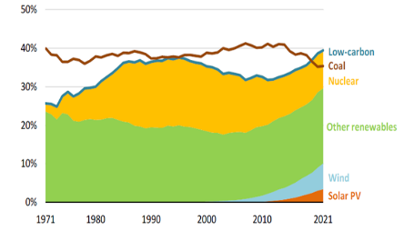
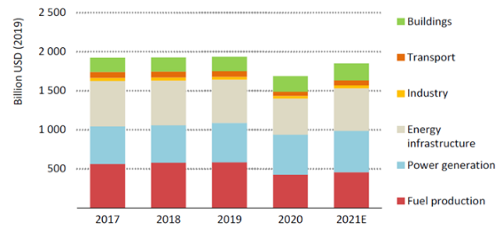
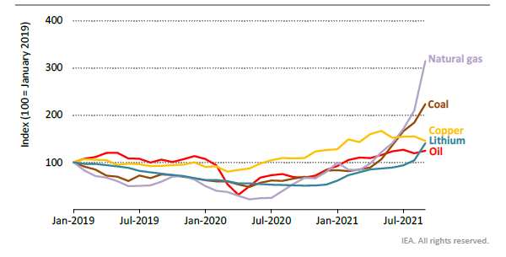
Energy transition in the post-pandemic period: mixed signals
Share of low carbon sources and coal in world electricity generattion (source: IEA – Global Energy review 2021)
Global energy investments (source: IEA – World Energy Investment 2021)
Trend of commodities prices (source: IEA – World Energy Outlook 2021)

Slide 4
The possible solutions to Ukrainian crisis and energy transition
33% of gas consumption in Europe and 38% of gas consumption in Italy comes from Russia
Development of renewables and biofuels
Increase energy efficiency
Increase national production
RE-GAS TERMINAL (LNG)
Interventions aimed at calming the expensive energy for industries and customers
Supply from other Countries
Accelerated
transition
Common denominator to these solutions are the bureaucratic and authorization difficulties
Gradual transition

Slide 5
SHELL CONTRIBUTION TO ITALY ENERGY MIX
Largest foreign investor in Italy
(VdA and TR JV produce 83% of national oil production and 33% of national gas production in Basilicata)
35 brands for B2B and B2c
10% market share
Carbon Neutal Products
2GW solar development pipeline
>12k Sonnen Batteries installed
Shell cards on 7k traditional service stations and on 24k public charging points through Shell Recharge Solutions.
Shell Brand on 500 service stations within 5 years
500 customers
10% market share in B2B gas & power sales market

Slide 6
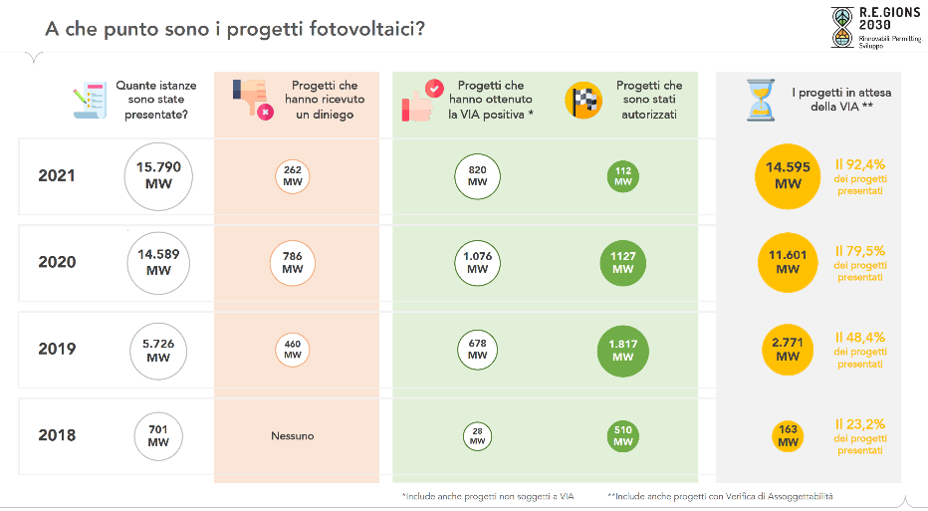
AUTHORIZATION DIFFICULTIES IN ITALY: THE PHOTOVOLTAICS case
The introduction, through the Simplification Decree, of the national EIA also for PV projects larger than 10 MW is, however, accelerating the authorization procedures starting from the second half of 2021

Slide 7
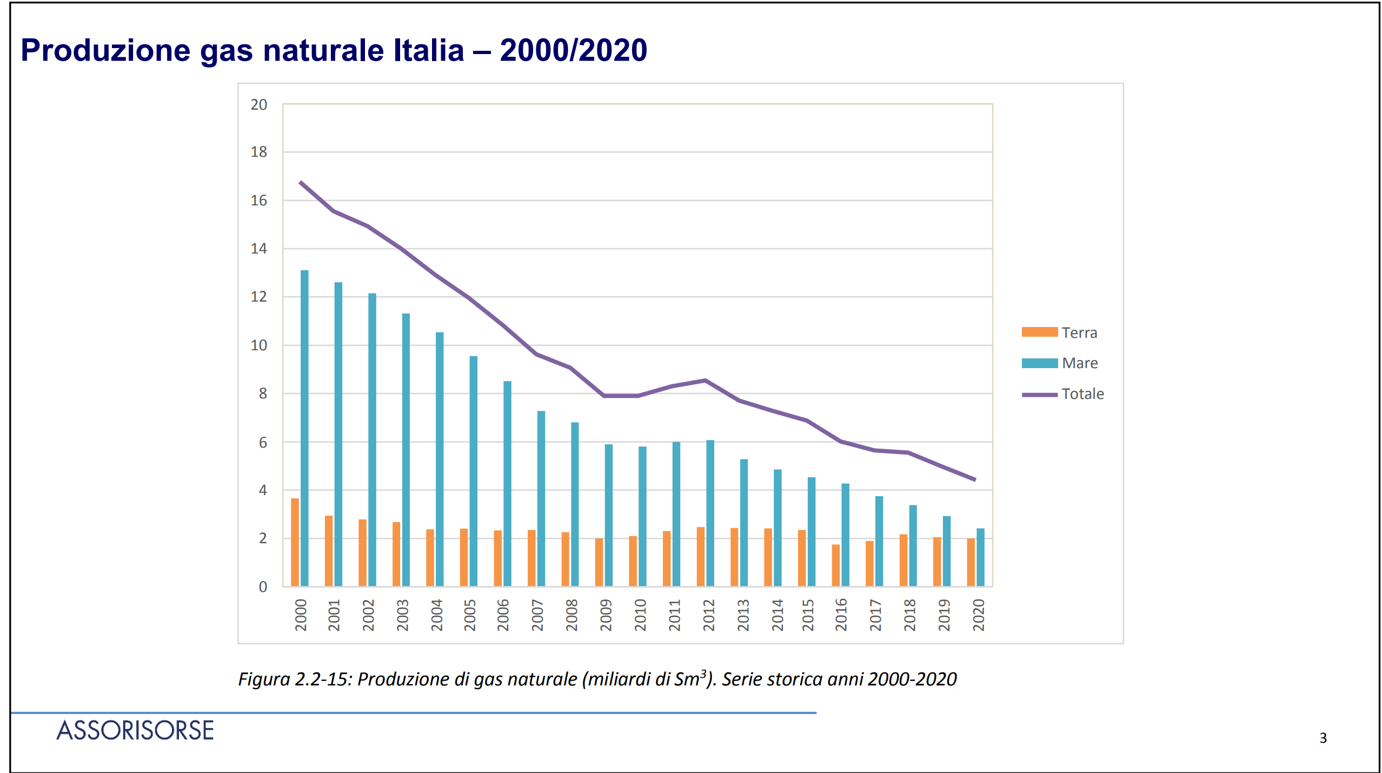
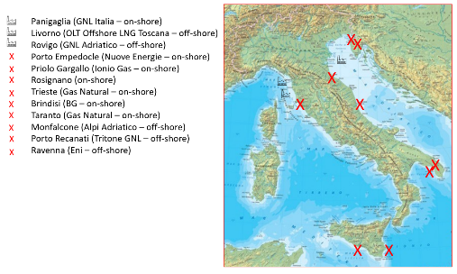
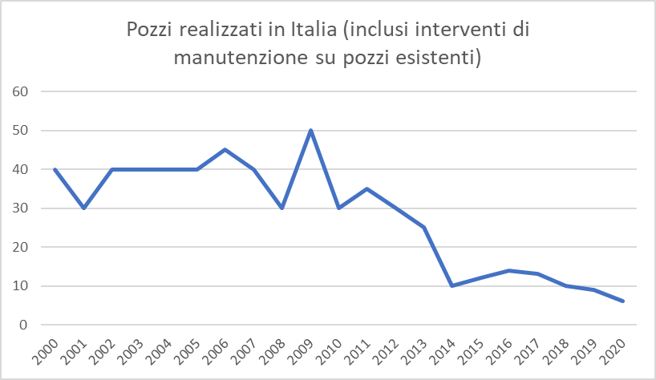
AUTHORIZATION DIFFICULTIES IN ITALY: THE gas case
The change of pace in domestic production and re-gas terminal has not yet taken place
It would be necessary to introduce a 'gas emergency commissioner' to provide simplifications in the area of authorisation for infrastructure (re-gas terminal) and new wells.

Slide 8
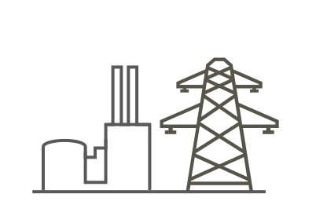
GETTING TO NET ZERO REQUIRES INVESTMENTS INTERNATIONAL COLLABORATION
WORKING TOGETHER
Turning challenge into opportunity
INNOVATION
POLICY
SECTOR BY SECTOR
COLLABORATION
PARTNERSHIPS

