Slide 2
Energy transition in Italy - challenges and opportunities in the European context
Marco Piredda
Head of International Affairs Analysis and Business Support - Eni
Milan, 18 May 2022

Slide 3
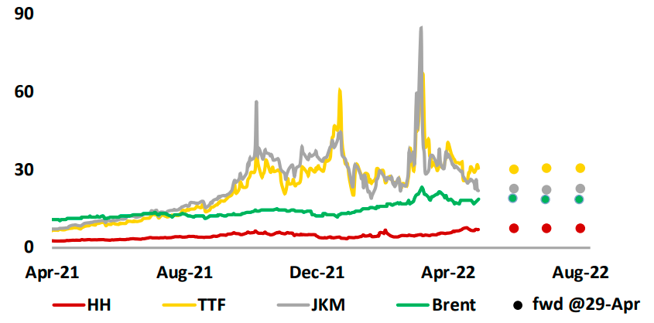
2021-2022: what happened on energy markets
GAS PRICES | $/MBtu
Ukraine crisis
JKM: 84.8 $/MBtu (447 $/boe)
TTF 67.8 $/MBtu (357 $/boe)
22 Dec. 2021 TTF: 59.6 $/MBtu (314 $/boe)
7 Oct. 2021 JKM: 56 $/MBtu (295 $/boe)
EU: focus on decarbonization
Asia: recovery of demand for energy
US: renewed focus on O&G supply
Demand side transformation and more LNG led to a shift from long term to spot contracts.
Ukraine crisis comes on top of exposure to extreme weather and unplanned supply outages.

Slide 4
EU gas market fundamentals
Most relevant gas routes to EU
EU gas supply by source
Indigenous
production
LNG
Norway
Azerbaijan
Russia
Libya
Norway
Algeria
2020
2021
Russia
395
BCM
412
BCM
Azerbaijan
2021
Total EU-27 regas capacity: 170 Bcm/y
Total EU-27+1 regas capacity: 218 Bcm/y
Regasification
terminals
Algeria
Libya
Gas pipelines

Slide 5
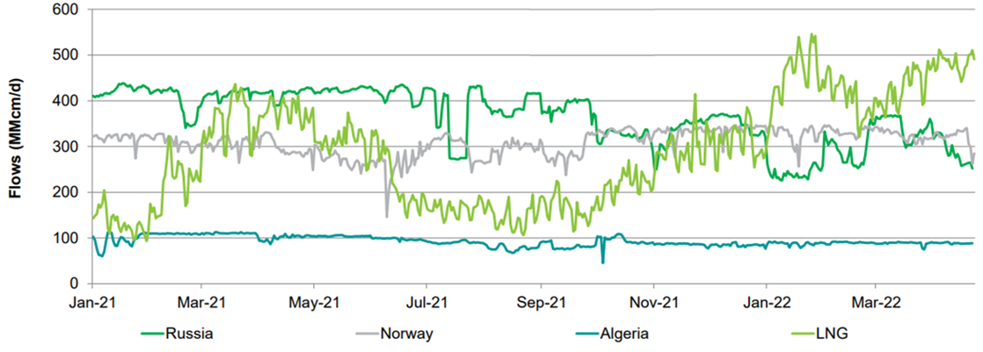
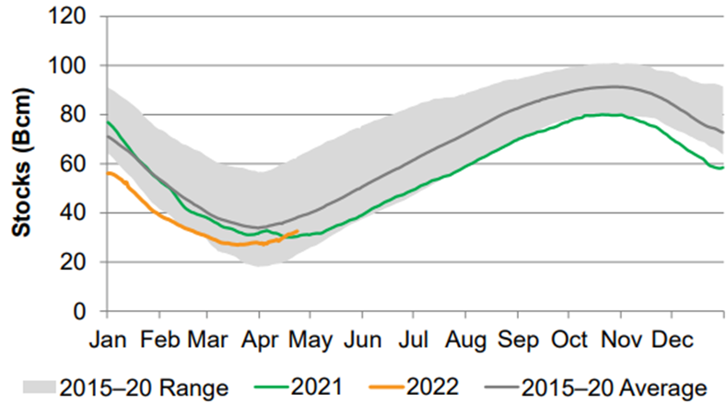
2021: less spot gas from Russia
Daily European Pipeline Imports | MMcm/d
European Storage inventories | Bcm
Dec 2021 EU filling rate: 53% - the lowest of the last decade
Significant fluctuation in Russian flows 2021-2022
Russia reluctant to supply additional gas beyond long-term contracted volumes
Russian gas supplies btw commercial strategies and sovereign influence
Growing LNG imports to record levels in April (82% of regas utilization rate)
Notes:
LNG imports in EU: Jan-Apr 2022 +56% YoY

Slide 6
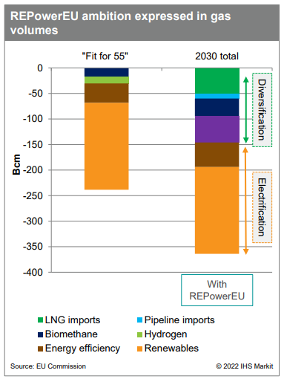
Conflict in Ukraine and EU policy response (RePowerEU)
Following Russia-Ukraine crisis, the EU expanded its energy transition goals beyond “Fit for 55” package, placing higher emphasis on security of supply in the context of evolving policy priorities
1
Diversification of gas supplies
Short-term: Increasing non-Russian supplies, leveraging on existing spare capacity (pipeline and LNG), refilling gas storages
Long-term: Investing in new gas infrastructures, demand reduction
2
Accelerating the transition
on green energies
Raising RES target to 45% by 2030
Further boost of biomethane and hydrogen
Streamlining permitting processes, incentivizing PPAs
3
Strengthening demand-side
measures
Prioritizing energy savings (e.g.: methane leakage)
Energy Efficiency Directive: higher 2030 final consumption reduction target, from 32% to 36%
More LNG: +50 Bcm by 2030
More pipeline gas: +10 Bcm
More biomethane gas: +18 Bcm
More hydrogen: additional 25 – 50 Bcm
Notes:
9% additional effort corresponds to the 39% and 36% energy efficiency targets for primary and final energy consumption outlined in the Climate Target Plan, and is simply measured against updated baseline projections made in 2020 - https://energy.ec.europa.eu/topics/energy-efficiency/energy-efficiency-targets-directive-and-rules/energy-efficiency-directive_en

Slide 7
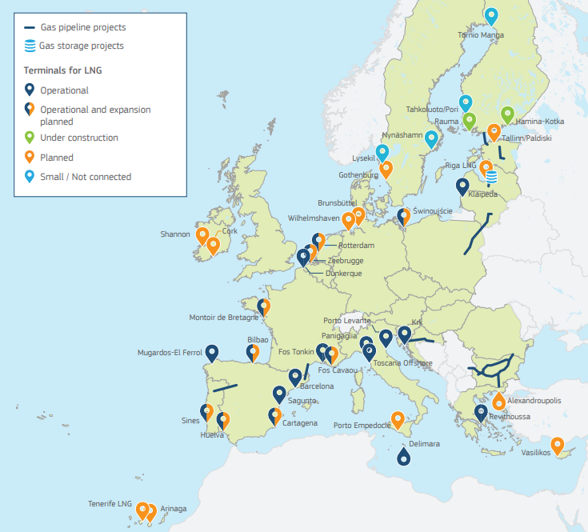
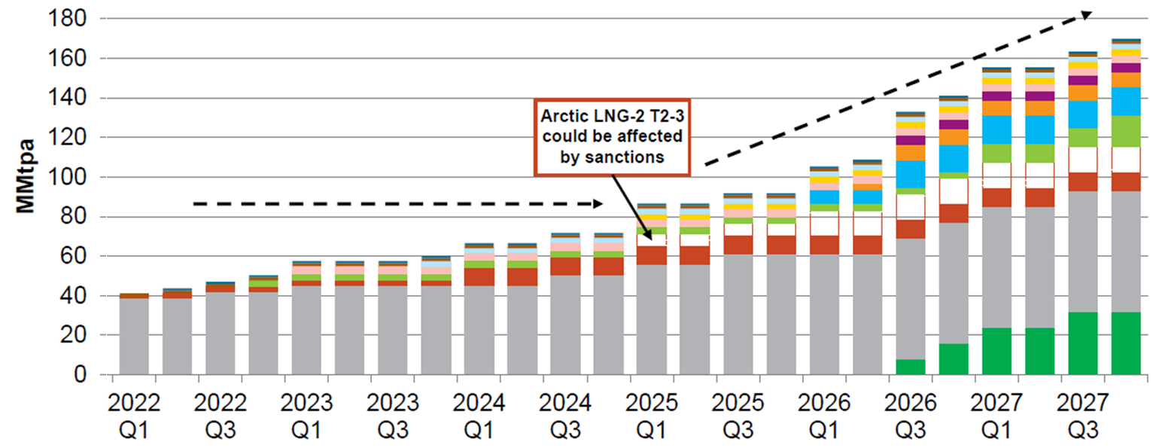
Market response to diversification through LNG
EU regas infrastructures
Future LNG supply projects (under development & to be sanctioned)
Short-term: Increasing LNG imports, leveraging on already present European regassification capacity
Medium-Term: Increasing regassification capacity mainly by FSRUs, starting with Germany and Italy
Future LNG market: flexible, mainly spot-based (residual) vs. long term contracts (redundancy of supplies)

Slide 8
Potential short/medium term policy interventions – focus on the EU gas sector
What level of “EU solidarity” for the financing of investments, in the context of the Ukraine crisis?
Regassification capacity
Gas interconnections
Gas storage
Price management
New regasification projects expected at ca. 82 Bcm/y (+ 37%) for EU27+1
Floating storage and regasification units (FSRUs) as the “least strandable assets”
Invest in new, hydrogen-ready gas infrastructure, if needed to “overcome bottlenecks and ensure full use of the EU’s LNG capacity”
Refilling target at 90% by 1 October of each year (80% in 2022)
Mandatory certification for all storage operators by regulatory authorities
States without physical storage required to book storage in other MS
Shielding most vulnerable consumers
Liquidity support measures for commodities traders
Temporary price caps at the national level (e.g., Spain)
EU-level price cap / common gas purchases (EU operating as a monopsony)
Notes:
Storage refilling for 2022 won’t be possible in case of a large-scale curtailment of Russian pipeline flows (OIES)

Slide 9
Trade-offs between short-term needs and long-term strategies
OPEN QUESTIONS
Reshaping the EU’s relationship with producing countries
What coherence with the energy transition?
Who takes commitments on long-term LNG supplies?
Who bears the costs for the financing of new gas import infrastructures?
Ready for achieving climate goals with differentiated energy transition? (EU&US vs Africa & Asia)
Is gas still a bridge fuel for Europe?
Understanding that energy security and flexible solutions come at a cost
Who finances these investments, the EU budget or Member States? Energy companies or public budgets? Shrinking public finances vs. support measures to shield the economy and consumers from high energy prices
What degree of redundancy and flexibility will be necessary?
Given that energy is a precious commodity and high prices can be seen as an incentive to the transition, are consumers aware of their key role?
Improving intra-EU gas interconnections to reduce bottlenecks
How to counter NIMBYism?
How to split the costs for the financing of new gas infrastructures?
What level of intra-EU coordination is desirable?
Will this crisis trigger institutional changes within the EU? Both in terms of institutional architecture and regulatory innovations, structural changes shall reflect long-term considerations and be “fit for the future”

