Slide 1
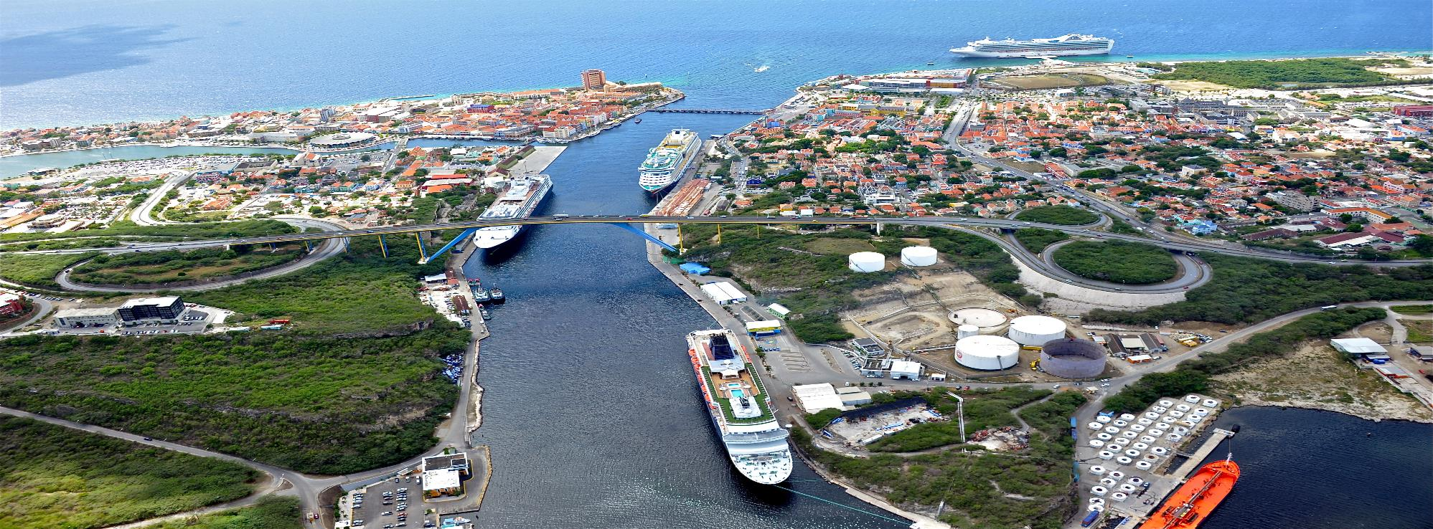
Oil locked in Curaçao due to OFAC sanctions
IBA Maritime and Transport Law Conference
Willemieke Princée

Slide 2
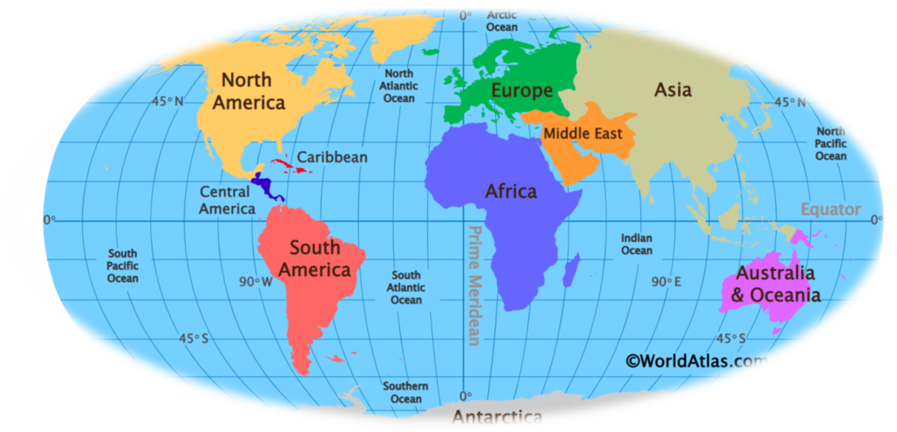
Curaçao

Slide 3
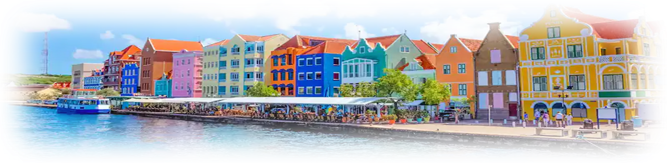
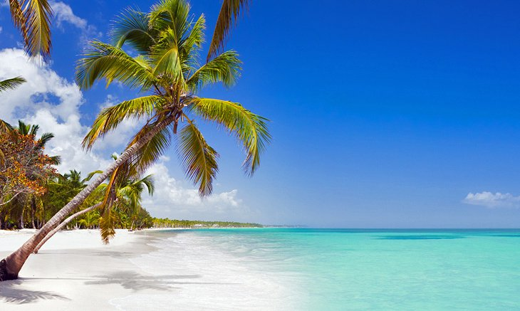
Curaçao

Slide 4
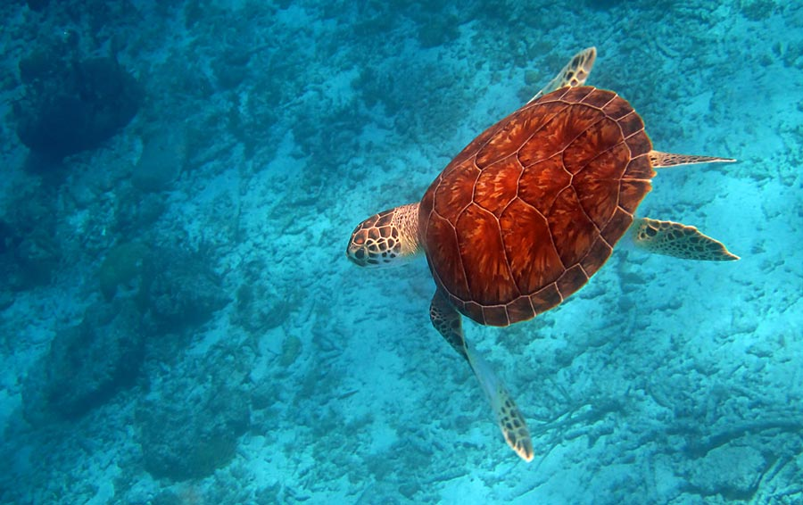
Close ties Venezuela
  Distance Venezuela-Curaçao only 37 miles
  Venezuela ran an oil refinery (335.000 barrel per day) on Curaçao
  Temporary storage Venezuelan oil on Curaçao
  Many oil tankers carrying Venezuelan oil to and from Curaçao
  → Oil industry pillar of the Curaçao economy

Slide 5
OFAC sanctions Venezuela
  Started in 2015, significantly extended in 2019
  Purpose: to combat corruption and criminal activities, restore democracy and respect human rights and to pressure Maduro to step down
  Primary sanctions:
    All assets (indirectly) owned/controlled by Venezuela located in the US are blocked
    US persons are prohibited from doing business with Venezuela and entities (indirectly) controlled/ owned by it
  Secondary sanctions.
    The US government can designate “any person” as a blocked person if this person has “materially assisted, sponsored or provided financial, material or technological support for, or goods or services to or in support of” Venezuela, and entities or assets (indirectly) controlled or owned by Venezuela (Executive Order (E.O.) 13850)

Slide 6
Implications crisis Venezuela and OFAC sanctions for Curaçao
Oil refinery came to a standstill
Venezuelan oil frozen and consequently locked in tanks in Curaçao
No tankers carrying oil calling for Curaçao anymore
Contribution oil industry to Curaçao economy dropped from 16 to 0%

Slide 7
Sale of locked sanctioned oil only allowed if:
  no US nexus
  forced public sale
  no remittance of sale proceeds to Venezuela or entities owned/controlled by it
Consequences:
  Forced public sale only possible if storage claim equals or exceeds value of oil
  Potential buyers are reluctant
  Sanctioned oil locked for years
  Bankruptcy oil storage companies?

Slide 8
Thank you
Masha danki

