Slide 6
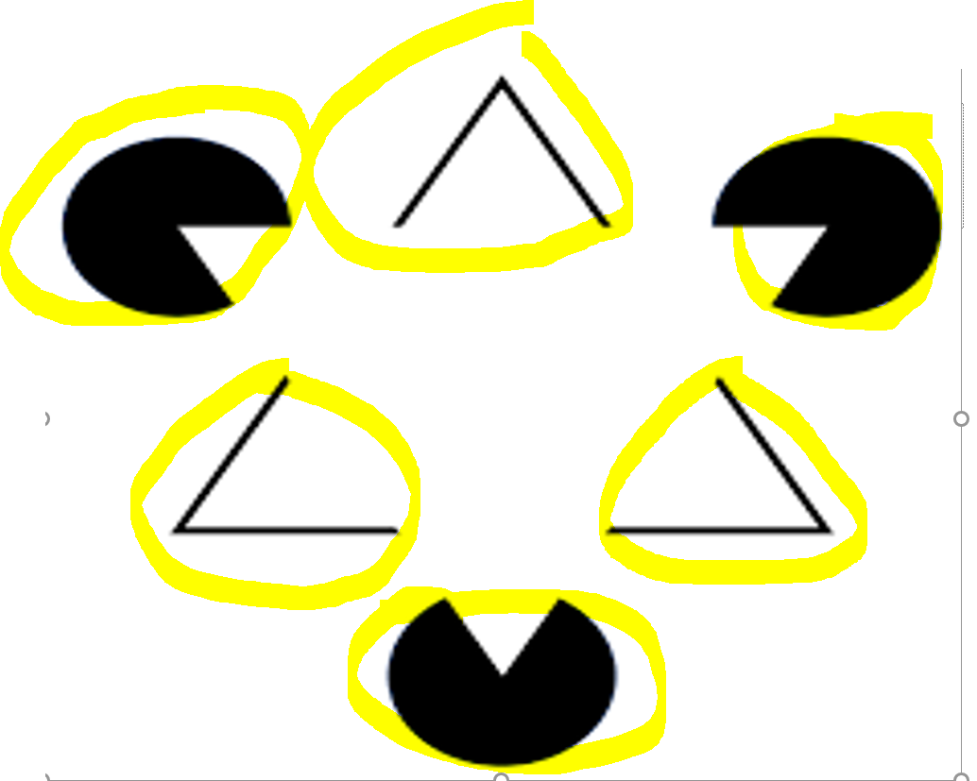

Slide 7
What you know, influences what you see
What's interesting is that the pictures don't change, but once your mind knows what kind of organization to impose, it's obvious what is there

