Slide 2
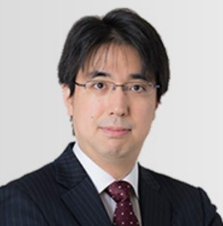
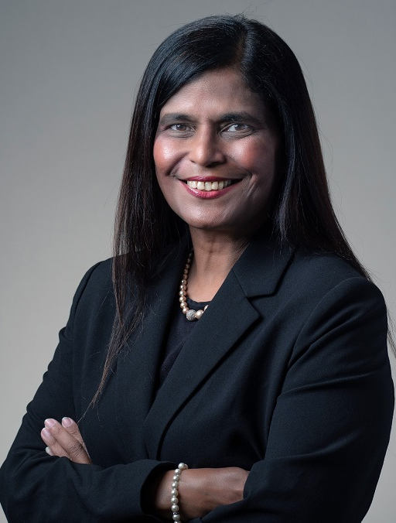
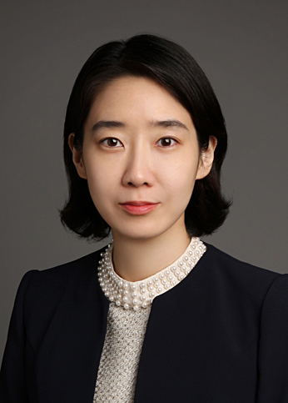
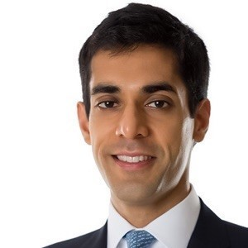
Moderator
Hideaki Roy Umetsu Mori Hamada & Matsumoto, Tokyo; Commissioner, IBA Future of Legal Services Commission
Moderator
Kala Anandarajah Rajah & Tann Singapore, Singapore
Panellist
Jeonghye Sophie Ahn Yulchon, Seoul
Panellist
Kapil Kirpalani Chief Compliance Officer, KKR, Hong Kong SAR
Panellist
Meredith Rathbone Steptoe & Johnson, Washington, DC
Legal and policy issues in the use of economic sanctions
24 Feb 2023 0930 – 1100 Concurrent session 3A

Slide 3
Developments in the use of economic sanctions and export/import controls
Singapore (Kala Anandarajah)
Korea (Jeonghye Sophie Ahn)
Japan (Hideaki Roy Umetsu)
U.S. (Kapil Kirpalani)
U.S. (Meredith Rathbone)

Slide 4
Discussions 1: M&A
Economic sanctions and export/import controls in the context of M&A
Pre-acquisition due diligence relating to FDI regulations, economic sanctions or export/import control

Slide 5
Discussions 2: Commercial Transactions
Economic sanctions and export/import controls in the context of entering into commercial agreements/transactions
What we need to be careful about in order to avoid potential violations

Slide 6
Identifying and Addressing Risk Points
Key sourcing
Key exports
High-risk products
Investment
High-risk entities
Corporate structure
Nationality of owners, officers, directors, managers, etc.
Banking relationships; financing covenants; cash flows
Contractual provisions –sanctions and export controls clauses
Insurance, logistics, technical support/etc.

Slide 7
Q&A

