Slide 1
ROLE OF YOUNG LAWYERS IN THE FUTURE OF THE LEGAL PROFESSION
ARUSH KHANNA
Partner, Numen Law Offices
Asia Pacific Regional Forum Liaison Officer, Young Lawyers Committee
BEN SMITH
Partner, Minter Ellison
Young Lawyers Committee,
Liaison Officer, Asia Pacific Regional Forum

Slide 2
IBA YOUNG LAWYERS’ SURVEY
The IBA Legal Policy & Research Unit (LPRU) and the IBA Young Lawyer’s Committee have worked with Acritas to compile this report.
A total of 3056 lawyers participated.
Issues covered:
Attraction to the Legal profession
Diversity and Inclusion
Job Culture
Flexibility in work culture
Role of Technology

Slide 4
SALIENT HIGHLIGHTS OF THE SURVEY
Attraction to the Legal Profession
Barriers to Career Progression
Diversity and Inclusion
Attrition Rates: Why are Young Lawyers leaving?
Impact of Covid-19 and the Future of Legal Profession

Slide 5
I. FACTORS ATTRACTING YOUNG LAWYERS TO THE LEGAL PROFESSION

Slide 6
II. BARRIERS TO CAREER PROGRESSION
37% of the Respondents have cited lack of mentorship and career guidance as a barrier to career progression.
31% of the Respondents have cited lack of promotion opportunities as a barrier to career progression.
26% of the Respondents have cited lack of on-the-job assistance as a barrier to career progression.
21% of Respondents have cited lack of performance appraisals as a barrier to career progression.

Slide 7
III. DIVERSITY AND INCLUSION
8% of the Respondents are likely to leave their current roles due to the diversity and inclusion rates.
37% of the Respondents expressed concern about the organization’s failure to address toxic workplace culture.
“Employer Ethics” considered a major factor attracting a young lawyer. (38%)
20% of female Respondents cited gender discrimination as a barrier to their career progression
9% of male Respondents cited gender discrimination as a barrier to their career progression

Slide 8
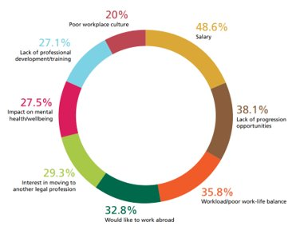
IV. ATTRITION RATES – WHY ARE YOUNG LAWYERS LEAVING?

Slide 9
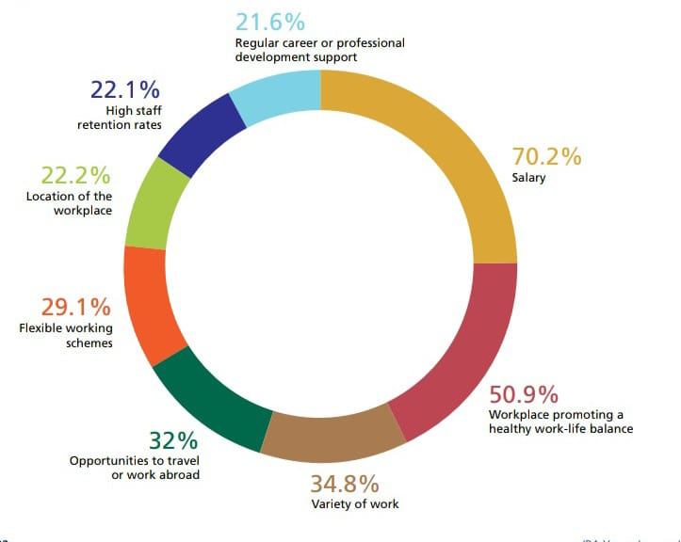
LOOKING FOR NEW OPPORTUNITIES !

Slide 10
V. IMPACT OF COVID-19 AND THE FUTURE OF LEGAL PROFESSION

Slide 11
MOVING FORWARD!
1. FLEXIBILITY
61% of female respondents, as opposed to 44% of male respondents, viewed flexibility as key for the legal profession’s long-term continuity
51% of solicitors view flexible working hours as a key to staying relevant in the future
2. Technology and career development
40% of the Respondents view AI and legal technology as key to staying relevant in the future.
Offering specific training with an emphasis on technology.
Keeping abreast with latest developments in technology and training professionals accordingly.
3. Work-life balance and mental wellbeing
.
Concern for over 60% of young lawyers.
Lawyers should be able to enjoy a healthy work-life balance outside work.
Firms need to revise their work-life balance-related policies.

Slide 12
THANK YOU

